Slide 1
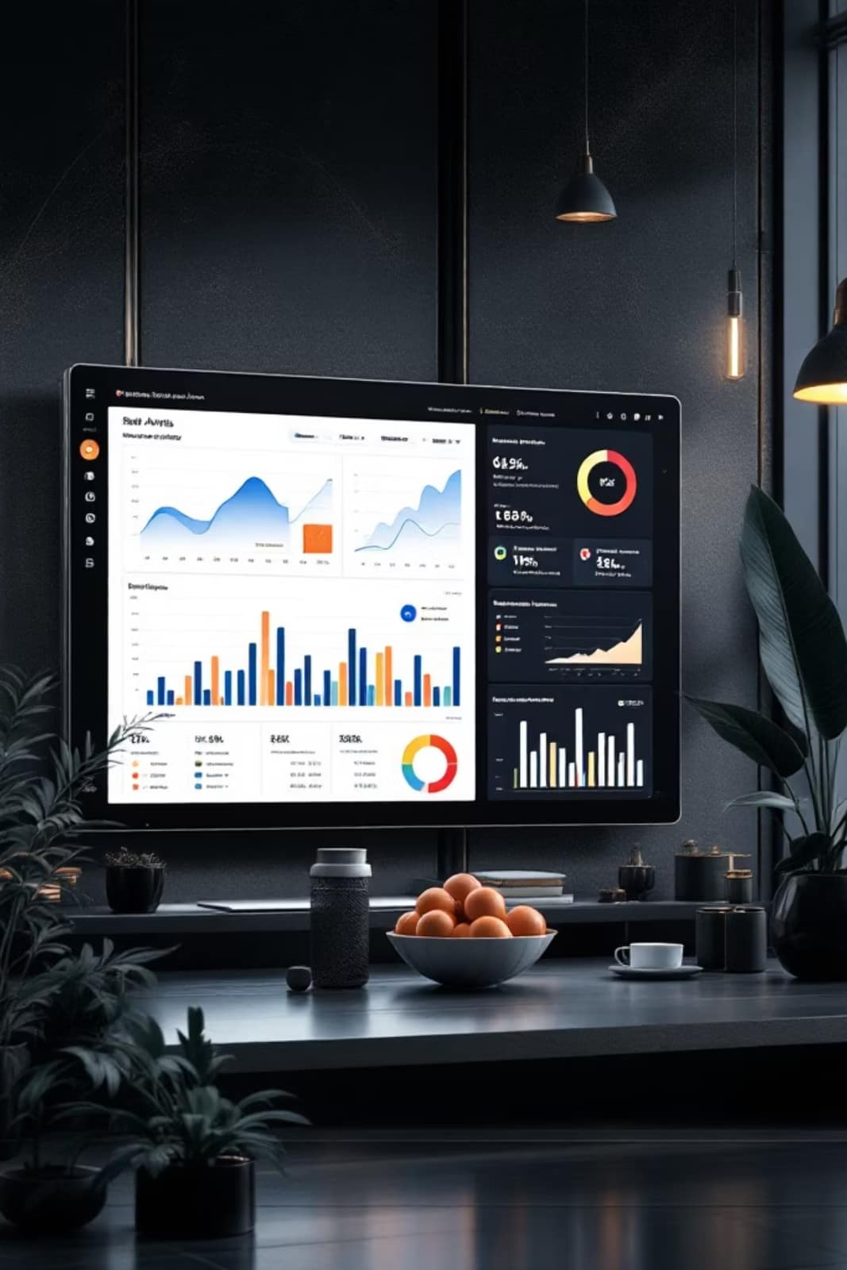
Customer Shopping Behavior Analysis
Uncovering insights from 3,900 purchases to drive strategic decisions

Slide 2
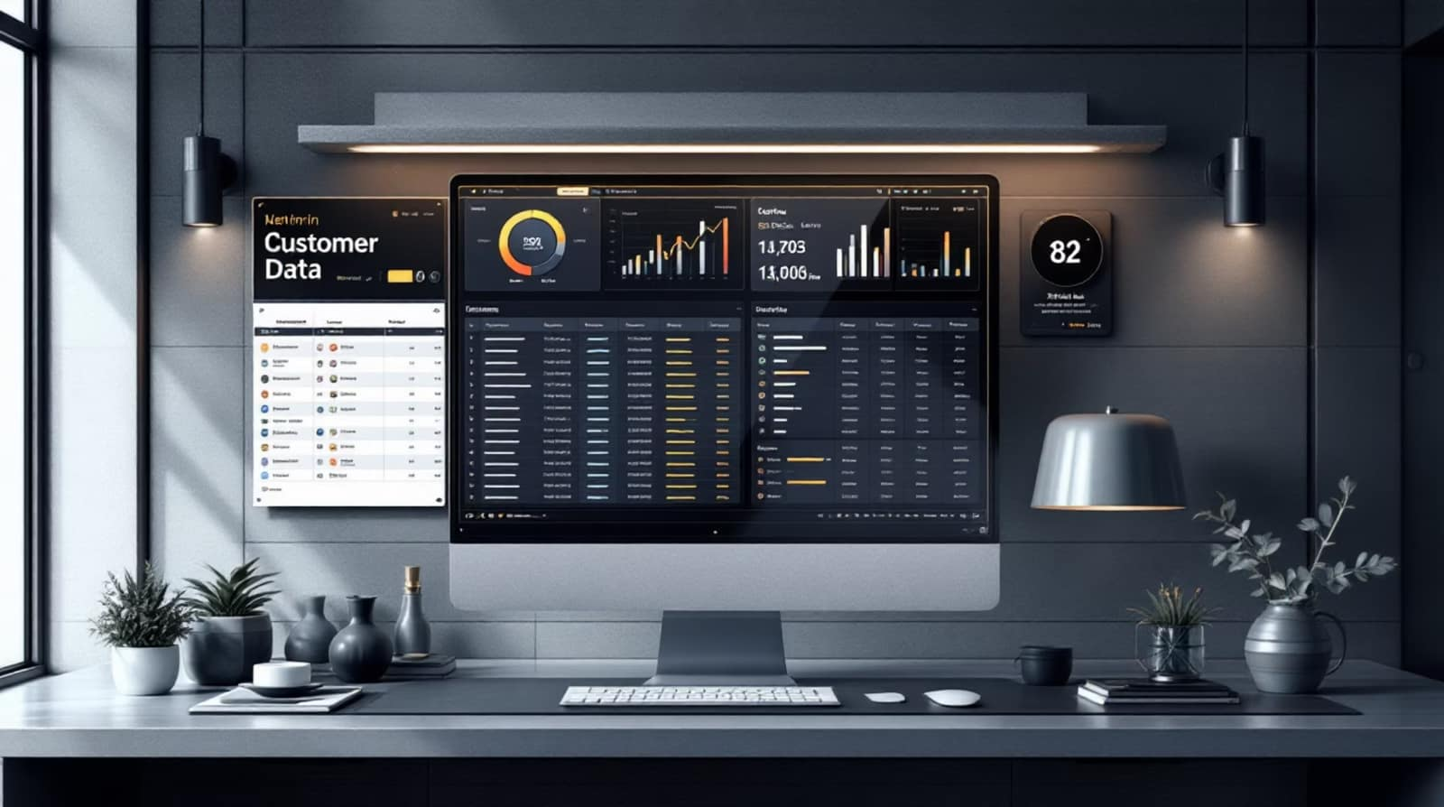
Dataset Overview
3,900
18
37
Transactions
Features
Missing Values
Purchase records analyzed
Data points per transaction
Review ratings imputed
Key Features
Demographics: Age, Gender, Location
Purchase details: Category, Amount, Season
Behavior: Discounts, Frequency, Ratings

Slide 3
Data Preparation Process
01
02
Data Loading
Exploration
Imported using pandas
Checked structure and statistics
03
04
Cleaning
Standardization
Handled missing values
Renamed to snake case
05
06
Feature Engineering
Database Load
Created age groups and frequency
Connected to PostgreSQL

Slide 4


Revenue by Gender
73%
27%
Male Customers
Female Customers
$157,890 revenue
$75,191 revenue

Slide 5

Product Performance Insights
Top-Rated Products
Discount-Heavy Products
Gloves (3.86)
Sandals (3.84)
Boots (3.82)
Hat (3.80)
Skirt (3.78)
Hat (50%)
Sneakers (49.66%)
Coat (49.07%)
Sweater (48.17%)
Pants (47.37%)

Slide 6

Shipping & Subscription Impact
Express Shipping
Non-Subscribers
$60.48 average spend vs. $58.46 standard
2,847 customers, $170,436 total revenue
Subscribers
1,053 customers, $62,645 total revenue

Slide 7



Customer Segmentation
Loyal
1
3,116 customers
Returning
2
701 customers
New
3
83 customers
958 repeat buyers with >5 purchases; 2,518 one-time customers

Slide 8



Revenue by Age Group
27%
25%
Young Adult
Middle-aged
$62,143 revenue
$59,197 revenue
24%
24%
Adult
Senior
$55,978 revenue
$55,763 revenue

Slide 9
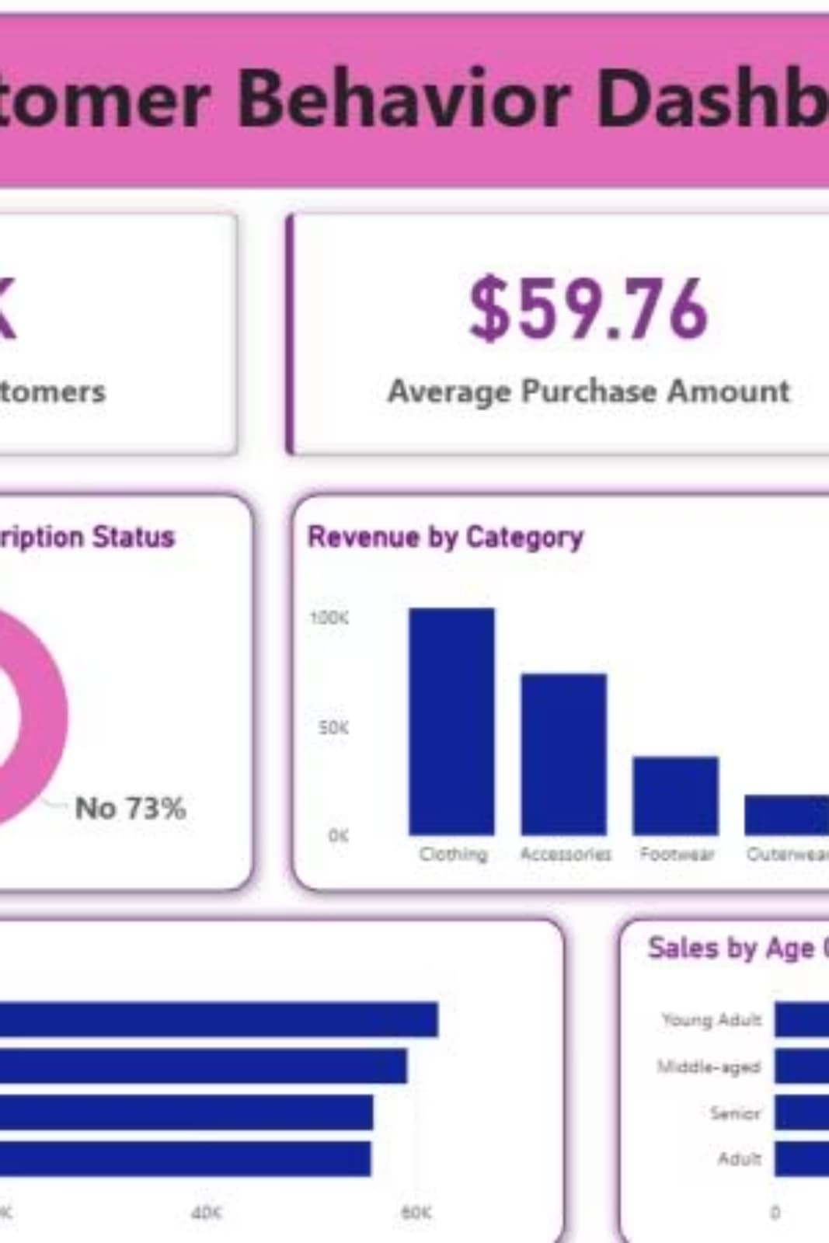
Power BI Dashboard
Key Metrics
Interactive Filters
3.9K customers, $59.76 average purchase, 3.75 average rating
Subscription, Gender, Category, Shipping Type
Visualizations
Donut charts, bar charts by category and age group

Slide 10






Strategic Recommendations
Boost Subscriptions
Promote exclusive benefits
Loyalty Programs
Reward repeat buyers
Review Discount Policy
Balance sales with margins
Targeted Marketing
Focus on high-revenue groups

