Slide 1
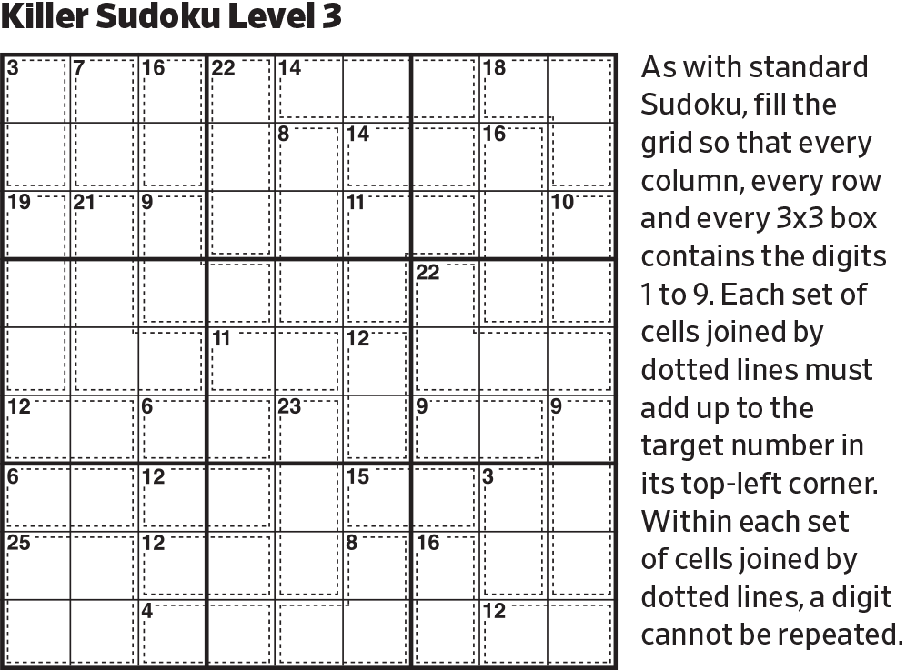
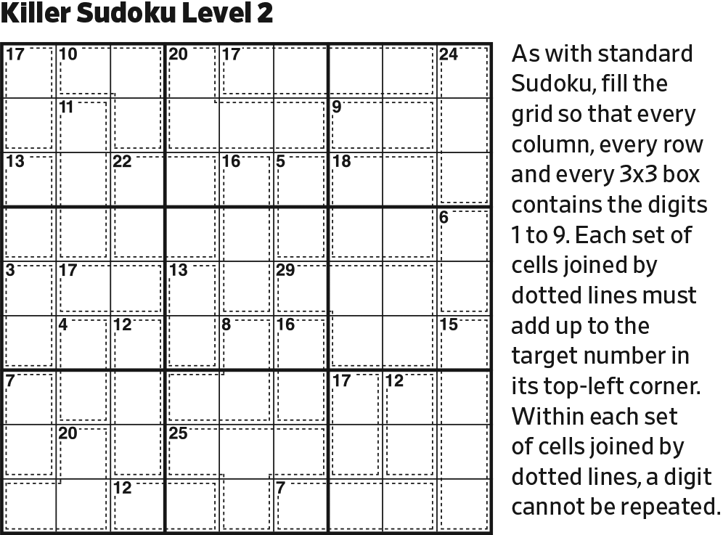
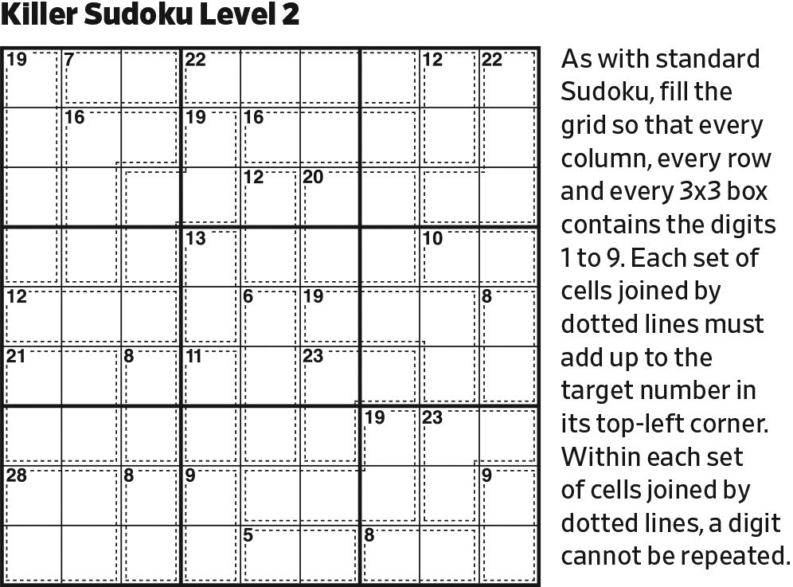
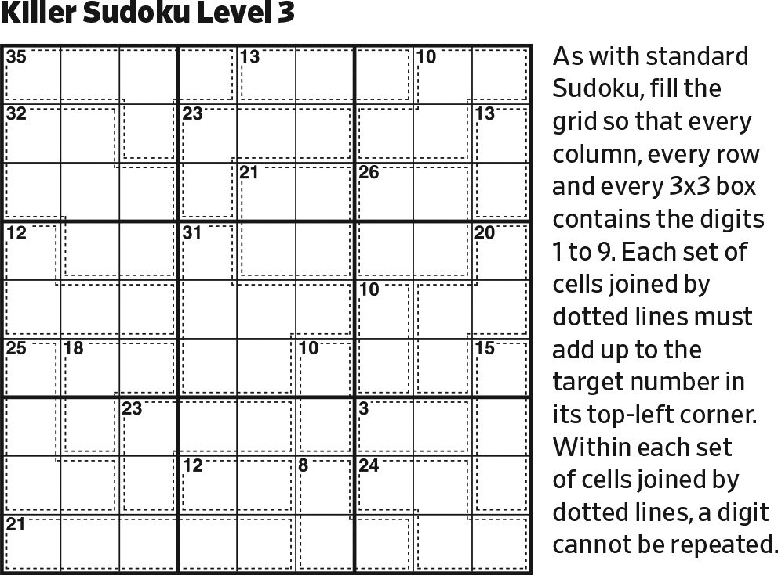
Start.

Slide 2
89
98
In Column 5, (18+27+17)–45 = 17, in 2, which must be 89.

Slide 3
57
136
89
75
136
24
98
136
42
In the center block, the only possibility left for [12 in 2] is 57.
Then, the only possibility left for [6 in 2] is 24.

Slide 4
123
123
123
57
136
89
75
136
24
98
136
42
789
789
789
123
123
123
[6 in 3] is 123. [24 in 3] is 789.

Slide 5
123
123
123
57
136
89
75
136
24
98
136
42
789
789
789
123
123
45
123
123
123
[8 in 3] is 125 or 134. 12 or 13 cannot be placed in Column 1 or Row 9.

Slide 6
123
123
123
57
136
89
75
136
24
145
98
136
42
789
456
2456
789
789
123
123
45
123
123
123
[11 in 3] can only contain one of 123 (none in Column 1 and one in Column 2). The possibilities are: 146 and 245 (with fits limited due to the 45 cell).
Note: [8 in 3] must contain a 1.

Slide 7
123
123
123
57
136
89
75
136
24
45
98
136
42
789
2
54
789
789
123
123
45
123
123
123
[11 in 3] cannot contain 1. Since [6 in 3] and [8 in 3] both must contain 1, a 1 in
[11 in 3] would put two 1’s in Column 1. (The X-wing construction.) [11 in 3] must be 245.

Slide 8
123
123
123
57
136
89
75
136
24
4
98
136
42
789
5
2
789
789
13
123
4
31
123
123
This forces [8 in 3] to be 134 (rather than 125).

Slide 9
123
13
123
57
136
89
4
75
136
4
2
98
136
789
5
2
789
789
13
31
4
31
123
123
Reduce.

Slide 10
123
13
123
7
36
89
5
1
4
4
2
98
63
789
5
2
789
789
13
31
4
31
123
123
In Row 5, 45–(16+19) = 10. 514 is the only possibility.
Then, reduce (resolve the [12 in 2]).

Slide 11
123
13
123
68
568
7
568
36
89
5
1
4
4
2
98
63
789
5
2
789
789
13
31
4
31
123
123
[19 in 3, no 1, 2, 3, 4] is 568.

Slide 12
123
13
123
68
568
7
85
36
89
5
1
4
678
678
23
4
2
98
63
789
5
2
789
789
13
31
4
31
123
123
[16 in 3, no 1, 4, 5] is 268 or 367

Slide 13
123
13
123
68
568
7
85
36
89
5
1
4
678
678
23
23789
23789
23789
4
2
98
63
87
5
2
789
789
13
31
4
31
123
123
This means that the opposite [19 in 3] must be 289 or 379.

Slide 14
123
13
123
789
68
568
7
98
85
36
89
5
1
4
678
678
23
23789
23789
23789
4
2
789
98
63
87
5
2
789
789
13
789
31
4
31
123
123
In Columns 1 and 2, 90–(6+19+(16–{23})+11+8) = 30+{23} in 4.
Two 9’s are needed, one each in Columns 1 and 2. At least one additional 7 is needed, since [16 in 3] can only hold one of them. To sum to 32 or 33, we need an additional 7 or 8.

Slide 15
123
13
123
79
68
86
5
7
98
36
89
5
1
4
678
678
23
23789
23789
23789
4
2
789
98
63
87
5
2
789
789
13
789
31
4
31
123
123
Note 98/89 pair in Row 4.
Then, reduce. Then, reduce.

Slide 16
123
13
123
79
68
86
5
7
98
123
36
89
12346
12346
12346
5
1
4
678
678
23
23789
23789
23789
4
2
789
98
63
87
5
2
789
789
13
789
31
4
31
123
123
Complete Row 4.

Slide 17
123
13
123
79
68
86
5
7
98
123
36
89
12346
12346
12346
5
1
4
678
678
23
23789
23789
23789
4
2
789
13
98
63
1356
87
1356
5
2
789
789
13
789
31
4
31
123
123
Note the 789/98/87 triplet in Row 6. Complete Row 6.

Slide 18
123
13
4579
123
79
4579
68
86
4579
5
7
98
123
36
89
12346
12346
12346
5
1
4
678
678
23
23789
23789
23789
4
2
789
13
98
63
1356
87
1356
5
2
678
789
789
13
789
6789
31
4
31
6789
123
123
Complete upper left block.
Complete lower left block. (Note that the 9 in Row 7 is in the lower right block.)

Slide 19
123
13
4579
123
79
4579
68
86
4579
5
7
98
123
36
89
12346
12346
12346
5
1
4
678
678
23
23789
23789
23789
4
2
789
13
98
63
1356
87
1356
5
2
678
789
789
13
97
6789
31
4
31
6789
123
123
In the lower left block, 8 is in Column 3.

Slide 20
123
13
4579
123
79
4579
68
86
4579
5
7
98
123
36
89
12346
12346
12346
5
1
4
678
68
23
23789
23789
23789
4
2
789
13
98
63
1356
87
1356
5
2
678
789
789
13
97
6789
31
4
31
6789
123
123
Note the 79/97 pair in Column 2.

Slide 21
123
13
4579
123
79
4579
123
68
86
4579
5
7
98
123
36
89
12346
12346
12346
5
1
4
678
68
23
23789
23789
23789
4
2
789
13
98
63
1356
87
1356
5
2
678
789
789
13
97
6789
31
4
31
6789
123
123
[14 in 3] consists of two of 4579, plus the matching third. The third can be 1, 2, or 3.

Slide 22
123
13
4579
123
79
4579
123
68
86
45
5
7
98
123
36
89
12346
12346
12346
5
1
4
678
68
23
23789
23789
23789
4
2
789
13
98
63
1356
87
1356
5
2
678
789
789
13
97
6789
31
4
31
6789
123
123
In the upper left block, 45–(6+(19–5)+(14–{1, 2, 3})) = {12, 13, 14}. The only way to get 12, 13, or 14 with 79+4579 is 7+5 (12), 9+4 (13), or 9+5 (14).

Slide 23
123
13
4579
123
79
4579
123
68
86
45
5
7
98
123
36
89
12346
12346
12346
5
1
4
678
68
23
23789
23789
23789
4
2
789
13
98
63
1356
87
1356
5
2
678
789
789
13
97
6789
24
31
4
31
6789
123
123
[19 in 3] consists two of 6789, plus the matching third. The third can be 2, 3, or 4—but 3 is precluded.

Slide 24
123
13
4579
123
79
4579
123
68
86
45
5
7
98
123
36
89
12346
12346
12346
5
1
4
678
68
23
23789
23789
23789
4
2
789
13
98
63
1356
87
1356
5
2
68
789
789
13
97
6789
24
31
4
31
6789
123
123
In the lower left block, 45–((11–4)+8+(19–{2, 4})) = {13, 15}. There is no way to construct a 13 or a 15 with this 7.

Slide 25
123
13
4579
24579
123
79
4579
123
24579
68
86
45
24579
5
7
98
123
36
89
12346
12346
12346
5
1
4
678
68
23
23789
23789
23789
4
2
789
13
98
63
1356
87
1356
5
2
68
24578
789
789
13
97
6789
24
24578
31
4
31
6789
24578
123
123
[17 in 3, no 1, 3, 6] is 278 or 458.
[18 in 3, no 1, 3, 6] is 279 or 459.

Slide 26
123
13
4579
24579
123
79
4579
123
24579
68
86
45
24579
5
7
98
123
36
89
12346
12346
12346
5
1
4
678
68
23
23789
23789
23789
4
2
789
13
98
63
1356
87
1356
5
2
68
478
789
789
13
97
6789
24
24578
31
4
31
6789
578
123
123
Reduce.

Slide 27
123
13
4579
24579
123
79
4579
123
24579
68
86
45
24579
5
7
98
123
36
89
12346
12346
12346
5
1
4
678
68
23
23789
23789
23789
4
2
789
13
98
63
1356
87
1356
5
2
68
478
789
789
13
97
6789
24
2458
31
4
31
6789
578
123
123
Since the 2 only appears in one cell in the [17 in 3], that cell can’t be 7.

Slide 28
123
13
4579
24579
123
79
4579
123
24579
68
86
45
24579
5
7
98
123
36
89
12346
12346
12346
5
1
4
678
68
23
23789
23789
23789
4
2
789
13
98
63
1356
87
1356
5
2
68
13
478
31
789
789
13
97
6789
24
2458
31
4
31
6789
578
123
123
Last possible positions for 1 and 3 in Row 7.

Slide 29
123
13
4579
24579
123
79
4579
123
24579
68
86
45
24579
5
7
98
123
36
89
12346
12346
12346
5
1
4
678
68
23
23789
23789
23789
4
2
789
13
98
63
1356
87
1356
5
2
68
13
478
31
4678
789
789
13
97
6789
24
2458
31
4
31
6789
578
123
123
Complete Row 7.

Slide 30
123
13
4579
24579
123
79
4579
123
24579
68
86
45
24579
5
7
98
123
36
89
12346
12346
12346
5
1
4
678
68
23
23789
23789
23789
4
2
789
13
98
63
1356
87
1356
5
2
68
13
478
31
4678
789
789
13
97
6789
24
2458
5679
4567
31
4
31
6789
578
5678
123
123
[18 in 3, no 1, 2, 3] can be 459, 468, or 567.

Slide 31
123
13
4579
24579
123
79
4579
123
24579
68
86
45
24579
5
7
98
123
36
89
12346
12346
12346
5
1
4
678
68
23
23789
23789
23789
4
2
789
13
98
63
1356
87
1356
5
2
68
13
478
31
4678
789
789
13
97
6789
24
2458
5679
4567
45678
31
4
31
6789
69
578
5679
5678
123
123
Complete Rows 8 and 9.

Slide 32
123
13
4579
123468
24579
135678
123
79
4579
123
24579
135678
68
86
45
1234
24579
1357
5
7
98
123
36
89
12346
12346
12346
5
1
4
678
68
23
23789
23789
23789
4
2
789
13
98
63
1356
87
1356
5
2
68
13
478
31
4678
789
789
13
97
6789
24
2458
5679
4567
45678
31
4
31
6789
69
578
5679
5678
123
123
Complete Columns 4 and 6.

Slide 33
123
13
4579
86
24579
135678
123
79
4579
123
24579
135678
68
86
45
1234
24579
1357
5
7
98
123
36
89
12346
12346
12346
5
1
4
678
68
23
23789
23789
23789
4
2
789
13
98
63
1356
87
1356
5
2
68
13
478
31
4678
789
789
13
97
6789
24
2458
5679
4567
45678
31
4
31
6789
69
578
5679
5678
123
123
Note 123/1234/13/24 quartet in Column 4.

Slide 34
123
13
4579
86
24579
135678
12345
4567
123
79
4579
123
24579
135678
12345
68
86
45
1234
24579
1357
5
7
98
123
36
89
12346
12346
12346
5
1
4
678
68
23
23789
23789
23789
4
2
789
13
98
63
1356
87
1356
5
2
68
13
478
31
4678
789
789
13
97
6789
24
2458
5679
4567
45678
31
4
31
6789
69
578
5679
5678
123
123
[10 in 3] can be 127, 136, 235, or 145. The first three fit like the [8 in 3], with 567 in the middle and with each wing guaranteed to have a 1, 2, or 3. However, 145 puts the 1 in only one wing. The 1 can’t be in the middle because it sees both a 13 and 31 cell.

Slide 35
123
13
4579
86
24579
135678
3456789
12345
4567
123
79
4579
123
24579
35678
3456789
12345
68
86
45
1234
24579
1357
5
7
98
123
36
89
12346
12346
12346
5
1
4
678
68
23
23789
23789
23789
4
2
789
13
98
63
1356
87
1356
5
2
68
13
478
31
4678
789
789
13
97
6789
24
2458
5679
4567
45678
31
4
31
6789
69
578
5679
5678
123
123
[20 in 3] can be 389, 479, 569, 578.

Slide 36
123
13
4579
86
24579
135678
3456789
12345
4567
123
79
4579
123
24579
35678
3456789
12345
68
86
45
1234
24579
1357
1234579
1234579
5
7
98
123
36
89
12346
12346
12346
5
1
4
678
68
23
23789
23789
23789
4
2
789
13
98
63
1356
87
1356
5
2
68
13
478
31
4678
789
789
13
97
6789
24
2458
5679
4567
45678
31
4
31
6789
69
578
5679
5678
123
123
[14 in 3] can be 149, 158, 167, 239, 248, 257, 347, 356. Here, 8 is precluded, leaving 149, 167, 239, 257, 347, 356.

Slide 37
123
13
4579
86
24579
135678
3456789
12345
4567
123
79
4579
123
24579
35678
3456789
123456789
12345
68
86
45
1234
24579
1357
1234579
1234579
1234579
5
7
98
123
36
89
12346
12346
12346
5
1
4
678
68
23
23789
23789
23789
4
2
789
13
98
63
1356
87
1356
5
2
68
13
478
31
4678
789
789
13
97
6789
24
2458
5679
4567
45678
31
4
31
6789
69
578
5679
5678
123
123
Complete upper right block.

Slide 38
123
13
4579
86
24579
135678
3456789
12345
4567
123
79
4579
123
24579
3567
3456789
123456789
12345
68
86
45
1234
24579
1357
1234579
1234579
1234579
5
7
98
123
36
89
12346
12346
12346
5
1
4
678
68
23
23789
23789
23789
4
2
789
13
98
63
1356
87
1356
5
2
68
13
478
31
4678
789
789
13
97
6789
24
2458
5679
4567
45678
31
4
31
6789
69
578
5679
5678
123
123
This cell can’t be 8, because that would leave no possibilities for 8 in the upper right block.

Slide 39
123
13
4579
86
24579
135678
345679
12345
4567
123
79
4579
123
24579
3567
3456789
123456789
12345
68
86
45
1234
24579
1357
1234579
1234579
1234579
5
7
98
123
36
89
12346
12346
12346
5
1
4
678
68
23
23789
23789
23789
4
2
789
13
98
63
1356
87
1356
5
2
68
13
478
31
4678
789
789
13
97
6789
24
2458
5679
4567
45678
31
4
31
6789
69
578
5679
5678
123
123
In the upper center block, 8 is in Row 1.

Slide 40
123
13
4579
86
24579
135678
45679
12345
4567
123
79
4579
123
24579
3567
45689
123456789
12345
68
86
45
1234
24579
1357
1234579
1234579
1234579
5
7
98
123
36
89
12346
12346
12346
5
1
4
678
68
23
23789
23789
23789
4
2
789
13
98
63
1356
87
1356
5
2
68
13
478
31
4678
789
789
13
97
6789
24
2458
5679
4567
45678
31
4
31
6789
69
578
5679
5678
123
123
[20 in 4] can be 389, 479, 569, 579. However, since only one cell could be 8, and since the left cell can’t be 4 or 9, there are fewer ways to actually map the possibilities to the three cells.

Slide 41
123
13
4579
86
24579
135678
45679
12345
4567
123
79
4579
123
24579
3567
45689
123456789
12345
68
86
45
1234
24579
1357
1234579
1234579
1234579
5
7
98
123
36
89
12346
12346
12346
5
1
4
678
68
23
23789
23789
23789
4
2
789
13
98
63
1356
87
1356
5
2
68
13
478
31
4678
789
789
13
97
6789
24
2458
5679
4567
45678
31
4
31
6789
69
578
5679
5678
123
123
In Row 5, there are two possible ways to split [16 in 3] and [19 in 3]:
6(28)–9(37) or 6(37)–9(28). We insert a small digression to show why the first of these is not possible.

Slide 42
123
13
4579
86
24579
135678
45679
12345
4567
123
79
4579
123
24579
3567
45689
123456789
12345
68
86
45
1234
24579
1357
1234579
1234579
1234579
5
7
98
123
36
89
12346
12346
12346
2
5
1
4
86
68
379
379
379
4
2
789
13
98
63
1356
87
1356
5
2
68
13
478
31
4678
789
789
13
97
6789
24
2458
679
4567
45678
31
4
31
6789
69
578
5679
5678
123
123
Try: 628/937
Obviously, this would lead to a non-unique solution because of the rectangular array of 68’s, but let’s see why it fails, anyway.

Slide 43
123
13
4579
86
24579
135678
45679
12345
4567
123
79
4579
123
24579
3567
45689
123456789
12345
68
86
45
1234
24579
1357
1234579
1234579
1234579
5
7
98
123
36
89
12346
12346
12346
2
5
1
4
86
68
379
379
379
4
2
8
789
13
98
63
1356
1356
5
2
68
13
478
31
4678
789
789
13
97
6789
24
2458
679
4567
45678
31
4
31
6789
69
578
5679
5678
123
123
Last possible 8 in right center block.

Slide 44
123
13
4579
86
24579
135678
45679
12345
4567
123
79
4579
123
24579
3567
45689
123456789
12345
68
86
45
1234
24579
1357
1234579
1234579
1234579
5
7
98
123
36
89
12346
12346
12346
2
5
1
4
86
68
379
379
379
4
2
8
789
13
98
63
1356
1356
5
2
68
13
478
31
4678
79
97
13
97
6789
24
2458
679
4567
45678
31
4
31
6789
69
578
5679
5678
123
123
Reduce.

Slide 45
123
13
4579
86
24579
135678
45679
12345
4567
123
79
4579
123
24579
3567
45689
123456789
12345
68
86
45
1234
24579
1357
1234579
1234579
1234579
5
7
98
123
36
89
12346
12346
12346
2
5
1
4
86
68
379
379
379
4
2
8
789
13
98
63
1356
1356
5
2
68
13
478
31
4678
79
97
13
97
6789
24
2458
679
4567
45678
31
4
31
6789
69
578
5679
5678
123
123
FAIL. No more possible 8’s in Column 9.

Slide 46
123
13
4579
86
24579
135678
45679
12345
4567
123
79
4579
123
24579
3567
45689
123456789
12345
68
86
45
1234
24579
1357
1234579
1234579
1234579
5
7
98
123
36
89
12346
12346
12346
7
6
3
5
1
4
289
289
289
4
2
789
13
98
63
1356
87
1356
5
2
68
13
478
31
4678
789
789
13
97
6789
24
2458
5679
4567
45678
31
4
31
6789
69
578
5679
5678
123
123
Continuing with 6(37)–9(28). Note that 367 only fits in one way.

Slide 47
123
13
4579
86
24579
135678
45679
12345
4567
123
79
4579
123
24579
3567
45689
123456789
12345
6
8
45
1234
24579
1357
1234579
1234579
1234579
5
7
98
12
36
89
1346
1346
1346
7
6
3
5
1
4
289
289
289
4
1
2
7
89
98
63
1356
1356
5
2
68
13
478
31
4678
789
789
13
97
6789
24
2458
5679
4567
45678
31
4
31
6789
69
578
5679
5678
123
123
Reduce.

Slide 48
123
13
4579
86
24579
135678
45679
12345
4567
123
79
4579
123
24579
3567
45689
12345689
12345
6
8
45
1234
24579
1357
1234579
123459
1234579
5
2
7
98
36
89
1346
1346
1346
7
6
3
5
1
4
289
289
289
4
1
2
7
89
98
63
356
356
5
2
68
13
478
31
4678
89
98
13
97
6789
24
2458
5679
4567
4568
31
4
31
6789
69
578
5679
5678
123
123
Reduce.

Slide 49
123
13
4579
86
24579
135678
45679
12345
4567
123
79
4579
123
24579
3567
45689
12345689
12345
6
8
45
1234
24579
1357
1234579
123459
1234579
5
2
7
98
36
89
1346
1346
1346
7
6
3
5
1
4
289
289
289
4
1
2
7
89
98
63
356
356
5
2
6
13
47
31
467
89
98
13
97
6789
24
2458
5679
4567
456
31
4
31
6789
69
578
5679
567
123
123
Reduce.

Slide 50
123
13
4579
86
24579
135678
45679
12345
4567
123
79
4579
123
24579
3567
45689
12345689
12345
6
8
45
1234
24579
1357
1234579
123459
1234579
5
2
7
98
36
89
1346
1346
1346
7
6
3
5
1
4
289
289
289
4
1
2
7
89
98
63
356
356
5
2
6
13
47
31
74
89
98
13
97
789
24
2458
5679
4567
456
31
4
31
789
69
578
5679
567
123
123
Reduce.

Slide 51
123
13
4579
86
24579
135678
45679
12345
4567
123
79
4579
123
24579
3567
45689
12345689
12345
6
8
45
1234
24579
1357
1234579
123459
1234579
5
2
7
98
36
89
1346
1346
1346
7
6
3
5
1
4
289
289
289
4
1
2
7
89
98
63
356
356
5
2
6
13
47
31
74
89
98
13
97
789
24
2458
679
4567
456
31
4
31
789
69
578
5679
567
123
123
This cell can’t be 5 because it would leave no possibilities for 5 in the bottom right block.

Slide 52
123
13
4579
86
24579
135678
45679
12345
4567
123
79
4579
123
24579
3567
45689
12345689
12345
6
8
45
1234
24579
1357
1234579
123459
1234579
5
2
7
98
36
89
1346
1346
1346
7
6
3
5
1
4
289
289
289
4
1
2
7
89
98
63
356
356
5
2
6
13
47
31
74
89
98
13
97
789
24
2458
679
4567
456
31
4
31
789
69
578
5679
567
123
123
In Column 5, there are two possible ways to split [18 in 3] and [17 in 3]:
9(27)–8(45) or 9(45)–8(27). We insert a small digression to show why the second of these is not possible.

Slide 53
123
13
4579
86
459
135678
45679
12345
4567
123
79
4579
123
459
3567
45689
12345689
12345
6
8
45
1234
459
1357
1234579
123459
1234579
5
2
7
98
36
89
1346
1346
1346
7
6
3
5
1
4
289
289
289
4
1
2
7
89
98
63
356
356
5
2
6
7
13
31
74
89
98
13
97
789
24
28
679
4567
456
31
4
31
789
69
78
5679
567
123
123
Try: 9(45)–8(27).

Slide 54
123
13
4579
86
459
13678
45679
12345
4567
123
79
4579
123
459
367
45689
12345689
12345
6
8
45
123
459
137
1234579
123459
1234579
5
2
7
98
36
89
1346
1346
1346
7
6
3
5
1
4
289
289
289
4
1
2
7
89
98
63
356
356
5
2
6
7
4
13
31
89
98
4
13
97
789
28
69
4567
456
31
4
8
31
789
69
569
567
123
123
Reduce.

Slide 55
123
13
4579
86
459
13678
5679
12345
4567
123
79
4579
123
459
367
5689
12345689
12345
6
8
45
123
459
137
123579
123459
1234579
5
2
7
98
36
89
136
1346
1346
7
6
3
5
1
4
289
289
289
4
1
2
7
89
98
63
356
356
5
2
6
7
4
13
31
89
98
4
2
13
97
789
69
567
56
31
4
8
5
31
79
69
567
123
123
Reduce.

Slide 56
123
13
4579
86
459
13678
5679
12345
4567
123
79
4579
123
459
367
5689
12345689
12345
6
8
45
123
459
137
123579
123459
1234579
5
2
7
98
36
89
136
1346
1346
7
6
3
5
1
4
289
289
289
4
1
2
7
89
98
63
356
356
5
2
6
7
4
13
31
89
98
8
4
2
13
97
69
567
56
31
4
8
5
31
79
69
67
123
123
Reduce.

Slide 57
123
13
4579
86
459
13678
5679
12345
4567
7
123
4579
123
459
367
5689
12345689
12345
6
8
45
123
459
137
123579
123459
1234579
5
2
7
98
36
89
136
1346
1346
7
6
3
5
1
4
289
289
289
4
1
2
7
89
98
63
356
356
5
2
6
7
4
13
31
89
98
9
8
4
2
13
69
567
56
31
4
7
8
5
31
69
67
123
123
Only the 7 completes the [19 in 3].

Slide 58
123
13
4579
86
459
13678
5679
12345
4567
7
123
4579
123
459
367
5689
12345689
12345
6
8
45
123
459
137
123579
123459
1234579
5
2
7
98
36
89
136
1346
1346
7
6
3
5
1
4
289
289
289
4
1
2
7
89
98
63
356
356
5
2
6
7
4
13
31
89
98
9
8
4
2
6
13
567
56
31
4
7
8
5
6
31
69
123
123
Reduce.
And FAIL.

Slide 59
123
13
4579
86
279
135678
45679
12345
4567
123
79
4579
123
279
3567
45689
12345689
12345
6
8
45
1234
279
1357
1234579
123459
1234579
5
2
7
98
36
89
1346
1346
1346
7
6
3
5
1
4
289
289
289
4
1
2
7
89
98
63
356
356
5
2
6
4
13
31
74
89
98
13
97
789
24
458
679
4567
456
31
4
31
789
69
58
5679
567
123
123
Continuing with 9(27)–8(45).

Slide 60
123
13
4579
86
279
13568
45679
12345
4567
123
79
4579
31
279
356
45689
12345689
12345
6
8
45
134
279
135
1234579
123459
1234579
5
2
7
98
36
89
1346
1346
1346
7
6
3
5
1
4
289
289
289
4
1
2
7
89
98
63
356
356
5
2
6
4
7
13
31
89
98
2
13
97
789
85
679
4567
456
31
4
31
789
69
58
679
567
123
123
Reduce.

Slide 61
123
13
4579
86
279
13568
4569
12345
4567
123
79
4579
31
279
356
45689
12345689
12345
6
8
4
45
279
135
123459
123459
1234579
5
2
7
98
36
89
1346
1346
1346
7
6
3
5
1
4
289
289
289
4
1
2
7
89
98
63
356
356
5
2
6
4
7
13
31
89
98
2
13
97
89
85
679
456
456
31
4
31
98
69
58
679
56
123
123
Reduce.

Slide 62
123
13
457
86
279
13568
4569
12345
4567
9
123
457
31
279
356
45689
12345689
12345
6
8
5
4
279
135
12359
12359
123579
5
2
7
98
36
89
1346
1346
1346
7
6
3
5
1
4
289
289
289
4
1
2
7
89
98
63
356
356
5
2
6
4
7
13
31
89
98
7
2
13
89
85
679
456
456
31
4
31
98
69
58
679
56
123
123
Reduce.

Slide 63
123
13
47
86
279
13568
4569
12345
4567
9
123
74
31
27
356
4568
1234568
12345
6
8
5
4
279
13
1239
1239
12379
5
2
7
98
36
89
1346
1346
1346
7
6
3
5
1
4
289
289
289
4
1
2
7
89
98
63
356
356
5
2
6
4
7
13
31
89
98
7
2
13
89
85
96
456
456
31
4
31
98
69
58
679
56
123
123
Reduce.

Slide 64
123
13
47
86
279
13568
4569
12345
4567
9
3
123
74
27
356
4568
1234568
12345
6
8
5
4
279
13
1239
1239
12379
5
2
7
98
36
89
1346
1346
1346
7
6
3
5
1
4
289
289
289
4
1
2
7
89
98
63
356
356
5
2
6
4
7
13
31
89
98
7
2
13
89
85
96
456
456
31
4
7
31
98
69
58
56
123
123
Reduce.

Slide 65
123
13
47
86
279
1568
4569
12345
4567
9
3
12
74
27
56
4568
124568
1245
6
8
5
4
1
279
1239
1239
12379
5
2
7
98
36
89
1346
1346
1346
7
6
3
5
1
4
289
289
289
4
1
2
7
89
98
63
356
356
5
2
6
1
4
3
7
89
98
7
2
13
89
85
96
456
456
31
4
7
31
98
69
58
56
123
123
Reduce.

Slide 66
123
13
47
86
279
568
4569
12345
4567
9
3
12
74
27
56
4568
124568
1245
6
8
5
4
1
279
239
239
2379
5
2
7
98
36
89
1346
1346
1346
7
6
3
5
1
4
289
289
289
4
1
2
7
89
98
63
356
356
5
2
6
1
4
3
7
89
98
7
2
13
89
85
96
456
456
31
4
7
31
98
69
58
56
123
123
Reduce.

Slide 67
123
13
47
86
279
568
4569
1245
4567
9
3
12
74
27
56
4568
124568
1245
6
8
5
4
1
279
239
239
2379
5
2
7
98
36
89
1346
1346
1346
7
6
3
5
1
4
289
289
289
4
1
2
7
89
98
63
356
356
5
2
6
1
4
3
7
89
98
7
2
13
89
85
96
456
456
31
4
7
31
98
69
58
56
123
123
In the upper right block, 3 is in Row 3.

Slide 68
123
13
47
86
279
568
4569
1245
457
9
3
12
74
27
56
4568
124568
1245
6
8
5
4
1
279
239
239
2379
5
2
7
98
36
89
1346
1346
1346
7
6
3
5
1
4
289
289
289
4
1
2
7
89
98
63
356
356
5
2
6
1
4
3
7
89
98
7
2
13
89
85
96
456
456
31
4
7
31
98
69
58
56
123
123
In the upper right block, this precludes the 136 and 235 solution for [10 in 3]. Only the 127 and 145 solutions remain,

Slide 69
123
13
47
86
279
568
4569
1245
457
9
3
12
74
27
56
4568
124568
1245
6
8
5
4
1
279
239
239
2379
5
2
7
98
36
89
134
134
1346
7
6
3
5
1
4
289
289
289
4
1
2
7
89
98
63
35
356
5
2
6
1
4
3
7
89
98
7
2
13
89
85
96
456
456
31
4
7
31
98
69
58
56
123
123
In the right center block, 6 is in Column 9.

Slide 70
9
123
13
47
86
279
568
1245
457
9
3
12
74
27
56
65
124568
1245
6
8
5
4
1
279
239
239
2379
5
2
7
98
36
89
134
134
1346
7
6
3
5
1
4
289
289
289
4
1
2
7
89
98
63
35
356
5
2
6
1
4
3
7
89
98
7
2
13
89
85
96
456
456
31
4
7
31
98
69
58
56
123
123
In the upper right block, revisiting the [20 in 3], the only that still fits is 569.

Slide 71
9
123
13
47
86
72
568
1245
457
9
3
12
74
27
56
65
1248
124
6
8
5
4
1
279
32
23
237
5
2
7
98
36
89
134
134
1346
7
6
3
5
1
4
28
289
289
4
1
2
7
89
98
63
35
356
5
2
6
1
4
3
7
89
98
7
2
13
89
85
96
456
456
31
4
7
31
98
69
58
56
123
123
Reduce.

Slide 72
9
123
13
47
86
72
568
145
457
9
3
12
74
27
56
65
148
14
6
8
5
4
9
1
7
32
23
5
2
7
98
36
89
134
134
1346
7
6
3
5
1
4
28
289
289
4
1
2
7
89
98
63
35
356
5
2
6
1
4
3
7
89
98
7
2
13
89
85
96
456
456
31
4
7
31
98
69
58
56
123
123
Reduce.

Slide 73
9
123
13
47
86
72
568
145
45
9
3
8
12
74
27
56
65
14
6
8
5
4
9
1
7
32
23
5
2
7
98
36
89
134
134
1346
7
6
3
5
1
4
28
289
289
4
1
2
7
89
98
63
35
356
5
2
6
1
4
3
7
89
98
7
2
13
89
85
96
456
456
31
4
7
31
98
69
58
56
123
123
Reduce. (Note the last remaining 8 in the upper right block.)

Slide 74
9
123
13
47
86
72
568
145
45
9
3
5
6
8
12
74
27
14
6
8
5
4
9
1
7
32
23
5
2
7
98
36
89
134
134
1346
7
6
3
5
1
4
28
29
289
4
1
2
7
89
98
63
35
356
5
2
6
1
4
3
7
9
8
7
2
13
89
85
96
456
456
31
4
7
31
98
69
58
56
123
123
Reduce.

Slide 75
9
123
13
47
86
72
68
145
45
9
3
5
6
8
12
74
27
14
6
8
5
4
9
1
7
32
23
5
2
7
98
36
89
134
134
1346
7
6
3
5
1
4
2
28
29
4
1
2
7
89
98
63
35
356
5
2
6
1
4
3
7
9
8
7
2
13
89
85
96
456
456
31
4
7
31
98
69
58
56
123
123
Reduce.

Slide 76
9
123
13
47
86
72
68
145
45
9
3
5
6
8
12
74
27
14
6
8
5
4
9
1
2
3
7
5
2
7
98
36
89
134
134
1346
7
6
3
5
1
4
8
2
9
4
1
2
7
89
98
63
35
356
5
2
6
1
4
3
7
9
8
7
2
13
89
85
96
456
456
31
4
7
31
98
69
58
56
13
123
Reduce.

Slide 77
1
9
123
47
86
72
68
145
45
9
3
5
6
8
12
74
27
14
6
8
5
4
9
1
2
3
7
5
2
7
4
98
36
89
134
1346
7
6
3
5
1
4
8
2
9
4
1
2
7
89
98
63
35
356
5
2
6
1
4
3
7
9
8
1
7
2
3
89
85
96
456
456
4
3
7
1
2
98
69
58
56
Reduce. (Note the completion of [14 in 3].)

Slide 78
1
9
5
23
47
86
72
68
45
2
9
3
5
6
8
74
27
14
6
8
5
4
9
1
2
3
7
5
2
7
4
98
36
89
13
136
7
6
3
5
1
4
8
2
9
4
1
2
7
89
98
63
35
356
5
2
6
1
4
3
7
9
8
1
7
2
3
89
85
96
456
56
4
3
7
1
2
98
69
58
56
Reduce.

Slide 79
3
1
2
9
5
4
47
86
68
2
9
3
7
5
6
8
74
14
6
8
5
4
9
1
2
3
7
5
2
7
4
98
36
89
13
136
7
6
3
5
1
4
8
2
9
4
1
2
7
89
98
63
35
356
5
2
6
1
4
3
7
9
8
1
7
2
6
3
89
85
96
456
4
3
7
1
2
98
69
58
56
Reduce.

Slide 80
3
1
7
2
9
5
4
86
68
2
9
4
3
7
5
6
8
1
6
8
5
4
9
1
2
3
7
5
2
7
4
98
36
89
13
136
7
6
3
5
1
4
8
2
9
4
1
2
7
89
98
63
35
356
5
2
6
1
4
3
7
9
8
1
7
2
9
6
3
89
85
45
4
3
7
5
1
2
98
69
58
Reduce.

Slide 81
3
1
7
2
9
5
4
86
68
2
9
4
3
7
5
6
8
1
6
8
5
4
9
1
2
3
7
9
5
2
7
8
4
36
13
63
7
6
3
5
1
4
8
2
9
8
4
1
9
2
3
7
63
356
5
2
6
1
4
3
7
9
8
1
7
8
2
5
9
4
6
3
4
3
9
6
8
7
5
1
2
Reduce.

Slide 82
3
1
7
8
2
6
9
5
4
2
9
4
3
7
5
6
8
1
6
8
5
4
9
1
2
3
7
9
5
2
7
3
8
1
4
6
7
6
3
5
1
4
8
2
9
8
4
1
9
6
2
3
7
56
5
2
6
1
4
3
7
9
8
1
7
8
2
5
9
4
6
3
4
3
9
6
8
7
5
1
2
Reduce.

Slide 83
3
1
7
8
2
6
9
5
4
2
9
4
3
7
5
6
8
1
6
8
5
4
9
1
2
3
7
9
5
2
7
3
8
1
4
6
7
6
3
5
1
4
8
2
9
8
4
1
9
6
2
3
7
5
5
2
6
1
4
3
7
9
8
1
7
8
2
5
9
4
6
3
4
3
9
6
8
7
5
1
2
Reduce.

