Slide 1
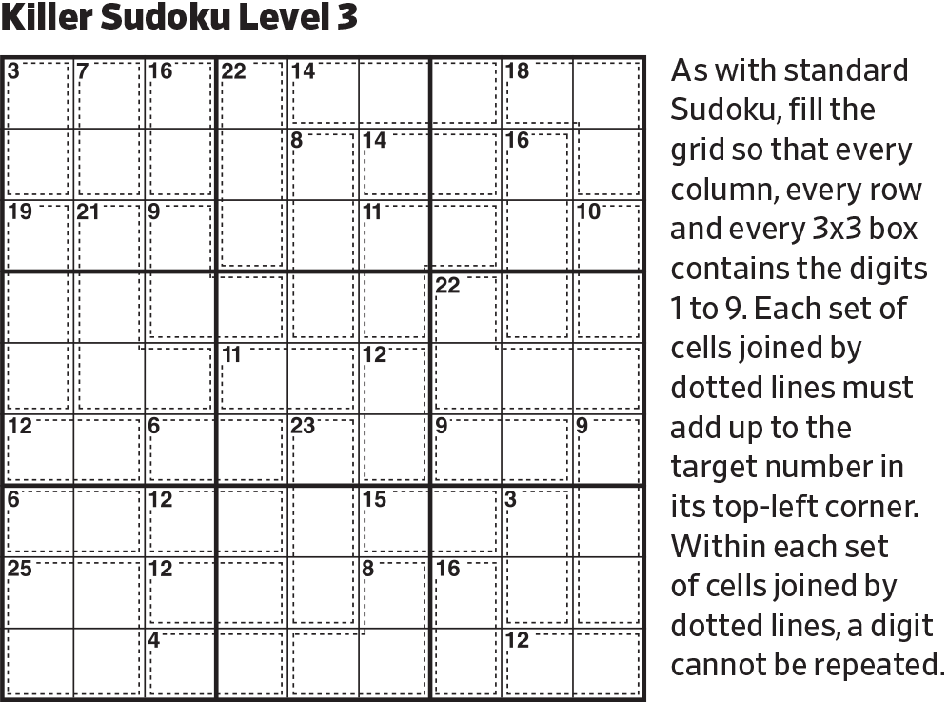
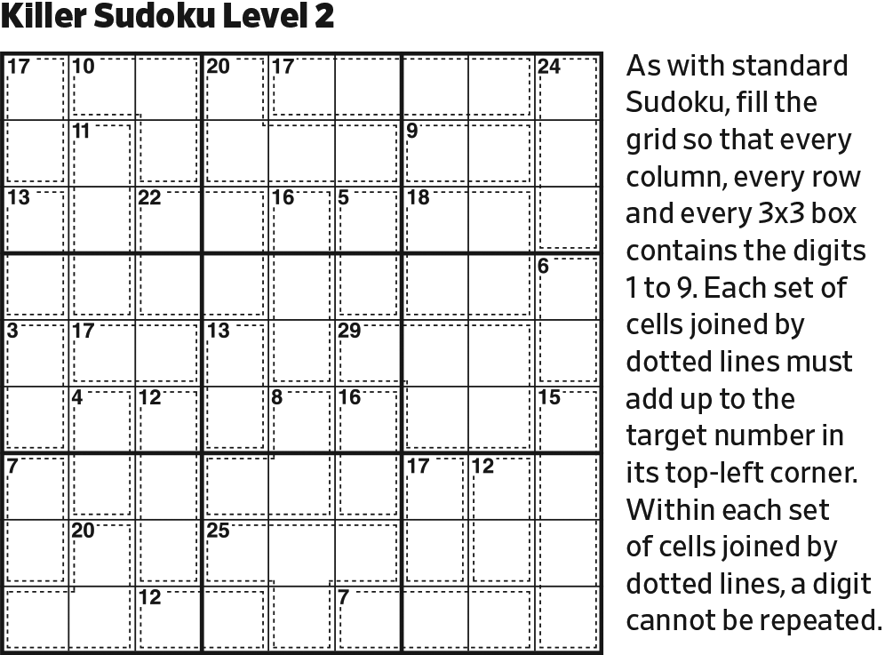
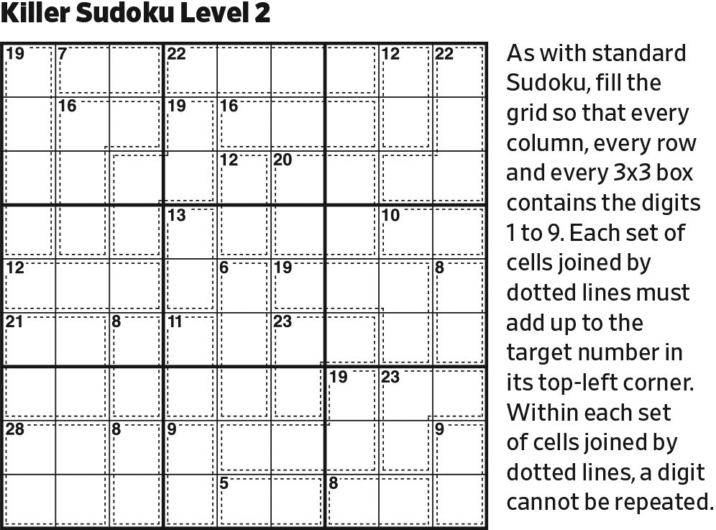
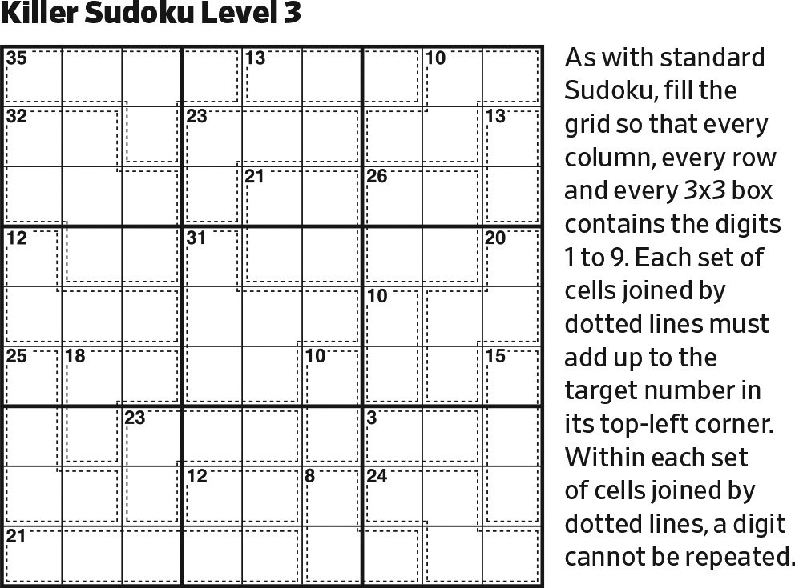
Start.

Slide 2
2
The top 6 blocks sum to 6×45 = 270. 270–(38+36+21+14+16+22+11+7+11+20+5+ 21+14+13+19) = 2.

Slide 3
1
9
2
The top 3 blocks sum to 3×45 = 135. (38+36+21+14+16+11+7+{1}) – 135 = {9}.

Slide 4
1
9
678
678
678
2
[22 in 4] -> [21 in 3, no 9] is 678.

Slide 5
34568
234568
79
1
34568
234568
234568
1
234568
97
9
678
678
678
2
[38 in 8] contains all digits except 7. There is only one remaining place for the 1, and the two cells outside of [38 in 8] in the upper left block are determined.
The color highlights cells that are linked together as a group.

Slide 6
34568
234568
79
23456
23456
1
34568
234568
234568
23456
1
234568
97
23456
23456
9
678
678
678
2
[36 in 7] -> [20 in 5, no 1] is 23456

Slide 7
34568
234568
79
23456
23456
789
1
34568
234568
234568
23456
89
65
1
234568
97
23456
23456
789
432
9
678
678
678
2
Complete the upper center block.
Then, complete the two 2-cages partially in that block.

Slide 8
34568
234568
79
23456
23456
789
1
8
6
34568
234568
234568
23456
79
97
1
234568
97
23456
23456
789
432
9
678
678
678
2
[16 in 2] is 79.
Then, reduce.

Slide 9
34568
234568
79
23456
23456
97
1
8
6
345
2345
2345
2345
79
97
1
234568
97
23456
23456
79
42
9
678
678
678
2
Reduce.

Slide 10
3456
23456
79
23456
23456
97
1
8
6
345
2345
2345
2345
79
97
1
8
97
23456
23456
79
42
9
678
678
76
2
Last possible 8 in Row 3. ([7 in 2] cannot contain 8.)
Then, reduce.

Slide 11
3456
23456
79
23456
23456
97
1358
1358
1358
1
8
6
345
2345
2345
2345
79
97
1
8
97
23456
23456
79
42
9
678
678
76
2
[21 in 4] must contain 1 and 8, and one of 79. The remaining cell is 3 or 5.
(While this is linked to the 97 cell, we’re not going to color it.)

Slide 12
3456
23456
79
23456
23456
97
1358
1358
1358
1
8
6
345
2345
2345
2345
79
97
1
8
97
23456
23456
79
42
2345
5432
9
678
678
76
2
[7 in 2, no 1] is either 25 or 34. It is linked to the green network of cells through the 42 cell (left) and the 35 options (above), though not in a specific orientation.

Slide 13
3456
23456
79
23456
23456
97
1358
1358
1358
1
8
6
345
2345
2345
2345
79
97
1
8
97
356
356
79
42
2345
5432
9
678
678
76
2
In the upper right block, 2 and 4 are in Row 3.

Slide 14
3456
23456
79
2345
2345
97
1358
1358
1358
1
8
6
345
2345
2345
2345
79
97
1
8
97
356
356
79
42
2345
5432
9
678
678
76
2
In the upper center block, 6 is in Row 3.

Slide 15
3456
23456
79
2345
2345
97
1358
1358
1358
1
8
6
345
2345
234
2345
79
97
1
8
97
356
356
79
42
2345
5432
9
678
5
9
678
76
2
In Row 5, only 59 fits [14 in 2], and in only one way.
Then, reduce.

Slide 16
3456
23456
79
2345
2345
97
1358
1358
1358
1
8
6
345
2345
234
2345
79
97
1
8
97
356
356
79
42
2345
5432
9
678
134
5
9
678
76
2
134
134
Complete left center block.

Slide 17
3456
23456
79
2345
2345
97
1358
1358
1358
1
8
6
345
2345
234
2345
79
97
1
8
97
356
356
79
42
2345
5432
9
678
13
235
1235
1235
5
9
678
76
2
134
134
In Row 4, [11 in 4] is 1235.

Slide 18
3456
23456
79
2345
2345
97
1358
1358
1358
1
8
6
345
2345
234
2345
79
97
1
8
97
356
356
79
42
2345
5432
9
678
13
235
1235
1235
5
9
678
76
2
134
134
68
In Row 6, [13 in 3, w/ 4] is either 148 or 346

Slide 19
3456
23456
79
2345
2345
97
1358
358
1358
1
8
6
345
2345
234
2345
79
97
1
8
97
356
356
79
42
235
542
9
4
678
13
235
1235
1235
5
9
1
678
76
2
134
134
68
In Column 8, there is only one solution to [5 in 2].
Then, reduce.

Slide 20
3456
23456
79
2345
2345
97
1358
358
1358
1
8
6
345
2345
234
2345
79
97
1
8
97
356
356
79
42
235
542
9
3
4
678
235
1235
1235
5
9
1
678
76
2
8
14
41
Since [19 in 3] cannot contain a 1, in the left center block the 1 is in Row 6.

Slide 21
3456
23456
79
2345
2345
97
1358
358
1358
1
8
6
345
2345
42
2345
79
97
1
8
97
356
356
79
42
235
542
9
3
4
678
25
125
125
5
9
1
678
76
2
8
14
41
Reduce.

Slide 22
3456
23456
79
2345
2345
97
1358
358
1358
1
8
6
345
2345
42
2345
79
97
1
8
97
356
356
79
42
235
542
9
3
4
678
25
125
125
5
9
1
678
76
2
8
14
41
56
65
In Row 6, 45–(2+13+19) = 11, in 2.

Slide 23
3456
23456
79
2345
2345
97
1358
358
1358
1
8
6
345
2345
42
2345
79
97
1
8
97
356
356
79
42
235
542
9
3
4
678
25
125
125
87
78
5
9
1
678
76
2
8
14
41
56
65
Complete Row 4.

Slide 24
345
23456
79
2345
2345
97
1358
358
1358
1
8
6
345
2345
42
2345
79
97
1
8
97
356
356
79
42
235
542
6
9
3
4
25
125
125
87
78
8
7
5
9
1
2
8
14
41
56
65
Reduce. Then, reduce. Then, reduce.

Slide 25
6
345
79
2345
2345
97
1358
358
1358
1
8
6
345
2345
42
2345
79
97
1
8
97
356
356
79
42
235
542
6
9
3
4
25
125
125
87
78
8
7
5
9
1
2
8
14
41
56
65
Last possible 6 in Row 1.

Slide 26
6
345
79
2345
2345
97
1358
358
1358
1
8
6
345
2345
42
345
79
97
1
8
97
356
356
79
42
235
542
6
9
3
4
25
125
125
87
78
8
7
5
9
1
2
8
14
41
56
65
In the upper left block, 2 is in Row 2.

Slide 27
6
345
79
2345
2345
97
1358
358
1358
1
8
6
345
2345
42
345
79
97
1
8
97
356
356
79
42
235
542
6
9
3
4
25
125
125
87
78
8
7
5
9
1
32
2
8
14
41
56
65
In Column 9, [21 in 4] -> [10 in 2].

Slide 28
6
345
79
2345
2345
97
1358
358
1358
1
8
6
345
2345
42
345
79
97
1
8
97
356
356
79
42
235
542
6
9
3
4
25
125
125
87
78
8
7
5
9
1
2346
2346
2346
32
2
8
14
41
379
379
379
56
65
Complete Rows 5 and 6.

Slide 29
6
345
79
2345
2345
97
1358
358
1358
1
8
6
345
2345
42
345
79
97
1
8
97
356
356
79
42
235
542
6
9
3
4
25
125
125
87
78
8
7
5
9
1
64
46
23
32
2
8
7
3
9
14
41
56
65
Reduce.
Then, reduce.

Slide 30
6
345
79
2345
2345
97
1358
358
1358
1
8
6
345
2345
42
345
79
97
1
8
97
356
356
79
42
235
542
6
9
3
4
25
125
125
87
78
8
7
5
9
1
64
46
23
32
2
8
7
3
9
14
41
56
65
3457
6542
In Row 8, 45–(9+15+12) = 9, in 2.

Slide 31
6
345
79
2345
2345
97
1358
358
1358
1
8
6
345
2345
42
345
79
97
1
8
97
356
356
79
42
235
542
6
9
3
4
25
125
125
87
78
8
7
5
9
1
64
46
23
32
2
8
7
3
9
14
41
56
65
569
652
3457
6542
Initialize the 2-cage in Row 7.

Slide 32
6
345
79
2345
2345
97
1358
358
1358
1
8
6
345
2345
42
345
79
97
1
8
97
356
356
79
42
235
542
6
9
3
4
25
125
125
87
78
8
7
5
9
1
64
46
23
32
2
8
7
3
9
14
41
56
65
569
652
3457
135
864
67
98
6542
Initialize the 2-cages in Row 8.

Slide 33
6
345
79
2345
2345
97
1358
358
1358
1
8
6
345
2345
42
345
79
97
1
8
97
356
356
79
42
235
542
6
9
3
4
25
125
125
87
78
8
7
5
9
1
64
46
23
32
2
8
7
3
9
14
41
56
65
569
652
7
8
3457
135
864
6542
[15 in 2] cannot be 69 because that would leave no possibilities for [11 in 2].

Slide 34
6
345
79
2345
2345
97
1358
358
1358
1
8
6
345
2345
42
345
79
97
1
8
97
356
356
79
42
235
542
6
9
3
4
25
125
125
87
78
8
7
5
9
1
64
46
23
32
2
8
7
3
9
14
41
56
65
569
652
7
8
345
35
64
654
Reduce.

Slide 35
6
345
79
2345
2345
97
1358
358
1358
1
8
6
345
2345
42
345
79
97
1
8
97
356
356
79
42
235
542
6
9
3
4
25
125
125
87
78
8
7
5
9
1
64
46
23
32
2
8
7
3
9
14
41
56
65
569
652
7
8
9
345
35
64
12
21
654
The remaining cells in Row 8 are 129.

Slide 36
6
345
79
2345
2345
97
1358
358
1358
1
8
6
7
9
345
2345
42
345
1
8
97
356
356
79
42
235
542
6
9
3
4
25
125
125
87
78
8
7
5
9
1
64
46
23
32
2
8
7
3
9
14
41
56
65
569
652
7
8
9
345
35
64
12
21
654
Reduce.

Slide 37
6
345
79
2345
2345
97
1358
358
1358
1
8
6
7
9
345
2345
42
345
1
8
97
356
356
79
42
235
542
6
9
3
4
25
125
125
87
78
8
7
5
9
1
64
46
23
32
2
8
7
3
9
14
41
56
65
79
569
652
7
8
9
345
35
64
12
21
654
97
Complete Column 1.

Slide 38
6
345
79
2345
2345
97
1358
358
1358
1
8
6
7
9
345
2345
42
345
1
8
97
356
356
79
42
235
542
6
9
3
4
25
125
125
87
78
([21 in 4, no 2] could be: 1389, 1479, 1569, 1578, 3459, 3468, or 3567.)
8
7
5
9
1
64
46
23
32
2
8
7
3
9
14
41
56
65
1
8
79
53
569
652
7
8
9
345
35
64
12
21
654
97
In Row 7, [23 in 5] -> [21 in 4]. Only 1389 and 1578 meet all the constraints: no 2, exactly one of 79, not both 5 & 9 (from the [11 in 2]), not both 6 & 9 (ditto), and not three of 3456 (number of cells containing 3456 in lower left block). The 8 fits in only one place. Then the 1 fits in only one place.

Slide 39
6
345
79
2345
2345
97
1358
358
1358
1
8
6
7
9
345
2345
42
345
1
8
97
356
356
79
42
235
542
6
9
3
4
25
125
125
87
78
8
7
5
9
1
64
46
23
32
2
4
1
8
7
3
9
56
65
1
8
79
53
569
652
7
8
9
345
35
64
12
21
654
97
Reduce.

Slide 40
6
345
79
2345
2345
97
1358
358
1358
1
8
6
7
9
345
235
42
345
1
8
97
356
356
79
42
235
542
6
9
3
4
25
125
125
87
78
8
7
5
9
1
64
46
23
32
2
4
1
8
7
3
9
56
65
1
8
79
53
569
652
7
8
9
345
35
64
12
21
654
97
Reduce.

Slide 41
6
345
79
2345
2345
97
1358
358
1358
1
8
6
7
9
345
235
42
345
1
8
97
356
356
79
42
235
542
6
9
3
4
25
125
125
87
78
8
7
5
9
1
64
46
23
32
2
4
1
8
7
3
9
56
65
1
8
79
53
569
652
23467
23467
23467
7
8
9
345
35
64
12
21
654
97
In Row 7, both [23 in 5] and [11 in 2] must contain a 5 or a 9. So, 5 and 9 cannot appear elsewhere in Row 7.

Slide 42
6
345
79
2345
2345
97
1358
358
1358
1
8
6
7
9
345
235
42
345
1
8
97
356
356
79
42
235
542
6
9
3
4
25
125
125
87
78
8
7
5
9
1
64
46
23
32
2
4
1
8
7
3
9
56
65
1
8
79
53
569
652
23467
23467
23467
7
8
9
43
35
64
12
21
56
97
In Row 7, 45–((23–2)+11) = 13, in 3. It consists of three of 23467, which sums to 22. So, we need to drop two that sum to 9, which could be 27 or 36. But we must keep the 4, which cannot repeat within the cage or block.

Slide 43
6
345
79
2345
2345
97
1358
358
1358
1
8
6
7
9
345
235
42
345
1
8
97
356
356
79
42
235
542
6
9
3
4
25
125
125
87
78
8
7
5
9
1
64
46
23
32
2
4
1
8
7
3
9
56
65
1
8
79
53
569
652
2347
236
23467
7
8
9
43
35
64
12
21
56
97
Reduce.

Slide 44
6
345
79
2345
2345
97
1358
358
1358
1
8
6
7
9
345
23
42
345
1
8
97
356
356
79
42
235
542
6
9
3
4
25
125
125
87
78
8
7
5
9
1
64
46
23
32
2
4
1
8
7
3
9
56
65
1
8
79
53
569
652
2347
236
23467
7
8
9
43
35
64
12
21
56
97
In the upper left block, 5 is in Column 1.

Slide 45
6
345
79
2345
2345
97
1358
358
138
1
8
6
7
9
345
23
42
345
1
8
97
356
356
79
42
53
24
6
9
3
4
25
125
125
87
78
8
7
5
9
1
64
46
23
32
2
4
1
8
7
3
9
56
65
1
8
79
53
569
652
2347
236
2347
7
8
9
43
35
64
12
21
56
97
In Column 9, note the 65/56 pair.

Slide 46
6
345
79
2345
2345
97
1358
358
138
1
8
6
7
9
345
23
42
345
1
8
97
356
356
79
42
53
24
6
9
3
4
25
125
125
87
78
8
7
5
9
1
64
46
23
32
2
4
1
8
7
3
9
56
65
1
8
79
53
569
652
347
236
347
7
8
2
1
9
43
35
64
56
97
In both Rows 3 and 5, 2’s are only possible in Columns 7 and 9. This is an X-wing configuration, that links the 23/32 pair to the green cells. It also links the 87/78 pair and excludes 2’s elsewhere in Columns 7 and 9.

Slide 47
6
345
79
2345
2345
97
358
358
138
1
8
6
7
9
345
23
42
345
1
8
97
356
356
79
42
53
24
6
9
3
4
25
125
51
87
78
8
7
5
9
1
64
46
23
32
2
4
1
8
7
3
9
56
65
1
8
79
53
56
65
347
236
347
7
8
2
1
9
43
35
64
56
97
Reduce.

Slide 48
6
1
345
79
2345
2345
97
358
358
1
8
6
7
9
345
23
42
345
1
8
97
356
356
79
42
53
24
6
9
3
4
25
125
51
87
78
8
7
5
9
1
64
46
23
32
2
4
1
8
7
3
9
56
65
9
1
8
3
56
65
347
23
347
7
8
2
1
9
43
35
64
56
7
Reduce.

Slide 49
6
1
345
79
245
2345
97
358
358
1
8
6
7
9
345
23
42
345
1
8
97
56
356
79
42
53
24
6
9
3
4
25
125
51
87
78
8
7
5
9
1
64
46
23
32
2
4
1
8
7
3
9
56
65
9
1
8
3
2
56
65
74
47
7
8
2
1
9
43
35
64
56
7
Reduce. (Note the X-wing on 4’s in Rows 3 and 7, and on 7’s in Rows 4 and 7.)

Slide 50
6
1
345
79
245
2345
97
358
358
1
8
6
7
9
345
23
42
345
1
8
6
97
35
79
42
53
24
6
9
3
4
25
125
51
87
78
8
7
5
9
1
64
46
23
32
2
4
1
8
7
3
9
56
65
9
1
8
3
2
56
65
74
47
7
8
2
1
9
43
35
64
56
7
Note the X-wing on 6’s in Columns 5 and 6.
Then, last possible 6 in Row 3.

Slide 51
6
1
345
79
245
2345
97
358
358
1
8
6
7
9
345
23
42
345
1
8
6
97
35
79
42
53
24
6
9
3
4
25
125
51
87
78
8
7
5
9
1
64
46
23
32
2
4
1
8
7
3
9
56
65
9
1
8
3
2
56
65
74
47
7
8
2
1
9
43
35
64
56
7
235
246
Complete Columns 2 and 3.

Slide 52
6
1
345
79
245
2345
97
358
358
1
8
6
7
9
345
23
42
345
1
8
6
97
35
79
42
53
24
6
9
3
4
25
125
51
87
78
8
7
5
9
1
64
46
23
32
2
4
1
8
7
3
9
56
65
9
1
8
3
2
56
65
74
47
7
8
2
1
9
43
35
64
56
7
52
26
In the lower left block, 3 and 4 are in Row 8.

Slide 53
6
1
345
79
245
2345
97
358
358
1
8
6
7
9
345
23
42
345
1
8
6
97
35
79
42
53
24
6
9
3
4
25
125
51
87
78
8
7
5
9
1
64
46
23
32
2
4
1
8
7
3
9
56
65
9
1
8
3
2
56
65
74
47
7
8
2
1
9
43
35
64
56
7
4
9
1
52
26
Complete the lower center block. The remaining digits, 149, fit in only one way.

Slide 54
6
1
345
79
52
2345
97
358
358
1
8
6
7
9
345
23
42
345
1
8
6
97
35
79
42
53
24
6
9
3
5
4
25
125
87
78
8
7
5
9
1
64
46
23
32
2
4
1
8
7
3
9
56
65
9
1
8
3
2
56
65
74
47
7
8
2
1
9
43
35
64
56
7
4
9
1
52
26
Reduce.

Slide 55
6
5
1
345
79
2345
97
358
358
1
8
6
7
9
345
23
42
345
1
8
6
97
35
79
42
53
24
6
9
3
2
5
4
12
87
78
8
7
5
9
6
4
1
23
32
2
4
1
8
7
3
9
56
65
9
1
8
3
5
6
2
74
47
7
8
2
1
9
43
35
64
56
7
4
9
1
52
26
Reduce.

Slide 56
6
7
5
9
1
34
234
38
83
1
8
6
7
9
345
23
42
34
1
8
9
6
3
7
4
5
2
6
9
3
2
1
5
8
4
7
8
7
5
9
6
4
2
1
3
2
4
1
8
7
3
9
56
65
9
1
8
3
5
6
7
2
4
7
8
2
1
9
43
35
64
56
7
4
9
1
52
26
Reduce.

Slide 57
4
6
7
5
9
3
8
1
24
5
3
2
1
4
8
6
7
9
1
8
9
6
3
7
4
5
2
6
9
3
2
1
5
8
4
7
8
7
5
9
6
4
2
1
3
2
4
1
8
7
3
9
6
5
9
1
8
3
5
6
7
2
4
3
5
4
7
8
2
1
9
6
7
2
6
4
9
1
Reduce.

Slide 58
4
6
7
5
2
9
3
8
1
5
3
2
1
4
8
6
7
9
1
8
9
6
3
7
4
5
2
6
9
3
2
1
5
8
4
7
8
7
5
9
6
4
2
1
3
2
4
1
8
7
3
9
6
5
9
1
8
3
5
6
7
2
4
3
5
4
7
8
2
1
9
6
7
2
6
4
9
1
5
3
8
Reduce, and finish Columns 7–9.

