Slide 1
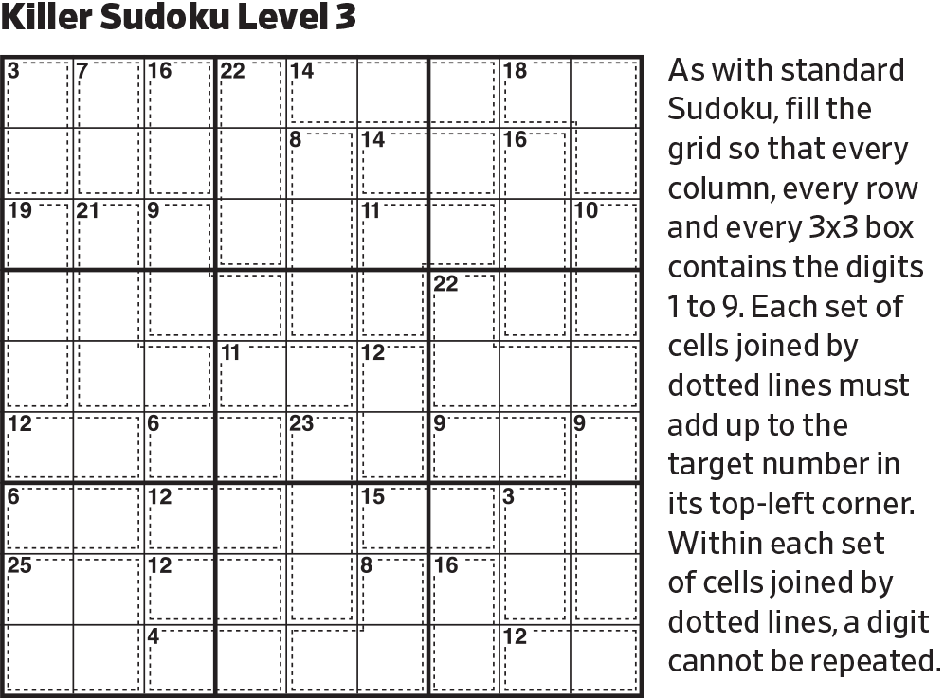
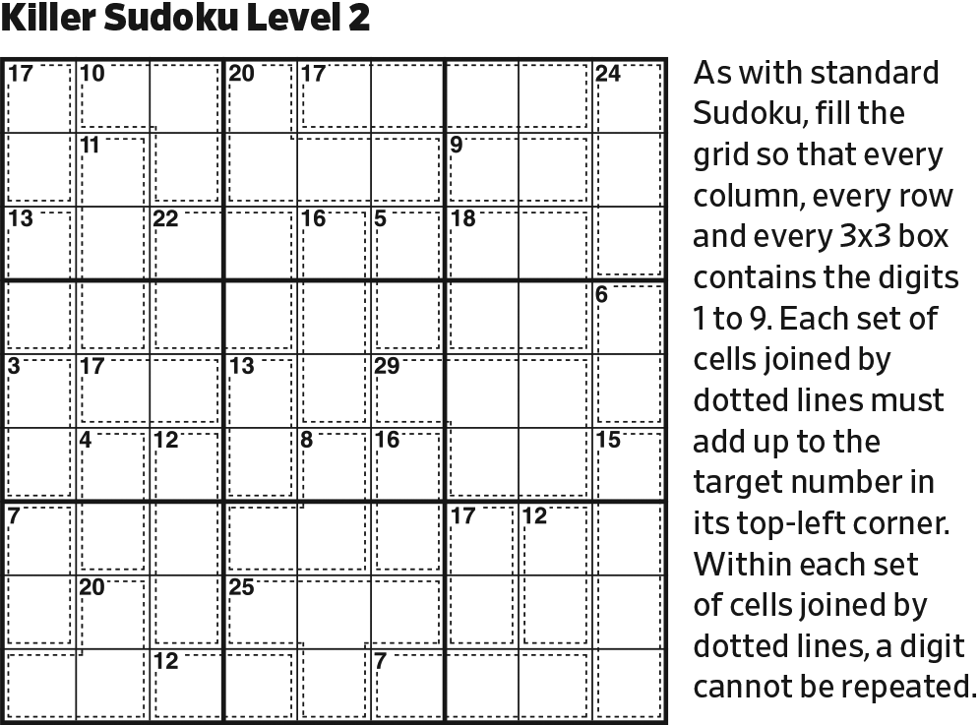
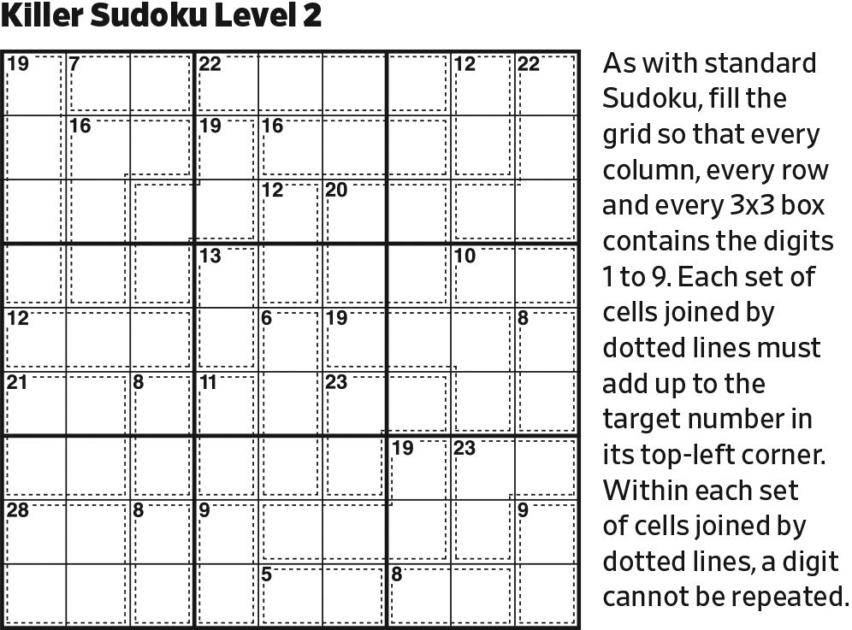
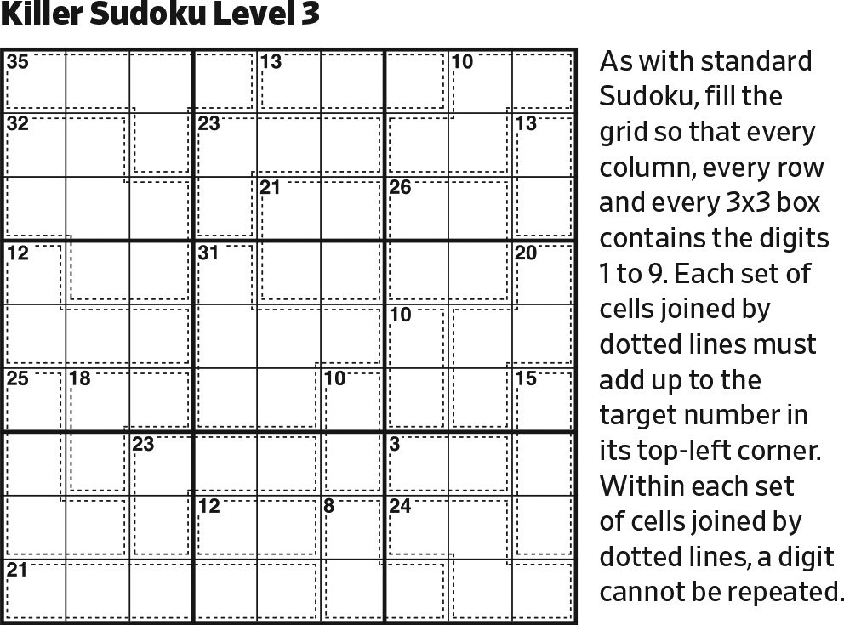
Start.

Slide 2
12345
12346
12356
789
12345
12346
12356
789
A 3-cell arrow all in one block must sum to at least 6 (123), but on these two arrows 6 is precluded by the given 6.

Slide 3
12345
12346
12356
789
12345
12346
12356
789
1345
1345
678
2345
This 3-cell arrow is similar, but the circle can’t be 9, limiting the cells on the arrow to 5.

Slide 4
12345
12346
12356
4579
789
1237
4579
12345
1237
1237
12346
1237
12356
1256
789
1256
1345
1345
678
2345
These 3-cell arrows NOT all in one block must sum to at least 4 (121).
The numbers on the arrow can go up to 7 (117).

Slide 5
12345
12346
12356
4579
789
89
1237
4579
12345
1237
1237
12346
1237
98
12356
1256
789
1256
1345
1345
678
2345
Complete center block.

Slide 6
12345
12346
12356
79
789
89
1237
97
12345
1237
1237
12346
1237
98
12356
1256
789
1256
1345
1345
678
2345
In the center block, the 7 will be on an arrow, and the sum of that arrow must be 9 (117). The other arrow will have 2 and 3 on it, so its sum must be at least 6 (123).

Slide 7
12345
12346
12356
79
789
89
1237
97
12345
1237
1237
12346
1237
98
12356
21
789
12
1345
1345
678
2345
Because of the green cells, the sums of both of these arrows can’t be 9. So, one arrow will be 117, and other one will be 223.

Slide 8
12345
1234
1235
79
78
89
1237
97
12345
1237
1237
1234
1237
98
1235
21
87
12
1345
1345
678
2345
Between these sums and the green cells, Row 4 and Column 6 will have a 9 in it. Therefore, the sums of these other arrows can’t be 9. And an arrow that can’t sum to 9 can’t have a 6 on it.

Slide 9
12345
1234
1235
79
78
89
123
97
12345
237
123
1234
237
98
1235
21
87
12
1345
1345
678
2345
Note the 78/89/97 triplets in Row 4 and Column 6. This limits possible positions of 7 in the center block. And since the 1 must be paired with the 7 on the same arrow, the cells with possible 7’s can’t also be possible 1’s.

Slide 10
12345
1234
7
1235
7
8
9
12345
123
237
123
1234
2
9
237
1235
1
8
1345
1345
678
2345
Where is the 1 in Row 7? Not in the first three columns (the given 1). Not is the last three columns (the arrow in the bottom right block must contain a 1 because the sum of 234 is 9, which is too large). Not in Column 5 because inferences would force Column 4 to also be 1. So, the 1 must be in Column 4.

Slide 11
124
124
2
7
7
8
9
12345
32
1
1234
23
2
7
9
135
1
8
1345
1345
678
2345
Reduce. Note that the arrow that sums to 7 must be 124.

Slide 12
4
1
2
7
7
8
2
9
12345
3
1
234
2
7
9
135
1
8
1345
1345
678
2345
Reduce.

Slide 13
4
1
2
7
7
8
2
9
1345
3
1
24
2
7
9
135
1
8
1345
1345
678
2345
Reduce.

Slide 14
4
1
2
7
7
8
2
9
135
3
1
24
2
7
9
135
1
8
1345
1345
678
2345
The arrow in the right center block that sums to 8 must be 125 or 134. So, no cell other than the middle one can be 2 or 4.

Slide 15
8
4
1
2
7
7
8
2
9
135
3
1
24
2
7
9
135
1
8
1345
1345
678
2
345
Last possible 8 in upper center block.
Last possible 2 in lower center block.
Then, reduce.

Slide 16
8
4
1
2
7
7
8
2
9
135
3
1
24
2
7
9
135
1
8
134
134
8
2
43
In the lower right block, the minimal arrow is now 134, summing to 8. Since that’s also the maximal sum, that must be the solution.

Slide 17
8
4
1
2
7
7
8
2
9
135
3
1
24
2
7
9
8
135
1
8
134
134
8
2
9
43
Last possible 8 in right center block.
Last possible 9 in lower right block. (There can’t be a 9 on an arrow).

Slide 18
15
8
4
1
458
2
7
569
7
8
2
9
135
3
1
24
2
7
9
8
135
1
8
7
25
52
65
9
134
134
8
2
9
34
43
Initialize the 2-arrows.

Slide 19
1
8
4
1
458
2
7
569
7
8
2
9
135
3
1
7
24
2
7
9
8
135
1
8
7
25
52
65
9
134
134
8
2
9
6
34
43
Complete lower right block.
Last possible 1 in Column 3.
Last possible 7 in Column 9.

Slide 20
1
8
4
9
1
458
2
7
569
7
8
2
9
135
3
1
6
7
24
2
7
9
8
135
1
8
7
25
52
65
9
134
134
8
7
2
9
6
34
43
Last possible 9 in upper center block.
Last possible 6 in right center block.
Last possible 7 in lower center block.

Slide 21
7
1
8
4
9
1
458
2
7
569
7
8
2
9
135
3
1
6
2
7
2
7
9
8
135
1
8
7
25
52
7
65
9
134
134
8
7
2
9
6
34
43
Last possible 7 in lower left block.
Then, last possible 7 in Row 1.
Last possible 2 in right center block.

Slide 22
7
1
8
4
9
1
458
2
7
569
7
8
2
9
51
3
1
6
2
7
2
7
9
8
15
1
8
7
5
2
7
65
9
134
134
8
7
2
9
6
34
43
Reduce. The arrow is now known to be 125 (rather than 134).

Slide 23
7
1
8
4
9
1
458
2
7
569
7
8
2
9
4
51
3
1
6
2
7
2
7
9
8
3
15
1
8
7
5
2
7
65
9
134
13
8
7
2
9
6
34
43
In right center block, the remaining digits (34) fit in only one way.
Then, reduce.

Slide 24
7
1
8
4
56
9
1
458
35
2
7
569
63
7
8
2
9
4
51
3
1
6
2
7
2
7
9
8
3
15
1
8
7
5
2
7
65
9
134
13
8
7
2
9
6
34
43
Complete upper center block.

Slide 25
7
1
8
4
56
9
1
458
35
2
7
569
63
7
8
2
9
4
51
3
1
6
2
7
2
7
9
8
3
15
1
8
7
5
2
46
7
65
9
134
13
8
53
7
2
9
6
34
43
Complete Column 6.
Then, complete Column 5.

Slide 26
7
1
8
4
56
9
1
458
35
2
7
569
63
7
8
2
9
4
51
3
1
6
2
7
2
7
9
8
3
15
1
8
7
5
2
964
964
46
7
65
9
134
13
8
46
53
7
2
9
6
58
85
34
43
Complete Row 9.
Then, complete bottom left block.

Slide 27
7
1
8
4
56
9
1
458
35
2
7
569
63
7
8
2
9
4
51
35
135
3
1
6
2
7
489
489
489
2
7
9
8
3
56
156
15
1
8
7
5
2
964
964
46
7
65
9
134
13
8
46
53
7
2
9
6
58
85
34
43
Complete Rows 3–5.

Slide 28
7
1
8
4
56
9
1
458
35
2
7
569
63
7
8
2
9
4
51
35
135
3
1
6
2
7
489
489
49
2
7
9
8
3
56
156
15
1
8
7
5
2
964
964
46
7
65
9
134
13
8
46
53
7
2
9
6
58
85
34
43
In Column 3, the arrow will contain a 5 or an 8. Together with the 58 cell, no other 5’s or 8’s can appear in Column 3.

Slide 29
7
1
8
4
2356
56
235
36
9
1
458
35
2
7
569
63
7
8
2
9
4
51
35
135
3
1
6
2
7
489
489
49
2
7
9
8
3
56
156
15
1
8
7
5
2
964
964
46
7
65
9
134
13
8
46
53
7
2
9
6
58
85
34
43
Complete Row 1.

Slide 30
7
1
8
4
2356
56
235
36
9
1
458
35
2345
45
2
7
569
63
136
145
7
8
2
9
4
51
35
135
3
1
6
2
7
489
489
49
2
7
9
8
3
56
156
15
1
8
7
5
2
964
964
46
7
65
9
134
13
8
46
53
7
2
9
6
58
85
34
43
Complete Columns 7–9.

Slide 31
7
1
8
4
2356
56
235
36
9
1
234568
34568
458
35
2345
45
2
7
34569
34569
569
63
136
145
7
8
2
9
4
51
35
135
3
1
6
2
7
489
489
49
2
7
9
8
3
56
156
15
1
8
7
5
2
964
964
46
7
65
9
134
13
8
46
53
7
2
9
6
58
85
34
43
Complete remaining cells.

Slide 32
7
1
8
4
2356
56
235
36
9
1
234568
34568
458
35
235
45
2
7
34569
34569
569
63
136
145
7
8
2
9
4
51
35
135
3
1
6
2
7
489
489
49
2
7
9
8
3
56
156
15
1
8
7
5
2
964
964
46
7
65
9
134
13
8
46
53
7
2
9
6
58
85
34
43
In upper right block, 4 is in Column 9.

Slide 33
7
1
8
4
235
56
235
36
9
1
234568
34568
48
35
235
45
2
7
3459
3459
59
63
136
145
7
8
2
9
4
51
35
135
3
1
6
2
7
489
489
49
2
7
9
8
3
56
156
15
1
8
7
5
2
964
964
46
7
65
9
134
13
8
46
53
7
2
9
6
58
85
34
43
In upper left block, 6 is in Row 2.

Slide 34
7
1
8
4
235
56
235
36
9
1
234568
34568
48
35
25
45
2
7
3459
3459
59
63
136
145
7
8
2
9
4
51
35
135
3
1
6
2
7
489
489
49
2
7
9
8
3
56
156
15
1
8
7
5
2
964
964
46
7
65
9
134
13
8
46
53
7
2
9
6
58
85
34
43
The blue cells are a related set. This cell can’t be 3 because that would veto both the left and right digits in the blue cells.

Slide 35
7
1
6
8
4
235
235
36
9
1
5
234568
34568
48
25
45
2
3
7
3459
3459
59
136
145
7
8
2
9
4
51
35
135
3
1
6
2
7
489
489
49
2
7
9
8
3
56
156
15
1
6
8
7
5
2
964
964
7
6
5
9
3
134
13
8
7
4
2
3
9
6
58
85
In Column 3, there must be either a 4 or a 9 on the arrow. Together with the 49 cell, no other 4’s or 9’s can appear in the column. So, only the RIGHT branch of the blue cells is possible.

Slide 36
7
1
6
8
4
3
235
235
9
1
5
2
4
23468
3468
48
2
3
7
459
459
59
16
145
7
8
2
9
4
51
35
135
3
1
6
2
7
489
489
49
2
7
9
8
3
56
156
15
1
6
8
7
5
2
49
94
7
6
5
9
3
14
1
8
7
4
2
3
9
6
58
85
Reduce.

Slide 37
7
1
6
8
4
5
3
25
8
9
1
5
2
4
2368
368
9
2
3
7
6
459
459
15
7
8
2
9
4
51
35
135
3
1
6
2
7
489
489
49
2
7
9
8
3
56
156
15
1
6
8
7
5
2
49
94
7
6
5
9
3
4
1
8
7
4
2
3
9
6
58
85
Reduce.

Slide 38
2
7
1
6
8
4
5
3
8
9
1
5
2
4
236
36
9
2
3
7
6
1
45
54
7
8
2
9
4
5
35
135
4
3
1
6
2
7
489
489
2
7
9
1
8
3
56
156
1
6
8
7
5
2
49
94
7
6
5
9
3
4
1
8
8
5
7
4
2
3
9
6
Reduce.

Slide 39
2
7
1
6
8
4
5
3
8
9
1
5
2
4
36
63
9
2
3
7
6
1
45
54
3
7
8
2
9
4
5
13
9
4
3
1
6
2
7
89
2
7
9
1
8
3
56
65
1
6
8
7
5
2
49
94
7
6
5
9
3
4
1
8
8
5
7
4
2
3
9
6
Reduce.

Slide 40
2
7
1
6
8
4
5
3
6
3
8
9
1
5
2
4
9
2
3
7
6
1
45
54
3
1
7
8
2
9
4
5
8
9
4
3
1
6
2
7
2
7
9
1
8
3
56
65
9
4
1
6
8
7
5
2
7
6
5
9
3
4
1
8
8
5
7
4
2
3
9
6
Reduce.

Slide 41
2
7
1
6
8
4
5
3
6
3
8
9
1
5
2
4
4
5
9
2
3
7
6
1
3
1
7
8
2
9
4
5
8
9
4
3
1
6
2
7
5
6
2
7
9
1
8
3
9
4
1
6
8
7
5
2
7
6
5
9
3
4
1
8
8
5
7
4
2
3
9
6
Reduce.

