Slide 1
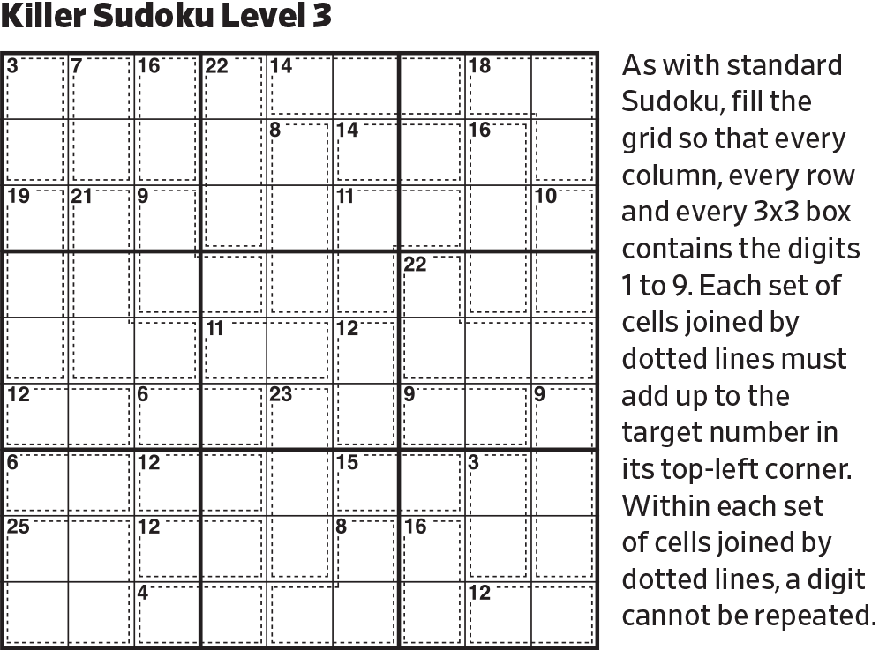
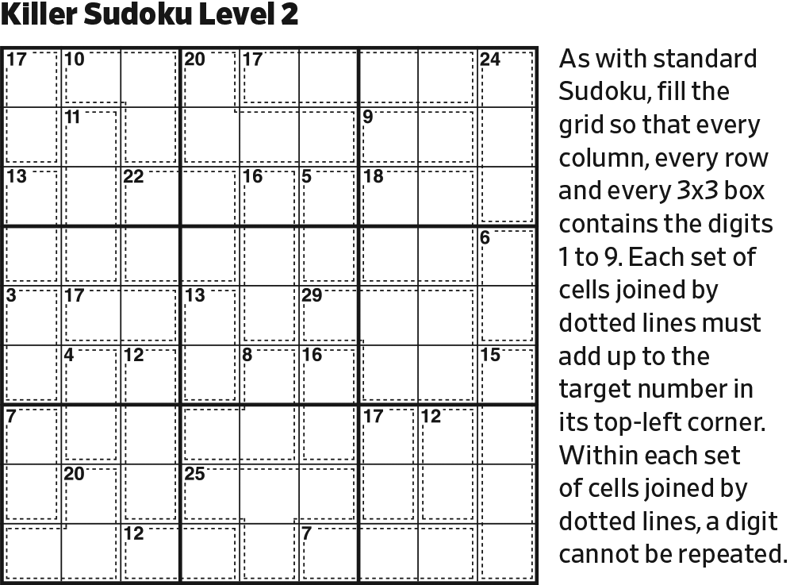
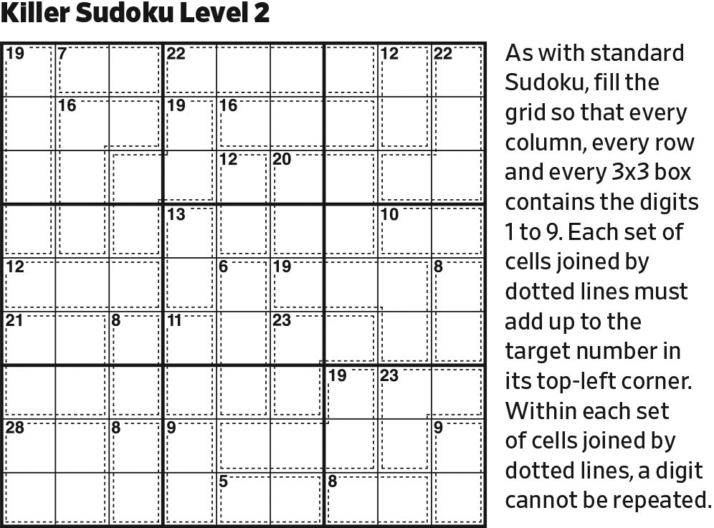
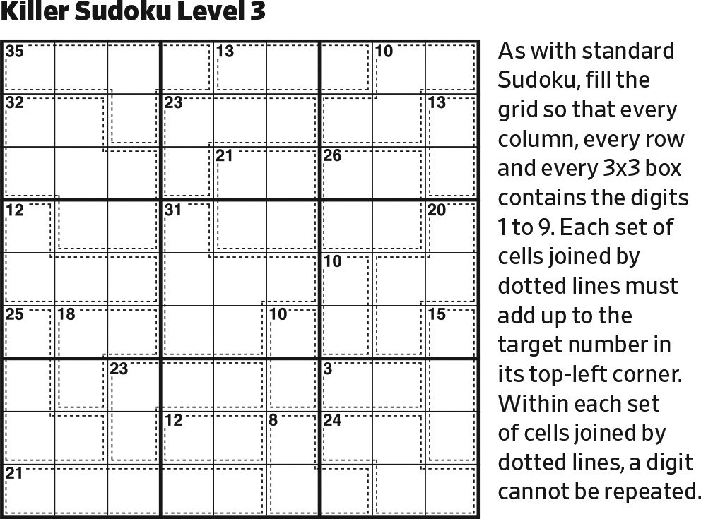
Start.

Slide 2
456
456
3789
3789
456
456
3789
3789
2789
2789
1467
1467
2789
2789
1467
1467
The circles at the box intersections contain the four surrounding digits.

Slide 3
5
46
3789
3789
5
64
3789
3789
2789
2789
1467
1467
2789
2789
1467
1467
Since adjacent digits on a green line must differ by at least 5, 5 cannot appear on a green line. At the upper left intersection, there is only one way to place two 5’s.

Slide 4
19
5
46
3789
3789
5
19
64
3789
3789
2789
2789
1467
1467
2789
2789
1467
1467
The only digits that are at least 5 away from 4 and 6 are 1 and 9.

Slide 5
19
5
46
3789
3789
5
19
64
3789
3789
2789
2789
1467
1467
2789
2789
1467
1467
14567
14567
14567
2389
2389
14567
2389
2389
Initialize bottom right block.

Slide 6
1234679
1234679
1234679
19
12346789
1234679
5
46
12346789
379
3789
5
19
64
379
3789
2789
2789
1467
1467
2789
279
12345679
1467
1467
14567
14567
1234679
1234679
12346789
14567
2389
2389
1234679
12345679
123456789
14567
2389
2389
The upper circled 8 must refer to an 8 in Column 5. Therefore, the lower circled 8 must refer to an 8 in Column 6.

Slide 7
1234679
1234679
1234679
19
12346789
1234679
5
46
12346789
379
3789
5
19
64
1234679
379
3789
12346789
12345679
12345679
2789
2789
12345679
1467
1467
2789
279
12345679
1467
1467
14567
14567
1234679
1234679
12346789
14567
2389
2389
1234679
12345679
123456789
14567
2389
2389
Initialize the center block.

Slide 8
123456789
123456789
234679
1234679
1234679
1234679
135789
13456789
13456789
123456789
123456789
234679
19
12346789
1234679
1235789
123456789
13456789
5
234679
234679
46
12346789
379
3789
123789
13789
5
19
64
1234679
379
3789
12346789
12345679
12345679
2789
2789
12345679
1467
1467
1235689
1235689
289
279
12345679
1467
1467
14567
14567
123456789
123456789
123689
1234679
1234679
12346789
14567
2389
2389
123456789
123456789
123689
1234679
12345679
123456789
14567
2389
2389
The remaining four circles do a poor job of telling us where those digits are, but an excellent job of telling us where they aren’t.

Slide 9
123456789
123456789
234679
1234679
1234679
1234679
135789
13456789
13456789
123456789
123456789
234679
19
12346789
1234679
1235789
123456789
13456789
5
234679
234679
46
12346789
379
3789
123789
13789
5
19
64
1234679
379
3789
12346789
12345679
12345679
2789
2789
12345679
1467
1467
1235689
1235689
289
279
12345679
1467
1467
14567
14567
12345679
12345679
12369
1234679
1234679
12346789
14567
2389
2389
12345679
12345679
12369
1234679
12345679
123456789
14567
2389
2389
In the lower left block, 8 is in Row 7.

Slide 10
123456789
123456789
234679
1234679
1234679
1234679
135789
13456789
13456789
123456789
123456789
234679
19
12346789
1234679
1235789
123456789
13456789
5
234679
234679
46
12346789
379
3789
123789
13789
5
12346789
19
64
1234679
379
3789
12346789
12346789
12346789
12346789
12346789
12346789
12345679
12345679
123456789
12346789
123456789
12346789
12346789
2789
2789
12345679
1467
1467
12346789
123456789
1235689
1235689
289
279
12345679
1467
1467
14567
14567
12345679
12345679
12369
1234679
1234679
12346789
14567
2389
2389
12345679
12345679
12369
1234679
12345679
123456789
14567
2389
2389
Initialize the two remaining blocks.

Slide 11
123456789
123456789
234679
1234679
1234679
1234679
13579
13456789
13456789
123456789
123456789
234679
19
12346789
1234679
123579
123456789
13456789
5
234679
234679
46
12346789
379
3789
123789
13789
5
12346789
19
64
1234679
379
3789
12346789
12346789
12346789
12346789
12346789
12346789
12345679
12345679
12345679
12346789
123456789
12346789
12346789
2789
2789
12345679
1467
1467
12346789
123456789
1235689
1235689
289
279
12345679
1467
1467
14567
14567
12345679
12345679
12369
1234679
1234679
12346789
14567
2389
2389
12345679
12345679
12369
1234679
12345679
123456789
14567
2389
2389
The 3789 circle puts the 8 in Column 7. 8 cannot be elsewhere in Column 7.

Slide 12
123456789
123456789
234679
1234679
1234679
1234679
13579
13456789
13456789
123456789
123456789
234679
19
12346789
1234679
123579
123456789
13456789
5
234679
234679
46
12346789
379
3789
123789
13789
5
12346789
19
64
1234679
379
3789
12346789
12346789
12346789
12346789
12346789
12346789
12345679
12345679
12345679
12346789
123456789
1234689
1234689
2789
2789
1234569
1467
1467
1234689
12345689
1235689
1235689
289
279
1234569
1467
1467
1456
1456
12345679
12345679
12369
1234679
1234679
12346789
14567
2389
2389
12345679
12345679
12369
1234679
12345679
123456789
14567
2389
2389
Considering the bottom two circles at block junctions, one will put a 7 in Row 6 and the other will put a 7 in Row 7. No other cell in Rows 6 and 7 can contain a 7.

Slide 13
123456789
123456789
234679
1234679
1234679
123469
1359
13456789
13456789
123456789
123456789
234679
19
12346789
123469
12359
123456789
13456789
5
234679
234679
46
12346789
379
3789
123789
13789
5
12346789
19
64
1234679
379
3789
12346789
12346789
12346789
12346789
12346789
12346789
12345679
1234569
1234569
12346789
123456789
1234689
1234689
2789
2789
1234569
1467
1467
1234689
12345689
1235689
1235689
289
279
1234569
1467
1467
1456
1456
12345679
12345679
12369
1234679
1234679
1234689
1456
2389
2389
12345679
12345679
12369
1234679
12345679
12345689
1456
2389
2389
Considering the right two circles at block junctions, one will put a 7 in Column 6 and the other will put a 7 in Column 7. No other cell in Column 6 and 7 can contain a 7.

Slide 14
123456789
123456789
234679
1234679
1234679
123469
1359
13456789
13456789
123456789
123456789
234679
19
12346789
123469
12359
123456789
13456789
5
234679
234679
46
12346789
379
3789
123789
13789
5
12346789
19
64
1234679
379
3789
12346789
12346789
12346789
12346789
12346789
12346789
12345679
1234569
1234569
12346789
123456789
1234689
1234689
2789
2789
1234569
1467
1467
1234689
12345689
7
1235689
1235689
289
279
1234569
1467
1456
1456
12345679
12345679
12369
1234679
1234679
1234689
1456
2389
2389
12345679
12345679
12369
1234679
12345679
12345689
1456
2389
2389
Last possible 7 in the lower right block.

Slide 15
123456789
123456789
234679
1234679
1234679
123469
1359
13456789
13456789
123456789
123456789
234679
19
12346789
123469
12359
123456789
13456789
5
234679
234679
46
12346789
379
389
123789
13789
5
12346789
19
64
1234679
379
389
12346789
12346789
12346789
12346789
12346789
12346789
12345679
1234569
1234569
12346789
123456789
1234689
1234689
2789
2789
1234569
146
146
1234689
12345689
7
1235689
1235689
289
29
1234569
146
1456
1456
12345679
12345679
12369
1234679
1234679
1234689
1456
2389
2389
12345679
12345679
12369
1234679
12345679
12345689
1456
2389
2389
Reduce.

Slide 16
123456789
123456789
234679
1234679
1234679
123469
1359
13456789
13456789
123456789
123456789
234679
19
12346789
1234
12359
123456789
13456789
5
234679
234679
46
12346789
379
89
123789
13789
5
12346789
19
64
1234679
379
389
1234
12346789
12346789
12346789
12346789
12346789
12345679
1234569
1234569
6789
123456789
1234689
1234689
2789
2789
1234569
146
146
12
12345689
7
1235689
1235689
289
29
1234569
146
1456
1456
12345679
12345679
12369
1234679
679
12
1456
2389
2389
12345679
12345679
12369
1234679
12345679
12345689
1456
2389
2389
The constraint that adjacent digits on a green line have differences of at least 5 means that digits must alternate between being a low one (1–4) and a high one (6–9). Now that we have a definite 7, we can pursue this. Also, only 1 and 2 can be adjacent to 7.

Slide 17
123456789
123456789
234679
1234679
1234679
123469
1359
13456789
13456789
123456789
123456789
234679
19
12346789
1234
12359
123456789
13456789
5
234679
234679
46
12346789
379
89
123789
13789
5
12346789
19
64
1234679
379
389
1234
12346789
12346789
12346789
12346789
12346789
12345679
1234569
1234569
6789
123456789
1234689
1234689
2789
2789
1234569
146
146
12
12345689
7
1235689
1235689
289
29
1234569
146
1456
1456
12345679
12345679
12369
1234679
679
12
1456
2389
2389
8
12345679
12345679
12369
1234679
12345679
1456
2389
2389
Last possible 8 in lower center block.

Slide 18
123456789
123456789
234679
1234679
1234679
123469
1359
13456789
13456789
123456789
123456789
234679
19
12346789
1234
12359
123456789
13456789
5
234679
234679
46
12346789
379
89
123789
13789
5
12346789
19
64
1234679
379
389
1234
12346789
12346789
12346789
12346789
12346789
12345679
1234569
1234569
6789
123456789
1234689
1234689
2789
2789
1234569
146
146
12
12345689
7
1235689
1235689
289
29
1234569
146
1456
1456
12345679
12345679
12369
1234679
679
12
1456
2389
2389
8
12345679
12345679
12369
1234679
12345679
1456
239
239
Reduce.

Slide 19
123456789
123456789
234679
1234679
1234679
123469
1359
13456789
13456789
123456789
123456789
234679
19
12346789
1234
12359
123456789
13456789
5
234679
234679
46
12346789
379
89
123789
13789
5
12346789
19
64
1234679
379
389
1234
12346789
12346789
12346789
12346789
12346789
1234679
1234569
1234569
6789
123456789
1234689
1234689
2789
2789
123469
146
146
12
12345689
7
1235689
1235689
289
29
1234569
146
1456
1456
12345679
12345679
12369
1234679
679
12
1456
2389
2389
8
12345679
12345679
12369
1234679
12345679
1456
239
239
In the lower center block, 5 is in Column 5.

Slide 20
123456789
123456789
234679
1234679
1234679
123469
1359
13456789
13456789
123456789
123456789
234679
19
12346789
1234
12359
123456789
13456789
5
234679
234679
46
12346789
379
89
123789
13789
5
12346789
19
64
1234679
379
389
1234
12346789
5
12346789
12346789
12346789
12346789
1234679
123469
6789
12346789
1234689
1234689
2789
2789
123469
146
146
12
12345689
7
1235689
1235689
289
29
1234569
146
1456
1456
12345679
12345679
12369
1234679
679
12
1456
2389
2389
8
12345679
12345679
12369
1234679
12345679
1456
239
239
Last possible 5 in the center block.
Then, reduce.

Slide 21
123456789
123456789
234679
1234679
1234679
123469
1359
13456789
1346789
123456789
123456789
234679
19
12346789
1234
12359
123456789
1346789
5
234679
234679
46
12346789
379
89
123789
13789
5
12346789
19
64
1234679
379
389
1234
12346789
5
12346789
12346789
12346789
12346789
1234679
123469
6789
12346789
5
1234689
1234689
2789
2789
123469
146
146
12
7
1235689
1235689
289
29
1234569
146
1456
146
12345679
12345679
12369
1234679
679
12
1456
2389
2389
8
12345679
12345679
12369
1234679
12345679
1456
239
239
Last possible 5 in the right center block.
Then, reduce.

Slide 22
123456789
123456789
234679
1234679
1234679
123469
1359
13456789
1346789
123456789
123456789
234679
19
12346789
1234
12359
123456789
1346789
6
5
234679
234679
12346789
379
89
123789
13789
5
12346789
19
64
1234679
379
389
1234
12346789
5
12346789
12346789
12346789
12346789
1234679
123469
6789
12346789
5
1234689
1234689
2789
2789
123469
146
146
12
7
1235689
1235689
289
29
1234569
146
1456
146
12345679
12345679
12369
1234679
679
12
1456
2389
2389
8
12345679
12345679
12369
1234679
12345679
1456
239
239
This cell must be 6. If it was 4, the green cell would be 9, the violet cell would be 2 (high/low alternation along green line), and the blue cell would be out of options.

Slide 23
12345789
12345789
23479
1234679
1234679
123469
1359
13456789
1346789
1
12345789
12345789
23479
12346789
1234
12359
123456789
1346789
6
5
23479
23479
1234789
379
89
123789
13789
1
5
4
12346789
1234679
379
389
1234
12346789
5
12346789
12346789
1234789
12346789
1234679
123469
6789
12346789
5
1234689
1234689
2789
2789
123469
146
146
12
7
1235689
1235689
289
29
1234569
146
1456
146
12345679
12345679
1239
1234679
679
12
1456
2389
2389
8
12345679
12345679
1239
1234679
12345679
1456
239
239
Reduce.

Slide 24
12345789
2345789
23479
23679
234679
23469
1359
13456789
1346789
1
2345789
2345789
23479
2346789
234
2359
23456789
346789
6
5
23479
23479
234789
379
89
123789
13789
1
5
4
236789
23679
379
389
23
236789
5
2346789
2346789
234789
236789
123679
123469
6789
12346789
5
234689
234689
2789
2789
12369
16
146
12
7
1235689
235689
289
29
1234569
146
1456
146
12345679
2345679
1239
23679
679
12
1456
2389
2389
8
12345679
2345679
1239
23679
12345679
1456
239
239
Reduce.

Slide 25
1
2345789
23479
23679
234679
23469
359
3456789
346789
1
2345789
2345789
23479
2346789
234
2359
23456789
346789
6
5
23479
23479
234789
379
89
123789
13789
1
5
4
236789
23679
379
389
23
236789
5
2346789
2346789
234789
236789
123679
123469
6789
12346789
5
234689
234689
2789
2789
12369
16
146
12
7
235689
235689
289
29
1234569
146
1456
146
2345679
2345679
1239
23679
679
12
1456
2389
2389
8
2345679
2345679
1239
23679
12345679
1456
239
239
Last possible 1 in upper left block.
Then, reduce.

Slide 26
1
2345789
23479
23679
234679
23469
359
3456789
346789
1
2345789
2345789
23479
6789
234
2359
23456789
346789
6
5
23479
23479
234789
379
89
123789
13789
1
5
4
236789
23679
379
389
23
236789
5
2346789
6789
234789
236789
123679
123469
6789
12346789
5
234689
234
2789
2789
12369
16
146
12
7
235689
235689
89
29
1234569
146
1456
146
2345679
2345679
1239
23
679
12
1456
2389
2389
8
2345679
2345679
1239
23679
12345679
1456
239
239
Extend high-/low-digit pattern along left green line.

Slide 27
1
2345789
23479
23679
234679
23469
359
3456789
346789
1
2345789
2345789
23479
6789
234
2359
23456789
346789
6
5
23479
23479
234789
379
89
123789
13789
1
5
4
236789
23679
379
389
23
236789
5
2346789
789
234789
236789
123679
123469
789
12346789
5
234689
234
2789
2789
12369
16
146
12
7
235689
235689
89
29
1234569
146
1456
146
2345679
2345679
1239
23
679
12
1456
2389
2389
8
2345679
2345679
1239
23679
12345679
1456
239
239
On a green line, you can’t reach 6 from a 234 cell or a 23 cell.

Slide 28
1
2345789
23479
23679
234679
23469
359
3456789
346789
1
2345789
2345789
23479
6789
234
2359
23456789
346789
6
5
23479
23479
234789
379
89
123789
13789
1
5
4
236789
23679
379
389
23
236789
5
2346789
789
234789
236789
123679
123469
789
12346789
5
234689
234
2789
2789
12369
16
146
12
7
23589
235689
89
29
1234569
146
1456
146
234579
2345679
1239
23
679
12
1456
2389
2389
8
234579
2345679
1239
23679
12345679
1456
239
239
In the left center block, 6 is in Column 1.

Slide 29
1
2345789
23479
23679
234679
23469
359
3456789
346789
1
2345789
2345789
23479
6789
234
2359
23456789
346789
6
5
23479
23479
234789
379
89
123789
13789
1
5
4
236789
23679
379
389
23
236789
5
2346789
789
234789
236789
123679
123469
789
12346789
5
234689
234
2789
2789
12369
16
146
12
7
23589
235689
89
29
1234569
146
1456
146
457
4567
1239
23
67
12
456
2389
2389
8
234579
2345679
1239
23679
12345679
1456
239
239
In Row 8, note the 1239/23/12/2389/2389 quintet.

Slide 30
1
2345789
23479
23679
234679
23469
359
3456789
346789
1
2345789
2345789
23479
6789
234
2359
23456789
346789
6
5
23479
23479
234789
379
89
123789
13789
1
5
4
236789
23679
379
389
23
236789
5
2346789
789
234789
236789
123679
123469
789
12346789
6
5
234689
234
2789
2789
12369
146
12
7
23589
235689
89
29
1234569
146
1456
146
457
4567
1239
23
67
12
456
2389
2389
8
234579
2345679
1239
23679
12345679
1456
239
239
This cell cannot be 1. If it were, the green cells would be 2. Then, the purple cells would be 3. Then, the blue cell would be both the last possible 2 and the last possible 3 in the lower right block.

Slide 31
1
2345789
23479
23679
234679
2349
359
3456789
346789
1
2345789
2345789
23479
6789
234
2359
23456789
346789
6
5
23479
23479
234789
379
89
123789
13789
1
5
4
236789
2379
379
389
23
236789
5
2346789
789
234789
23789
12379
123469
789
12346789
6
5
23489
234
2789
2789
1239
41
12
7
23589
235689
89
29
1234569
14
1456
146
457
4567
1239
23
67
12
456
2389
2389
8
234579
2345679
1239
23679
12345679
1456
239
239
Reduce.

Slide 32
1
2345789
23479
23679
234679
2349
359
3456789
346789
1
2345789
2345789
23479
6789
234
2359
23456789
346789
6
5
23479
23479
234789
379
89
123789
13789
1
5
4
236789
2379
379
389
23
236789
5
2346789
789
234789
23789
12379
123469
789
12346789
6
5
23489
234
2789
2789
1239
41
12
7
23589
235689
89
29
234569
14
1456
146
457
4567
1239
23
67
12
456
2389
2389
8
234579
2345679
1239
23679
2345679
1456
239
239
In the center block, 1 is in Column 5.

Slide 33
1
2345789
23479
23679
234679
2349
359
3456789
346789
1
2345789
2345789
23479
6789
234
2359
23456789
346789
6
5
23479
23479
234789
379
89
123789
13789
1
5
4
236789
2379
379
389
23
236789
5
2346789
789
234789
23789
12379
123469
789
12346789
6
5
23489
234
2789
2789
239
41
12
7
23589
235689
89
29
234569
14
1456
146
457
4567
1239
23
67
12
456
2389
2389
8
234579
2345679
1239
23679
2345679
1456
239
239
This cell cannot be 1. If it were, the light green cell would be 4 and the light violet cell would be 2. The light green 4 would force the dark green 1, which would force the dark violet 2. This puts us back to where we were a moment ago, with the blue cell being both the last possible 2 and the last possible 3 in the lower right block.

Slide 34
1
2345789
23479
23679
234679
2349
359
3456789
346789
1
2345789
2345789
23479
6789
234
2359
23456789
346789
6
5
23479
23479
234789
379
89
123789
13789
1
5
4
236789
2379
379
389
23
236789
1
5
2346789
789
234789
23789
23469
789
2346789
6
5
23489
234
2789
2789
239
41
12
7
23589
235689
89
29
234569
14
1456
146
457
4567
1239
23
67
21
456
2389
2389
8
234579
2345679
1239
23679
2345679
1456
239
239
Last possible 1 in the center block.
Then, reduce.

Slide 35
1
2345789
23479
23679
234679
2349
359
3456789
346789
1
2345789
2345789
23479
6789
234
2359
23456789
346789
6
5
23479
23479
234789
379
89
123789
13789
1
5
4
236789
2379
379
389
23
236789
1
5
2346789
789
234789
23789
23469
789
2346789
6
5
23489
234
2789
2789
239
41
12
7
23589
235689
89
29
234569
14
1456
146
457
4567
1239
23
67
21
456
389
2389
8
234579
2345679
1239
23679
2345679
1456
239
239
This cell can’t be 2. There are only two remaining possible 1’s in both Row 6 and Column 6. The 1467 circle is down to one cell being 1 and the other being 4. In both cases it would determine the positions of the 1’s. This cell being 2 would preclude both possibilities.

Slide 36
1
2345789
23479
23679
234679
2349
359
3456789
346789
1
2345789
2345789
23479
6789
234
2359
23456789
346789
6
5
23479
23479
234789
379
89
123789
13789
1
5
4
236789
2379
379
389
23
236789
1
5
2346789
789
234789
23789
23469
789
2346789
6
5
23489
234
2789
2789
239
41
12
7
23589
235689
89
29
234569
14
1456
146
457
4567
1239
23
67
21
456
89
2389
8
234579
2345679
1239
23679
2345679
1456
239
239
This cell can’t be 3, either. A 3 would force both orange cells to be 2, which creates the same mess.

Slide 37
1
2345789
23479
23679
234679
2349
359
3456789
346789
1
2345789
2345789
23479
6789
234
2359
23456789
346789
6
5
23479
23479
234789
379
89
123789
13789
1
5
4
236789
2379
379
389
23
236789
1
5
2346789
789
234789
23789
2369
789
2346789
6
5
23489
234
2789
2789
239
41
12
7
23589
235689
89
29
23569
14
1456
146
457
4567
1239
23
67
21
456
89
2389
8
234579
2345679
1239
23679
2345679
1456
239
239
These two cells cannot be 4. A 4 would preclude a 4 in the adjacent 14 cell. Then, its influence would loop around in the bottom right block to preclude a 4 in the other 14 cell.

Slide 38
1
2345789
23479
23679
234679
2349
359
3456789
346789
1
2345789
2345789
23479
6789
234
2359
23456789
346789
6
5
23479
23479
234789
379
89
123789
13789
1
5
4
236789
2379
379
389
23
236789
1
5
2346789
789
234789
23789
2369
789
2346789
6
5
23489
234
2789
2789
239
41
12
9
7
23589
235689
29
23569
14
1456
146
457
4567
1239
23
67
21
456
89
2389
8
234579
2345679
1239
23679
2345679
1456
239
239
A short digression to show why this cell can’t be 9.

Slide 39
1
2345789
23479
23679
234679
2349
359
3456789
346789
1
2345789
2345789
23479
6789
234
2359
23456789
346789
6
5
23479
23479
234789
379
89
123789
13789
1
5
4
236789
2379
379
389
23
236789
1
5
2346789
789
234789
23789
2369
789
2346789
6
5
23489
234
2789
2789
239
41
12
9
2
7
23589
235689
23569
14
1456
146
457
4567
1239
23
67
21
456
89
2389
8
234579
2345679
1239
23679
2345679
1456
239
239
Reduce.

Slide 40
1
2345789
23479
23679
234679
2349
359
3456789
346789
1
2345789
2345789
23479
6789
234
2359
23456789
346789
6
5
23479
23479
234789
379
89
123789
13789
1
5
4
236789
2379
379
389
23
236789
1
5
2346789
789
234789
23789
2369
789
2346789
6
1
2
5
23489
234
2789
2789
239
9
2
4
7
23589
235689
23569
1456
146
3
1
457
4567
1239
67
456
89
2389
8
234579
2345679
1239
23679
2345679
1456
239
239
Reduce.

Slide 41
1
2345789
23479
23679
234679
2349
359
3456789
346789
1
2345789
2345789
23479
6789
234
2359
23456789
346789
6
5
23479
23479
234789
379
89
123789
13789
1
5
4
3
236789
2379
379
389
236789
1
5
2346789
789
234789
23789
2369
789
2346789
6
1
2
5
23489
234
2789
2789
239
9
2
4
7
23589
235689
23569
1456
146
3
1
457
4567
1239
67
456
89
289
8
234579
2345679
1239
23679
2345679
1456
39
239
Reduce.

Slide 42
1
2345789
23479
23679
234679
2349
359
3456789
346789
1
2345789
2345789
23479
6789
234
2359
23456789
346789
6
5
23479
23479
234789
379
89
123789
13789
1
5
4
3
236789
2379
379
389
236789
1
5
2346789
789
234789
23789
2369
789
2346789
6
1
2
5
23489
234
2789
2789
239
9
2
4
7
23589
235689
23569
1456
146
3
1
457
4567
1239
67
456
89
289
8
9
234579
2345679
1239
23679
2345679
1456
239
Reduce.

Slide 43
1
2345789
23479
23679
234679
2349
359
3456789
346789
1
2345789
2345789
23479
6789
234
2359
23456789
346789
6
5
23479
23479
234789
379
89
123789
13789
1
5
4
3
236789
2379
379
389
236789
1
5
2346789
789
234789
23789
2369
789
2346789
6
1
2
5
23489
234
2789
2789
239
9
2
4
7
23589
235689
23569
1456
146
3
1
8
457
4567
1239
67
456
28
8
9
234579
2345679
1239
23679
2345679
1456
23
Reduce.

Slide 44
1
2345789
23479
23679
234679
2349
359
3456789
346789
1
2345789
2345789
23479
6789
234
2359
23456789
346789
6
5
23479
23479
234789
379
89
123789
13789
1
5
4
3
236789
2379
379
389
236789
1
5
2346789
789
234789
23789
2369
789
2346789
6
1
2
5
23489
234
2789
2789
239
9
2
4
7
23589
235689
23569
1456
146
3
1
8
2
457
4567
1239
67
456
8
9
234579
2345679
1239
23679
2345679
1456
23
Reduce.
And FAIL.

Slide 45
1
2345789
23479
23679
234679
2349
359
3456789
346789
1
2345789
2345789
23479
6789
234
2359
23456789
346789
6
5
23479
23479
234789
379
89
123789
13789
1
5
4
236789
2379
379
389
23
236789
1
5
2346789
789
234789
23789
2369
789
2346789
6
5
23489
234
2789
2789
239
41
12
8
7
23589
235689
29
23569
14
1456
146
457
4567
1239
23
67
21
456
89
2389
8
234579
2345679
1239
23679
2345679
1456
239
239
Continuing with the correct assignment of 8.

Slide 46
1
2345789
23479
23679
234679
2349
359
3456789
346789
1
2345789
2345789
23479
6789
234
2359
23456789
346789
6
5
23479
23479
234789
379
89
123789
13789
1
5
4
236789
2379
379
389
23
236789
1
5
2346789
789
23479
23789
2369
789
2346789
6
5
23489
23
279
279
239
41
12
8
7
2359
23569
29
23569
14
1456
146
457
4567
1239
23
67
21
456
89
2389
8
234579
2345679
1239
23679
2345679
1456
239
239
Reduce. (Note that 4 cannot be adjacent to 8 on the green line, since they only differ by 4.)

Slide 47
1
2345789
23479
23679
234679
2349
359
3456789
346789
1
234579
2345789
23479
6789
234
2359
23456789
346789
6
5
23479
23479
234789
379
89
123789
13789
1
5
4
23679
2379
379
389
23
236789
8
1
5
234679
79
23479
2369
79
234679
8
6
5
23
279
279
239
41
12
8
7
2359
23569
29
23569
14
1456
146
457
4567
1239
23
67
21
456
89
2389
8
234579
2345679
1239
23679
2345679
1456
239
239
Last possible 8 in Row 6.
Last possible 8 in Column 4 (and center block).
Then, reduce.

Slide 48
1
2345789
23479
23679
234679
2349
359
3456789
346789
1
234579
2345789
23479
6789
234
2359
23456789
346789
6
5
23479
23479
234789
379
89
123789
13789
1
5
4
23679
2379
379
389
23
236789
8
1
5
234679
79
23479
2369
79
234679
8
6
4
1
5
23
279
279
239
8
1
7
2359
23569
29
23569
1456
146
2
457
4567
1239
23
67
456
89
2389
8
234579
2345679
1239
23679
2345679
1456
239
239
Last possible 4 in Row 6.
Then, last possible 1 in Row 6.

Slide 49
1
2345789
23479
23679
234679
349
359
3456789
346789
1
234579
2345789
23479
6789
34
2359
23456789
346789
6
5
23479
23479
234789
379
89
23789
13789
1
5
4
23679
2379
379
389
23
236789
8
1
5
2346
79
234
236
79
236
8
6
4
1
5
23
279
279
239
8
9
1
7
2359
23569
3569
456
46
3
7
2
457
4567
139
56
89
389
8
234579
2345679
1239
3679
345679
156
239
239
Reduce. (Note 79 pair in Row 5.) (Note that 7, but not 6, can be adjacent to a 2 on a green line.)

Slide 50
1
2345789
23479
267
23469
349
359
3456789
346789
1
234579
2345789
23479
689
34
2359
23456789
346789
6
5
1
23479
23479
23489
379
89
23789
1
5
4
23679
239
379
389
23
236789
8
1
5
2346
79
234
236
79
236
8
6
4
1
5
23
27
72
239
8
9
1
7
235
2356
56
456
46
3
7
2
45
456
19
56
89
98
6
8
1
234579
2345679
1239
456
239
239
Reduce. (Note last possible 1’s in upper right and lower right blocks.)

Slide 51
1
2345789
23479
27
23469
349
359
3456789
346789
1
234579
2345789
23479
689
34
2359
23456789
346789
6
5
1
23479
23479
23489
379
89
23789
1
5
4
23679
239
379
389
23
236789
8
1
5
2346
79
234
236
79
236
8
3
6
4
1
5
27
72
39
8
9
5
1
7
235
2356
456
46
3
7
2
45
456
19
56
89
98
6
8
1
234579
234579
239
45
32
23
Reduce.

Slide 52
1
245789
23479
27
23469
349
359
456789
346789
1
234579
245789
23479
689
34
2359
456789
346789
6
5
1
23479
2479
23489
379
89
789
1
5
4
2679
239
379
389
23
236789
8
1
5
246
79
24
236
79
236
8
3
9
6
4
1
5
27
72
8
9
5
1
7
23
26
64
46
1
3
7
2
45
456
56
89
98
9
6
4
8
1
4579
4579
32
23
Reduce. (Note last possible 1 in lower left block.)

Slide 53
1
245789
2347
27
236
349
359
456
346789
1
2
234579
245789
2347
68
34
456
346789
6
5
1
23479
2479
238
379
89
789
1
5
4
2679
23
37
389
23
236789
8
1
5
246
79
24
236
79
236
8
3
9
6
4
1
5
27
72
2
8
9
5
1
7
23
64
46
1
3
7
2
5
45
456
89
98
9
6
4
8
1
57
75
32
23
Reduce. (Note 789/789/89 triplet in Column 8.) (Note last possible 2 in upper right block.)

Slide 54
1
45789
2347
27
236
349
39
456
346789
1
2
34579
45789
347
68
34
456
346789
6
5
1
23479
479
238
379
89
789
1
5
4
2679
23
37
389
23
236789
8
1
5
6
246
79
24
79
236
8
3
9
6
4
1
5
27
72
3
2
8
9
5
1
7
64
46
4
1
3
7
2
5
46
89
98
9
6
4
8
1
57
75
32
23
Reduce. (Note last 6 in Column 7.)

Slide 55
1
45789
2347
27
236
349
39
456
346789
1
2
579
45789
347
68
34
456
346789
6
5
1
279
479
238
379
89
789
1
5
4
2679
23
37
389
23
23789
2
8
1
5
6
79
24
79
23
8
3
9
6
4
1
5
27
72
3
2
8
9
5
1
7
64
46
4
6
1
3
7
2
5
89
98
9
6
4
8
1
57
75
32
23
Reduce.

Slide 56
1
45789
2347
27
236
349
39
456
346789
1
2
579
45789
347
68
34
456
346789
6
5
1
79
479
238
379
89
789
6
1
5
4
23
37
389
23
23789
2
4
8
1
5
6
3
79
79
8
3
7
2
9
6
4
1
5
3
2
8
9
5
1
7
64
46
4
6
1
3
7
2
5
89
98
9
6
4
8
1
57
75
32
23
Reduce. (Note last possible 6 in Column 1 (and left center block).)

Slide 57
1
7
45789
234
236
349
39
456
46789
1
2
579
45789
34
68
34
456
46789
6
5
1
79
479
238
379
89
789
6
1
5
4
3
2
37
98
2789
2
9
4
8
1
5
6
7
3
8
3
7
2
9
6
4
1
5
3
2
8
9
5
1
7
64
46
4
6
1
3
7
2
5
89
98
9
6
4
8
1
3
2
57
75
Reduce.

Slide 58
1
7
3
458
234
26
349
456
4689
1
2
579
4578
34
68
34
456
46789
6
5
1
79
47
82
379
89
789
6
1
5
4
3
7
2
98
89
2
9
4
8
1
5
6
7
3
8
3
7
2
9
6
4
1
5
3
2
8
9
5
1
7
64
46
4
6
1
3
7
2
5
89
98
9
6
4
8
1
3
2
57
75
Reduce.

Slide 59
1
7
3
458
42
26
49
456
46
1
2
579
4578
34
68
34
456
467
6
5
1
79
47
82
93
89
789
6
1
5
4
3
7
2
98
89
2
9
4
8
1
5
6
7
3
8
3
7
2
9
6
4
1
5
3
2
8
9
5
1
7
64
46
4
6
1
3
7
2
5
89
98
9
6
4
8
1
3
2
57
75
Reduce.

Slide 60
1
7
3
458
42
26
49
456
46
3
1
2
579
4578
68
34
456
467
6
5
1
79
47
82
93
89
98
6
1
5
4
3
7
2
98
89
2
9
4
8
1
5
6
7
3
8
3
7
2
9
6
4
1
5
3
2
8
9
5
1
7
64
46
4
6
1
3
7
2
5
89
98
9
6
4
8
1
3
2
57
75
Reduce.

Slide 61
1
7
6
9
3
458
42
456
46
3
1
8
4
2
579
4578
456
467
7
6
5
2
3
1
47
89
98
6
1
5
4
3
7
2
98
89
2
9
4
8
1
5
6
7
3
8
3
7
2
9
6
4
1
5
3
2
8
9
5
1
7
64
46
4
6
1
3
7
2
5
89
98
9
6
4
8
1
3
2
57
75
Reduce.

Slide 62
1
7
6
9
3
4
458
42
45
5
3
1
8
4
2
59
56
67
7
4
6
5
2
3
9
8
1
6
1
5
4
3
7
8
2
89
2
9
4
8
1
5
6
7
3
8
3
7
2
9
6
4
1
5
3
2
8
9
5
1
7
64
46
4
6
1
3
7
2
5
89
98
5
7
9
6
4
8
1
3
2
Reduce. (Note that only 9 can be adjacent to 4 on a green line.)

Slide 63
1
8
2
7
6
9
3
5
4
9
5
3
1
8
4
2
6
67
7
4
6
5
2
3
9
8
1
6
1
5
4
3
7
8
2
9
2
9
4
8
1
5
6
7
3
8
3
7
2
9
6
4
1
5
3
2
8
9
5
1
7
4
6
4
6
1
3
7
2
5
9
8
5
7
9
6
4
8
1
3
2
Reduce.

Slide 64
1
8
2
7
6
9
3
5
4
9
5
3
1
8
4
2
6
7
7
4
6
5
2
3
9
8
1
6
1
5
4
3
7
8
2
9
2
9
4
8
1
5
6
7
3
8
3
7
2
9
6
4
1
5
3
2
8
9
5
1
7
4
6
4
6
1
3
7
2
5
9
8
5
7
9
6
4
8
1
3
2
Reduce.

