Slide 1
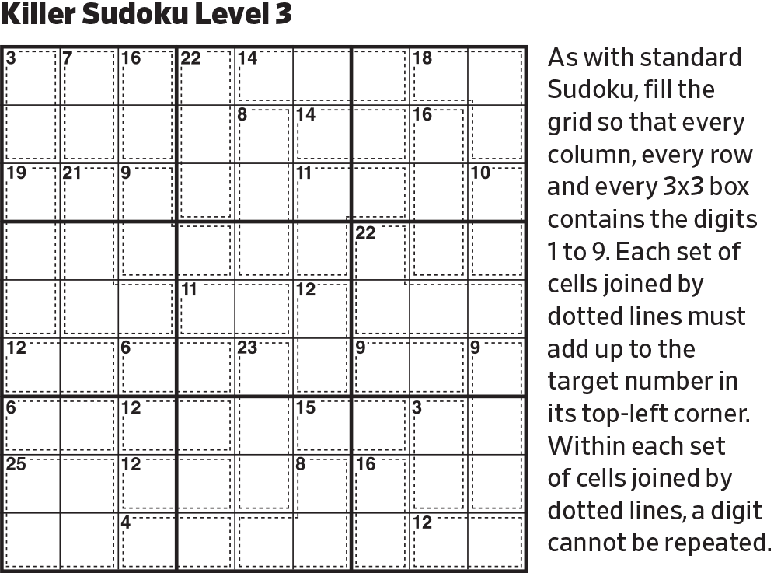
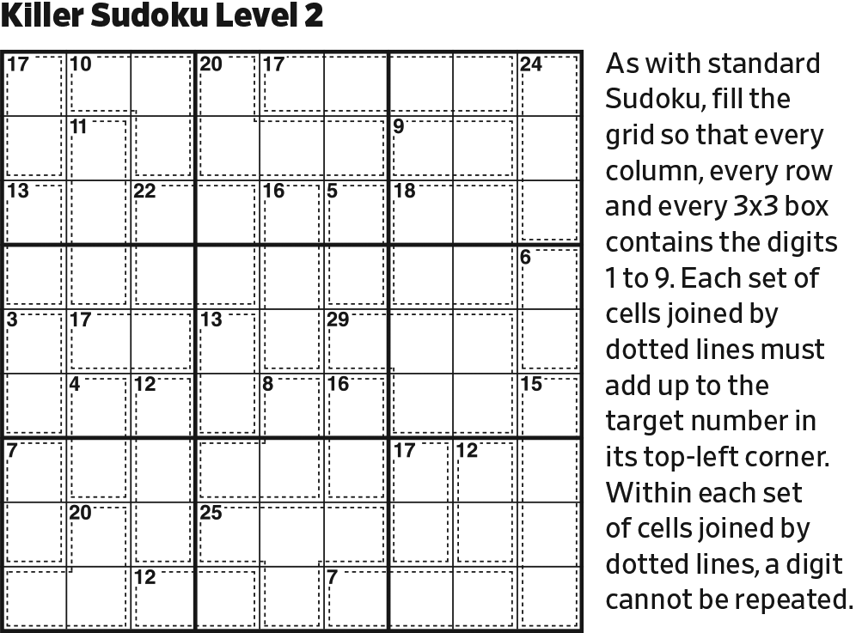
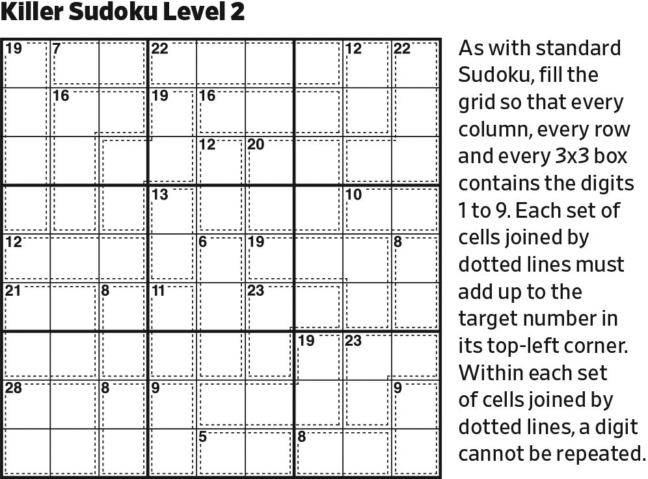
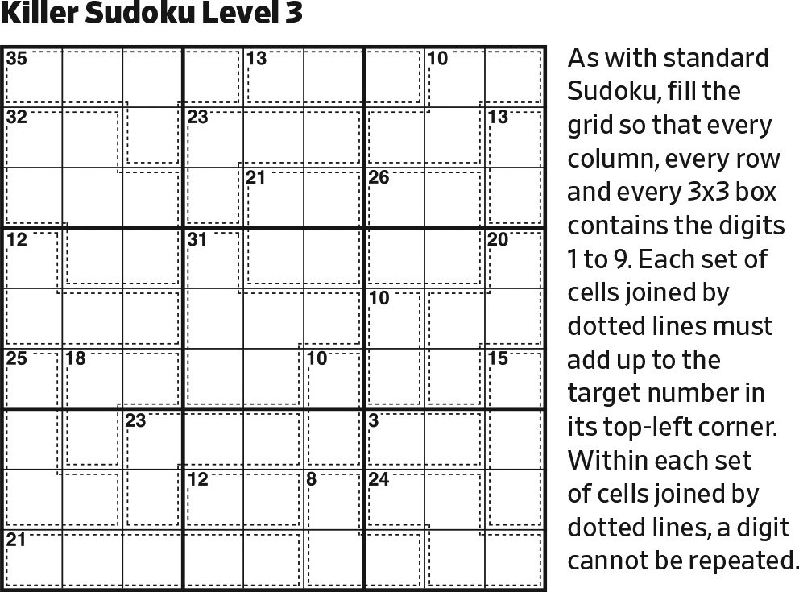
Start.

Slide 2
6789
6789
6789
6789
5789
5789
5789
5789
12345
12345
12345
1235
12345
6789
1235
12345
6789
1235
6789
1235
6789
[11 in 4] is 1235. [29 in 4] is 5789. [30 in 4] 6789. [15 in 5] is 12345.

Slide 3
6789
6789
6789
6789
5
5789
5789
5789
12345
12345
12345
1235
12345
6789
1235
12345
6789
1235
6789
1235
6789
Reduce.

Slide 4
6789
6789
6789
6789
5
789
789
789
1234
12345
1234
1235
12345
6789
1235
12345
6789
1235
6789
1235
6789
Reduce.

Slide 5
6789
6789
6789
6789
24
42
5
789
789
789
136
641
1234
12345
1234
1235
12345
6789
1235
12345
6789
1235
6789
1235
6789
[6 in 2] must be 24 (rather than 15).
Then, initialize [7 in 2].

Slide 6
6789
6789
6789
6789
135
135
24
42
13
5
789
789
789
136
31
641
1234
12345
1234
1235
12345
6789
1235
12345
6789
1235
6789
1235
6789
Complete Row 1 and Column 9.

Slide 7
6789
6789
6789
6789
135
135
24
42
13
5
789
789
789
6
31
1
24
12345
42
1235
12345
6789
1235
12345
6789
1235
6789
1235
6789
Reduce.

Slide 8
6789
6789
6789
6789
135
135
24
42
13
5
789
789
789
6
31
1
24
35
42
1235
53
6789
1
1235
6789
1235
6789
1235
6789
Reduce.

Slide 9
6789
6789
6789
6789
135
135
24
42
13
5
789
789
789
6
31
1
24
35
42
1235
53
6789
1
235
6789
1235
6789
1235
6789
Reduce.

Slide 10
6789
6789
6789
6789
135
135
24
42
13
5
789
789
789
6
789
31
1
24
35
42
1235
53
6789
1
235
6789
1235
6789
1235
6789
Complete the upper right block.

Slide 11
6789
6789
6789
6789
135
135
24
42
13
5
789
789
789
6
4789
2345789
2345789
789
789
31
1
24
35
42
1235
53
6789
1
235
6789
1235
6789
1235
6789
In the upper left block, [24 in 4] must contain 5. -> [19 in 3, no 5, 6] could be 289, 379, or 478. The portion in the upper left block can only support one of 789, but it must contain one of them.

Slide 12
6789
6789
6789
6789
135
135
24
42
13
5
46
12346
12346
12346
12346
789
789
789
6
4789
2345789
2345789
789
1234
1234
789
31
1
24
35
42
1235
53
6789
1
235
6789
1235
6789
1235
6789
Complete Rows 2 and 3.

Slide 13
6789
6789
6789
6789
135
135
24
42
13
5
46
12346
12346
2346
2346
789
789
789
6
4789
2345789
2345789
789
1234
1234
789
31
1
24
35
42
1235
53
6789
1
235
6789
1235
6789
1235
6789
In the upper left block, 1 is in Row 2.

Slide 14
6789
6789
6789
6789
135
135
24
42
13
5
46
12346
12346
2346
2346
789
789
789
6
4789
2345789
2345789
789
1234
1234
789
31
1
6789
24
789
35
42
1235
789
53
6789
1
235
6789
1235
6789
1235
6789
Complete right center block.

Slide 15
6789
6789
6789
6789
135
135
24
42
13
5
46
12346
12346
2346
2346
789
789
789
6
4789
2345789
2345789
789
1234
1234
789
31
1
6789
24
789
35
42
1235
789
53
6789
1
235
2345
6789
1235
2345
246789
6789
1235
2345
246789
6789
Complete Columns 7 and 8.

Slide 16
6789
6789
6789
6789
135
135
24
42
13
5
46
12346
12346
2346
2346
789
789
789
6
4789
2345789
2345789
789
1234
1234
789
31
1
6789
24
789
35
42
235
123
123
78
53
6789
1
235
2345
6789
1235
2345
246789
6789
1235
2345
246789
6789
[11 in 3] could be 128 or 137. It must contain 1.

Slide 17
5
6789
6789
6789
6789
135
24
42
13
6
5
46
12346
12346
2346
789
789
789
6
4789
2345789
2345789
789
43
1234
789
31
1
89
6789
24
789
35
42
235
123
123
78
53
6789
1
235
2345
6789
1235
2345
246789
6789
1235
2345
246789
6789
The maximum [23 in 4] could be with the current assignment is 15 (456). Therefore, the last cell must be 8 or 9, with the first three no less than 14.

Slide 18
5
6789
6789
6789
789
31
24
42
13
4
6
5
1234
1234
234
789
789
789
6
4789
2345789
2345789
789
43
1234
789
31
1
89
6789
24
789
35
42
235
123
123
78
53
6789
1
235
2345
6789
1235
2345
246789
6789
1235
2345
246789
6789
Reduce.

Slide 19
5
6789
6789
6789
789
31
24
42
13
4
6
5
123
123
32
789
789
789
6
789
235789
235789
789
43
1234
789
31
1
89
6789
24
789
35
42
235
123
123
78
53
6789
1
235
2345
6789
1235
2345
246789
6789
1235
2345
246789
6789
Reduce.

Slide 20
5
6789
6789
6789
789
31
24
42
13
4
6
5
123
123
32
789
789
789
6
789
235
235
789
43
1234
789
31
1
89
6789
24
789
35
42
235
123
123
78
53
6789
1
235
2345
6789
1235
2345
246789
6789
1235
2345
246789
6789
Reduce.

Slide 21
5
6789
6789
6789
789
31
24
42
13
4
6
5
123
123
32
78
789
789
6
789
235
235
789
43
1234
78
31
1
89
6789
24
789
35
42
235
123
123
78
53
6789
1
235
2345
6789
1235
2345
246789
6789
1235
2345
246789
6789
Remember that [24 in 4] without a 4 must contain a 9.
Then, reduce.

Slide 22
5
6789
6789
6789
789
31
24
42
13
4
6
5
123
123
32
78
789
789
6
789
235
235
789
43
1234
78
31
1
89
6789
24
789
35
42
1
235
32
78
53
6789
1
235
2345
6789
1235
2345
246789
6789
1235
2345
246789
6789
In the upper center block, 1 is in Column 6.

Slide 23
5
6789
6789
6789
789
31
24
42
13
4
6
5
123
123
32
78
789
789
6
789
235
235
789
43
1234
78
31
1
89
6789
24
789
35
42
1
235
46789
46789
4678
32
78
53
6789
1
235
2345
6789
1235
2345
246789
6789
1235
2345
246789
6789
Note 235/32/53 triplet in Row 6. (Note that in the upper center block, 9 is in Column 4.)

Slide 24
5
6789
6789
6789
789
31
24
42
13
4
6
5
123
123
32
78
789
789
6
789
235
235
789
43
1234
78
31
1
6789
89
6789
24
6789
789
35
42
1
235
46789
46789
4678
32
78
53
6789
1
235
2345
6789
1235
2345
246789
6789
1235
2345
246789
6789
Complete Column 1.

Slide 25
5
6789
6789
6789
789
31
24
42
13
4
6
5
123
123
32
78
789
789
6
789
235
235
789
43
1234
78
31
1
6789
89
6789
24
1
6789
789
35
42
1
235
46789
46789
4678
32
78
53
6789
1
235
2345
6789
1235
2345
246789
6789
1235
2345
246789
6789
Last possible 1 in left center block, since [22 in 3] cannot contain 1.

Slide 26
5
6789
6789
6789
789
31
24
42
13
4
1
6
5
23
32
78
789
789
6
789
235
235
789
43
1234
78
31
1
6789
89
6789
24
1
6789
789
35
42
1
235
46789
46789
4678
32
78
53
6789
1
235
2345
6789
1235
2345
246789
6789
1235
2345
246789
6789
Reduce.
Then, last possible 1 in upper left block.

Slide 27
5
6789
6789
6789
789
31
24
42
13
4
1
6
5
23
32
78
789
789
6
789
235
235
789
43
1234
78
31
1
6789
89
6789
24
1
6789
789
35
42
1
235
46789
46789
4678
32
78
53
6789
1
235
2345
6789
1
2345
246789
6789
1
235
2345
246789
6789
Last possible 1 in lower left block, because [19 in 5] must contain 1, and there’s only one possible position for it. (23456 sums to 20.)

Slide 28
5
6789
6789
6789
789
31
24
42
13
4
1
6
5
23
32
78
789
789
6
789
235
235
789
43
1234
78
31
1
6789
89
6789
24
1
6789
345789
987543
789
35
42
1
235
46789
46789
4678
32
78
53
6789
1
235
2345
6789
1
2345
246789
6789
1
235
2345
246789
6789
Initialize [13 in 3] -> [12 in 2].

Slide 29
5
6789
6789
6789
789
31
24
42
13
4
1
6
5
23
32
78
789
789
6
789
235
235
789
43
1234
78
31
1
6789
89
6789
24
1
6789
3458
9874
789
35
42
1
235
46789
46789
4678
32
78
53
6789
1
235
2345
6789
1
2345
246789
6789
1
235
2345
246789
6789
Reduce.

Slide 30
5
6789
678
6789
789
31
24
42
13
4
1
6
5
23
32
78
789
789
6
789
235
235
789
43
1234
78
31
1
678
56789
2345678
89
6789
24
1
678
56789
3458
9874
789
35
42
1
235
6789
4678
4678
32
78
53
6789
1
235
2345
6789
1
2345
246789
6789
1
235
2345
246789
6789
[22 in 3] could be 589 or 679—in either case, containing a 9.

Slide 31
5
6789
678
678
789
31
24
42
13
4
1
6
5
23
32
78
789
789
6
789
235
235
789
43
1234
78
31
1
678
56789
2345678
89
6789
24
1
678
56789
3458
9874
789
35
42
1
235
6789
4678
4678
32
78
53
6789
1
235
2345
6789
1
2345
246789
6789
1
235
2345
246789
6789
In the upper left block, 9 is in Column 1.

Slide 32
5
6789
678
678
789
31
24
42
13
4
1
6
5
23
32
78
789
789
6
789
235
235
789
43
1234
78
31
1
678
56789
234
89
6789
24
1
678
56789
3458
9874
789
35
42
4
1
23
6789
4678
32
78
53
6789
1
235
2345
6789
1
2345
246789
6789
1
235
2345
246789
6789
In the left center block, note the quintet with digits 5–9.

Slide 33
5
6789
678
678
789
31
24
42
13
4
1
6
5
23
32
78
789
789
6
789
235
235
789
43
1234
78
31
1
678
56789
32
89
6789
24
1
3
678
56789
3458
9874
789
42
4
1
5
23
6789
678
32
78
6789
1
235
2345
6789
1
2345
246789
6789
1
235
2345
246789
6789
Reduce.

Slide 34
5
6789
678
678
789
31
24
42
13
4
1
6
5
23
32
78
789
789
5
6
789
235
789
43
1234
78
31
1
678
56789
32
89
6789
24
1
3
678
56789
458
874
789
42
4
1
5
23
6789
678
32
78
6789
1
235
2345
6789
1
2345
246789
6789
1
235
2345
246789
6789
Reduce.

Slide 35
5
6789
678
678
789
31
24
42
13
4
1
6
5
23
32
78
789
789
5
6
789
32
789
43
1234
78
31
1
678
56789
32
89
6789
24
1
3
678
56789
458
874
789
42
4
1
5
23
6789
678
32
78
6789
1
235
2345
6789
1
2345
246789
6789
1
235
2345
246789
6789
Reduce.

Slide 36
5
6789
678
678
789
31
24
42
13
4
1
6
5
23
32
78
789
789
5
6
789
32
789
43
1234
78
31
1
678
589
32
89
6789
24
1
3
678
589
458
874
789
42
4
1
5
23
89
678
32
78
6789
1
235
2345
6789
1
2345
246789
6789
1
235
2345
246789
6789
In the left center block, [22 in 3] must contain 5.

Slide 37
5
6789
67
678
789
31
24
42
13
4
1
6
5
23
32
78
789
789
5
6
789
32
789
43
1234
78
31
1
67
589
32
89
6789
24
1
3
76
589
458
874
789
42
4
1
5
23
89
678
32
78
6789
1
235
2345
6789
1
2345
246789
6789
1
235
2345
246789
6789
Reduce.

Slide 38
5
89
67
678
789
31
24
42
13
4
1
6
5
23
32
78
789
789
5
6
98
32
789
43
1234
78
31
1
67
589
32
89
6789
24
1
3
76
589
458
874
789
42
4
1
5
23
89
678
32
78
6789
1
235
2345
6789
1
2345
246789
6789
1
235
2345
246789
6789
Reduce.

Slide 39
5
89
67
76
789
31
24
42
13
4
1
6
5
23
32
78
789
789
5
6
98
32
789
43
1234
78
31
1
67
589
32
89
6789
24
1
3
76
589
458
874
789
42
4
1
5
23
89
678
32
78
6789
1
235
2345
6789
1
2345
246789
6789
1
235
2345
246789
6789
Reduce.

Slide 40
5
89
67
76
98
31
24
42
13
4
1
6
5
23
32
78
789
789
5
6
98
32
789
43
1234
78
31
1
67
589
32
89
6789
24
1
3
76
589
458
874
789
42
4
1
5
23
89
678
32
78
6789
1
235
2345
6789
1
2345
246789
6789
1
235
2345
246789
6789
Reduce.

Slide 41
5
89
67
76
98
31
24
42
13
4
1
6
5
23
32
78
789
789
5
6
98
32
789
43
1234
78
31
1
67
589
32
89
6789
24
1
3
76
589
458
874
789
42
4
1
5
23
89
678
32
78
6789
1
235
3467
6789
34789
2345
6789
1
23467
6789
234789
2345
246789
6789
1
235
23467
6789
234789
2345
246789
6789
Complete Columns 2, 3, and 5. (Note that [27 in 4] cannot contain a 2.)

Slide 42
5
89
67
76
98
31
24
42
13
4
1
6
5
23
32
78
789
789
5
6
98
32
789
43
1234
78
31
1
67
589
32
89
6789
24
1
3
76
589
458
874
789
42
4
1
5
23
89
678
32
78
6789
1
235
3467
6789
34789
2345
6789
1
23467
6789
234789
2345
246789
6789
1
235
467
679
2347
234567
2345
46789
6789
[19 in 5] could be 12349, 12358, 12367, 12457, 13456. 12358 is precluded by the 235 cell. The rest contain two of the set 235 which, together with the 235 cell, precludes other 2’s, 3’s, and 5’s in Row 9. No valid solution contains 8, and 9, if it is used, must be in the leftmost cell.

Slide 43
5
89
67
76
98
31
24
42
13
4
1
6
5
23
32
78
789
789
5
6
98
32
789
43
1234
78
31
1
67
589
32
89
6789
24
1
3
76
589
458
874
789
42
4
1
5
23
89
678
32
78
6789
1
235
3467
6789
34789
2345
679
1
23467
6789
234789
2345
24679
679
1
235
467
679
2347
234567
2345
46789
6789
In the bottom right block, 8 is in Row 9.

Slide 44
5
89
67
76
98
31
24
42
13
4
1
6
5
23
32
78
789
789
5
6
98
32
789
43
1234
78
31
1
67
589
32
89
6789
24
1
3
76
589
458
874
789
42
4
1
5
23
89
678
32
78
6789
1
235
3467
6789
34678
34789
2345
2345
67
1
23467
6789
234789
2345
24679
679
1
235
467
679
2347
234567
2345
46789
6789
[27 in 4] could be 3789 or 4689. It can’t be 5679, because that would interfere with the 679 cell. So, it must contain 8 and 9, a 6 or 7, and a 3 or 4. (Remember, the upper center block has a 9 in Column 4.) Containing a 6 or 7, in combination with the 67 cell, precludes other 6’s or 7’s in Row 7.

Slide 45
5
89
67
76
98
31
24
42
13
4
1
6
5
23
32
78
789
789
5
6
98
32
789
43
1234
78
31
1
67
589
32
89
6789
24
1
3
76
589
458
874
789
42
4
1
5
23
89
678
32
78
6789
1
235
3467
6789
34678
34789
345
2345
67
1
23467
6789
345678
234789
3456789
2345
24679
679
1
235
467
679
2347
34567
2345
46789
6789
In the bottom center block, 2 is in Column 5.

Slide 46
5
89
67
76
98
31
24
42
13
4
1
6
5
23
32
78
789
789
5
6
98
32
789
43
1234
78
31
1
67
589
32
89
6789
24
1
3
76
589
458
874
789
42
4
1
5
23
89
678
32
78
6789
1
235
3467
6789
34678
34789
345
2345
67
1
23467
6789
345678
234789
3456789
2345
24679
679
1
235
467
679
2347
34567
2345
46789
6789
Being at an impass, we note the two possible solutions in [23 in 4] in Column 5. Let’s try one, to see if we could eliminate it.

Slide 47
5
89
67
76
98
31
24
42
13
4
1
6
5
23
32
78
789
789
5
3
6
98
32
789
1234
78
31
9
1
67
589
32
6789
24
1
3
76
589
458
874
789
42
4
1
5
23
89
678
32
78
6789
1
235
3467
6789
34678
34789
345
2345
67
1
23467
6789
345678
234789
3456789
2345
24679
679
1
235
467
679
2347
34567
2345
46789
6789
Try: 5639 in [23 in 4].

Slide 48
5
1
89
67
76
98
24
42
13
4
1
3
2
6
5
78
789
789
2
5
3
6
1
98
789
124
78
9
1
67
58
32
678
24
1
3
76
589
458
874
789
42
4
1
5
23
89
678
32
78
6789
1
235
3467
6789
34678
478
345
2345
67
1
23467
6789
345678
2478
3456789
2345
24679
679
1
235
467
679
247
34567
2345
46789
6789
Reduce.

Slide 49
5
1
3
89
67
76
98
24
42
4
1
3
2
6
5
78
789
789
2
5
3
4
6
1
98
789
78
2
9
1
67
58
678
24
1
3
76
589
458
874
789
42
3
4
1
5
89
678
32
78
6789
1
235
3467
6789
34678
478
345
2345
67
1
9
3467
6789
345678
2478
2345
24679
679
1
235
467
679
247
34567
2345
46789
6789
Reduce. (Note last possible 9 in lower center block.)

Slide 50
5
1
3
89
67
76
98
24
42
4
1
3
2
6
5
78
789
789
2
5
3
4
6
1
98
789
78
2
9
1
4
67
58
678
1
3
2
76
589
458
874
789
3
4
1
2
8
5
89
678
6789
1
235
3467
6789
34678
478
345
2345
67
1
9
3467
678
345678
2478
2345
24679
76
1
235
467
679
247
34567
2345
46789
6789
Reduce.

Slide 51
5
1
3
89
67
76
98
24
42
4
1
3
2
6
5
78
79
789
2
5
3
4
6
1
98
789
78
2
9
1
4
67
58
67
1
3
2
76
589
458
874
79
3
9
4
1
2
8
5
9
67
1
235
3467
6789
34678
478
345
2345
67
1
9
3467
678
345678
2478
2345
24679
76
1
235
467
679
247
34567
2345
46789
6789
Reduce, and FAIL.

Slide 52
5
89
67
76
98
31
24
42
13
4
1
6
5
23
32
78
789
789
5
4
6
98
32
789
1234
78
31
8
1
67
589
32
6789
24
1
3
76
589
458
874
789
42
4
1
5
23
89
678
32
78
6789
1
235
3467
6789
34678
34789
345
2345
67
1
23467
6789
345678
234789
3456789
2345
24679
679
1
235
467
679
2347
34567
2345
46789
6789
We proceed with the other possible solution, 5648.

Slide 53
5
89
67
76
98
31
24
42
13
4
1
6
5
23
32
78
789
789
5
4
6
98
32
789
123
78
31
8
1
67
59
32
679
24
1
5
7
3
76
589
789
42
4
1
5
23
89
67
32
78
6789
1
235
3467
6789
34678
379
345
2345
67
1
23467
6789
345678
2379
3456789
2345
24679
679
1
235
467
679
237
34567
2345
46789
6789
Reduce.

Slide 54
5
89
67
76
98
31
24
42
13
4
1
6
5
23
32
78
789
789
5
4
6
98
32
789
123
78
31
7
8
1
59
32
679
24
6
1
5
7
3
98
89
42
4
6
1
5
23
89
32
78
6789
1
235
3467
6789
34678
39
45
2345
67
1
23467
6789
34678
239
456789
2345
24679
679
1
235
467
679
23
4567
2345
46789
6789
Reduce. (Note the 31/123/32 triplet in Column 6.)

Slide 55
5
89
67
76
98
31
24
42
13
4
1
6
5
23
32
78
789
789
5
4
6
98
32
789
123
78
31
7
5
8
1
32
69
24
6
1
5
7
3
98
89
42
4
6
1
5
23
89
32
78
789
1
235
3467
6789
478
39
45
2345
67
1
23467
6789
478
239
45678
2345
24679
679
1
235
467
679
23
4567
2345
46789
6789
Reduce.

Slide 56
5
89
67
76
98
31
24
42
13
4
1
6
5
23
32
78
789
789
5
4
6
98
32
789
123
78
31
7
5
8
1
6
32
24
6
1
5
7
3
98
89
42
4
6
1
5
23
89
32
78
789
1
235
3467
6789
478
39
45
2345
67
1
23467
6789
478
239
45678
2345
2479
679
1
235
467
679
23
4567
2345
4789
6789
Reduce.

Slide 57
5
89
67
76
98
31
24
42
13
4
1
6
5
23
32
78
789
789
5
4
6
98
32
789
123
78
31
7
5
8
1
6
32
24
6
1
5
7
4
3
98
89
42
4
6
1
5
23
89
32
78
789
1
235
3467
6789
478
39
45
2345
67
1
23467
6789
478
239
45678
2345
2479
679
1
235
467
679
23
4567
2345
4789
6789
In Row 5, the remaining cell could be 2 or 4. But remembering the 31/123/32 triplet in Column 6, it’s 4.

Slide 58
5
89
67
76
98
31
24
42
13
4
1
6
5
23
32
78
789
789
5
4
6
98
32
789
123
78
31
7
5
8
1
6
4
32
6
1
5
7
4
3
2
98
89
4
6
1
5
23
89
32
78
789
5
1
235
3467
6789
478
39
2345
67
1
23467
6789
478
239
5678
2345
2479
679
1
235
467
679
23
567
2345
4789
6789
Reduce.

Slide 59
5
89
67
76
98
31
24
42
13
4
1
6
5
23
32
78
789
789
5
4
6
98
32
789
123
78
31
7
5
8
1
6
4
32
6
1
5
7
4
3
2
98
89
4
6
1
5
23
89
32
78
789
5
1
32
3467
6789
478
39
234
67
1
23467
6789
478
239
678
2345
2479
679
1
235
467
679
23
76
2345
4789
6789
Reduce.

Slide 60
5
89
67
76
98
31
24
42
13
4
1
6
5
23
32
78
789
789
5
4
6
98
32
789
123
78
31
7
5
8
1
6
4
32
6
1
5
7
4
3
2
98
89
4
6
1
5
23
89
32
78
789
5
1
32
3467
6789
478
39
234
67
1
23467
6789
478
239
678
2345
2479
679
5
1
467
679
23
76
234
4789
6789
Reduce. Then, reduce.

Slide 61
5
89
67
76
98
31
24
42
13
4
1
6
5
23
32
78
789
789
5
4
6
98
32
789
123
78
31
7
5
8
1
6
4
32
6
1
5
7
4
3
2
98
89
4
6
1
5
23
89
32
78
789
5
1
32
3467
6789
478
39
234
67
1
5
23467
6789
478
239
678
2479
679
5
1
467
679
23
76
234
4789
6789
Last possible 5 in lower right block (completing all nine 5’s).

Slide 62
5
89
67
76
98
31
24
42
13
4
1
6
5
23
32
78
789
789
5
4
6
98
32
789
123
78
31
7
5
8
9
1
6
4
32
23
6
1
5
7
4
3
2
98
89
4
6
1
5
23
89
32
78
789
5
1
32
3467
6789
478
39
234
67
1
5
23467
6789
478
239
678
2479
679
5
1
467
679
23
76
234
4789
6789
Last possible 9 in center block.
Then, complete center block.

Slide 63
5
89
67
76
98
31
24
42
13
4
1
6
5
23
32
78
789
789
5
4
6
98
32
789
123
78
31
7
5
8
9
1
6
4
32
23
6
1
5
7
4
3
2
98
89
4
6
1
5
23
89
32
78
789
5
1
32
3467
6789
478
39
234
67
1
5
23467
6789
478
239
678
2479
679
5
1
467
67
23
76
32
4789
6789
Revisiting [19 in 5], the possible solutions were: 12349, 12367, 12457, 13456. None contain both a 9 and a 6 or 7. Then, the only solution containing both 6 and 7 is 12367.

Slide 64
5
89
67
76
98
31
24
42
13
4
1
6
5
23
32
78
789
789
5
4
6
98
32
789
123
78
31
7
5
8
9
1
6
4
32
23
6
1
5
7
4
3
2
98
89
4
6
1
5
23
89
32
78
789
5
1
32
3467
89
478
39
234
67
1
5
23467
98
478
239
678
2479
679
5
4
1
67
23
76
32
489
89
Reduce.

Slide 65
5
89
67
76
98
31
24
42
13
4
1
6
5
23
32
78
789
789
5
4
6
98
32
789
123
78
31
7
5
8
9
1
6
4
32
23
6
1
5
7
4
3
2
98
89
4
6
1
5
23
89
32
78
789
5
1
32
367
89
478
39
234
67
1
5
2367
98
478
239
678
2479
679
5
4
1
67
23
76
32
98
89
Reduce.

Slide 66
5
89
67
76
98
31
24
42
13
4
1
6
5
23
32
78
789
789
5
4
6
98
32
789
123
78
31
7
5
8
9
1
6
4
32
23
6
1
5
7
4
3
2
98
89
4
6
1
5
23
89
32
78
789
5
1
32
367
89
478
39
234
67
1
5
2367
98
478
239
678
247
76
5
4
1
67
23
76
32
98
89
Reduce.

Slide 67
5
89
67
76
98
31
24
42
13
4
1
6
5
23
32
78
789
789
5
4
6
98
32
789
123
78
31
7
5
8
9
1
6
4
32
23
6
1
5
7
4
3
2
98
89
4
6
1
5
23
89
32
78
98
5
1
32
367
89
478
39
234
67
1
5
2367
98
478
239
678
24
76
5
4
1
67
23
76
32
98
89
Reduce.

Slide 68
5
89
67
76
98
31
24
42
13
4
1
6
5
23
32
78
789
789
5
4
6
98
32
789
123
78
31
7
5
8
9
1
6
4
32
23
6
1
5
7
4
3
2
98
89
4
6
1
3
7
5
23
89
98
5
1
32
367
89
478
39
234
67
1
5
2367
98
478
239
678
24
76
5
4
1
67
23
76
32
98
89
Reduce.

Slide 69
5
1
89
67
76
98
24
42
13
4
1
2
3
6
5
78
98
789
3
5
4
6
98
789
12
78
31
7
5
3
2
8
9
1
6
4
6
1
5
7
4
3
2
98
89
2
4
6
1
3
7
5
89
98
3
5
1
367
89
478
39
234
67
1
5
2367
98
478
239
678
24
76
5
4
1
67
23
76
32
98
89
Reduce.

Slide 70
5
1
3
89
67
76
98
24
42
4
1
2
3
6
5
78
98
789
3
5
4
2
6
1
98
789
78
7
5
3
2
8
9
1
6
4
6
1
5
7
4
3
2
98
89
2
4
6
1
3
7
5
89
98
3
9
5
1
76
89
478
42
67
1
5
267
98
478
239
678
24
76
5
4
1
67
23
76
32
98
89
Reduce.

Slide 71
5
1
3
89
67
76
98
24
42
4
1
2
3
6
5
78
98
789
3
5
4
2
6
1
98
789
78
7
5
3
2
8
9
1
6
4
6
1
5
7
4
3
2
98
89
2
4
6
1
3
7
5
89
98
3
8
9
5
1
76
48
42
67
1
2
5
98
478
32
678
24
76
5
4
1
67
23
76
32
98
89
Reduce.

Slide 72
5
1
3
89
67
76
98
24
42
4
1
2
3
6
5
78
98
789
3
5
4
2
6
1
98
789
78
7
5
3
2
8
9
1
6
4
6
1
5
7
4
3
2
98
89
2
4
6
1
3
7
5
89
98
3
8
4
9
5
1
76
42
67
1
2
9
3
5
4
478
678
76
5
4
1
2
67
76
32
98
89
Reduce.

Slide 73
5
1
4
2
3
89
67
76
98
4
1
2
3
6
5
78
98
789
3
5
4
2
6
1
98
789
78
7
5
3
2
8
9
1
6
4
6
1
5
7
4
3
2
98
89
2
4
6
1
3
7
5
89
98
3
8
4
9
5
2
1
76
67
1
2
9
3
5
4
78
678
76
5
4
1
2
3
67
76
98
89
Reduce.

Slide 74
5
1
4
2
3
89
67
76
98
4
1
2
3
6
5
78
98
789
9
3
5
7
4
2
6
1
78
7
5
3
2
8
9
1
6
4
6
1
5
7
4
3
2
98
89
2
4
6
1
3
7
5
89
98
3
8
4
9
5
2
1
76
67
1
2
9
3
5
4
78
678
76
5
4
1
2
3
67
76
98
89
In Row 3, [24 in 4] -> [16 in 2] must be 79, which fits in only one way.

Slide 75
8
5
1
4
2
3
67
76
98
4
1
2
3
6
8
5
98
789
9
3
5
7
4
2
6
8
1
7
5
3
2
8
9
1
6
4
6
1
5
7
4
3
2
98
89
2
4
6
1
3
7
5
89
98
3
8
4
9
5
2
1
76
67
1
2
9
8
3
5
4
678
76
5
4
1
2
3
67
76
98
89
Reduce.

Slide 76
8
9
5
1
4
2
3
67
76
4
1
2
3
6
8
9
5
79
9
3
5
7
4
2
6
8
1
7
5
3
2
8
9
1
6
4
6
1
5
7
4
8
3
2
98
2
4
6
1
3
7
5
89
98
3
8
4
9
5
2
1
76
67
1
2
9
8
3
5
4
67
76
5
4
1
2
3
9
67
76
89
Reduce.

Slide 77
8
9
5
1
4
2
3
67
76
4
1
2
3
6
8
9
7
5
9
3
5
7
4
2
6
8
1
7
5
3
2
8
9
1
6
4
6
9
1
5
7
4
8
3
2
2
8
4
6
1
3
7
5
9
3
8
4
9
5
2
1
76
67
1
2
9
8
3
5
4
67
76
5
4
1
2
3
9
8
67
76
Reduce.

Slide 78
8
9
5
1
4
2
3
67
76
4
1
2
3
6
8
9
7
5
9
3
5
7
4
2
6
8
1
7
5
3
2
8
9
1
6
4
6
9
1
5
7
4
8
3
2
2
8
4
6
1
3
7
5
9
3
6
8
4
9
5
2
1
67
1
2
9
8
3
5
4
67
76
5
4
1
2
3
9
8
67
76
In Row 7, 6 completes [27 in 4].

Slide 79
8
7
6
9
5
1
4
2
3
4
1
2
3
6
8
9
7
5
9
3
5
7
4
2
6
8
1
7
5
3
2
8
9
1
6
4
6
9
1
5
7
4
8
3
2
2
8
4
6
1
3
7
5
9
3
6
8
4
9
5
2
1
7
1
2
9
8
3
7
5
4
6
5
4
7
1
2
6
3
9
8
Reduce.

Slide 81
8
8
8
8
8
8
8
8
8
8
8
8
8
8
8
8
8
8
8
8
8
8
8
8
8
8
8
8
8
8
8
8
8
8
8
8
8
8
8
8
8
8
8
8
8
8
8
8
8
8
8
8
8
8
8
8
8
8
8
8
8
8
8
8
8
8
8
8
8
8
8
8
8
8
8
8
8
8
8
8
8

Slide 82
123456
123456
123456
123456
123456
123456
123456
123456
123456
123456
123456
123456
123456
123456
123456
123456
123456
123456
123456
123456
123456
123456
123456
123456
123456
123456
123456
123456
123456
123456
123456
123456
123456
123456
123456
123456
123456
123456
123456
123456
123456
123456
123456
123456
123456
123456
123456
123456
123456
123456
123456
123456
123456
123456
123456
123456
123456
123456
123456
123456
123456
123456
123456
123456
123456
123456
123456
123456
123456
123456
123456
123456
123456
123456
123456
123456
123456
123456
123456
123456
123456

