Slide 1
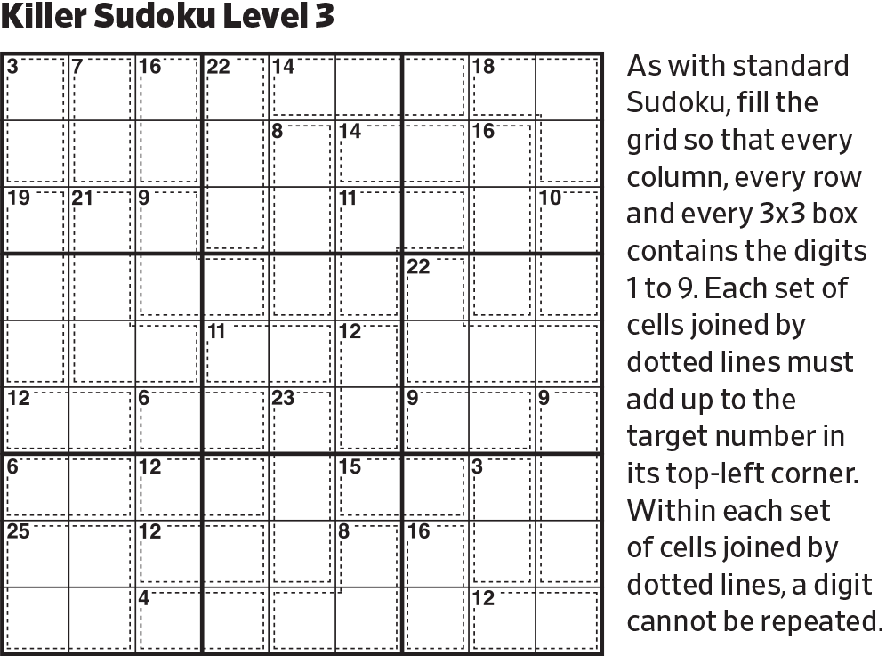
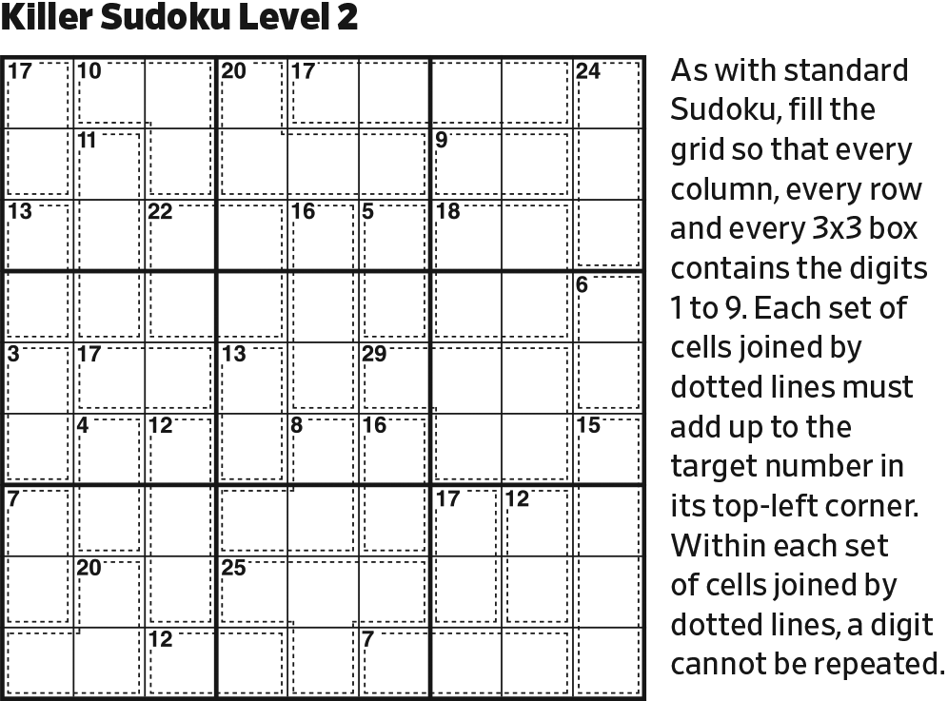
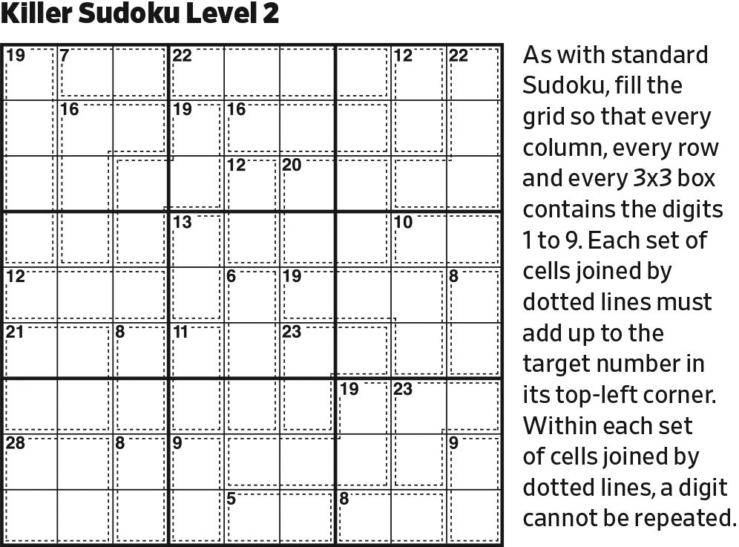
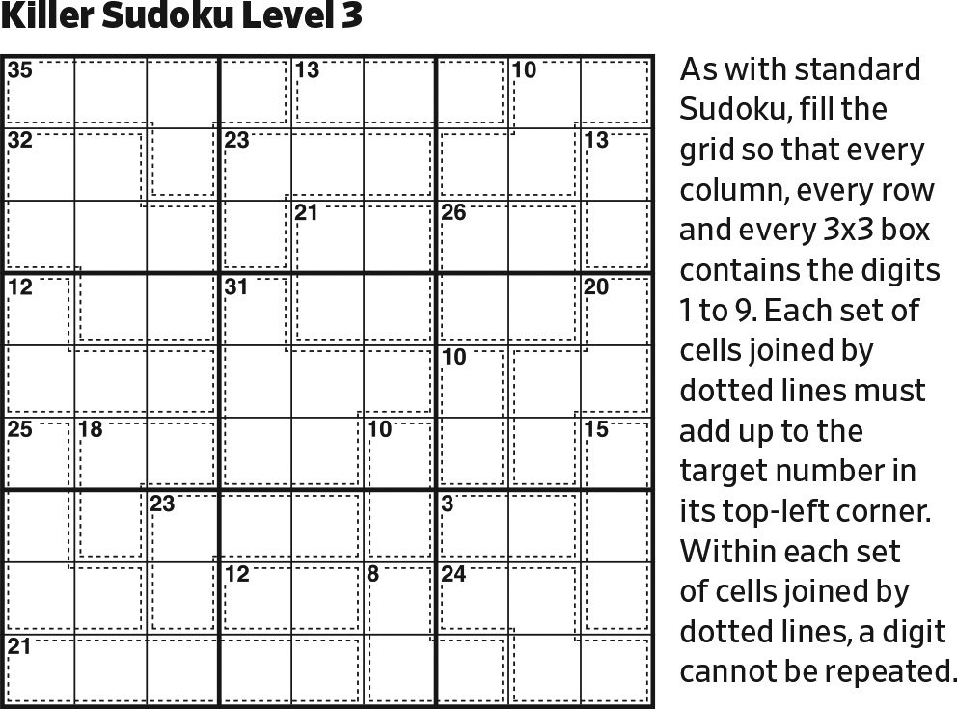
Start.

Slide 2
1
The only digit less than 2 is 1.

Slide 3
9
1
In Column 4, there is only one cell that could be 9. 9 cannot appear in a grey cell with adjacency, because there is no digit that 9 could be less than.

Slide 4
9
9
1
Last possible 9 in Column 6 (and center block).

Slide 5
9
2
9
1
This cell must be less than 4, but not 1 or 3. The only possibility is 2.

Slide 6
9
2
3
9
1
This cell must be less than 6, but not 1, 2, 4, or 5. The only possibility is 3.

Slide 7
9
4
2
3
9
1
This cell must be less than 5, but not 1, 2, or 3. The only possibility is 4.

Slide 8
9
4
2
3
9
1
8
Last possibility for 8 in Column 3.

Slide 9
9
4
2
3
9
1
69
8
96
The remaining digits in Column 3 are 69.

Slide 10
9
4
2
3
1
9
1
69
8
96
This cell must be less than 4, but not 2 or 3. The only possibility is 1.

Slide 11
9
4
3
2
3
1
9
1
69
8
96
This cell must be less than 4, but not 1 or 2. The only possibility is 3.

Slide 12
9
4
3
1
2
3
1
9
1
69
8
96
Last possible 1 in Row 4, since 1 isn’t greater than 2.

Slide 13
9
4
3
1
2
3
1
9
1
56
69
8
567
96
567
The remaining digits in Column 4 are 567. Note that 7 can’t be greater than 7.

Slide 14
9
4
3
1
2
3
1
9
1
56
69
8
65
7
96
In the bottom grey cell, 7 isn’t less than 5, 6, or 7, which places the 7 in the column.

Slide 15
9
4
3
1
2
3
1
9
2
1
56
69
8
65
7
96
This cell must be less than 4, but not 1 or 3. The only possibility is 2.

Slide 16
9
4
3
1
2
3
1
9
2
58
578
78
1
56
69
8
65
7
96
The remaining digits in Row 5 are 578.

Slide 17
9
3678
237
456
567
4
789
1567
5678
3
4678
789
1
2
589
789
678
3
1
9
2
58
578
78
1
56
68
2347
2347
69
23679
13467
8
12345
12345
65
3467
123467
7
12345
96
23469
Initialize all the interfacial cells.

Slide 18
9
3678
237
456
567
4
789
1567
5678
3
4678
789
1
2
589
5678
5679
789
678
3
1
9
2
58
578
78
1
4589
4589
56
68
35689
3689
2347
2347
69
23679
13467
8
12345
12345
65
3467
123467
7
12345
96
23469
Initialize the middle group of blocks.

Slide 19
9
3678
237
456
456
567
4
789
15
5678
3
46
789
1
2
589
5678
5679
789
678
3
1
9
2
58
578
78
1
4589
4589
56
68
35689
3689
2347
2347
69
23679
13467
8
12345
12345
65
3467
123467
7
12345
96
23469
In the center block, 7 and 8 are in Column 5.

Slide 20
9
3678
237
456
456
567
4
1
789
78
3
46
789
1
2
589
5678
5679
789
678
3
1
9
2
58
578
78
1
4589
4589
56
68
35689
3689
2347
2347
69
23679
13467
8
12345
12345
65
3467
123467
7
12345
96
23469
In the upper center block, note the 456/456/46 triplet.

Slide 21
9
3678
237
456
456
567
4
1
789
78
3
46
87
789
1
2
589
5678
5679
789
678
3
1
9
2
58
578
78
1
4589
4589
56
68
35689
3689
2347
2347
69
23679
13467
8
12345
12345
65
3467
123467
7
12345
96
23469
Complete the upper center block.

Slide 22
9
3678
237
456
456
67
4
1
789
78
3
46
87
789
1
2
589
5678
5679
789
678
3
1
9
2
58
578
78
1
4589
4589
56
68
35689
3689
2347
2347
69
23679
13467
8
12345
12345
65
3467
123467
7
12345
96
23469
In the upper center block, 5 is in Row 1.

Slide 23
9
3678
237
456
456
67
4
1
789
78
3
1
46
87
789
1
2
589
5678
5679
789
678
3
1
9
2
58
578
78
1
4589
4589
56
68
35689
3689
2347
2347
69
23679
13467
8
12345
12345
65
3467
123467
7
12345
96
23469
Last possible 1 in the upper right block (and Row 3).

Slide 24
9
3678
237
456
456
67
4
1
789
78
3
1
46
87
789
1
2
589
5678
5679
789
678
3
1
9
2
58
578
78
1
4589
4589
56
68
35689
3689
2347
2347
69
679
3467
8
12345
12345
65
467
123467
7
12345
96
23469
Reduce.

Slide 25
9
3678
237
456
456
67
4
1
789
78
3
1
46
87
789
1
2
589
5678
5679
789
678
3
1
9
2
58
578
78
1
4589
4589
56
68
35689
3689
2347
2347
69
679
3467
8
1
12345
12345
65
467
7
12345
96
23469
Last possible 1 in lower right block.

Slide 26
9
3678
237
456
456
67
4
1
789
78
3
1
46
87
789
1
2
589
5678
5679
789
678
3
1
9
2
58
578
78
1
4589
4589
56
68
35689
3689
347
347
69
679
3467
8
1
2345
2345
65
467
1
7
96
23469
Reduce.
Then, last possible 1 in lower left block.

Slide 27
9
3678
237
456
456
67
4
1
789
78
3
1
46
87
789
1
2
589
5678
5679
789
678
3
1
9
2
58
578
78
1
4589
4589
56
68
35689
3689
2
1
347
347
69
679
3467
8
1
2345
2345
65
467
1
7
96
23469
Last possible 1 in the bottom center block.
Then, last possible 2 in Row 7.

Slide 28
9
3678
237
456
456
67
4
1
789
78
3
1
46
87
789
1
2
589
5678
5679
789
678
3
1
9
2
58
578
78
1
4589
4589
56
68
35689
3689
2
1
347
347
69
679
3467
8
1
2345
2345
65
467
1
7
3
96
2469
Last possible 3 in Column 5.
Then, reduce.

Slide 29
9
3678
237
456
456
67
4
1
789
78
3
1
46
87
789
1
2
589
5678
5679
789
678
3
1
9
2
58
578
78
1
4589
4589
56
68
35689
3689
2
1
347
347
69
679
3467
8
1
2345
2345
65
456
2367
467
1
7
3
245
96
456
469
2469
Initialize bottom group of blocks.

Slide 30
9
3678
237
456
456
67
4
1
789
78
3
1
46
87
789
1
2
589
5678
5679
789
678
3
1
9
2
58
578
78
1
4589
4589
56
68
35689
3689
2
1
347
347
69
96
346
8
1
2345
2345
65
456
2367
467
1
7
3
245
96
456
469
2469
In the bottom left block, 7 is in Row 7.

Slide 31
9
3678
237
456
456
67
4
1
789
78
3
1
46
87
789
1
2
589
5678
5679
789
678
3
1
9
2
58
578
78
1
4589
4589
56
68
35689
3689
2
1
347
347
69
96
34
8
1
2345
2345
65
456
2367
467
1
7
3
245
96
456
469
2469
Reduce.

Slide 32
9
3678
237
456
65
67
4
1
789
78
3
1
46
87
789
1
2
589
5678
5679
789
678
3
1
9
2
58
578
78
1
4589
4589
56
68
35689
3689
2
1
347
347
69
96
34
8
1
2345
2345
65
456
2367
467
1
7
3
245
96
456
469
2469
In the bottom center block, 4 is in Column 6.

Slide 33
9
3678
237
456
65
67
34678
234678
4
1
36789
789
78
35679
356789
36789
3
1
26789
2789
46
87
2679
789
1
2
589
5678
5679
789
678
3
1
9
2
58
578
78
1
4589
4589
56
68
35689
3689
2
1
347
347
69
96
34
8
1
2345
2345
65
456
2367
467
1
7
3
245
96
456
469
2469
Initialize the remaining cells.

Slide 34
9
3678
237
456
65
67
34678
234678
4
1
36789
789
78
35679
356789
36789
3
4
1
26789
2789
87
2679
789
1
2
589
5678
5679
789
678
3
1
9
2
58
578
78
1
4589
4589
56
68
35689
3689
2
1
347
347
69
96
34
8
1
2345
2345
65
456
2367
467
1
7
3
245
96
456
469
2469
Last possible 4 in Row 3.

Slide 35
9
3678
237
56
65
67
34678
234678
4
1
36789
789
78
35679
356789
36789
3
4
1
26789
2789
87
2679
789
1
2
589
5678
5679
789
678
3
1
9
2
58
578
78
1
4589
4589
56
68
35689
3689
2
1
347
347
69
96
34
8
1
2345
2345
65
456
2367
467
1
7
3
245
96
456
469
2469
Reduce

Slide 36
9
7
378
237
56
65
3478
23478
4
1
36789
789
78
35679
356789
36789
3
4
1
26789
2789
87
2679
789
1
2
589
5678
5679
789
678
3
1
9
2
58
578
78
1
4589
4589
56
68
35689
3689
2
1
347
347
69
96
34
8
1
2345
2345
65
456
2367
467
1
7
3
245
96
456
469
2469
Reduce

Slide 37
9
7
38
23
56
65
348
2348
4
1
36789
789
78
3569
35689
3689
3
4
1
26789
2789
87
269
89
1
2
589
5678
569
789
678
3
1
9
2
58
578
78
1
4589
4589
56
68
35689
3689
2
1
347
347
69
96
34
8
1
2345
2345
65
456
236
467
1
7
3
245
96
456
469
2469
Reduce

Slide 38
9
7
38
23
56
65
348
2348
4
1
36789
789
78
3569
35689
3689
3
4
1
26789
2789
87
269
89
1
2
589
5678
569
789
678
3
1
9
2
58
578
78
1
4589
4589
56
68
35689
3689
2
1
347
347
69
96
34
8
7
1
2345
2345
65
456
236
1
7
3
245
96
456
469
2469
Last possible 7 in lower right block.

Slide 39
9
7
38
23
56
65
348
2348
4
1
36789
789
78
3569
35689
3689
3
4
1
26789
2789
87
269
89
1
2
589
5678
569
89
678
3
1
9
2
58
578
78
1
4589
4589
56
68
35689
3689
2
1
347
347
69
96
34
8
7
1
2345
2345
65
456
236
1
7
3
245
96
456
469
2469
Reduce.

Slide 40
9
7
38
23
56
65
348
2348
4
1
36789
789
78
3569
35689
3689
3
4
1
26789
2789
87
269
89
1
2
589
5678
569
89
678
3
1
9
2
58
578
78
1
4589
4589
56
68
35689
3689
2
1
347
347
69
96
34
8
7
1
2345
2345
65
456
236
1
7
3
245
96
456
469
2469
Stuck. We progress by trying the different alternatives.

Slide 41
2
9
7
38
56
65
348
2348
4
1
36789
789
78
3569
35689
3689
3
4
1
26789
2789
87
269
89
1
2
589
5678
569
89
678
3
1
9
2
58
578
78
1
4589
4589
56
68
35689
3689
2
1
347
347
69
96
34
8
7
1
2345
2345
65
456
236
1
7
3
245
96
456
469
2469
Try: 2 here.

Slide 42
2
9
7
38
56
65
348
348
4
1
36789
789
78
3569
35689
3689
3
4
1
6789
789
87
269
89
1
2
589
5678
569
89
678
3
1
9
2
58
578
78
1
4589
4589
56
68
35689
3689
2
1
347
47
69
96
34
8
7
1
2345
345
65
456
236
1
7
3
245
96
456
469
2469
Reduce.

Slide 43
2
9
7
38
56
65
348
348
4
1
36789
789
78
3569
35689
3689
3
4
2
1
6789
789
87
89
1
2
589
5678
569
89
678
3
1
9
2
58
578
78
1
4589
4589
56
68
35689
3689
2
1
347
47
69
96
34
8
7
1
2345
345
65
456
236
1
7
3
245
96
456
469
2469
Last possible 2 in upper right block (and Row 3).

Slide 44
2
9
7
38
56
65
348
348
4
1
36789
789
78
3569
35689
3689
6
3
4
2
1
789
87
89
1
2
589
5678
569
89
678
3
1
9
2
58
578
78
1
4589
4589
56
68
35689
3689
2
1
347
47
69
96
34
8
7
1
2345
345
65
456
36
1
7
3
2
245
96
456
469
Reduce.
Then, last possible 2 in the lower right block.
Last possible 6 in Row 3.

Slide 45
2
9
7
38
56
65
348
348
4
1
3789
789
78
3569
35689
3689
6
3
4
2
1
789
87
89
1
2
589
5678
569
89
678
3
1
9
2
58
578
78
1
4589
4589
56
68
35689
3689
2
1
347
47
69
96
34
2
8
7
1
345
65
456
36
1
7
3
2
45
96
456
469
Reduce.
Then, last possible 2 in the lower left block.

Slide 46
2
9
7
38
56
65
348
348
4
1
3789
789
78
3569
35689
3689
6
3
4
2
1
789
87
89
1
2
589
5678
569
89
678
3
1
9
2
58
578
78
1
4589
4589
56
68
35689
3689
2
1
74
47
69
96
34
2
8
7
1
345
65
456
36
1
7
3
2
45
96
456
469
In the upper left block, 3 is in Column 1.

Slide 47
2
9
7
38
56
65
348
348
4
1
3789
789
78
3569
35689
3689
6
3
4
2
1
789
87
89
1
2
589
5678
569
89
678
3
1
9
2
58
578
78
1
4589
4589
56
68
35689
3689
2
1
3
74
47
69
96
2
3
8
7
1
65
456
36
5
1
7
3
2
96
456
469
Reduce.
Last possible 3 in lower left block.

Slide 48
2
9
7
38
56
65
48
348
4
1
3789
789
78
3569
5689
3689
6
3
4
2
1
789
87
89
1
2
589
5678
569
89
678
8
3
1
9
2
578
78
1
489
4589
56
68
5689
3689
2
1
3
74
47
69
96
2
3
8
6
7
1
65
456
5
1
7
3
2
96
46
469
Reduce.

Slide 49
3
2
9
6
5
7
48
348
4
1
379
789
78
359
5689
3689
6
3
4
2
1
789
87
89
1
2
59
5678
59
89
678
8
3
1
9
2
7
57
6
1
49
459
68
5689
3689
6
2
1
9
3
74
47
2
3
8
5
6
7
1
45
5
1
9
7
3
2
46
49
Reduce.

Slide 50
3
2
9
6
5
7
48
84
4
1
97
789
78
35
5689
3689
6
3
4
2
1
789
87
89
1
2
5
59
578
89
68
8
3
1
5
9
2
7
6
8
1
49
459
589
389
6
2
1
9
3
74
47
2
3
8
5
4
6
7
1
5
1
9
7
3
4
2
46
Reduce.

Slide 51
3
2
9
6
5
7
8
4
4
1
3
97
789
78
569
369
6
3
4
2
1
9
789
87
1
9
2
7
5
89
68
8
3
1
5
9
2
7
6
8
1
9
49
459
39
6
2
1
9
3
74
47
2
3
8
5
4
6
7
1
5
1
9
7
3
6
4
2
Reduce, and FAIL.

Slide 52
3
9
7
38
56
65
348
2348
4
1
36789
789
78
3569
35689
3689
3
4
1
26789
2789
87
269
89
1
2
589
5678
569
89
678
3
1
9
2
58
578
78
1
4589
4589
56
68
35689
3689
2
1
347
347
69
96
34
8
7
1
2345
2345
65
456
236
1
7
3
245
96
456
469
2469
Continuing with the alternative digit (3).

Slide 53
8
3
9
7
56
65
48
248
4
1
6789
789
78
3569
35689
3689
3
4
1
26789
2789
87
269
89
1
2
589
5678
569
89
678
3
1
9
2
58
578
78
1
4589
4589
56
68
35689
3689
2
1
347
47
69
96
34
8
7
1
2345
245
65
456
236
1
7
3
245
96
456
469
2469
Reduce.

Slide 54
8
3
9
7
4
56
65
24
4
1
679
79
78
3569
35689
3689
3
4
1
2679
279
87
269
89
1
2
589
5678
569
89
678
5
3
1
9
2
578
78
1
459
4589
56
68
35689
3689
2
1
347
47
69
96
34
8
7
1
2345
245
65
456
236
1
7
3
245
96
456
469
2469
Reduce.

Slide 55
8
3
9
7
4
2
56
65
4
1
679
79
78
3569
35689
3689
3
4
1
2679
279
87
269
89
1
2
89
5678
569
89
678
5
3
1
9
2
87
78
1
49
489
56
68
35689
3689
2
1
3
347
47
69
96
8
7
1
2345
245
65
456
236
1
7
3
245
96
456
69
2469
Reduce.

Slide 56
8
3
9
7
4
2
56
65
4
1
679
79
78
3569
5689
3689
3
4
1
2679
279
87
269
89
1
2
89
5678
569
89
678
5
3
1
9
2
87
78
1
49
489
56
68
5689
3689
2
1
3
347
47
69
96
8
2
7
1
2345
245
65
456
1
7
3
4
245
96
45
69
Reduce.

Slide 57
8
3
9
7
4
2
56
65
4
1
679
79
78
3569
5689
3689
3
4
1
2679
279
87
69
89
1
2
89
5678
569
89
678
5
3
1
9
2
87
78
1
49
489
56
68
5689
3689
2
1
3
347
47
69
96
8
2
7
1
345
45
65
456
1
7
3
5
4
25
96
69
Reduce.

Slide 58
8
3
9
5
6
7
4
2
4
1
679
79
78
35
5689
3689
3
4
1
2679
279
87
69
89
1
2
5
89
5678
89
678
5
3
1
9
2
87
78
5
1
49
489
68
5689
3689
2
1
3
347
47
69
96
8
6
2
7
1
345
45
46
2
1
7
3
5
4
96
69
Reduce.

Slide 59
8
3
9
5
6
7
4
2
4
1
3
679
79
78
5689
3689
3
4
1
2679
279
87
69
89
1
2
5
89
678
89
678
5
3
1
9
2
87
78
5
1
49
489
68
689
3689
2
1
3
47
47
69
96
8
6
4
2
7
1
345
45
2
1
7
3
5
4
96
69
Reduce.

Slide 60
8
3
9
5
6
7
4
2
4
1
3
5
679
79
78
689
3
4
1
2679
279
87
69
89
1
2
5
89
678
89
678
5
3
1
9
2
87
78
5
1
49
489
68
689
3689
2
1
3
47
47
69
96
5
8
6
4
2
7
1
35
2
1
7
3
5
4
96
69
Reduce.

Slide 61
8
3
9
5
6
7
4
2
4
1
3
5
679
79
78
689
3
4
1
2679
279
87
69
89
1
2
5
89
678
89
67
5
3
1
9
2
7
87
5
1
49
489
68
689
369
7
2
1
3
47
69
96
3
5
8
6
4
2
7
1
2
1
7
3
5
4
96
69
Reduce.

Slide 62
8
3
9
5
6
7
4
2
9
4
1
3
5
679
78
689
3
4
1
2679
29
87
69
89
1
2
5
6
89
678
89
5
3
1
8
9
2
7
5
1
49
489
68
689
369
4
7
2
1
3
69
96
3
5
8
6
4
2
7
1
2
1
7
3
5
4
96
69
Reduce.

Slide 63
8
3
9
5
6
7
4
2
9
4
1
3
5
8
67
78
2
3
4
1
267
87
69
89
1
8
2
7
5
6
89
5
3
1
8
9
2
7
9
5
6
1
48
98
39
4
7
2
1
3
69
96
3
5
8
6
4
2
7
1
2
1
7
3
5
4
96
69
Reduce.

Slide 64
8
3
9
5
6
7
4
2
9
4
1
7
3
5
8
67
2
3
4
8
6
1
9
76
1
8
2
7
5
9
6
5
3
1
8
9
2
7
9
4
5
6
1
8
3
4
7
2
1
3
69
96
3
5
8
6
4
2
7
1
2
1
7
3
5
6
4
96
Reduce.

Slide 65
8
3
9
5
6
7
4
2
6
9
4
1
7
3
5
8
7
2
3
4
8
6
1
9
1
8
2
7
5
9
6
5
3
1
8
9
2
7
9
4
5
6
1
8
3
4
7
6
2
1
9
3
3
5
8
6
4
2
7
1
2
1
9
7
3
5
6
4
Reduce.

Slide 67
8
8
8
8
8
8
8
8
8
8
8
8
8
8
8
8
8
8
8
8
8
8
8
8
8
8
8
8
8
8
8
8
8
8
8
8
8
8
3
8
8
8
8
8
8
8
8
8
8
8
8
8
8
8
8
8
8
8
8
8
8
8
8
8
8
8
8
8
8
8
8
8
8
8
8
8
8
8
8
8
8

Slide 68
123456
123456
123456
123456
123456
123456
123456
123456
123456
123456
123456
123456
123456
123456
123456
123456
123456
123456
123456
123456
123456
123456
123456
123456
123456
123456
123456
123456
123456
123456
123456
123456
123456
123456
123456
123456
123456
123456
123456
123456
123456
123456
123456
123456
123456
123456
123456
123456
123456
123456
123456
123456
123456
123456
123456
123456
123456
123456
123456
123456
123456
123456
123456
123456
123456
123456
123456
123456
123456
123456
123456
123456
123456
123456
123456
123456
123456
123456
123456
123456
123456

