Slide 1
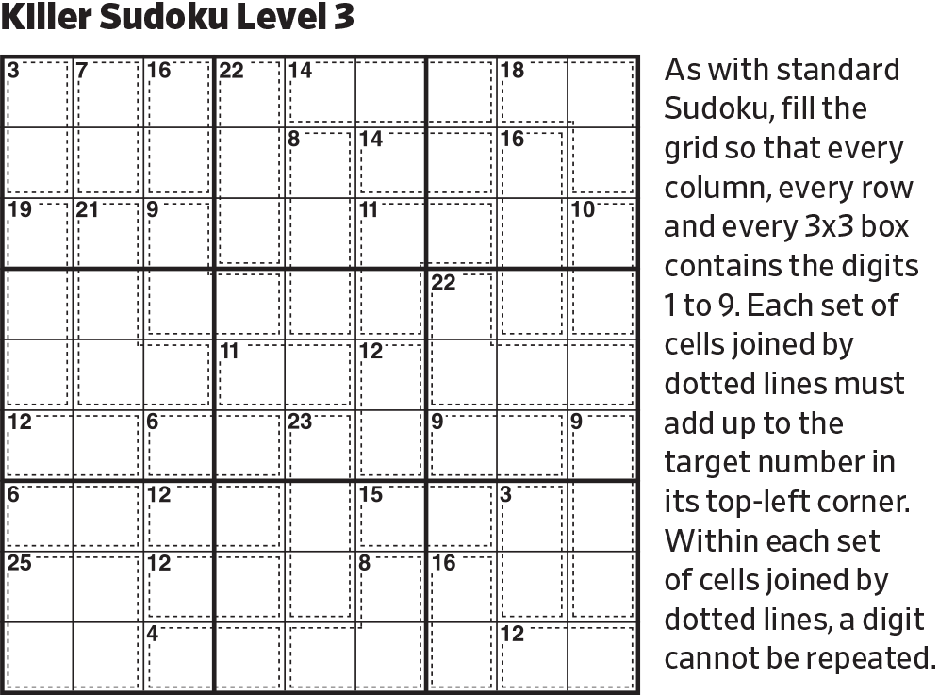
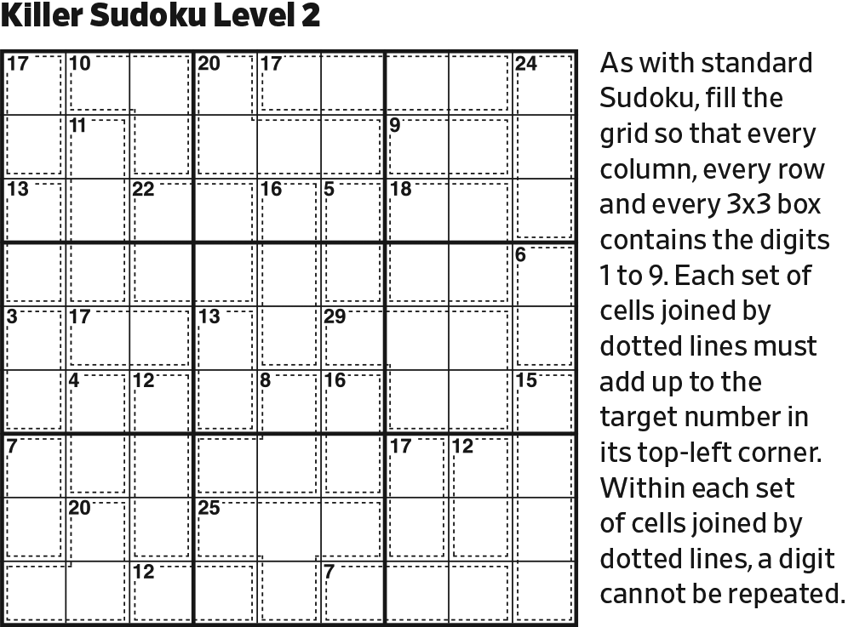
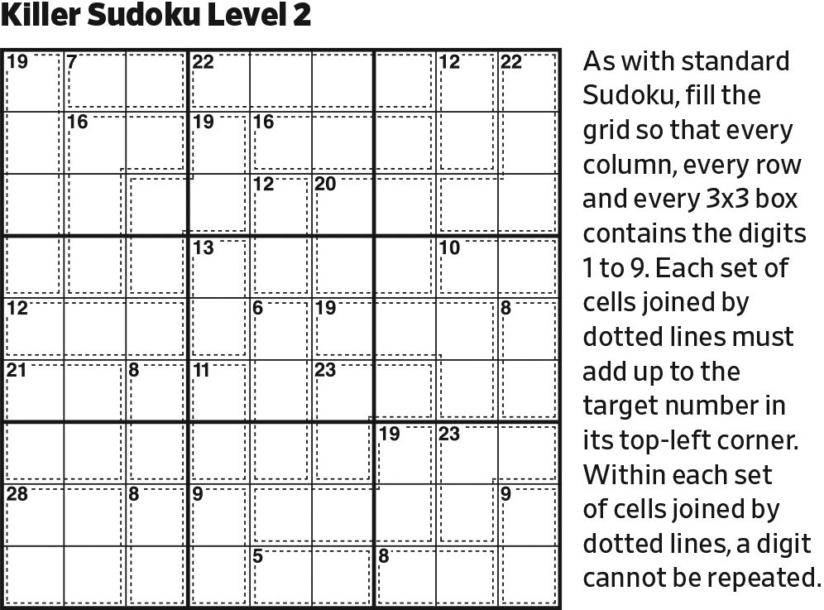
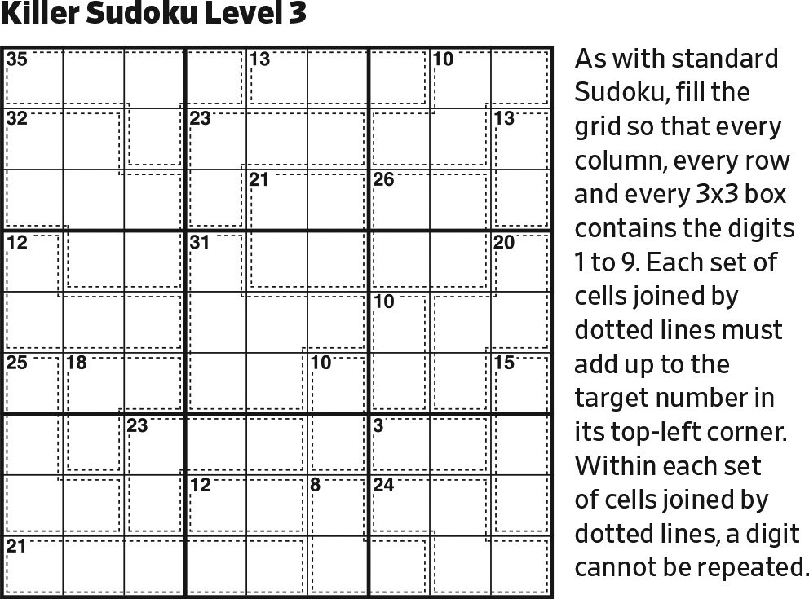
Start.

Slide 2
568
234
234
568
234
234
568
In the center block, and in the lower left block, we have two digits, other than 1, where their sum and product must both be single digits. The only possibilities for that are 2-3 and 2-4.

Slide 3
8
24
42
6
234
234
58
The product of two digits is always greater than the sum of those digits, unless one of the digits is 1 or they both are 2. So, in Column 3, the one-digit sum is on the bottom, and the two-digit product is on the top. There are no two integers that sum to 5 or 6 that, when multiplied, result in a 2-digit number.

Slide 4
1
5
35
53
8
24
42
6
24
234
58
The two possibilities for the line in Column 3 are 2×6=12 and 3×5=15, but only the latter fits.

Slide 5
1
5
35
1
53
1
8
24
42
6
24
234
58
The 10’s digit on a 2-digit sum can be at most 1, and there can be no further 1’s in Row 1. Therefore, these must be the sums.

Slide 6
1
5
35
1
53
1
8
24
42
6
24
56
1
234
58
57
In the bottom center block, the 2-4 solution is precluded. 2-3 has a sum of 5, which is precluded. So, this line must contain a 1.

Slide 7
1
5
35
1
53
1
8
24
42
6
6
24
1
234
7
58
Again, a 5 in the circle is precluded.

Slide 8
2
1
5
47
6789
35
1
7698
53
1
8
24
37
42
6
6
24
1
234
7
58
In the upper left block, we are looking for two digits with a sum > 11, with a product > 20, which don’t conflict with the existing 3’s and 5’s, and which don’t repeat a multiplicand in the product. The possibilities are 6-7 (13, 42) and 8-9 (17, 72).

Slide 9
2
1
5
47
6789
35
1
7698
53
1
8
24
37
42
6
2
6
1
34
7
58
Reduce.

Slide 10
2
1
5
3
6
47
6789
35
49
1
3
7698
53
94
1
8
24
37
42
6
2
6
1
34
7
58
In the upper center block, we are looking for two digits with a sum > 11, with a product > 20, which don’t conflict with the existing 2, 5, and 6, and which don’t repeat a multiplicand in the product. The only digits that fit are 4-9 (13, 36),

Slide 11
2
1
5
3
6
47
3
6789
49
5
1
3
7698
94
1
8
24
37
42
6
2
6
1
34
7
58
Reduce.

Slide 12
2
1
5
3
6
47
4789
4789
4789
3
6789
49
5
1
3
7698
94
1
8
24
37
42
12
6
2
6
1
34
7
58
For the line in the upper right block, the 1 and 2 in Row 1 tell us that the upper pill is the product and the lower pill is the sum.

Slide 13
2
1
5
3
6
8
47
49
479
3
6789
49
26
5
1
3
7698
94
267
1
8
24
47
37
1
42
26
6
2
6
1
34
7
58
The upper pill can’t have repeating digits, be a prime number, etc. The possibilities are 48 (2-6-4 or 6-2-4) and 98 (2-7-7).

Slide 14
2
1
5
3
6
8
47
49
479
3
6789
49
26
5
1
3
7698
94
267
1
8
24
47
37
1
2
42
6
75
57
2
6
3
5
1
34
7
58
For the last line, we are looking for two digits that sum to 12 or 16 and have a product > 30. The only digits that fit are 5-7 (12, 35).

Slide 15
2
1
5
3
6
4
8
47
479
3
6789
49
26
5
1
3
7698
94
62
1
8
2
4
37
4
1
2
6
75
57
2
6
3
5
1
34
7
58
Reduce.

Slide 16
7
2
1
5
3
6
4
8
9
3
89
49
26
5
1
3
98
94
62
1
7
8
2
4
4
1
2
6
75
57
2
6
3
5
1
34
7
58
Reduce.

Slide 17
7
2
1
5
3
6
4
8
9
3
89
49
26
5
1
3
98
94
62
1
7
8
2
4
4
1
2
6
75
57
2
6
3
5
3
1
5
7
Reduce.

Slide 18
7
2
1
5
3
6
4
8
9
3
5
1
89
49
26
5
1
3
7
98
94
62
1
7
8
2
4
4
1
2
6
75
57
2
6
3
5
3
1
5
7
The remaining digits in the upper right block (157) fit in only one way.

Slide 19
7
2
1
5
3
6
4
8
9
3
5
1
89
49
26
5
1
3
7
98
94
62
1
7
8
2
4
4
1
2
6
5
7
2
6
3
5
3
1
5
7
Reduce.

Slide 20
7
2
1
5
3
6
4
8
9
3
5
1
89
49
26
5
1
3
7
98
94
62
1
7
8
2
4
5
4
1
2
2
6
5
7
2
6
1
3
5
3
1
5
7
Last possible 1 in the lower right block (and Row 7).
Last possible 2 in the left center block.
Last possible 5 in the left center block.

Slide 21
7
2
1
5
3
6
4
8
9
3
5
1
89
49
26
5
1
3
7
98
94
62
1
7
8
2
4
3
5
6
4
1
2
2
9
4
6
5
7
8
2
6
1
3
5
3
1
5
7
Last possible 8 in Column 2.
Then, last possible 9 in Column 2.
Then, remaining digits in left center block (346) fit in only one way.

Slide 22
7
2
1
5
3
6
4
8
9
3
2
5
1
89
49
26
5
1
3
7
98
94
62
1
7
8
2
4
3
5
6
4
1
2
2
9
4
6
5
7
4
8
2
6
1
3
5
6
3
9
1
7
5
7
Remaining digits in bottom left block (469) fit in only one way.
Last possible 7 in bottom right block.
Last possible 2 in upper center block.

Slide 23
7
2
1
5
3
6
4
8
9
3
2
6
5
1
89
49
5
1
3
2
7
98
94
1
7
8
2
4
3
5
6
4
1
2
2
9
4
6
5
7
4
8
2
6
1
3
5
6
3
9
1
2
7
5
7
2
Reduce.
Then, last possible 2 in bottom right block.
Then, last possible 2 in bottom center block.

Slide 24
7
2
1
5
3
6
4
8
9
8
4
3
7
9
2
6
5
1
9
6
5
8
4
1
3
2
7
1
7
8
2
4
3
5
6
4
1
2
2
9
4
6
5
7
4
8
2
6
1
3
5
6
3
9
1
2
7
5
7
2
Remaining cells in upper left block (46) fit in only one way.
Remaining cells in upper center block (78) fit in only one way.
Then, reduce.

Slide 25
7
2
1
5
3
6
4
8
9
8
4
3
7
9
2
6
5
1
9
6
5
8
4
1
3
2
7
1
7
8
2
4
3
5
6
4
1
2
2
9
4
6
5
7
4
8
2
9
6
7
1
3
5
6
3
9
1
2
7
5
7
3
2
9
Remaining cells Column 4 (39) fit in only one way.
Then, complete Row 7
Last possible 9 in lower right block.

Slide 26
7
2
1
5
3
6
4
8
9
8
4
3
7
9
2
6
5
1
9
6
5
8
4
1
3
2
7
1
7
8
2
6
4
3
5
6
4
1
2
2
9
4
6
5
7
3
4
8
2
9
6
7
1
3
5
6
3
9
1
2
5
7
4
8
5
7
3
8
4
2
9
6
Remaining cells in bottom center block (458) fit in only one way.
Remaining cells in bottom center block (468) fit in only one way.
Then, complete Columns 8 and 9.

Slide 27
7
2
1
5
3
6
4
8
9
8
4
3
7
9
2
6
5
1
9
6
5
8
4
1
3
2
7
1
7
8
2
5
3
9
6
4
3
5
6
4
7
9
8
1
2
2
9
4
6
8
5
7
3
4
8
2
9
6
7
1
3
5
6
3
9
1
2
5
7
4
8
5
7
3
8
4
2
9
6
Remaining cells in Column 7 (89) fit in only one way.
Complete Row 6.
Then, finish puzzle.

Slide 29
8
8
8
8
8
8
8
8
8
8
8
8
8
8
8
8
8
8
8
8
8
8
8
8
8
8
8
8
8
8
8
8
8
8
8
8
8
8
8
8
8
8
8
8
8
8
8
8
8
8
8
8
8
8
8
8
8
8
8
8
8
8
8
8
8
8
8
8
8
8
8
8
8
8
8
8
8
8
8
8
8

Slide 30
123456
123456
123456
123456
123456
123456
123456
123456
123456
123456
123456
123456
123456
123456
123456
123456
123456
123456
123456
123456
123456
123456
123456
123456
123456
123456
123456
123456
123456
123456
123456
123456
123456
123456
123456
123456
123456
123456
123456
123456
123456
123456
123456
123456
123456
123456
123456
123456
123456
123456
123456
123456
123456
123456
123456
123456
123456
123456
123456
123456
123456
123456
123456
123456
123456
123456
123456
123456
123456
123456
123456
123456
123456
123456
123456
123456
123456
123456
123456
123456
123456

