Slide 1
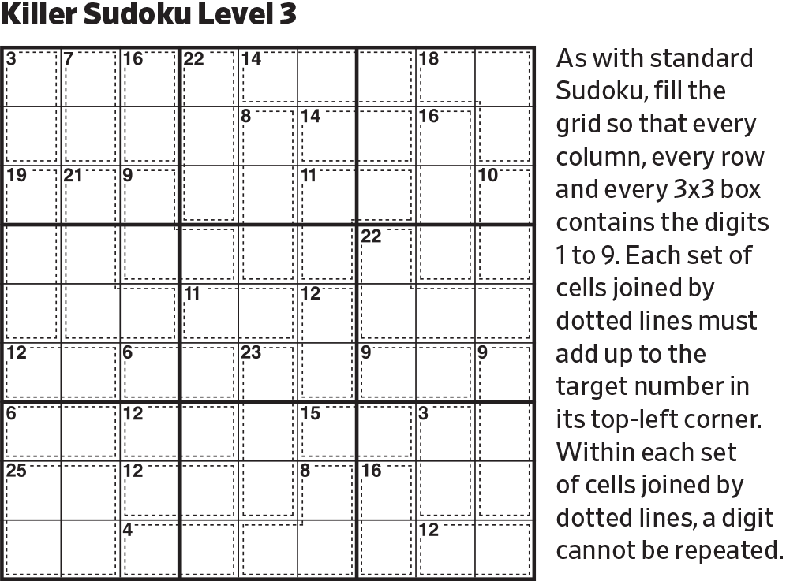
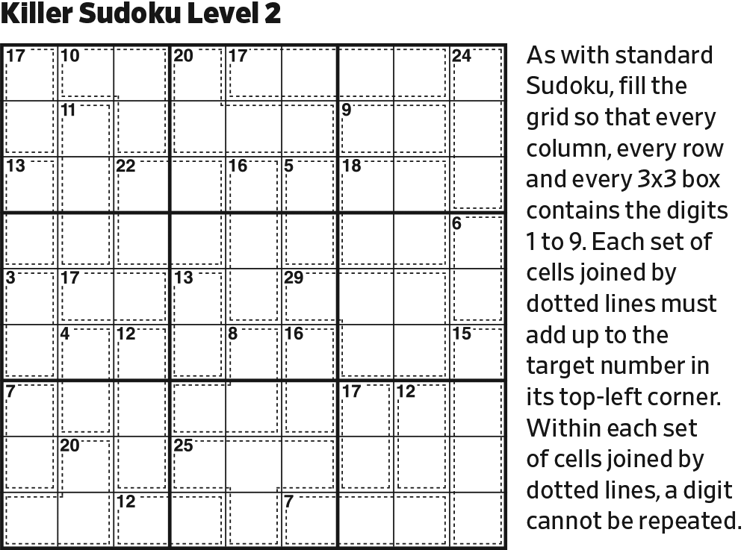
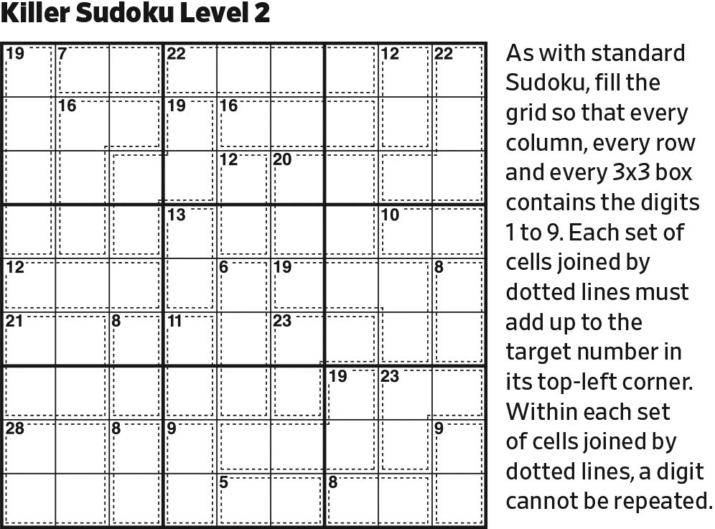
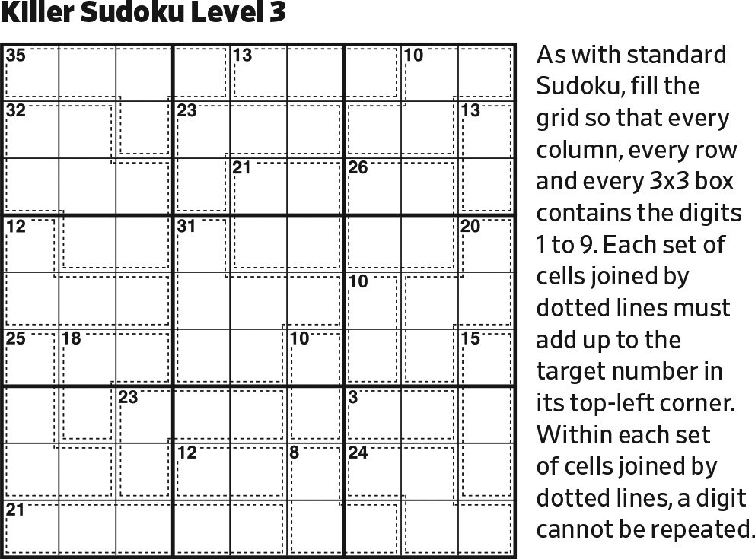
Start.

Slide 2
9
6
7
9
In the upper right block, the largest possible digits on the 31 diagonal are 6 and 7, which fit in only one way. To reach 31, the other digits on the diagonal must be 9.

Slide 3
6
7
9
6
7
9
Last possible 7 in the upper center block.
Then, last possible 6 in the upper center block.

Slide 4
6
7
9
6
21
7
12
2
9
On the 11 diagonal, the least possible contribution in the upper left block is 1 and 2. The least possible contribution in the left center block is 2 (because of the given 1). Since these add to 11, they must be the solution.

Slide 5
6
7
9
9
6
21
7
12
2
9
Last possible 9 in upper left block.

Slide 6
6
7
9
9
6
21
7
12
2
9
8
56
7
98
On the 29 diagonal, the most the lower left block could contribute is 6+7. The remaining two cells must sum to at least 16. Since the given 7 precludes the use of 7’s, they could be 8+8, 8+9, or 9+9. However, the 9 in Column 1 precludes 9+9. The two cells in the lower left block can be no less than 5—5+7 or 6+7. The 7 fits in only one place.

Slide 7
8
6
7
9
9
6
21
7
12
2
7
9
7
8
56
7
98
Last possible 7 in Column 1.
Last possible 8 in Column 2.
Then, last possible 7 in Row 4.

Slide 8
8
6
7
9
9
6
21
7
12
2
7
9
7
8
5
7
9
In the left center block, 6 must be in Column 2.

Slide 9
8
6
7
9
9
6
21
7
12
2
8
7
9
7
8
9
5
9
7
9
Last possible 8 in Row 4.
Last possible 9 in center block.
Last possible 9 in lower right block.

Slide 10
8
6
7
9
9
6
21
7
12
2
8
7
9
7
9
2
6
8
9
5
9
7
9
In the center block, the remaining digits (26) fit in only one way.
Last possible 9 in left center block.

Slide 11
8
6
7
9
9
6
21
7
12
2
8
7
9
7
9
2
6
8
9
1
5
9
7
1
9
1
With a 9 on the 12 diagonal, the remaining three cells must be 111.

Slide 12
8
6
7
9
9
1
6
2
7
2
8
7
9
7
1
9
2
6
8
9
1
1
5
9
7
1
9
1
Last possible 1 in Row 7.
Last possible 1 in Row 5,
which resolves the 11 diagonal.

Slide 13
8
6
7
9
1
2
9
1
6
2
1
7
2
8
7
9
7
1
9
2
6
8
9
2
1
1
5
9
7
1
2
9
1
Last possible 2’s in right center block and lower left blocks.
Last possible 1’s in upper center and upper right blocks.
Then, last possible 2 in Row 1.

Slide 14
8
6
7
9
1
2
9
1
6
2
1
7
2
5
8
7
9
7
1
9
2
6
8
9
2
1
1
5
7
9
7
1
2
9
1
7
Last possible 5 in left center block.
Last possible 7 in bottom center block.
Then, last possible 7 in bottom right block.

Slide 15
8
6
7
9
1
2
9
1
6
2
1
7
2
5
8
7
9
7
1
9
2
6
5
8
9
2
1
1
5
7
9
7
1
2
9
1
7
Last possible value for this cell.

Slide 16
8
6
7
9
1
2
9
1
6
2
1
7
2
3
5
8
7
6
9
7
1
9
2
6
5
8
9
2
1
1
5
7
9
7
1
2
9
1
3
7
Last possible 6 in right center block.
Then, complete Row 4 and Column 8 (with 3’s.)

Slide 17
8
6
7
9
1
2
9
1
6
2
1
7
2
3
5
8
7
6
9
7
1
9
2
6
5
8
6
4
9
2
1
1
5
7
9
3
7
1
2
9
1
3
7
Last possible 6 in left center block.
Then, complete left center block (with 4).
Last possible 3 in lower left block.

Slide 18
8
3
6
7
9
1
2
9
1
6
2
1
7
2
3
5
8
7
6
9
7
1
9
2
6
5
8
6
4
9
3
2
1
1
5
7
9
3
7
1
6
4
2
9
1
3
7
In lower left block, remaining cells (46) fit in only one way.
Complete Column 3.
Complete Row 6.

Slide 19
8
3
6
7
9
1
2
9
1
6
2
1
7
2
3
5
8
7
6
9
7
1
9
2
6
4
5
8
8
6
4
9
3
2
1
1
5
7
9
6
3
7
1
5
6
4
2
9
5
1
8
3
7
In Row 9, remaining cells (58) fit in only one way.
Then, in right center block, remaining cells (48) fit in only one way.
Then, in lower right block, remaining cells (56) fit in only one way.

Slide 20
4
8
3
6
7
9
5
1
2
9
1
5
6
5
2
1
7
2
3
5
8
7
6
9
7
1
9
2
6
4
5
8
8
6
4
9
3
2
1
1
5
7
9
6
3
7
1
5
6
4
2
9
5
1
8
3
7
In Row 1, remaining cells (45) fit in only one way.
Then, complete upper right block.
Then, last possible 5 in upper center block.

Slide 21
4
8
3
6
7
9
5
1
2
9
1
5
6
5
2
4
1
7
2
3
5
8
7
6
9
7
1
9
2
6
4
5
8
8
6
4
9
3
2
1
1
5
3
4
7
9
6
3
7
8
6
2
1
5
6
4
2
9
5
1
8
3
7
In Row 7, remaining cells (34) fit in only one way.
In Row 8, remaining cells (268) fit in only one way.
Then, complete Column 4.

Slide 22
4
8
3
6
7
9
5
1
2
9
1
5
2
3
6
4
5
2
4
1
8
7
3
2
3
5
8
7
6
9
7
1
9
2
6
4
5
8
8
6
4
9
3
2
1
1
5
3
4
7
9
6
3
7
8
6
2
1
5
6
4
2
9
5
1
8
3
7
In Column 9, remaining cells (34) fit in only one way.
In Column 8, remaining cells (38) fit in only one way.
Then, finish puzzle.

