Slide 1
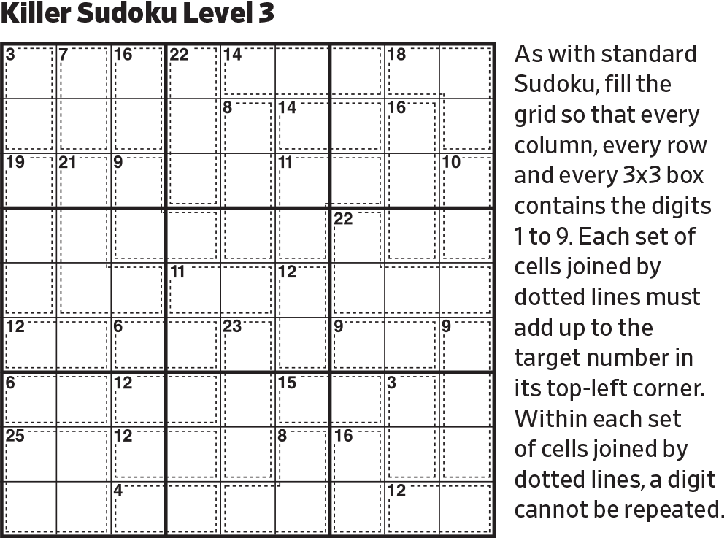
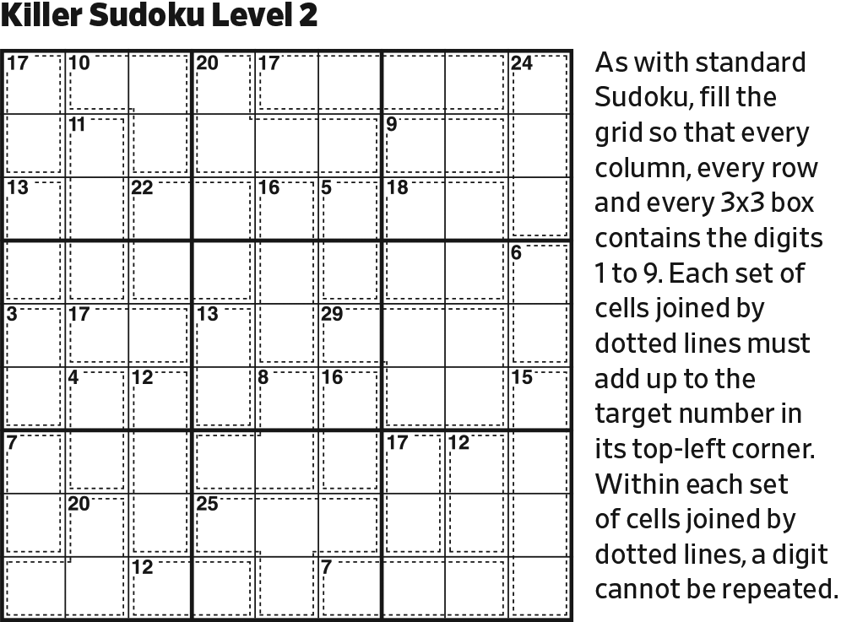
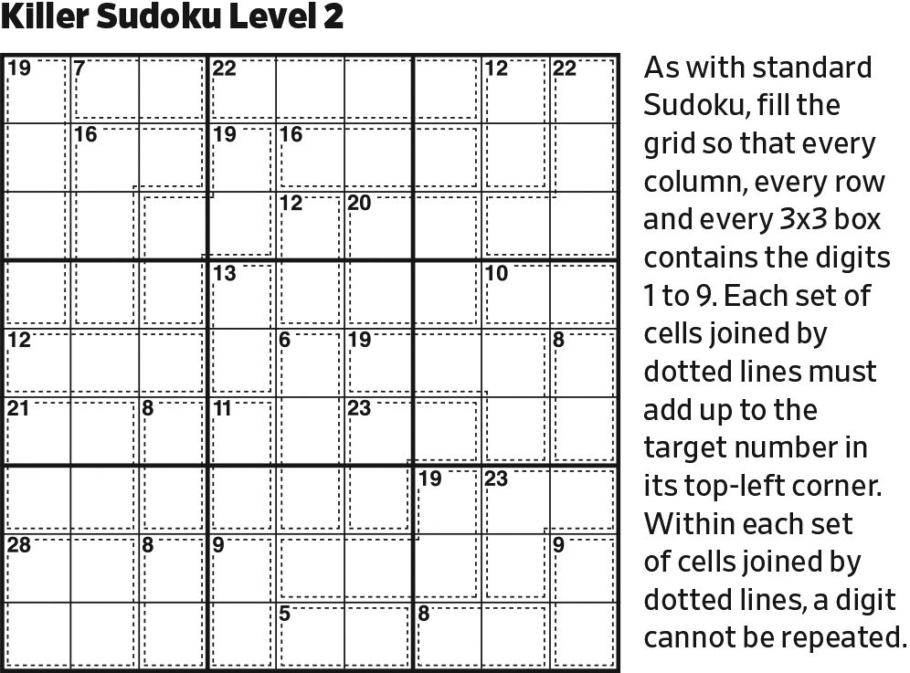
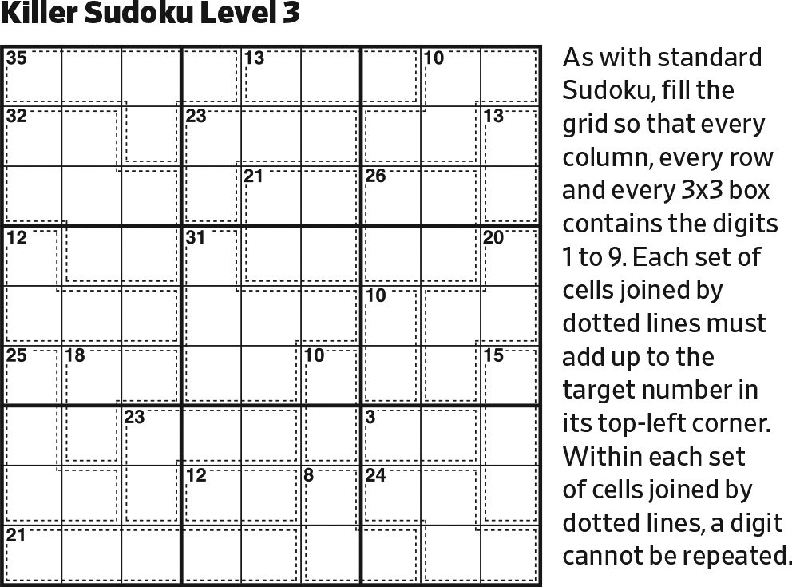
Start.

Slide 2
5789
5789
5789
5789
[29 in 4] must be 5789.

Slide 3
469
469
469
578
578
578
123
123
123
9
In Row 5, 19+29=48, which already exceeds 45 by 3. The remainder of Row 5 is, at a minimum, 123, which sums to 6. So, this is the only way to populate Row 5.

Slide 4
469
469
469
578
578
578
123
123
123
9
7
9
The remainder of [22 in 5] -> [16 in 2] must be 79, which fits in only one way.

Slide 5
12
21
1
469
469
469
578
578
578
123
123
123
9
7
9
In the top center block, 16+13+20 = 49, which exceeds 45 by 4. There is only one way to get the three excess cells to sum to 4.

Slide 6
134
134
56789
568
134
56789
2
1
1
469
469
469
578
578
578
23
123
123
9
7
9
[8 in 3] is 125 or 134.
This resolves the 12 pair, which forces [8 in 3] to be 134.
[22 in 3] is 589 or 679. Note that it must contain 9.

Slide 7
134
134
56789
568
134
56789
2
1
1
9
469
469
469
578
578
578
23
123
123
9
7
9
Last possible 9 in right center block (and Column 9).

Slide 8
134
134
56789
568
234
134
56789
234
2
1
34
1
9
469
469
469
578
578
578
23
123
123
9
7
9
In Column 9, [18 in 4] -> [9 in 3, no 1] must be 234.

Slide 9
134
134
56789
568
234
134
56789
234
2
1
34
1
9
1
469
469
469
578
578
578
23
32
9
7
9
Reduce.
Then, reduce.

Slide 10
6
134
134
79
234
134
97
58
234
2
1
85
34
1
9
1
469
469
469
578
578
578
23
32
9
7
9
In the upper right block, since we now know that [22 in 3] must contain 7, it’s 679 (rather than 589).
The remaining two cells in the block must be 58.

Slide 11
6
134
134
79
234
134
97
58
234
2
1
85
34
1
9
1
469
469
469
578
578
578
23
32
9
7
9
1
Last possible 1 in the lower right block (and Column 8). [18 in 3, no 9] cannot contain a 1.

Slide 12
6
134
134
79
234
134
97
58
234
2
1
78
85
34
1
9
87
1
469
469
469
578
578
578
23
32
9
7
9
1
Since [15 in 2] can’t be 69 it must be 78.

Slide 13
6
134
134
79
234
9
134
97
58
234
2
1
78
85
34
1
9
87
1
469
46
469
578
578
578
23
32
9
7
9
1
In the upper right block, that portion of [21 in 4] must be filled with 5 or greater. Were it to contain 9, it would be at a minimum 569, sum to 20, which would require its bottom cell to be 1. It can’t be. Therefore, there is one remaining place for 9.

Slide 14
9
6
134
134
234
9
7
134
58
234
2
1
78
85
34
1
9
87
1
469
46
469
578
578
578
23
32
9
7
9
1
Reduce.

Slide 15
9
6
134
134
234
9
7
134
58
234
2
1
78
85
34
1
9
87
1
469
46
469
578
578
578
23
32
9
7
8
9
6
9
1
[23 in 3] must 689, which fits in only one way.

Slide 16
9
6
13
134
234
9
7
134
58
234
2
1
78
85
34
1
9
87
9
4
6
1
578
578
578
23
32
9
7
8
9
6
9
1
Reduce.
Then, reduce twice more.

Slide 17
9
6
578
13
134
234
9
7
568
134
58
234
2
1
5678
78
85
34
1
9
32
87
9
4
6
1
578
578
578
23
32
9
7
8
9
6
9
1
Going back to the contents of [21 in 4], it must contain 5 and 6 and one of 78. Therefore, the bottom cell must be 2 or 3.

Slide 18
9
6
578
13
134
234
9
7
568
134
58
234
2
1
5678
78
85
34
1
9
32
87
9
4
6
1
578
578
578
23
32
9
7
25
8
9
124
1245
6
9
124
1
[12 in 4, no 6] is 1245.
It must contribute the 1 to the lower left block, because the 1 can’t be elsewhere.

Slide 19
9
6
578
13
134
234
9
7
568
134
58
234
2
1
5678
78
85
34
1
9
32
87
9
4
6
1
578
578
578
23
32
9
7
25
8
9
7
124
1245
6
9
3
8
124
1
In the bottom left block, 7 must be in Row 9. So, in the bottom right block, the 7 must be in the [18 in 3]. The remaining two cells sum to 11, and could be 38 or 56. The only possibility for the left cell is 3. Then, the 78 fits in only one way.

Slide 20
9
6
578
13
134
234
9
7
568
134
58
234
2
1
5678
78
85
34
1
9
32
87
9
4
6
3
2
1
578
578
578
9
7
25
8
9
7
124
1245
6
9
3
8
124
1
Reduce.

Slide 21
9
6
578
13
134
234
9
7
568
134
58
234
2
1
5678
78
85
34
1
4
9
32
87
9
4
6
3
2
1
578
578
578
9
7
25
8
9
7
124
1245
6
9
3
8
124
1
Complete Column 8.

Slide 22
9
6
578
13
134
234
9
7
568
134
58
234
2
1
5678
78
85
34
1
4
9
32
87
568
9
4
6
3
2
1
578
578
578
9
7
25
568
56
8
9
7
124
1245
6
9
3
8
124
1
65
Complete Column 9.
Complete right center block.

Slide 23
9
6
578
13
134
234
9
7
568
134
58
234
2
1
5678
78
85
34
1
4
9
32
87
236
236
568
9
4
6
3
2
1
578
578
578
9
7
25
2346
2346
568
56
8
9
7
124
1245
6
9
3
8
124
1
65
Complete center block.

Slide 24
9
6
578
13
134
234
9
7
568
134
58
234
2
1
5678
78
85
34
1
4
9
32
87
75
236
236
58
9
4
6
3
2
1
578
578
578
9
7
25
2346
2346
568
56
8
9
7
124
1245
6
9
3
8
124
1
65
Note 32/236/236 triple in Row 4.

Slide 25
9
6
578
13
134
234
9
7
568
134
58
234
2
1
5678
78
85
34
1
4
9
32
87
75
236
236
58
9
4
6
3
2
1
578
578
578
9
7
25
234
234
568
56
8
9
7
124
1245
6
9
3
8
124
1
65
In the center block, 6 is in Row 3.

Slide 26
9
6
578
13
134
234
9
7
568
134
58
234
2
1
5678
78
85
34
1
4
9
32
87
75
236
236
58
9
4
6
3
2
1
578
578
578
9
7
25
234
234
568
56
8
9
7
124
1245
6
9
3
8
124
1
237
235
357
65
Complete lower left block.

Slide 27
9
6
578
13
134
234
9
7
568
134
58
234
2
1
5678
78
85
34
1
4
9
32
87
75
236
236
58
9
4
6
3
2
1
578
578
578
9
7
1238
25
135
234
234
568
56
8
9
7
124
1245
6
9
3
8
124
1
237
235
357
65
Complete left center block.

Slide 28
9
6
578
13
134
234
9
7
568
134
58
234
2
1
5678
78
85
34
1
4
9
32
87
75
236
236
58
9
4
6
3
2
1
578
578
578
9
7
1238
25
135
234
234
568
56
8
9
7
124
1245
2456
6
9
3
8
124
245
1
237
235
357
2456
65
Complete bottom right block.

Slide 29
9
6
578
13
134
234
9
7
568
134
58
234
2
1
5678
78
85
34
1
4
9
32
87
75
236
236
58
9
4
6
3
2
1
578
578
578
9
7
1238
25
135
234
234
568
56
8
9
7
124
1245
2456
6
9
1
2
3
8
124
6
1
237
235
357
65
In the [9 in 3], one of the digits must be 2 because a sum of any of the others exceeds 9. Pairing with 456 to make 7 would be 321, but 3 is disallowed and 2 would be a duplicate within the cage. So, the cage must be 126, which fits in only one way.

Slide 30
9
6
578
13
134
234
9
7
568
134
58
234
2
1
5678
78
85
34
1
4
9
32
87
75
236
236
58
9
4
6
3
2
1
578
578
578
9
7
6
1238
25
135
234
234
85
8
9
7
124
1245
45
4
6
9
1
2
3
8
6
1
5
237
235
357
Reduce.

Slide 31
9
6
578
13
134
234
9
7
568
134
58
234
2
1
5678
78
85
34
1
4
9
32
87
75
236
236
58
9
4
6
3
2
1
578
578
578
9
7
6
1238
25
135
234
234
85
8
4
9
7
12
125
4
6
9
1
2
3
8
6
1
5
237
23
37
Reduce.

Slide 32
9
6
578
13
134
234
9
7
568
134
58
234
2
1
5678
78
85
34
1
4
9
32
87
75
236
236
58
9
4
6
3
2
1
578
578
578
9
7
6
1238
25
135
234
234
85
1
8
4
9
7
15
4
6
9
1
2
3
8
6
1
5
237
23
37
Reduce.

Slide 33
9
6
578
13
134
234
9
7
568
134
58
234
2
1
5678
78
85
34
1
4
9
32
87
75
236
236
58
9
4
6
3
2
1
578
578
578
9
7
6
238
25
135
234
234
85
1
5
8
4
9
7
4
6
9
1
2
3
8
6
1
5
237
23
37
Reduce.

Slide 34
9
6
578
13
134
234
9
7
568
134
58
234
2
1
5678
78
85
34
1
4
9
32
87
75
236
236
58
9
4
6
3
2
1
578
578
578
2
9
7
6
238
135
234
234
85
1
5
8
4
9
7
4
6
9
1
2
3
8
6
1
5
237
23
37
Reduce.

Slide 35
9
6
578
13
134
234
9
7
568
134
58
234
2
1
5678
78
85
34
3
1
4
9
87
75
236
236
58
9
4
6
3
2
1
578
578
578
2
9
7
6
38
135
34
43
85
1
5
8
4
9
7
4
6
9
1
2
3
8
3
6
1
5
237
37
Reduce.

Slide 36
1
9
6
75
134
234
9
7
56
134
58
234
2
1
567
78
85
34
3
1
4
9
87
75
26
62
58
9
4
6
3
2
1
578
578
578
8
2
9
7
6
15
34
43
85
1
5
8
4
9
7
4
6
9
1
2
3
8
3
7
6
1
5
27
Reduce.

Slide 37
1
9
6
75
34
234
9
7
56
43
58
234
8
2
1
567
85
34
3
7
1
4
9
75
26
62
58
9
4
6
3
2
1
578
578
578
8
2
9
7
6
15
34
43
85
1
5
8
4
9
7
4
6
9
1
2
3
8
2
3
7
6
1
5
Reduce.

Slide 38
1
9
6
75
34
234
9
7
8
56
43
234
8
2
1
5
567
34
3
7
5
1
4
9
26
62
58
9
4
6
3
2
1
578
578
578
8
2
9
7
6
15
34
43
85
1
5
8
4
9
7
4
6
9
1
2
3
8
2
3
7
6
1
5
Reduce.

Slide 39
1
9
6
75
34
234
9
7
8
56
43
234
8
2
1
5
67
34
3
7
5
1
8
4
9
26
62
9
4
6
3
2
1
578
578
578
8
2
1
9
5
7
6
34
43
1
5
8
4
9
7
4
6
9
1
2
3
8
2
3
7
6
1
5
Reduce.

Slide 40
1
9
6
75
34
234
9
7
8
56
43
234
8
2
1
5
67
34
3
7
5
1
8
4
9
26
62
9
4
6
3
2
1
578
578
578
8
2
1
9
5
7
6
34
43
1
5
8
4
9
7
36
63
4
6
9
1
2
3
8
2
3
7
6
1
5
In Row 7, [9 in 2] must be a 36 pair.

Slide 41
1
9
6
75
34
234
9
7
8
56
43
234
8
2
1
5
67
34
3
7
5
1
8
4
9
26
62
9
4
6
3
2
1
578
578
578
8
2
1
9
5
7
6
34
43
1
5
8
2
4
9
7
36
63
4
6
9
1
2
3
8
57
75
2
3
7
6
1
5
489
48
489
In the bottom center block, initialize [14 in 3].
Complete Row 9.

Slide 42
1
9
6
75
34
234
9
7
8
56
43
234
8
2
1
5
67
34
3
7
5
6
1
2
8
4
9
9
4
6
3
2
1
578
578
578
8
2
1
9
5
7
6
34
43
1
5
8
2
4
9
7
36
63
4
6
9
1
2
3
8
57
75
2
3
7
6
1
5
489
48
489
Reduce.

Slide 43
1
9
6
75
34
234
9
1
7
8
56
43
234
8
2
1
5
67
34
3
7
5
6
1
2
8
4
9
9
4
6
3
2
1
578
578
578
8
2
1
9
5
7
6
34
43
1
5
8
2
4
9
7
36
63
4
6
9
1
2
3
8
57
75
2
3
7
6
1
5
489
48
489
Last possible 1 in upper center block.

Slide 44
1
9
6
75
34
4589
234
9
1
7
8
56
43
234
8
2
1
5
67
9854
34
3
7
5
6
1
2
8
4
9
9
4
6
3
2
1
578
578
578
8
2
1
9
5
7
6
34
43
1
5
8
2
4
9
7
36
63
4
6
9
1
2
3
8
57
75
2
3
7
6
1
5
489
48
489
[16 in 4] -> [13 in 2, no 6] could be 49 or 58.

Slide 45
1
4
9
6
75
34
234
9
1
7
8
56
43
234
8
2
9
1
5
67
34
3
7
5
6
1
2
8
4
9
9
4
6
3
2
1
578
578
578
8
2
1
9
5
7
6
34
43
1
5
8
2
4
9
7
36
63
4
6
9
1
2
3
8
57
75
2
3
7
6
1
5
489
48
489
Reduce.

Slide 46
1
3
4
9
6
75
23
9
4
1
7
8
56
234
8
2
9
1
5
67
34
3
7
5
6
1
2
8
4
9
9
4
6
3
2
1
578
578
578
8
2
1
3
9
4
5
7
6
1
5
8
2
4
9
7
36
63
4
6
9
1
2
3
8
57
75
2
3
7
8
6
1
5
48
489
Reduce.

Slide 47
1
3
4
9
6
2
75
9
4
1
7
8
56
23
8
2
9
1
5
67
34
3
7
5
6
1
2
8
4
9
9
4
6
3
2
1
75
578
578
8
2
1
3
9
4
5
7
6
1
5
8
2
4
9
7
36
63
4
6
9
1
2
3
8
57
75
2
3
7
8
4
6
1
5
49
Reduce.

Slide 48
1
3
4
9
6
2
75
9
4
1
7
8
3
56
8
2
9
1
5
4
67
3
7
5
6
1
2
8
4
9
9
4
6
3
2
1
75
578
578
8
2
1
3
9
4
5
7
6
1
5
8
2
4
9
7
36
63
4
6
9
1
2
3
8
57
75
2
3
7
8
4
9
6
1
5
Reduce.
Then, reduce.

Slide 49
1
3
4
9
6
2
75
9
4
1
2
7
8
3
56
8
2
9
1
5
4
67
3
7
5
6
1
2
8
4
9
9
4
6
3
2
1
75
578
578
8
2
1
3
9
4
5
7
6
1
5
8
2
4
9
7
36
63
4
6
9
1
2
3
8
57
75
2
3
7
8
4
9
6
1
5
Last possible 2 in upper center block.

Slide 50
1
3
4
7
9
6
2
75
9
4
1
2
7
8
3
56
8
2
9
3
1
5
4
67
3
7
5
6
1
2
8
4
9
9
4
6
3
2
1
75
578
578
8
2
1
3
9
4
5
7
6
1
5
8
2
4
9
7
36
63
4
6
9
1
2
3
8
57
75
2
3
7
8
4
9
6
1
5
[13 in 4] -> [10 in 2, no 1, 2] could be 37 or 46. Only one, in one orientation fits.

Slide 51
5
1
3
4
7
9
6
2
6
9
4
1
2
7
8
3
7
8
2
9
3
1
5
4
3
7
5
6
1
2
8
4
9
9
4
6
3
2
1
75
58
578
8
2
1
3
9
4
5
7
6
1
5
8
2
6
3
4
9
7
4
6
9
7
5
1
2
3
8
2
3
7
8
4
9
6
1
5
[13 in 4] -> [10 in 2, no 1, 2] could be 37 or 46. Only one, in one orientation fits.

Slide 52
5
1
3
4
7
8
9
6
2
6
9
4
1
2
5
7
8
3
7
8
2
9
3
6
1
5
4
3
7
5
6
1
2
8
4
9
9
4
6
5
8
7
3
2
1
8
2
1
3
9
4
5
7
6
1
5
8
2
6
3
4
9
7
4
6
9
7
5
1
2
3
8
2
3
7
8
4
9
6
1
5
Finish.

