Slide 1
EDGE DETECTION
JUBAYER Hossain Arnob
1813124

Slide 2
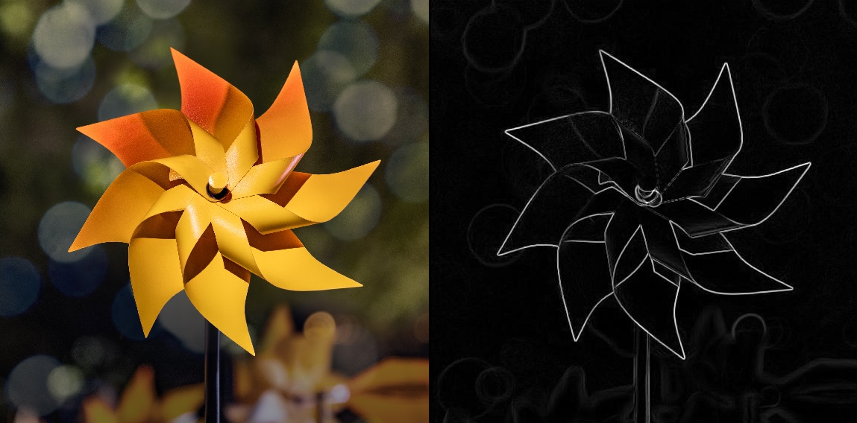
Introduction
Edge detection
Purpose of this work

Slide 3
Related Works
Segmentation Development of Edge Detection for Image
Author Z Zainal Abidin
S A Asmai
Z Abal Abas
N A Zakaria
S N Ibrahim
Edge Detection Enhancement Based on Filtering and Threshold Estimation
Performance Evaluation of Edge Detection Using Sobel, Homogeneity and Prewitt Algorithms
Khalid Alshalfan
Abdel Karim M. Baareh
Mohammed Zakariah
Ahmad Al-Jarrah
Ahmad M. Smadi
Ghazi H. Shakah

Slide 4
Basic Edge Detection Techniques
GRADIENT BASED -
Sobel Edge Detection
Prewitt Edge Detection
Roberts Edge Detection
GAUSSIAN BASED -
Canny Edge Detection
Log Edge Detection

Slide 5
Strategy
Find out Edge detection issues
Collect set of Images (Detailed/Minimal, RGB/Gray)
Set criteria for Comparison & gather information's of measurement
Evaluate output by evaluation metrics
Apply edge detection method
using MATLAB tool
Compare results following the evaluated data

Slide 6
Issues with Edge Detection
Some major edge detecting issues are this –
• Noise Sensitivity
• Edge loss or discontinuity in edges
• Loss in details of the image
• Complexity & accuracy
Edge detecting methods that are good at handling these issues are better.

Slide 7
Evaluation Criteria
Noise in image
Discontinuity in edges
Details in image (Loss of information)
Overall Image Quality
Approach of evaluation is to evaluate the generated image quality.
A Noble approach in edge detection is to smoothing the image before applying edge detection technique.

Slide 8
Evaluation Metrics
MSE (Mean Square Error) Score
PSNR (Peak Signal-to-Noise Ratio) Score
Number of Connected Components (8-CC)
Entropy of grayscale image
Information loss value = entropy(Original Image) – entropy(Output)
PIQE (Perception based Image Quality Evaluator (no-reference)
Lower values are better: MSE score, PIQE score, No. of CC, Information loss value
Higher values are better: PSNR score, Entropy value

Slide 9
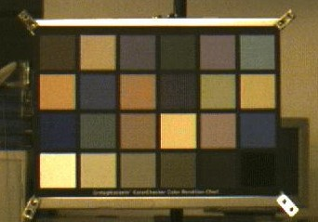
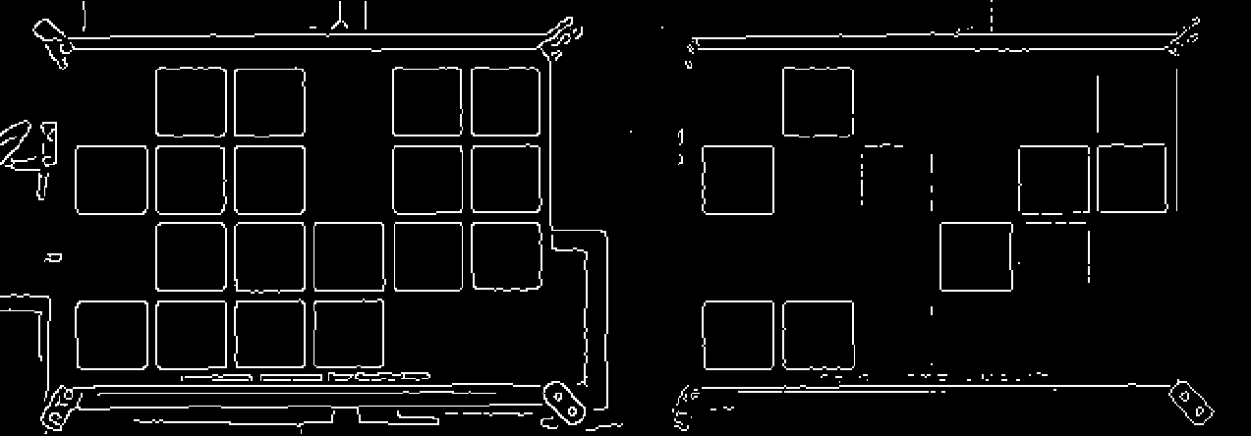
Apply Edge Detection Method
Convert input image from RGB to Gray
Smoothen Image to lessen noise
Apply all methods at it’s default to get the general Idea of it’s performance.
Sample input and outputs:

Slide 10
Evaluation

Slide 11
Evaluation

Slide 12
Evaluation

Slide 13
Evaluation

Slide 14
Evaluation

Slide 15
Conclusion
Edge detection is a fundamental principle on which lots of image processing work must be based. An attempt has been made in this work to offer a quick review of some of the most reliable, well-known, and effective edge detection approaches which concludes the performance comparison and why canny is better among these edge detection techniques. Future scope for this work is to find out the weak points for each technique and find a strategy to get better outcome from these techniques of edge detection which will be experimental and based on results.

