Slide 1
China
Ka’Chandan Banks
Saiyeid Sewell
Josh Harris

Slide 2
China – AT&T
China Internal Factors
China market entry: Challenges, Opportunities, and Strategy’s
Future Aspects

Slide 3

INTERNAL FACTORS
China is a Communist country
All political and economic systems are owned and controlled by China’s government
Gross Domestic Product (GDP) is $12.36 trillion
Largest manufacturing hub in the world
Second largest overall economy in the world
Behind the United States

Slide 4

Economic growth - TECHNOLOGY
China is on a mission to transition their economy to a more technology driven and innovative model.
This will help develop new industries and business models such as e-commerce, mobile payment, and channels of rapid and reliable communication
Their new transition is projected to increase their job opportunities by 70 percent

Slide 5


Slide 6

Add a Slide Title - 1

Slide 7
China market entry: Challenges, Opportunities, and Strategy’s

Slide 8

Why China?
With 1.3 billion people china is the world largest consumer market
China has bilateral investment agreements with over 100 countries and economies
China maintains 14 Free Trade Agreements (FTAs)
China’s 13th five year plan

Slide 9
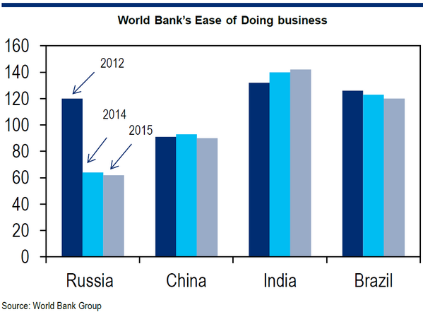
Market Challenges/barriers to entry
The World Bank ranks China China 78th out of 190 countries with respect to opening and running a business while complying with local regulations.
For starting a business, the World Bank ranked China 127th
starting a business requires at least 11 procedures in Shanghai and Beijing that average more than 30 days to complete

Slide 10

industrial policies seek to limit market access for imported goods, foreign manufacturers, and foreign services providers, while offering substantial government guidance, resources, and regulatory support to Chinese industries.
• The principal beneficiaries of these policies are state-owned enterprises, as well as other favored domestic companies
• Provincial and local governments often have an ownership stake in private companies

Slide 11
Challenges Cont...
Foreign enterprises report that Chinese government officials may condition approvals on a foreign enterprise’s agreement to transfer technology; conduct research and development in China; satisfy performance requirements relating to exportation or the use of local content; or make valuable, deal-specific commercial concessions.

Slide 12
Cont…
Foreign firm margins are shrinking, reflecting increasing competition, rising costs, heightened regulatory impediments, and a shrinking labor pool.
In 2016, China experienced its lowest economic growth rate in more than a quarter century with real GDP growth decelerating to 6.7%
many economists remain concerned about China’s medium-term prospects for economic growth due to the slow pace of economic reforms and a failure to bring corporate debt levels under control.

Slide 13
Market opportunities:
Growing middle class.
E-commerce
Globalization of Chinese companies and increased outbound investment.
Urbanization push and continued support for infrastructure projects.
Stronger environmental regulations and more stringent emissions standards.

Slide 14
Market opportunities:
Growing middle class.
E-commerce
Globalization of Chinese companies and increased outbound investment.
Urbanization push and continued support for infrastructure projects.
from stronger environmental regulation and more stringent emissions standards.
Some top sectors:
Aviation
Education
Energy & Environment
Medical Devices
Tourism

Slide 15
Market entry strategy:
• Representation in China by a Chinese agent, distributors, or partners who can provide essential local knowledge and contacts
Intellectual property rights holders should understand how to protect their IP under Chinese law
wide range of options for corporate formation in China, including Wholly Foreign Owned Enterprises, Joint Ventures, Representative Offices, and other investment vehicles.
consult closely with lawyers who have extensive experience with the China market, including lawyers based in the United States and China.

Slide 16
Market entry strategy: Cont…
The U.S. Department of Commerce, United States Foreign Commercial Service (USFCS) offers customized solutions to help U.S. companies, including small- and medium-sized enterprises, succeed in the China market.
the U.S. Department of Agriculture’s Foreign Agricultural Service (FAS) provides equivalent-level trade services at no cost for U.S. companies interested in exporting agricultural, fishery, and forestry products through their Agricultural Trade Offices.

Slide 18
Add a Slide Title - 4

Slide 19
Add a Slide Title - 5

Slide 20
Add a Slide Title - 6

