Slide 1


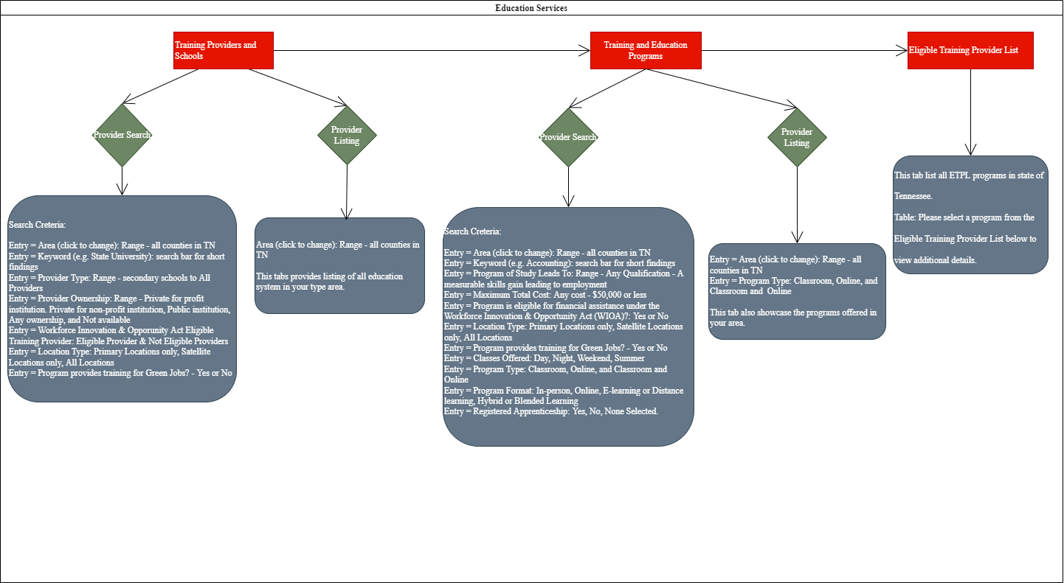
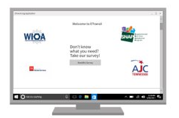
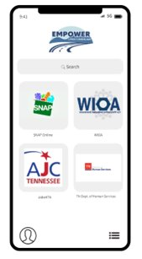


TANF Opportunity Act
TANF Applications
Eric Brown
Michael Aikens &Megan Spurgeon
Department of Computer Science, Tennessee Technological University
This project will focus on Tennessee Tech’s participation in the TANF Opportunity Act. The goal of this project is to bring 800 families out of poverty through the application of financial and training resources made available via the grant. To accomplish this task, there are multiple agencies and their related workflows that must be traversed. The goal of this project is to analyze the workflows seeking optimizations as well as the development of software to assist the process.
This computer science applied research project addresses the disparities between rural Upper Cumberland residents in poverty and the agencies which seek to help them. This project will create efficiencies to fix a broken and outdated system. These agencies include the Upper Cumberland Human Resources Agency, the American Jobs Center, and Tennessee Assistance for Needy Families. Currently, each agency utilizes ten or more systems that do not integrate. Consequently, those in poverty are left at a distinct disadvantage and hardship when attempting to navigate the agencies' services. Accordingly, this project will develop the foundation and framework to unify these systems and to create a brighter future for those in poverty.
Team designed a Qualtrics survey which showcased how the redundant data can be combined to one to eliminate unnecessary storage of data in the backend of the system. ​
Master Application was designed by taking similar pattern data points from all agency's application set and integrating it into one functional application. ​
Main objective was of this initial phase of this project which will span over the years was achieve well worked documentation and research.​
As a team we developed a prototype application using Qualtrics software to show a Minimum Viable Product (MVP) for the EtansX.
Your observations on the progress
Any recommendations you think can aid the project
What could have been done better, if any
Brief concept and Elevator statement
Discussions
Figure 3: Flowchart Diagram for Education Services. This picture shows how data flow through the system according to user's choice.
Team was divided in subgroups to research and create accounts with agencies to measure time, information and other data needed to fill out application.
Master Application was developed to integrate all the data points from different agencies and create one application to eliminate redundancies.​
Goal was to create one Master Application that will work as one for all the agencies applications to make it easier for user rather than filling out application for each different agency.​
From collected data through all different agency portals and applications we presented this detailed documentation to the contractors of this project (EtransX) who will design the system.
Project Progress Overview
Conclusion
TANF Applications
Team Members: Zoey Bolduc, Devraj Chauhan, Jacob Harris, Alexander Omran, Aidan Hurst, Apple Lee & Jonathan Spradlin
Outcome
Each sprint cycle in this project had scope of 40 points.
All the stories were prioritized according to the planned features for MVP.
We also hosted team scrum meetings weekly to check progress on stories started in sprint.
We use Gitlab to visualize our sprint board and used board to organize projects, breaking them down into defined time.
Team Temperature was also considered to measure team workload and happiness for definite results.
Agile Sprint Board Overview
-include end product overview or pictures if you have any
Steps you followed .
Describe different aspects of your process- software, hardware ,Security etc,
You can include timelines , initial state and the end product.
Include explanations on these aspects. Keep them short and simple
Primarily Flowcharts and MS Excel were used to collect the data points from all the agencies applications.​
Flowchart model was used to visualize different agencies process user data during application process and collect those their data points.
MS Excel was for documentation of each agency’s application and their specific roles in rural communities.
Project Overview
Technology Used: GitLab, MS Teams, Mockflow, Qualtrics, and MS Excel
.
Reference
Include burnup/burndown charts and explain it in brief.
You can include spider chart
Burn up/Burndown Charts
Acknowledgement
Figure 1: Representation for the Desktop UI
Figure 2: Representation for the Smartphone UI

