Slide 1

Stock Picker
Harry Chapman
Mike Hughes
Donald Stegman
Hena Venu
Issac Vilchis

Slide 2

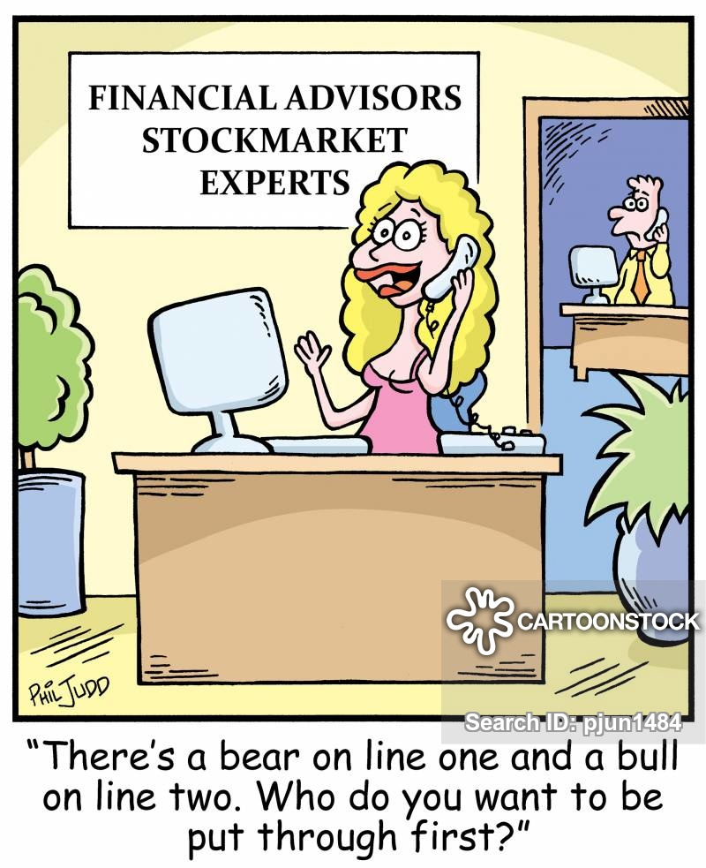
Context
The algorithmic trading space is buzzing with new strategies. Companies have spent billions in infrastructures and R&D to be able to jump ahead of the competition and beat the market. Still, it is well acknowledged that the buy & hold strategy is able to outperform many of the algorithmic strategies, especially in the long-run. However, finding value in stocks is an art that very few mastered, can a computer do that?

Slide 3
Data: Financial_Indicators.csv
Our dataset (.csv) collects 200+ financial indicators for many of the stocks of the US stock market. The financial indicators have been scraped from Financial Modeling Prep API, and are those found in the 10-K SEC filings that publicly traded companies release yearly.
Credit: https://www.kaggle.com/cnic92/200-financial-indicators-of-us-stocks-20142018#2018_Financial_Data.csv

Slide 4
Data: Financial Source
This 10-K annual dataset (2014-2018) was downloaded from Kaggle.com
​
The data was gathered by:
​
Nicolas Carbone
Machine Learning Engineer at Polytechnic of Milan
​
Milano, Metropolitan City of Milan, Italy
​
The CSV files were read in to dataframes and we added a column called "Reporting Year" and all rows for this new column recieved value of the year in the filename. Also the stock/symbol column did not have a title so "Ticker" was inserted as a coloumn heading in each year that was read in during the loop functions of Kaggle_DataSet_10-K.md.

Slide 5
The Science
Model Comparison on Test Mean Absolute Error (MAE)
Test Values and Predictions
Distribution of Residuals
Density Plot of Sector Price Performance – Outliers Removed

Slide 6
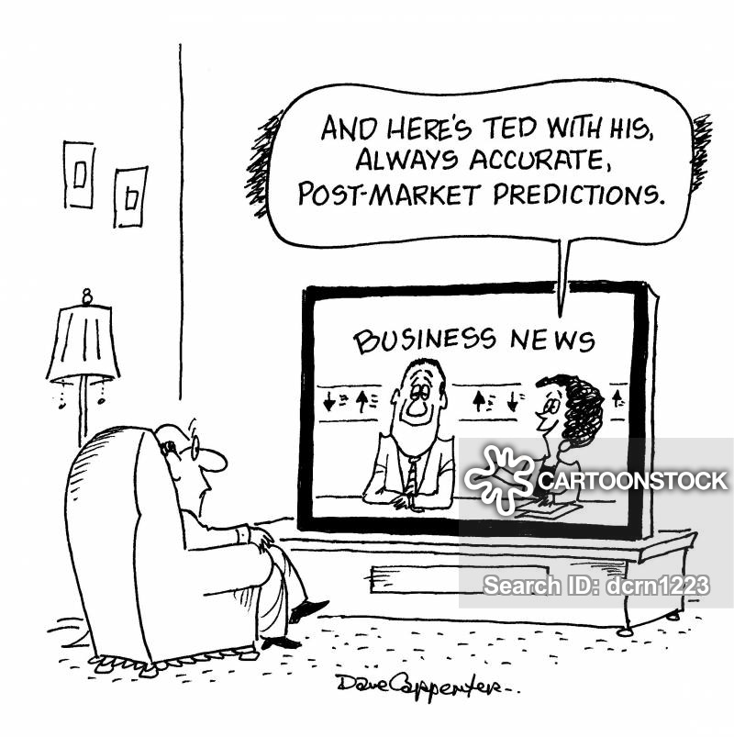

Machine Learning – Model Prediction

Slide 7
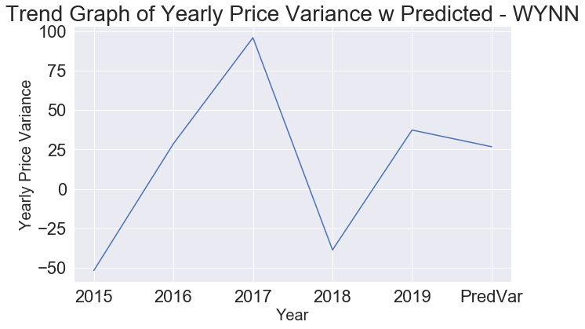
Machine Learning – Model Prediction

Slide 8
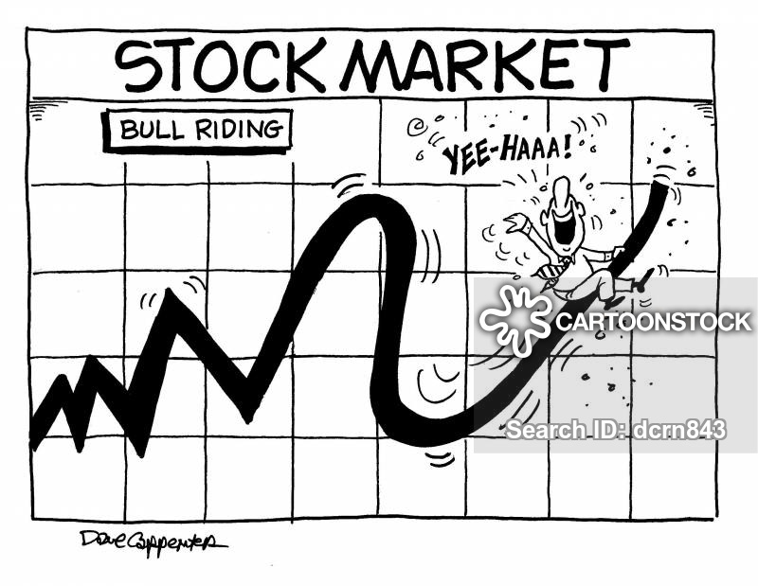
Machine Learning – Model Prediction

Slide 9
Data Preparation
Remove Columns with Many Missing Values
Correlation between Features and Target
To account for possible non-linear relationships, I now take the square root and natural log transformations of the features and then calculate the correlation coefficients with the 2019 price performance and Remove Collinear Features # Remove the collinear features above a specified correlation coefficient df_3 = remove_collinear_features(df_2, 0.6)
Separate out the features x and targets y
imputer = SimpleImputer(strategy='median’)
Split into Train and test
Scaled it using MinMax Scaler.
Fit the model

Slide 10
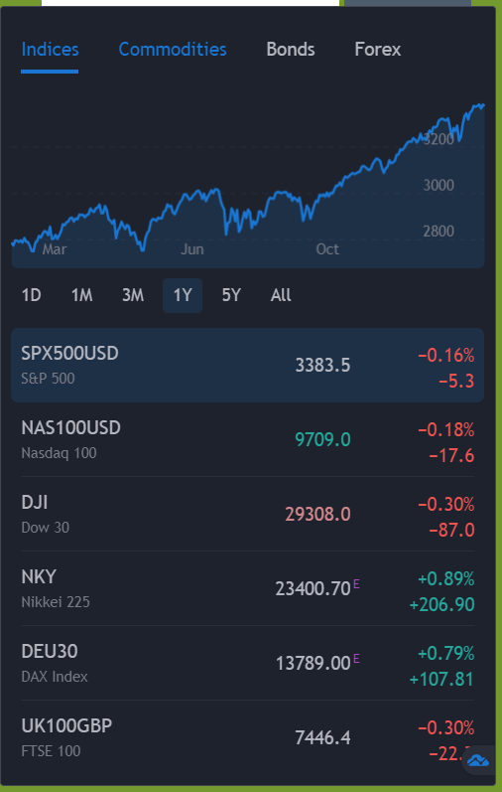
Research
Despite gathering the data from past performances, this does not guarantee our future results.

Slide 11
Image Courtesy
Cartoonstock.com

