Slide 1
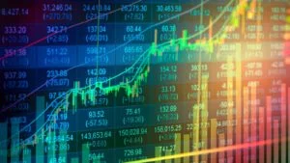
Stock Picker
Harry Chapman
Mike Hughes
Donald Stegman
Hena Venu
Issac Vilchis

Slide 2

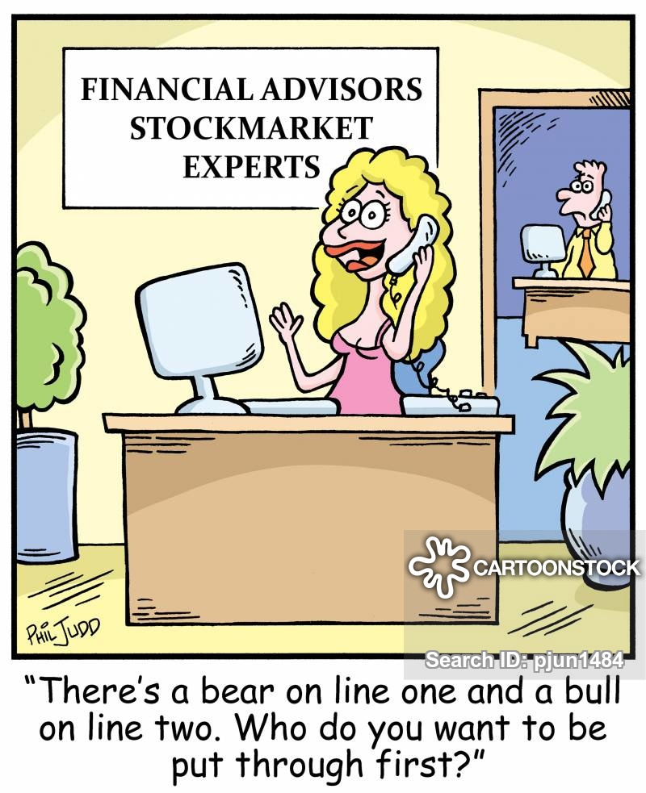
Context
The algorithmic trading space is buzzing with new strategies. Companies have spent billions in infrastructures and R&D to be able to jump ahead of the competition and beat the market. Still, it is well acknowledged that the buy & hold strategy is able to outperform many of the algorithmic strategies, especially in the long-run. However, finding value in stocks is an art that very few mastered, can a computer do that?

Slide 3
Data: Financial_Indicators.csv
Our dataset (.csv) collects 200+ financial indicators for many of the stocks of the US stock market. The financial indicators have been scraped from Financial Modeling Prep API, and are those found in the 10-K SEC filings that publicly traded companies release yearly.
Credit: https://www.kaggle.com/cnic92/200-financial-indicators-of-us-stocks-20142018#2018_Financial_Data.csv

Slide 4
Data: Financial Source
This 10-K annual dataset (2014-2018) was downloaded from Kaggle.com
​
The data was gathered by:
​
Nicolas Carbone
Machine Learning Engineer at Polytechnic of Milan
​
Milano, Metropolitan City of Milan, Italy
​
The CSV files were read in to dataframes and we added a column called "Reporting Year" and all rows for this new column received value of the year in the filename. Also the stock/symbol column did not have a title so "Ticker" was inserted as a column heading in each year that was read in during the loop functions of Kaggle_DataSet_10-K.md.

Slide 5
The Science
Model Comparison on Test Mean Absolute Error (MAE)
Test Values and Predictions
Distribution of Residuals
Density Plot of Sector Price Performance – Outliers Removed

Slide 6
Data Preparation
Remove Columns with Many Missing Values
Correlation between Features and Target
To account for possible non-linear relationships, I now take the square root and natural log transformations of the features and then calculate the correlation coefficients with the 2019 price performance and Remove Collinear Features # Remove the collinear features above a specified correlation coefficient df_3 = remove_collinear_features(df_2, 0.6)
Separate out the features x and targets y
imputer = SimpleImputer(strategy='median’)
Split into Train and test
Scaled it using MinMax Scaler.
Fit the model

Slide 7
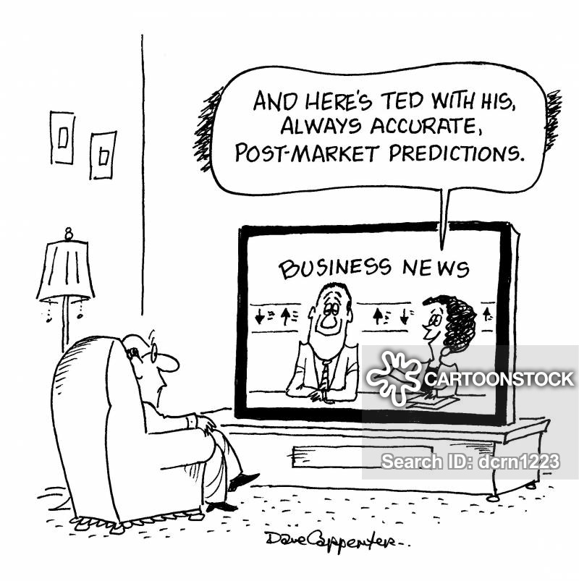

Machine Learning – Model Prediction
Image Courtesy:
Cartoonstock.com

Slide 8
Models
Create Baseline Guess
Median of y
Machine Learning
Linear Regression
XGBoost
SVM
Random Forrest
Gradient Boosted Regression
KNN
Neural Network
4-layer sequential with categorical crossentropy loss minimization

Slide 9
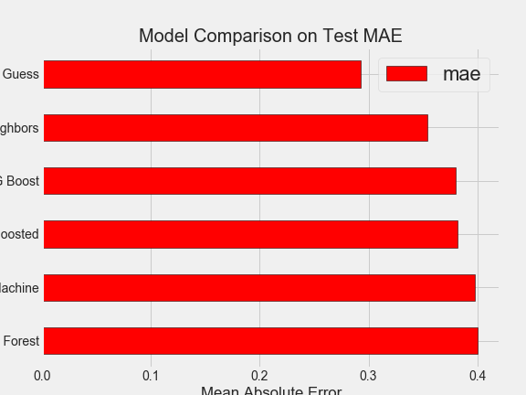
Data Comparison
https://stockpickflask.herokuapp.com/science

Slide 10
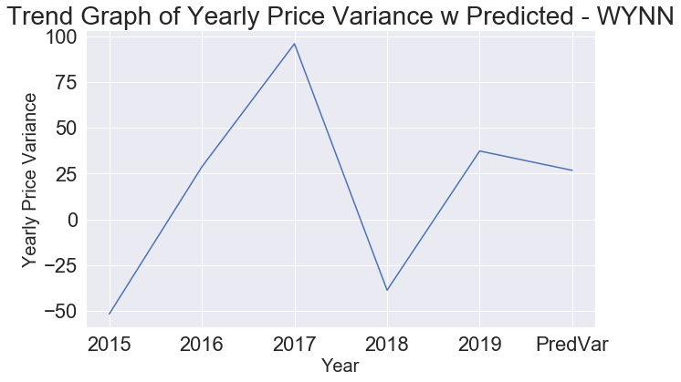
Machine Learning – Model Prediction

Slide 11
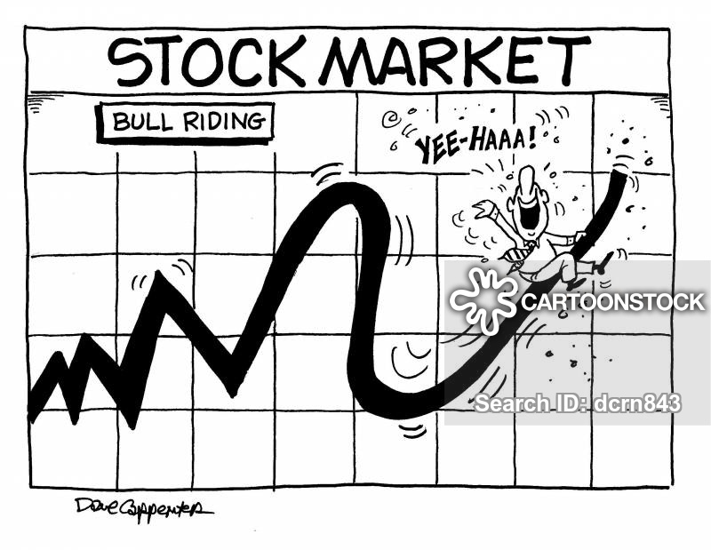
Machine Learning – Model Prediction

Slide 12
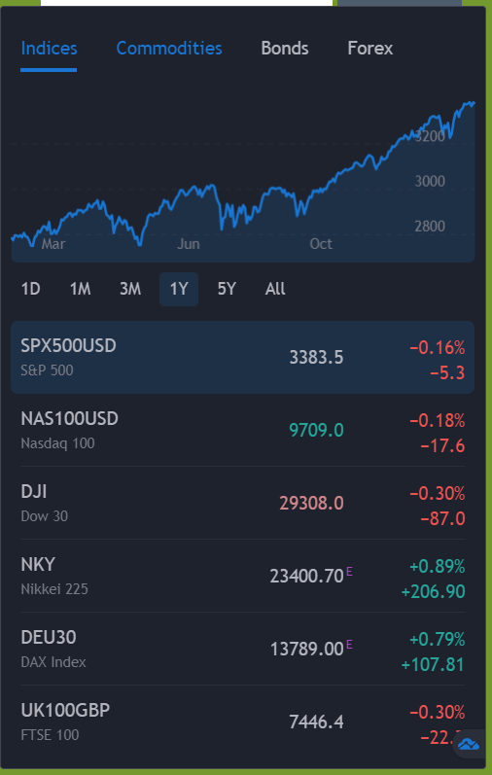
Research
Despite gathering the data from past performances, this does not guarantee our future investment results.
https://stockpickflask.herokuapp.com/test

