Slide 1
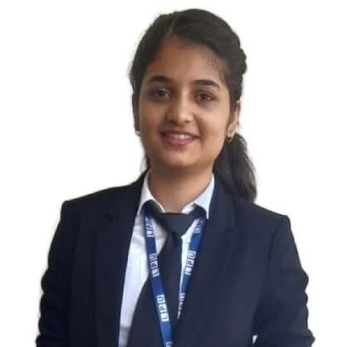

Sakshi Jha
Analyst/Software Engineer
Bachelor of Engineering
Computer Science : 2018 - 2022
Skills
Java 8 /J2EE | Java Basics, OOPS, Generics, Collections, Arrays, Loops, Lambda Exp, Stream API Junit, Mockito
Spring core | IOC & Dependency Injection, Autowire
Spring REST | REST controllers, Implementation of GET, POST, PUT & DELETE, Bean Validation & Exception Handling, Testing Services, Controller & Repository layer
Spring Data JPA | Implement DAO layer using spring Data repositories, Transaction Management
Spring Boot Microservices | Spring Boot Starters, annotations, Messaging Service, Sync/Async comms, Swagger API documents
Spring Cloud | Eureka, Netflix Ribbon, Feign Client, Netflix Hystrix & Config Server
React | Components, Hooks, Event handling, Redux, Reducers
Database | MongoDB No SQL
UI Tech | HTML 5 & CSS 3,JavaScript, ES6 & TypeScript Reusable templates, Optimized UI Designed
Tools | Git, Postman, Maven, IDE
Add On skills | Communications, Team management. Peer learning
Bangalore
sakshi.jha@capgemini.com
+91 9599635350
A4
Full Stack Developer
Hands on experience in creating microservices with Springboot, Spring Security, Spring Cloud API Gateway, Eureka server, Rest Template .
Hands on experience in developing web pages using HTML5, CSS3, Object Oriented Java script, ES6 & Typescript, JSON, XML. Intermediate knowledge on ReactJS(Hooks, redux).
Experience in creating documentation with swagger and in unit testing using Junit, Mockito including code quality compliance using SonarQube
E-Commerce Shopping Cart Application
Completed end to end case study of Shopping Cart Application. Along with Swagger and payment testing using Razorpay, Material-UI and React Bootstrap used for user interface.
Event Handling website
Developed event handling website named Socially for people to search for events nearby and book their seats to attend accordingly, using HTML, CSS , JavaScript, Bootstrap.
Completed ”AWS Cloud Practitioner“ from AWS.
Completed ”ReactJS“ course at Simplilearn.
Completed ”Web Development“ course at Coursera.

