Slide 1

Massachusetts General Hospital A Data-Driven Approach to Patient Care
Santanu Jha

Slide 2
Hospital Overview
Mission: Providing high-quality, compassionate care to our community.
Services: Comprehensive range of medical services including emergency care, inpatient care, outpatient services, and specialized treatments.
Facilities: State-of-the-art medical equipment, experienced healthcare professionals, and patient-centered care environments.

Slide 3
Importance of Data-Driven Decision-Making
Enhances Patient Care: Data helps in identifying trends, improving treatment protocols, and optimizing patient outcomes.
Operational Efficiency: Analyzing data streamlines processes, reduces costs, and improves resource allocation.
Strategic Planning: Informed decisions for future growth, policy development, and service expansion.

Slide 4
Purpose of the Analysis
Objective: To evaluate current operations and identify opportunities for improvement.
Focus: Assessing performance metrics, patient trends, and cost trends in services and insurance.
Outcome: Recommendations for enhancing hospital performance and achieving strategic goals.

Slide 5


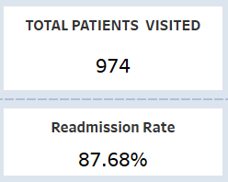
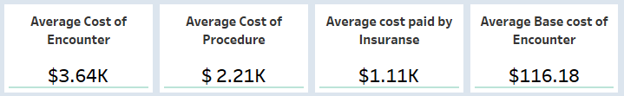
Key Metrics Overview

Slide 6
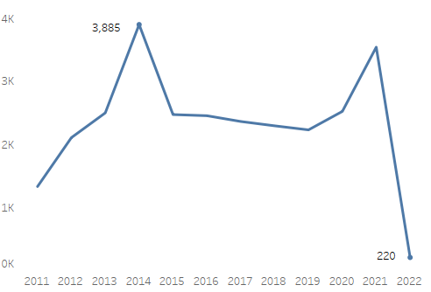
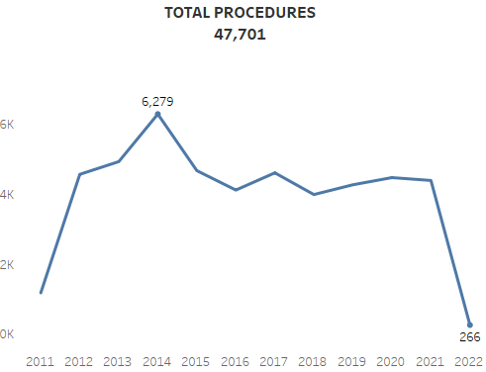
Patient Encounters and Procedures
Peak in encounters and procedures in 2014.
Steady decline in recent years.
High readmission rate has its impact on hospital resources.

Slide 7
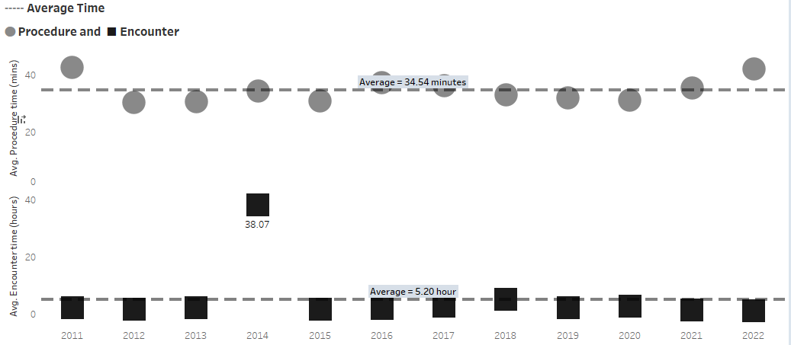
Average Time in Hospital

Slide 8
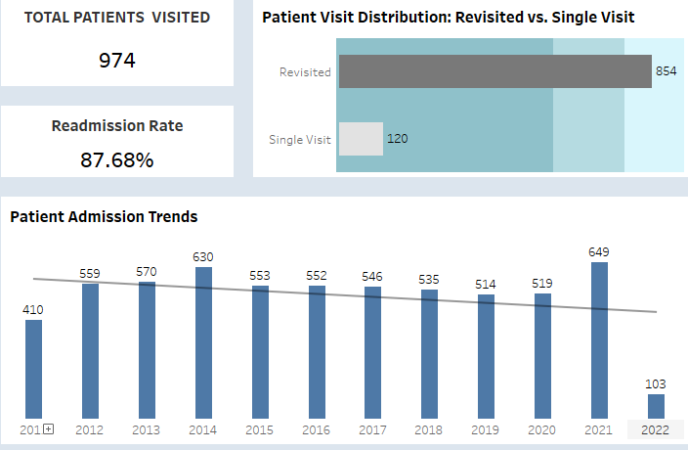
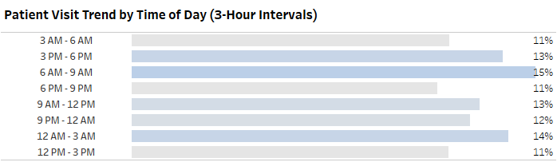
Patient Visit Trends

Slide 9
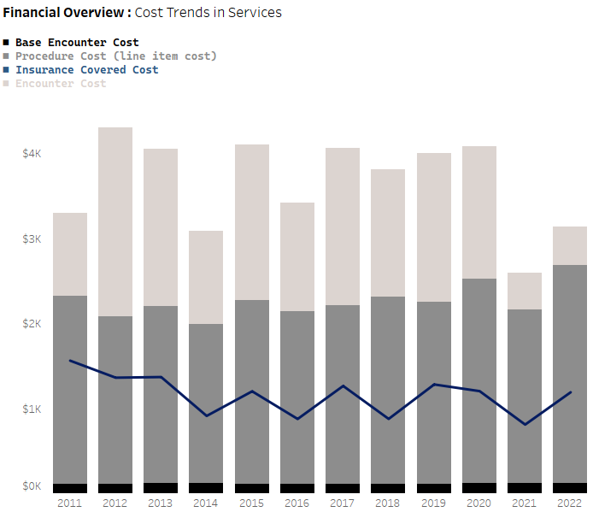

Cost Analysis
The light grey part of the bar graph shows the gross profit of the hospital.

Slide 10
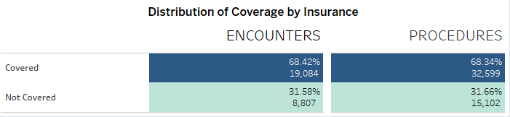
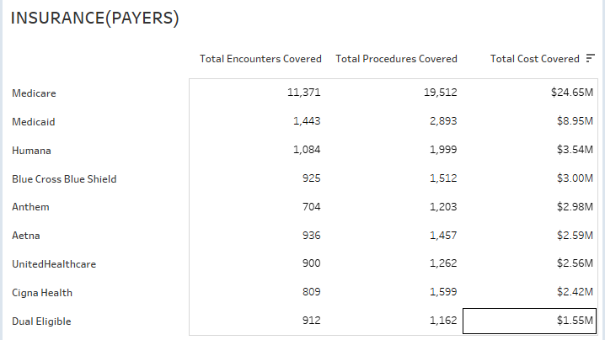
Insurance Coverage for patients and who paid it ?

Slide 11
Key Findings and Insights
Implications:
Need for targeted interventions to reduce readmissions.
Potential for cost-saving measures.
Summary:
High readmission rates indicate potential areas for improvement.
Efficient procedure times but room for reducing average encounter times.
Significant financial burden on uninsured patients.

Slide 12
Strategic Recommendations
Reduce Readmissions: Implement follow-up care programs and patient education.
Optimize Procedure and Encounter Times: Streamline operational processes and enhance resource allocation.
Cost Management: Explore financial assistance programs for uninsured patients and negotiate better insurance coverage terms.
Patient Flow Management: Adjust staffing and resources based on peak visit times.

Slide 13
Conclusion
This comprehensive approach enabled Massachusetts General Hospital to gain valuable insights into patient care trends and financial performance, facilitating better decision-making and optimized healthcare delivery. The project provided a robust foundation for ongoing data analysis and informed strategic planning.

