Slide 1
LPC speech synthesis and autocorrelation-based pitch tracking
ECE 401, Signal Processing

Slide 2
Outline
The LPC-10 speech synthesis model
The LPC-10 excitation model: white noise, pulse train
Linear predictive coding: how to find the coefficients
Linear predictive coding: how to make sure the coefficients are stable
Autocorrelation-based pitch tracking
Inter-frame interpolation of pitch and energy contours

Slide 3
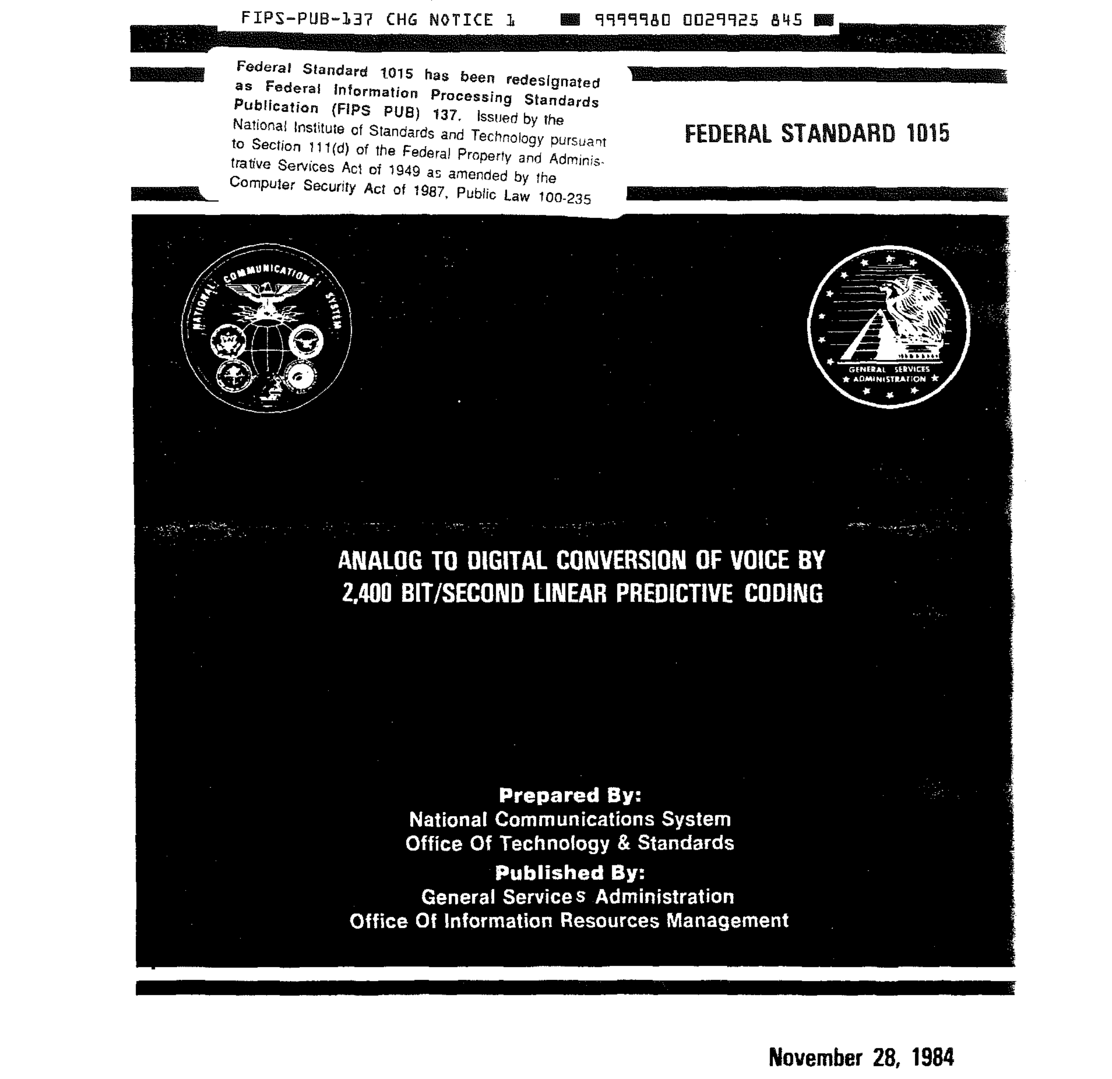
The LPC-10 speech synthesis model

Slide 4
The LPC-10 Speech Coder: Transmitted Parameters
Each frame is 54 bits, and is used to synthesize 22.5ms of speech.
(54 bits/frame)/(0.0225 seconds/frame)=2400 bits/second
Pitch: 7 bits/frame (127 distinguishable non-zero pitch periods)
Energy: 5 bits/frame (32 levels, on a log-energy scale)
10 linear predictive coefficients (LPC): 41 bits/frame
Synchronization: 1 bit/frame

Slide 5
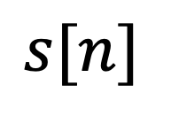
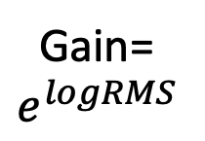



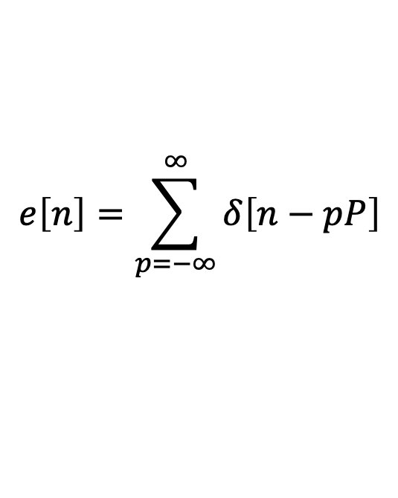
The LPC-10 speech synthesis model
$$e\left[n\right]=\sum_{p=−∞}^{∞}{δ\left[n−pP\right]}$$
Voiced Speech,
pitch period P
G
$$G$$
$$H(e^{jω})$$
$$s[n]$$
$$e\left[n\right]\sim 𝒩\left(0,1\right)$$
Gain=
$$e^{logRMS}$$
Unvoiced Speech
Vocal Tract:
Modeled by
an LPC synthesis
Filter.
Binary Control
Switch:
Voiced (P>0) vs.
Unvoiced (P=0)

Slide 6
Outline
The LPC-10 speech synthesis model
The LPC-10 excitation model: white noise, pulse train
Linear predictive coding: how to find the coefficients
Linear predictive coding: how to make sure the coefficients are stable
Autocorrelation-based pitch tracking
Inter-frame interpolation of pitch and energy contours

Slide 7
The LPC-10 speech synthesis model
$$e\left[n\right]=\sum_{p=−∞}^{∞}{δ\left[n−pP\right]}$$
Voiced Speech,
pitch period P
G
$$G$$
$$H(e^{jω})$$
$$s[n]$$
$$e\left[n\right]\sim 𝒩\left(0,1\right)$$
Gain=
$$e^{logRMS}$$
Unvoiced Speech
Vocal Tract:
Modeled by
an LPC synthesis
Filter.
Binary Control
Switch:
Voiced vs.
Unvoiced

Slide 8
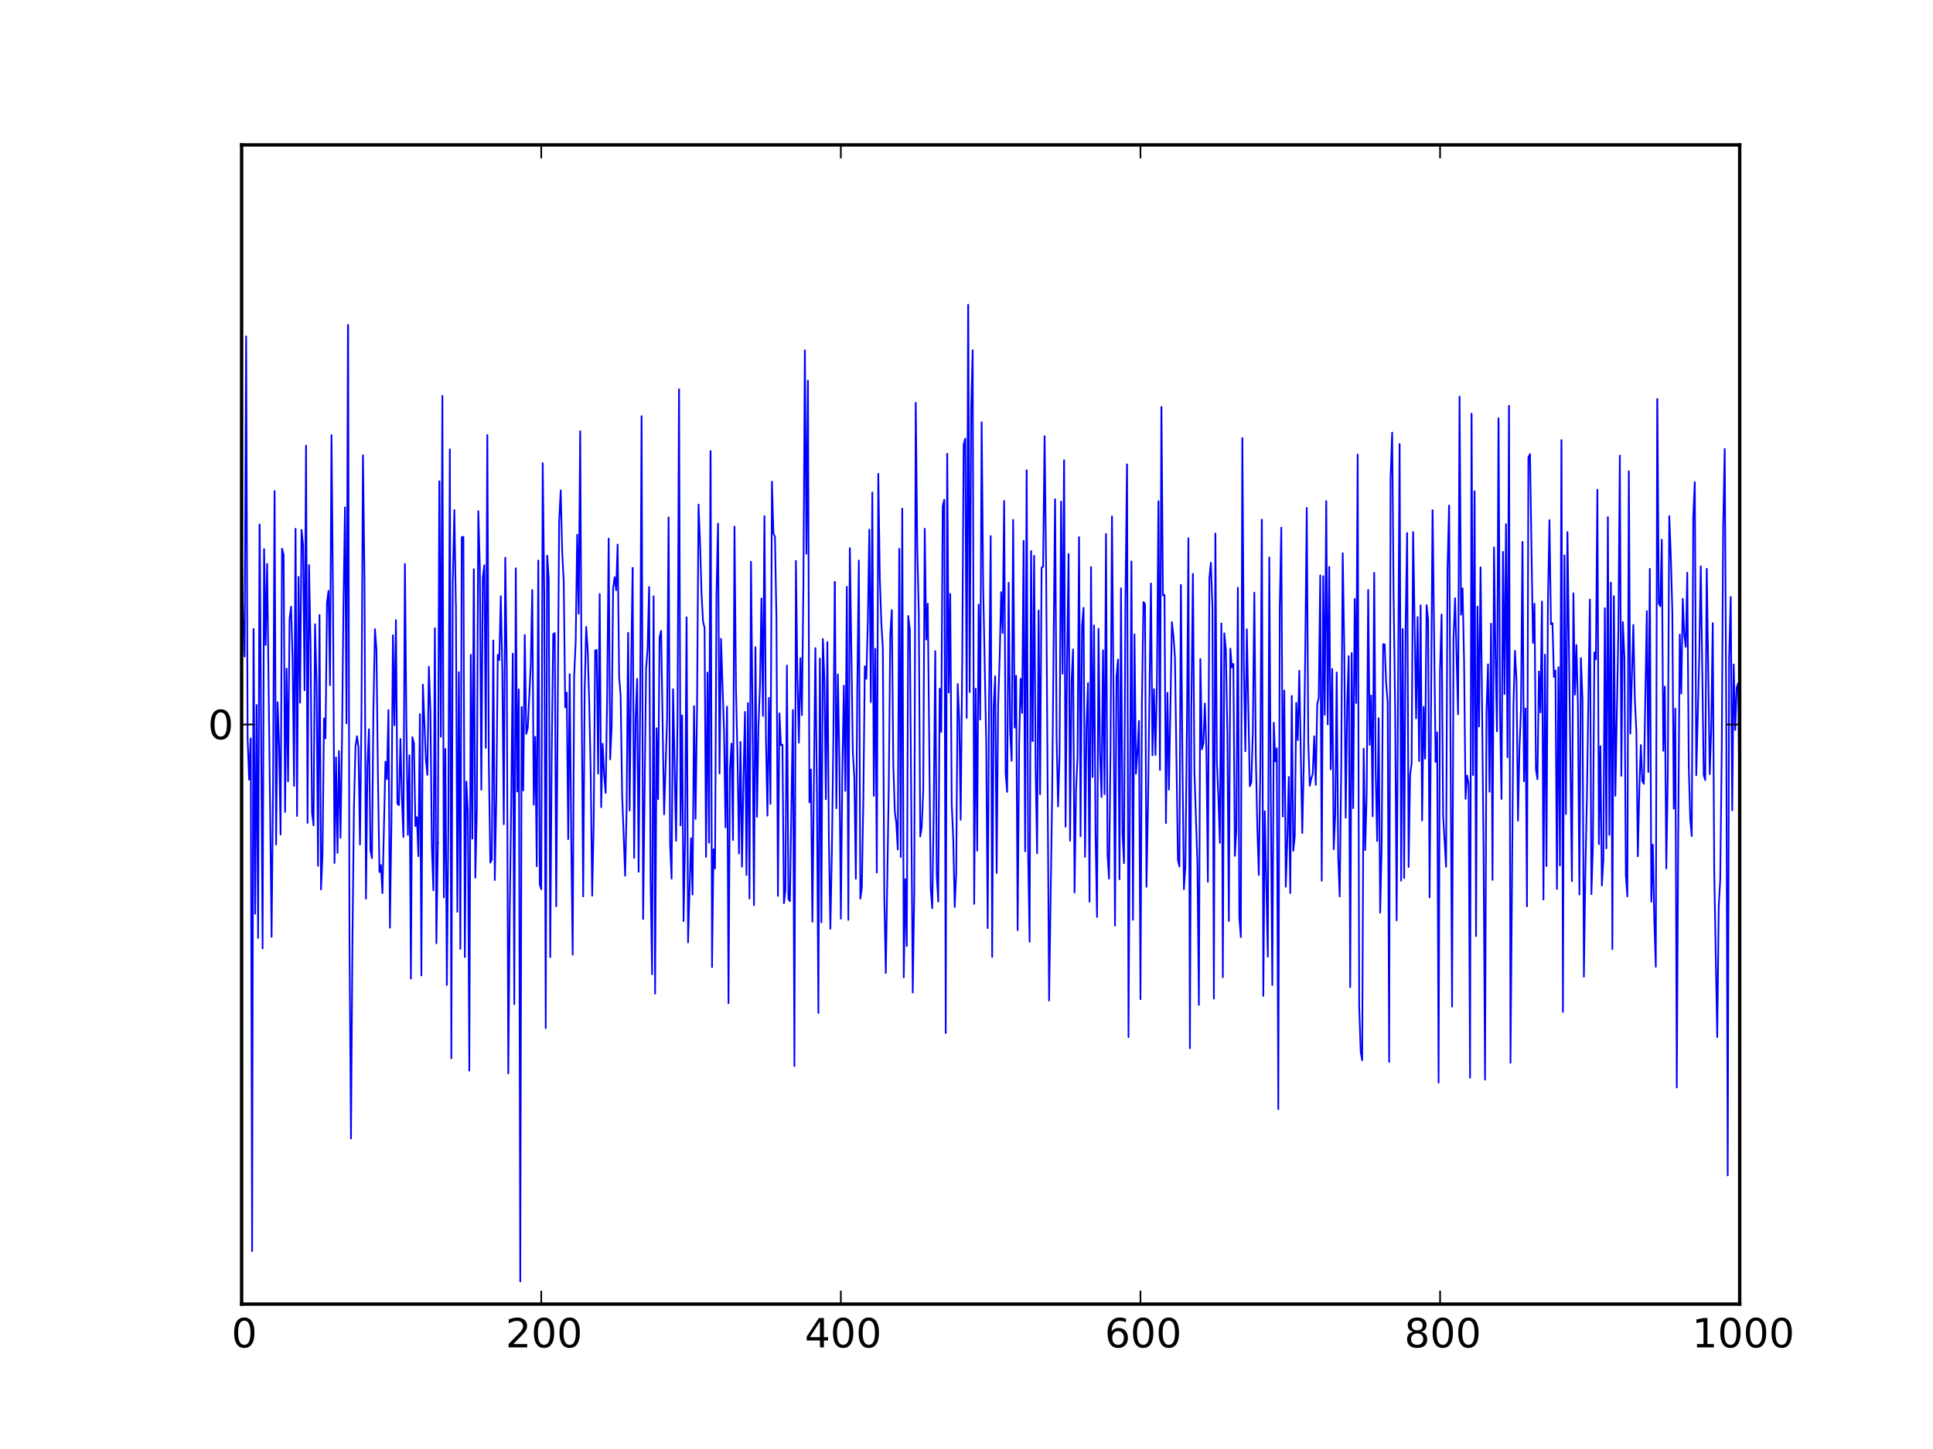
Unvoiced speech: e[n]=white noise
Use zero-mean, unit-variance Gaussian white noise
The choice, to use “unvoiced speech,” is communicated by the special code word “P=0”
By Morn - Own work, CC BY-SA 3.0, https://commons.wikimedia.org/w/index.php?curid=24084756

Slide 9
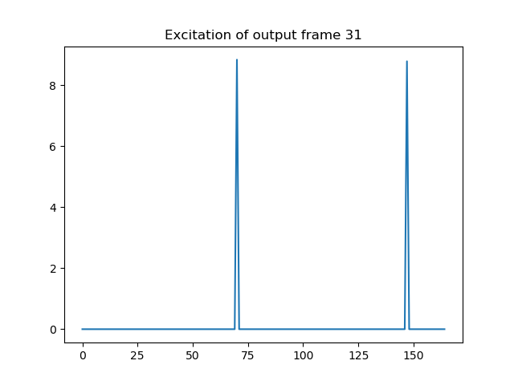
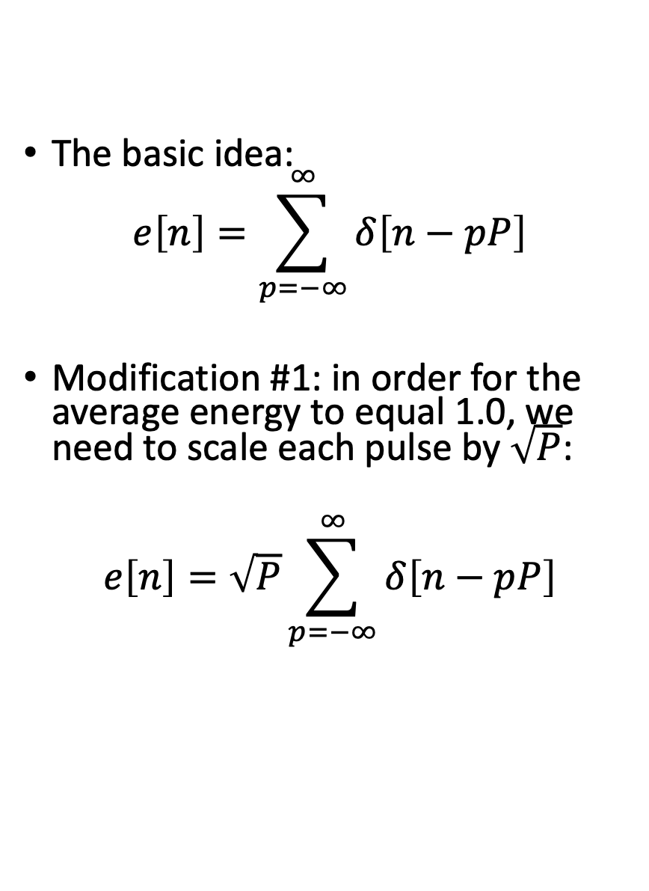
Voiced speech: e[n]=pulse train
The basic idea:
$$e\left[n\right]=\sum_{p=−∞}^{∞}{δ\left[n−pP\right]}$$
Modification #1: in order for the average energy to equal 1.0, we need to scale each pulse by $\sqrt{P}$:
$$e\left[n\right]=\sqrt{P}\sum_{p=−∞}^{∞}{δ\left[n−pP\right]}$$

Slide 10
Modification #2: the first pulse is not at n=0
30
Pitch period = 80 samples $⇒$ first pulse in frame 31 can’t occur until the 70th sample of the frame

Slide 11
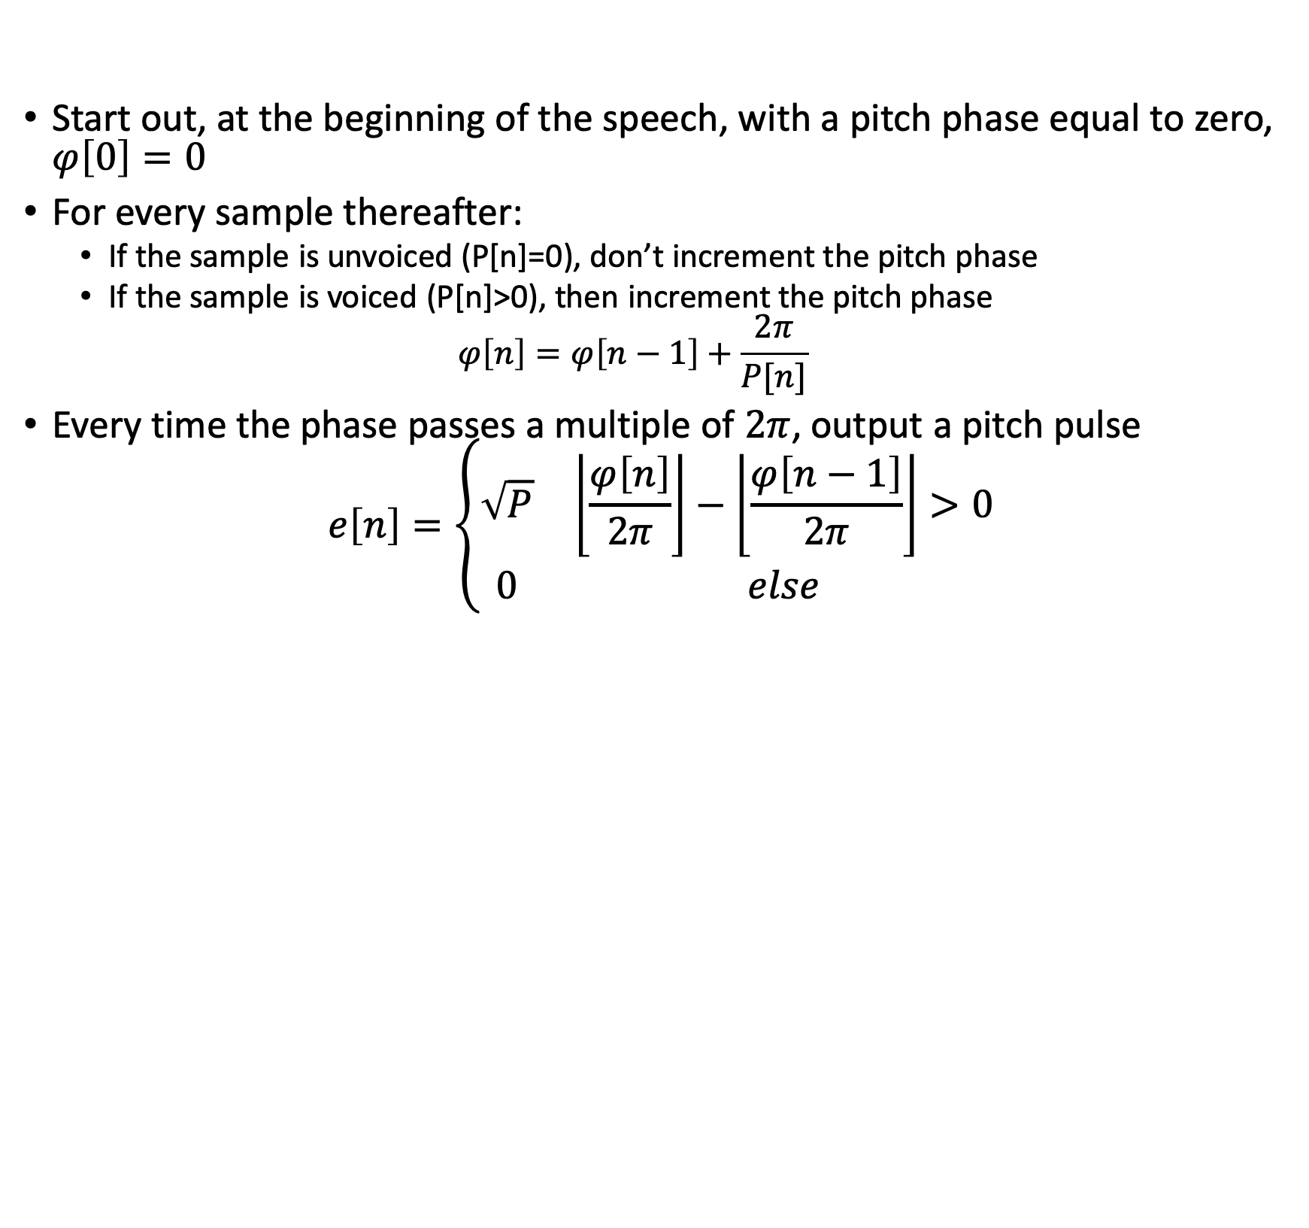
A mechanism for keeping track of pitch phase from one frame to the next
Start out, at the beginning of the speech, with a pitch phase equal to zero, $φ\left[0\right]=0$
For every sample thereafter:
If the sample is unvoiced (P[n]=0), don’t increment the pitch phase
If the sample is voiced (P[n]>0), then increment the pitch phase
$$φ\left[n\right]=φ\left[n−1\right]+\frac{2π}{P[n]}$$
Every time the phase passes a multiple of $2π$, output a pitch pulse
$$e\left[n\right]=\left\{\begin{matrix}\sqrt{P} & \left\lfloor \frac{φ\left[n\right]}{2π}\right\rfloor −\left\lfloor \frac{φ\left[n−1\right]}{2π}\right\rfloor >0 \\ 0 & else\end{matrix}\right.$$

Slide 12






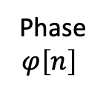

The pitch phase method: generate an excitation pulse whenever pitch phase crosses a $2π$-level
Phase
$$φ\left[n\right]$$
$$φ\left[n\right]$$
$$8π$$
$$6π$$
$$4π$$
$$2π$$
Sample Number, n
30
$$e\left[n\right]$$

Slide 13
Outline
The LPC-10 speech synthesis model
The LPC-10 excitation model: white noise, pulse train
Linear predictive coding: how to find the coefficients
Linear predictive coding: how to make sure the coefficients are stable
Autocorrelation-based pitch tracking
Inter-frame interpolation of pitch and energy contours

Slide 14
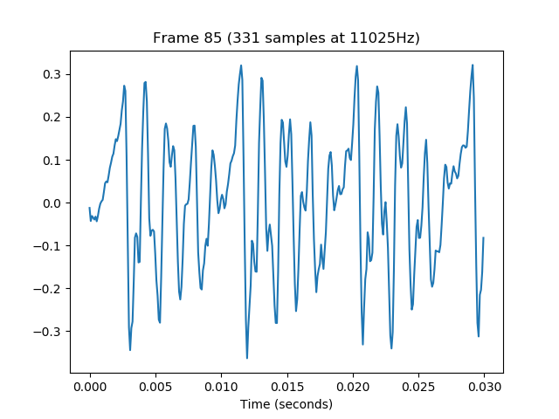
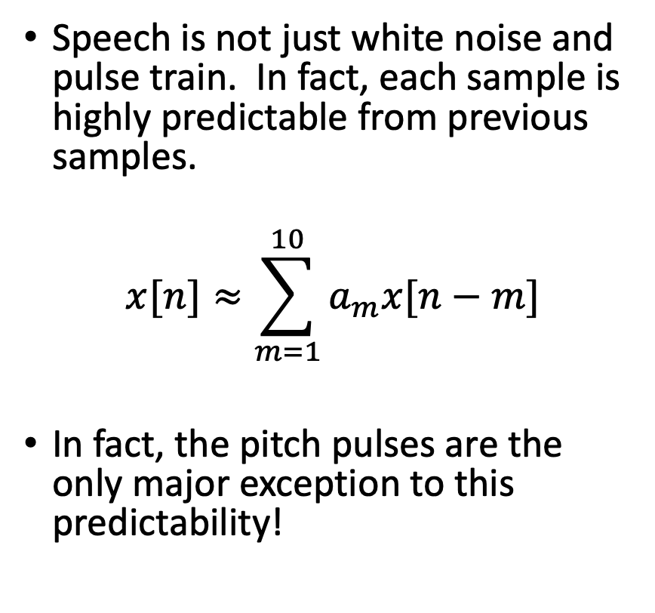
Speech is predictable
Speech is not just white noise and pulse train. In fact, each sample is highly predictable from previous samples.
$$x[n]≈\sum_{m=1}^{10}{a_{m}x[n−m]}$$
In fact, the pitch pulses are the only major exception to this predictability!

Slide 15
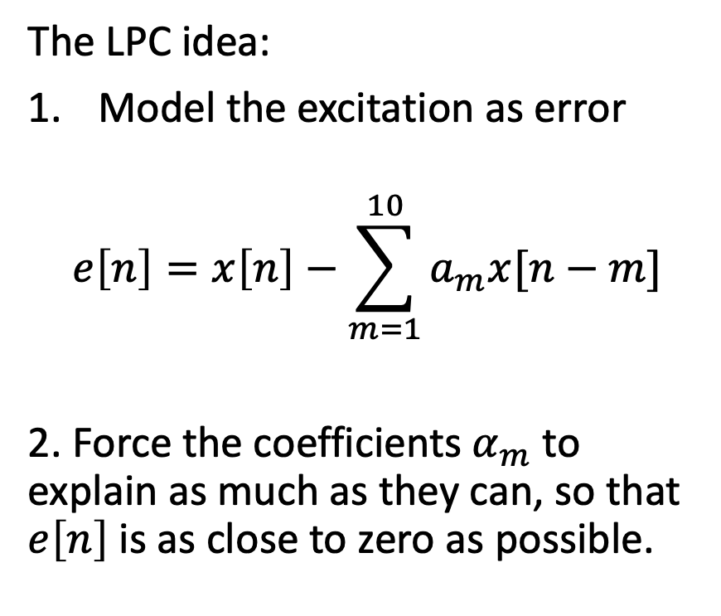


Linear predictive coding (LPC)
$$x\left[n\right]$$
The LPC idea:
Model the excitation as error
$$e\left[n\right]=x\left[n\right]−\sum_{m=1}^{10}{a_{m}x[n−m]}$$
2. Force the coefficients $α_{m}$ to explain as much as they can, so that $e\left[n\right]$ is as close to zero as possible.
$$e\left[n\right]$$

Slide 16

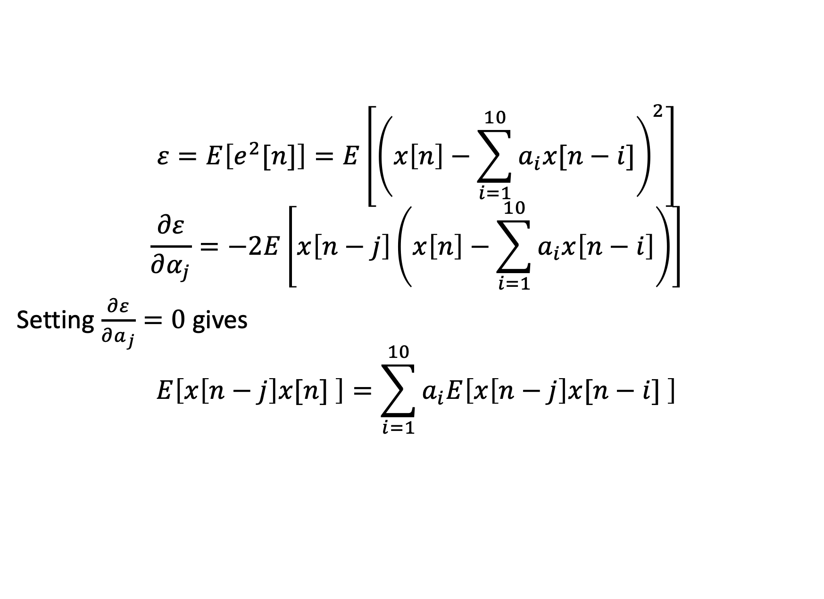

Linear predictive coding (LPC)
$$ε=E\left[e^{2}[n]\right]=E\left[{\left(x\left[n\right]−\sum_{i=1}^{10}{a_{i}x[n−i]}\right)}^{2}\right]$$
$$\frac{∂ε}{∂α_{j}}=−2E\left[x\left[n−j\right]\left(x\left[n\right]−\sum_{i=1}^{10}{a_{i}x\left[n−i\right]}\right)\right]$$
Setting $\frac{∂ε}{∂a_{j}}=0$ gives
$$E\left[x\left[n−j\right]x[n] \right]=\sum_{i=1}^{10}{a_{i}E\left[x\left[n−j\right]x[n−i] \right]}$$
$$R_{xx}\left[j\right]$$
$$R_{xx}\left[|i−j|\right]$$

Slide 17
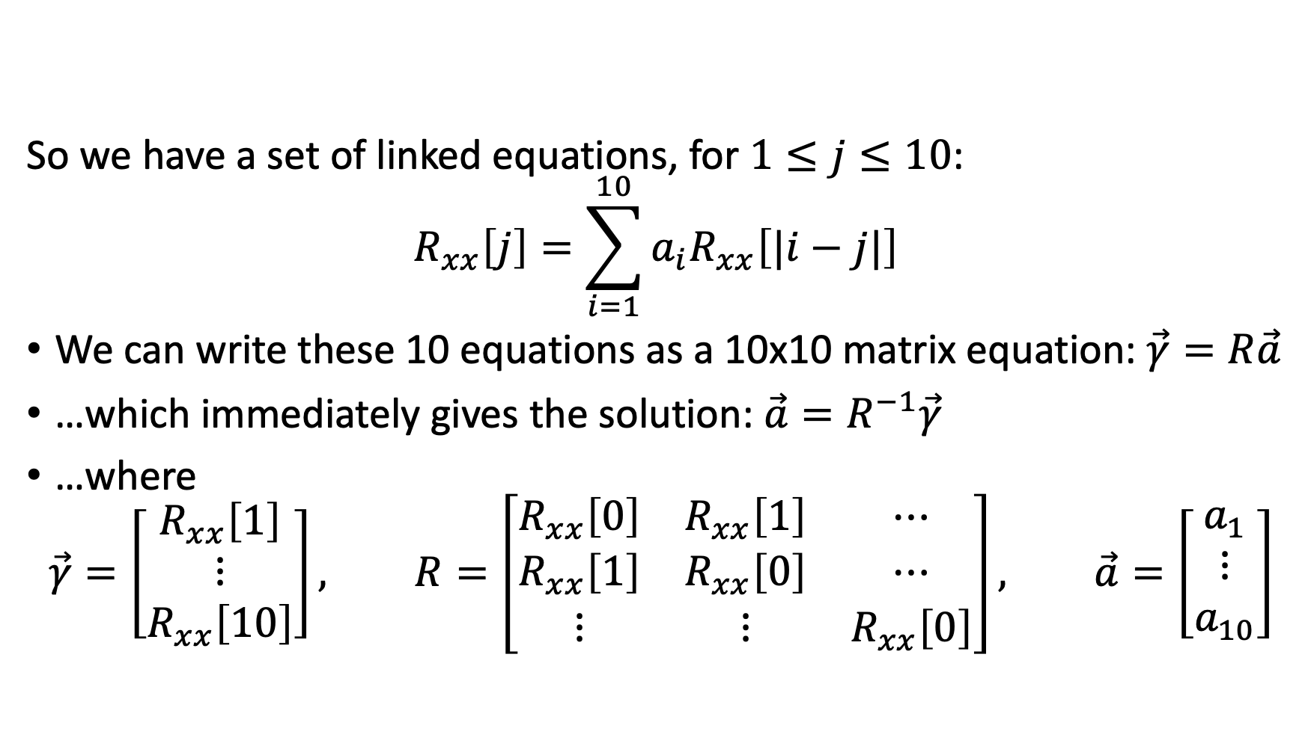
Linear predictive coding (LPC)
So we have a set of linked equations, for $1≤j≤10$:
$$R_{xx}\left[j\right]=\sum_{i=1}^{10}{a_{i}R_{xx}\left[|i−j|\right] }$$
We can write these 10 equations as a 10x10 matrix equation: $\vec{γ}=R\vec{a}$
…which immediately gives the solution: $\vec{a}=R^{−1}\vec{γ}$
…where
$$\vec{γ}=\left[\begin{matrix}R_{xx}\left[1\right] \\ ⋮ \\ R_{xx}\left[10\right]\end{matrix}\right], R=\left[\begin{matrix}R_{xx}\left[0\right] & R_{xx}\left[1\right] & ⋯ \\ R_{xx}\left[1\right] & R_{xx}\left[0\right] & ⋯ \\ ⋮ & ⋮ & R_{xx}\left[0\right]\end{matrix}\right], \vec{a}=\left[\begin{matrix}a_{1} \\ ⋮ \\ a_{10}\end{matrix}\right]$$

Slide 18
Outline
The LPC-10 speech synthesis model
The LPC-10 excitation model: white noise, pulse train
Linear predictive coding: how to find the coefficients
Linear predictive coding: how to make sure the coefficients are stable
Autocorrelation-based pitch tracking
Inter-frame interpolation of pitch and energy contours

Slide 19
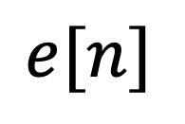
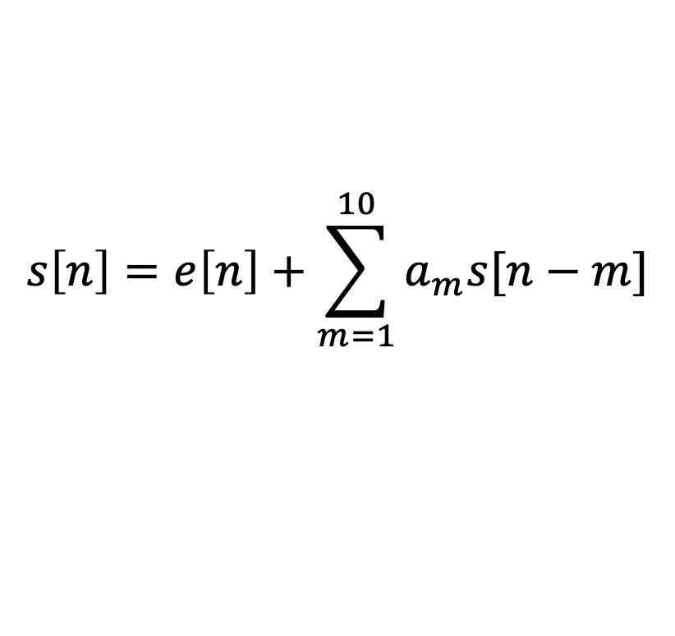
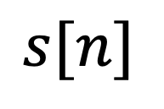
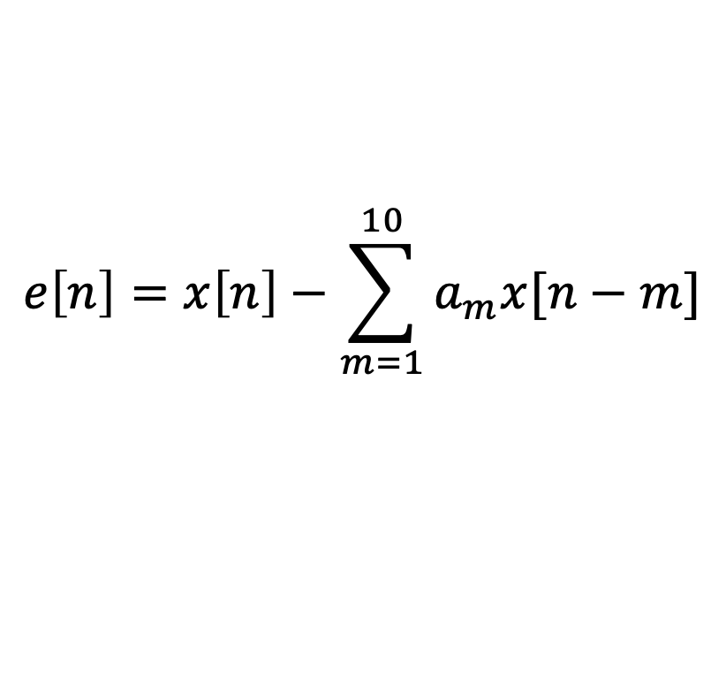
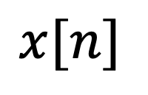
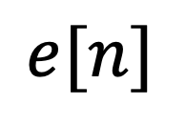
Speech -> Excitation -> Speech
Now that we know how to find the LPC coefficients, we can imagine an end-to-end LPC analysis-by-synthesis:
Model
excitation
using pulse train and white noise
LPC
analysis
LPC
synthesis
$$x[n]$$
$$e[n]$$
$$e[n]$$
$$s[n]$$
$$e\left[n\right]=x\left[n\right]−\sum_{m=1}^{10}{a_{m}x[n−m]}$$
$$s\left[n\right]=e\left[n\right]+\sum_{m=1}^{10}{a_{m}s[n−m]}$$

Slide 20
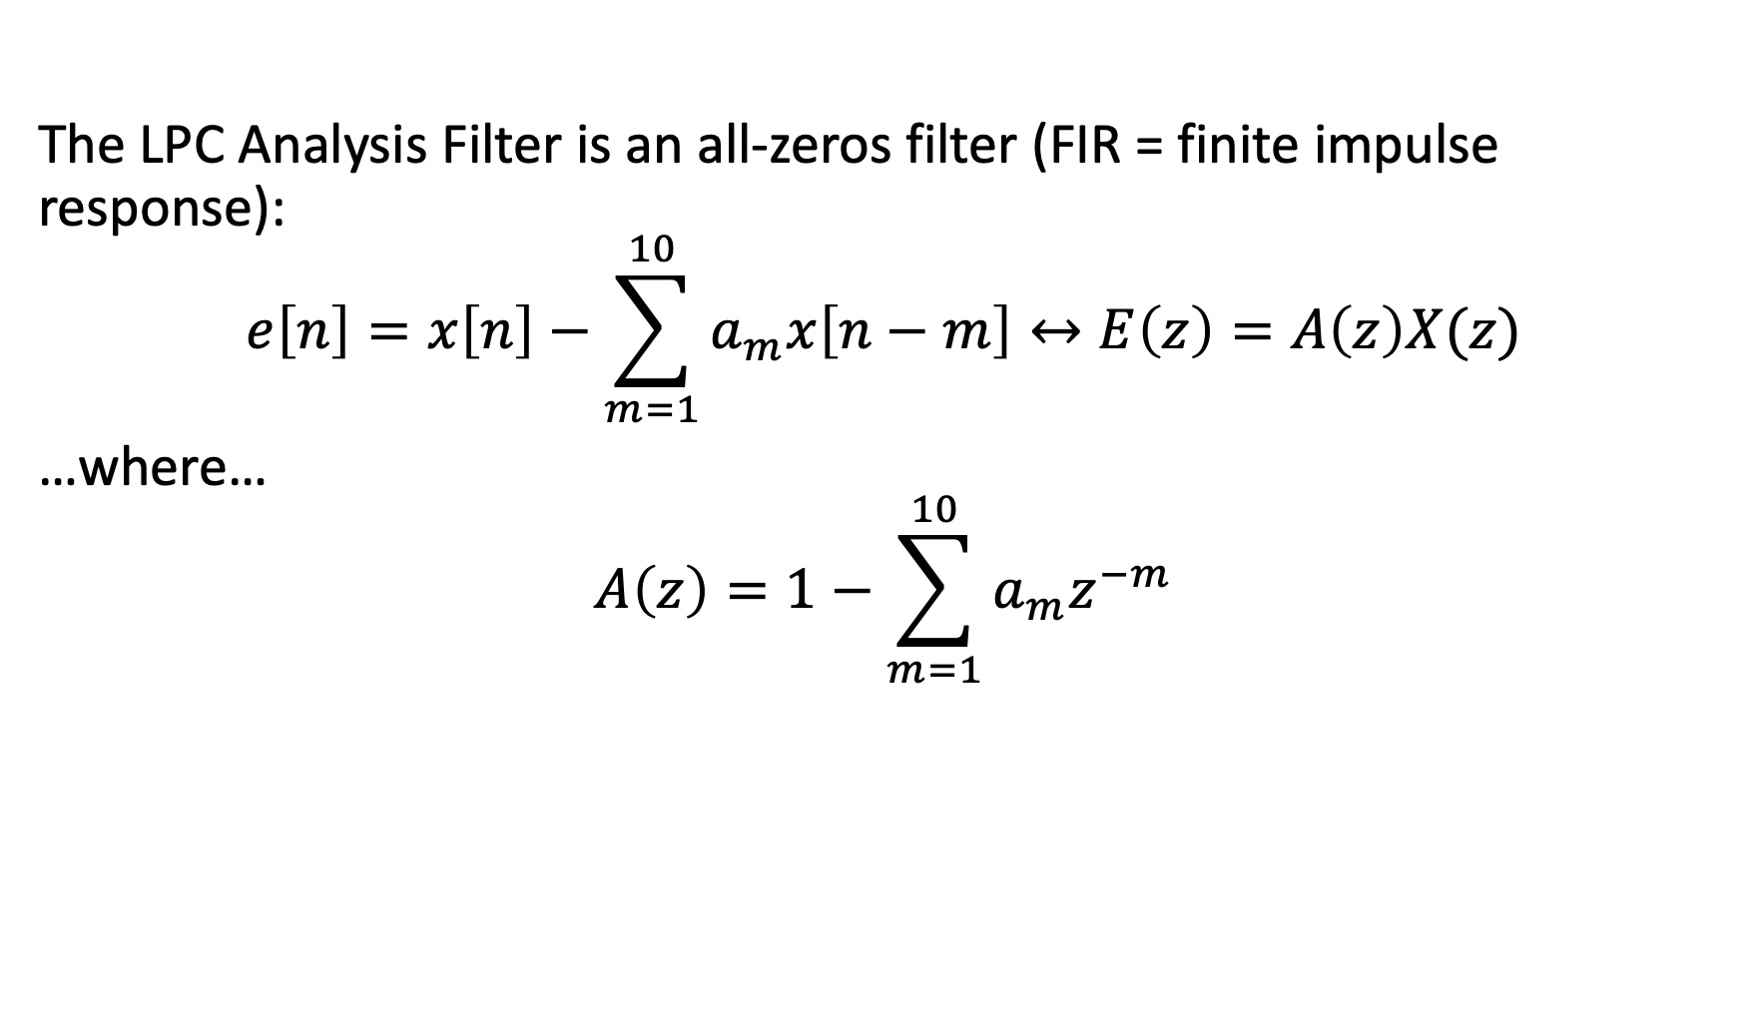
The LPC Analysis Filter
The LPC Analysis Filter is an all-zeros filter (FIR = finite impulse response):
$$e\left[n\right]=x\left[n\right]−\sum_{m=1}^{10}{a_{m}x\left[n−m\right]}↔E\left(z\right)=A\left(z\right)X(z)$$
…where…
$$A\left(z\right)=1−\sum_{m=1}^{10}{a_{m}z^{−m}}$$

Slide 21
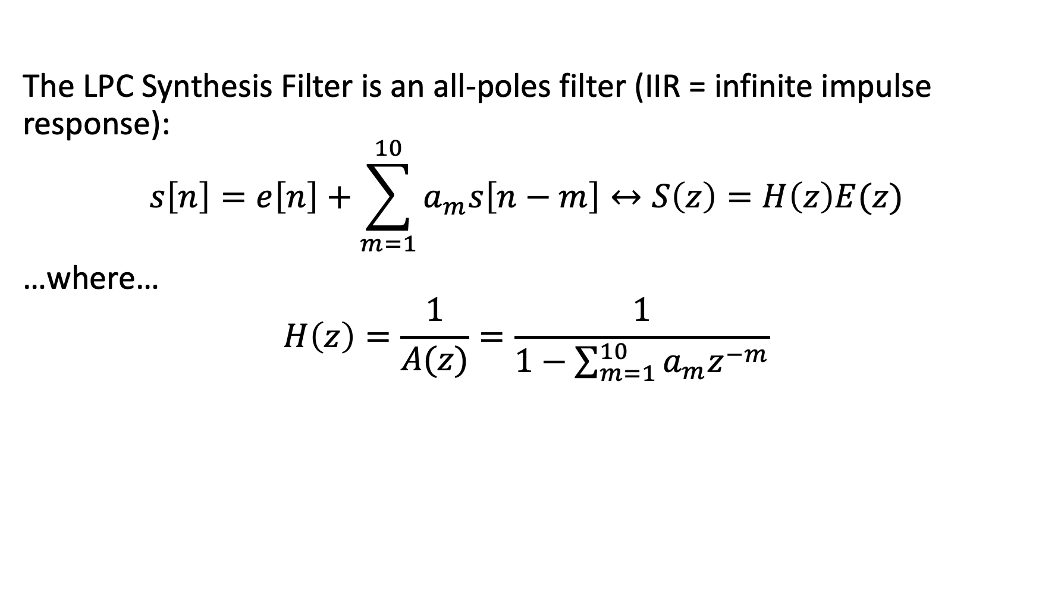
The LPC Synthesis Filter
The LPC Synthesis Filter is an all-poles filter (IIR = infinite impulse response):
$$s\left[n\right]=e\left[n\right]+\sum_{m=1}^{10}{a_{m}s\left[n−m\right]}↔S\left(z\right)=H\left(z\right)E(z)$$
…where…
$$H\left(z\right)=\frac{1}{A(z)}=\frac{1}{1−\sum_{m=1}^{10}{a_{m}z^{−m}}}$$

Slide 22
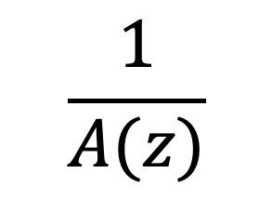

Speech -> Excitation -> Speech
Excitation Model
$$\frac{1}{A(z)}$$
$$x[n]$$
$$A\left(z\right)$$
$$e[n]$$
$$e[n]$$
$$s[n]$$

Slide 23
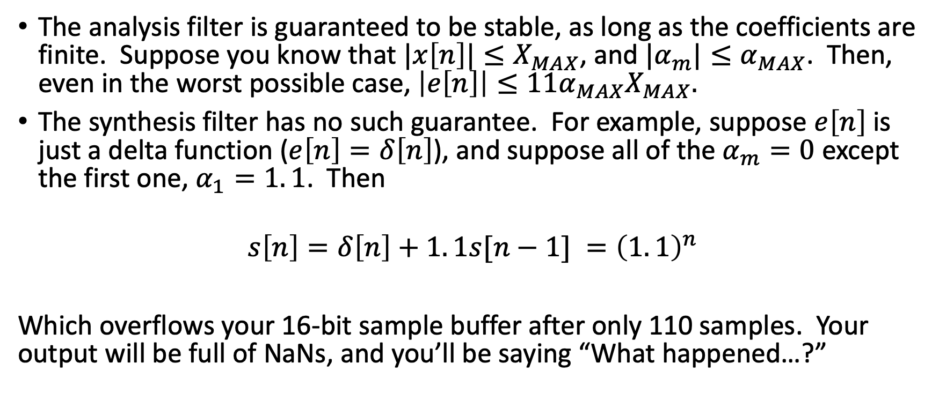
The Stability Problem
The analysis filter is guaranteed to be stable, as long as the coefficients are finite. Suppose you know that $|x\left[n\right]|≤X_{MAX}$, and $|α_{m}|≤α_{MAX}$. Then, even in the worst possible case, $\left|e\left[n\right]\right|≤11{α_{MAX}X}_{MAX}.$
The synthesis filter has no such guarantee. For example, suppose $e\left[n\right]$ is just a delta function ($e\left[n\right]=δ\left[n\right]$), and suppose all of the $α_{m}=0$ except the first one, $α_{1}=1. 1$. Then
$$s\left[n\right]=δ\left[n\right]+1. 1s[n−1] ={\left(1. 1\right)}^{n}$$
Which overflows your 16-bit sample buffer after only 110 samples. Your output will be full of NaNs, and you’ll be saying “What happened…?”

Slide 24
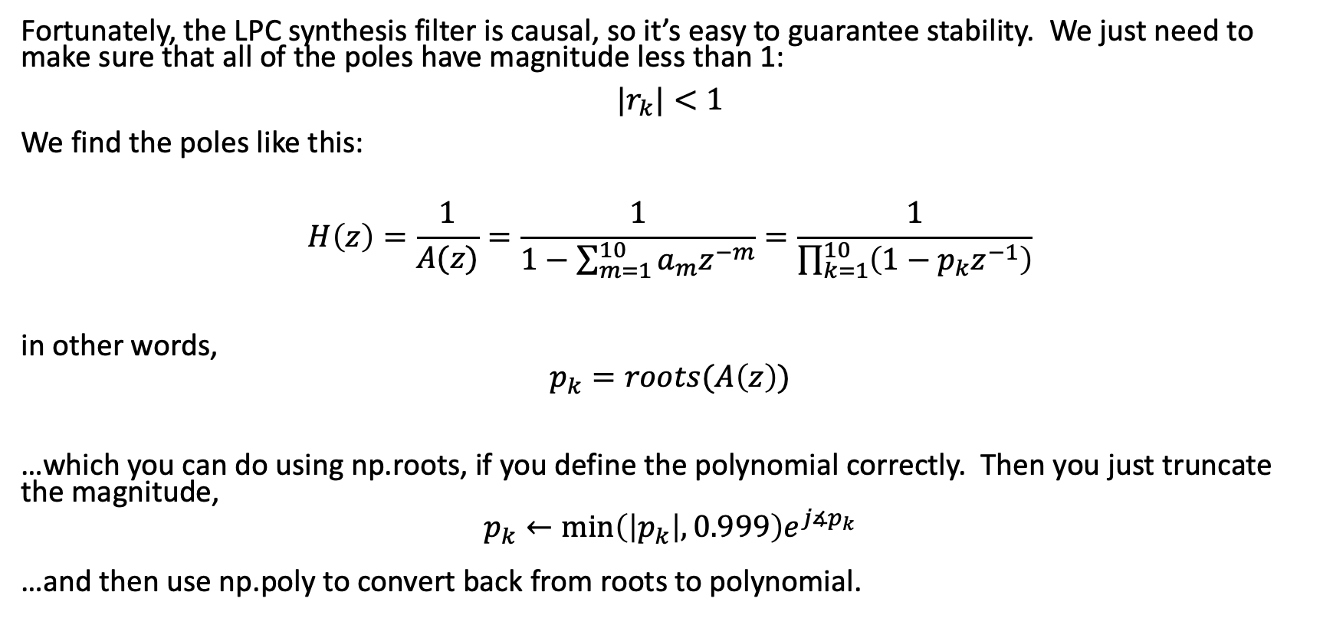
How to Guarantee Stability
Fortunately, the LPC synthesis filter is causal, so it’s easy to guarantee stability. We just need to make sure that all of the poles have magnitude less than 1:
$|r_{k}|<1$
We find the poles like this:
$$H\left(z\right)=\frac{1}{A(z)}=\frac{1}{1−\sum_{m=1}^{10}{a_{m}z^{−m}}}=\frac{1}{\prod_{k=1}^{10}{\left(1−p_{k}z^{−1}\right)}}$$
in other words,
$$p_{k}=roots(A\left(z\right))$$
…which you can do using np.roots, if you define the polynomial correctly. Then you just truncate the magnitude,
$$p_{k}←\min_{}\left(\left|p_{k}\right|,0.999\right)e^{j∡p_{k}}$$
…and then use np.poly to convert back from roots to polynomial.

Slide 25
Outline
The LPC-10 speech synthesis model
The LPC-10 excitation model: white noise, pulse train
Linear predictive coding: how to find the coefficients
Linear predictive coding: how to make sure the coefficients are stable
Autocorrelation-based pitch tracking
Inter-frame interpolation of pitch and energy contours

Slide 26
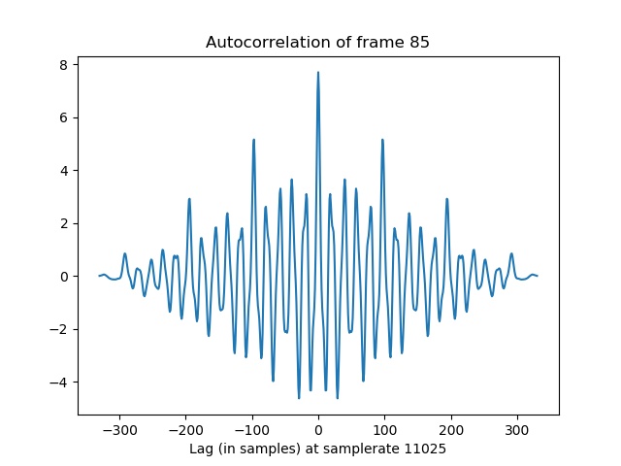
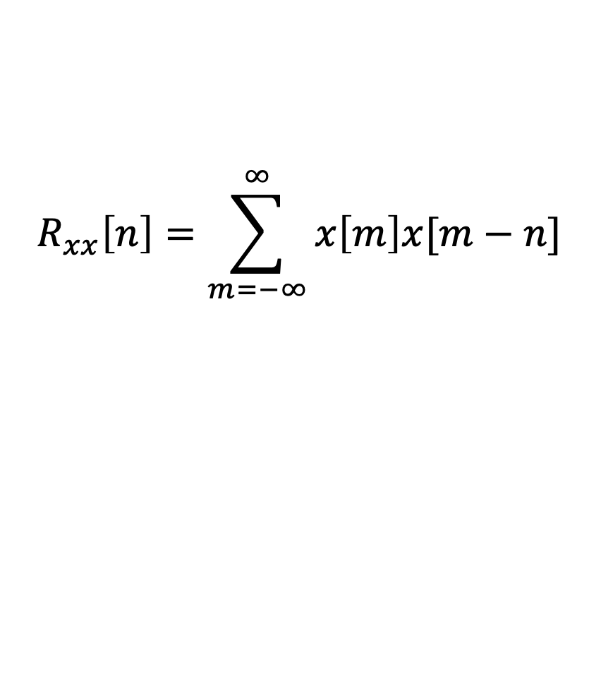
Autocorrelation is maximum at n=0
$$R_{xx}\left[n\right]=\sum_{m=−∞}^{∞}{x\left[m\right]x[m−n]}$$

Slide 27
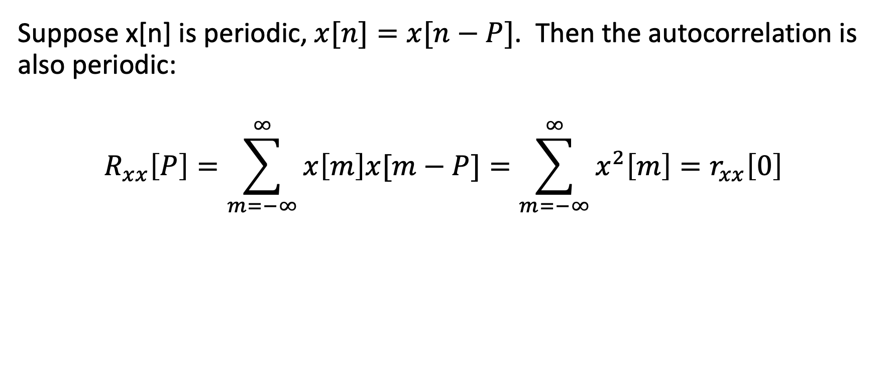
Autocorrelation of a periodic signal
Suppose x[n] is periodic, $x[n]=x[n−P]$. Then the autocorrelation is also periodic:
$$R_{xx}\left[P\right]=\sum_{m=−∞}^{∞}{x\left[m\right]x[m−P]}=\sum_{m=−∞}^{∞}{x^{2}\left[m\right]}=r_{xx}\left[0\right]$$

Slide 28
Autocorrelation of a periodic signal is periodic
Pitch period = 9ms = 99 samples
Pitch period = 9ms = 99 samples

Slide 29
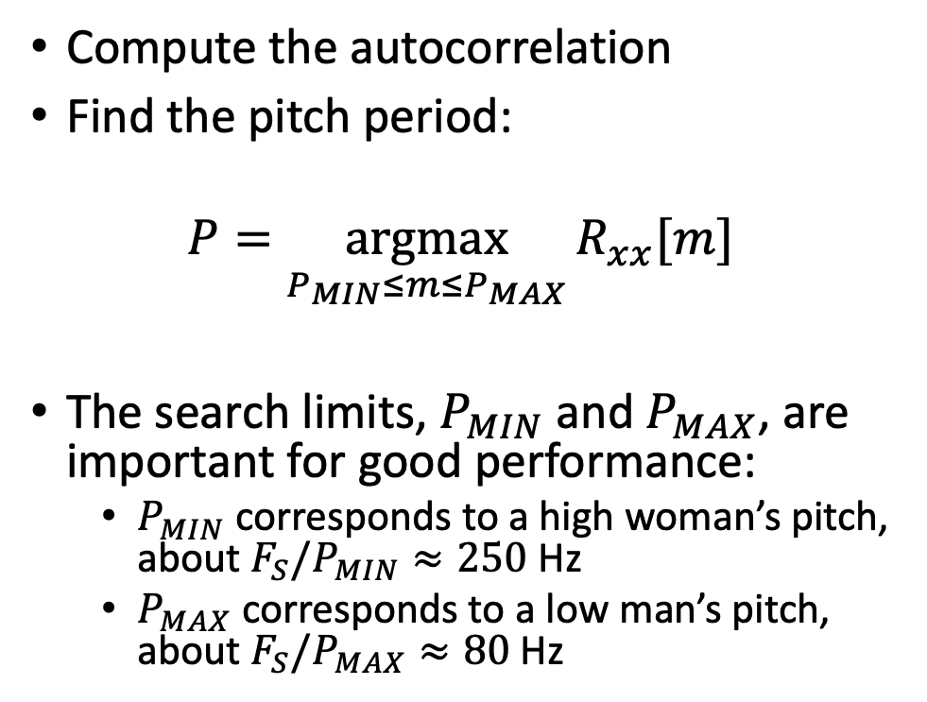


Autocorrelation pitch tracking
Compute the autocorrelation
Find the pitch period:
$$P=\underset{P_{MIN}≤m≤P_{MAX}}{argmax}{R_{xx}[m]}$$
The search limits, $P_{MIN}$and $P_{MAX}$, are important for good performance:
$P_{MIN}$ corresponds to a high woman’s pitch, about $F_{S}/P_{MIN}≈250$Hz
$P_{MAX}$ corresponds to a low man’s pitch, about $F_{S}/P_{MAX}≈80$Hz
$$P_{MIN}$$
$$P_{MAX}$$

Slide 30
The LPC-10 speech synthesis model
$$e\left[n\right]=\sum_{p=−∞}^{∞}{δ\left[n−pP\right]}$$
Voiced Speech,
pitch period P
G
$$G$$
$$H(e^{jω})$$
$$s[n]$$
$$e\left[n\right]\sim 𝒩\left(0,1\right)$$
Gain=
$$e^{logRMS}$$
Unvoiced Speech
Vocal Tract:
Modeled by
an LPC synthesis
Filter.
Binary Control
Switch:
Voiced (P>0) vs.
Unvoiced (P=0)

Slide 31
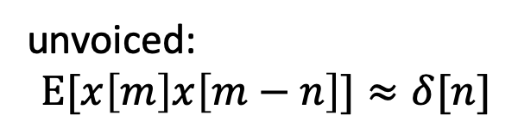
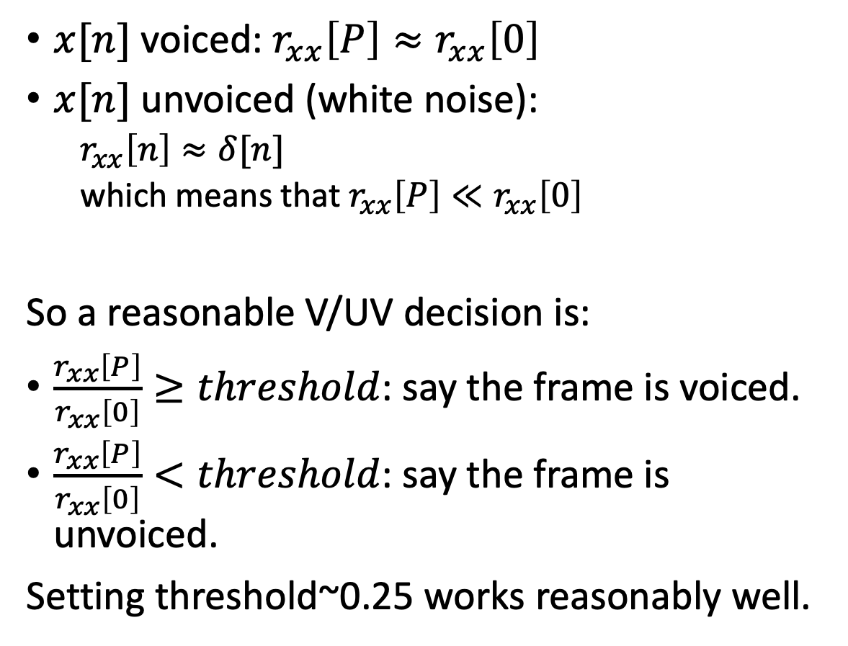
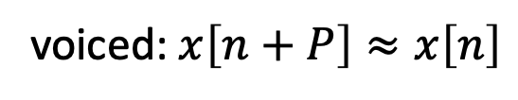
The voiced/unvoiced decision
voiced: $x\left[n+P\right]≈x\left[n\right]$
$x[n]$ voiced: $r_{xx}\left[P\right]≈r_{xx}\left[0\right]$
$x[n]$ unvoiced (white noise):
$r_{xx}\left[n\right]≈δ[n]$
which means that $r_{xx}\left[P\right]≪r_{xx}\left[0\right]$
So a reasonable V/UV decision is:
$\frac{r_{xx}\left[P\right]}{r_{xx}\left[0\right]}≥threshold$: say the frame is voiced.
$\frac{r_{xx}\left[P\right]}{r_{xx}\left[0\right]}<threshold$: say the frame is unvoiced.
Setting threshold~0.25 works reasonably well.
unvoiced:
$$E[x\left[m\right]x\left[m−n\right]]≈δ[n]$$

Slide 32
Outline
The LPC-10 speech synthesis model
The LPC-10 excitation model: white noise, pulse train
Linear predictive coding: how to find the coefficients
Linear predictive coding: how to make sure the coefficients are stable
Autocorrelation-based pitch tracking
Inter-frame interpolation of pitch and energy contours

Slide 33
Inter-frame interpolation of pitch contours
We don’t want the pitch period to change suddenly at frame boundaries; it sounds weird.
Pitch
Period
Frame Boundary
Frame Boundary
Frame Boundary
Frame Boundary
Sample Number, n

Slide 34
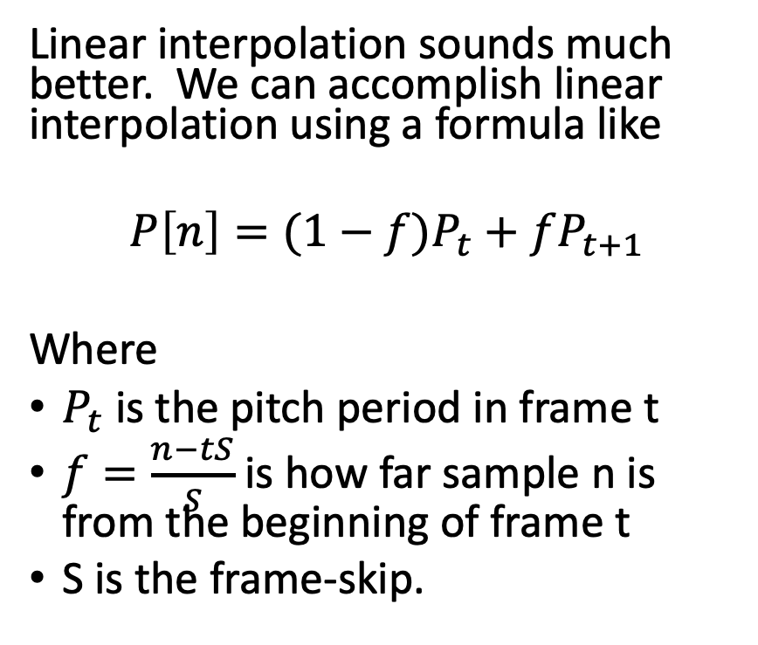
Inter-frame interpolation of pitch contours
Linear interpolation sounds much better. We can accomplish linear interpolation using a formula like
$$P\left[n\right]=(1−f)P_{t}+fP_{t+1}$$
Where
$P_{t}$ is the pitch period in frame t
$f=\frac{n−tS}{S}$ is how far sample n is from the beginning of frame t
S is the frame-skip.
Pitch
Period
Frame Boundary
Frame Boundary
Frame Boundary
Frame Boundary
Sample Number, n

Slide 35
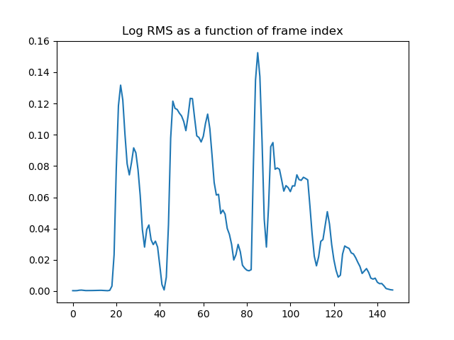
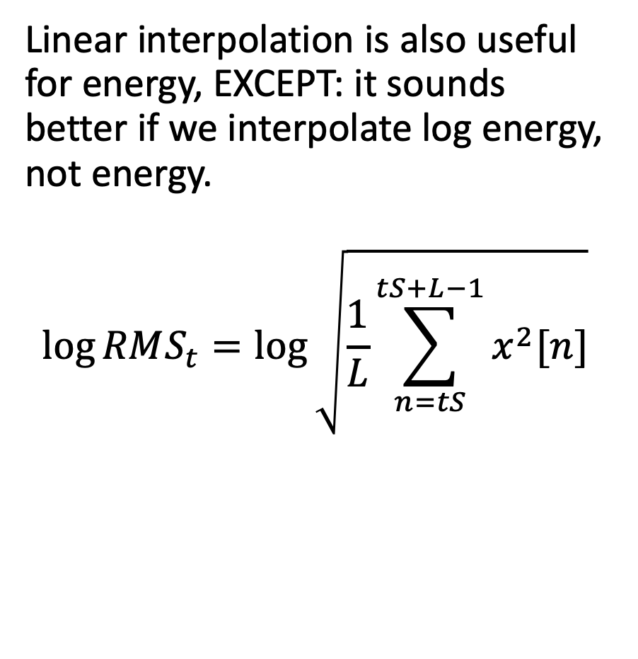
Inter-frame interpolation of energy
Linear interpolation is also useful for energy, EXCEPT: it sounds better if we interpolate log energy, not energy.
$$\log{RMS_{t}}=\log{\sqrt{\frac{1}{L}\sum_{n=tS}^{tS+L−1}{x^{2}[n]}}}$$

Slide 36
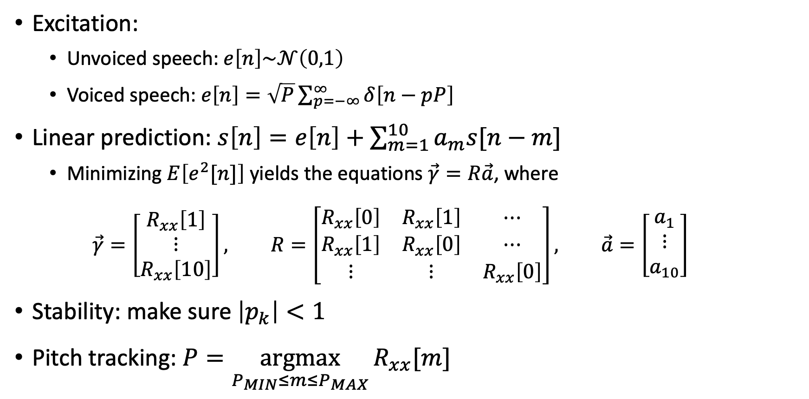
The LPC-10 Speech Synthesis Model
Excitation:
Unvoiced speech: $e\left[n\right]\sim 𝒩\left(0,1\right)$
Voiced speech: $e\left[n\right]=\sqrt{P}\sum_{p=−∞}^{∞}{δ\left[n−pP\right]}$
Linear prediction: $s\left[n\right]=e\left[n\right]+\sum_{m=1}^{10}{a_{m}s[n−m]}$
Minimizing $E\left[e^{2}[n]\right]$yields the equations $\vec{γ}=R\vec{a}$, where
$$\vec{γ}=\left[\begin{matrix}R_{xx}\left[1\right] \\ ⋮ \\ R_{xx}\left[10\right]\end{matrix}\right], R=\left[\begin{matrix}R_{xx}\left[0\right] & R_{xx}\left[1\right] & ⋯ \\ R_{xx}\left[1\right] & R_{xx}\left[0\right] & ⋯ \\ ⋮ & ⋮ & R_{xx}\left[0\right]\end{matrix}\right], \vec{a}=\left[\begin{matrix}a_{1} \\ ⋮ \\ a_{10}\end{matrix}\right]$$
Stability: make sure $\left|p_{k}\right|<1$
Pitch tracking: $P=\underset{P_{MIN}≤m≤P_{MAX}}{argmax}{R_{xx}[m]}$

