Slide 1
Lecture 14: ZCR, Autocorrelation and AMDF
ECE 537

Slide 2
Outline
Zero-crossing rate (ZCR)
Autocorrelation
Modified short-time autocorrelation
Average magnitude difference function (AMDF)
Example

Slide 3
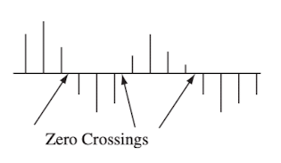
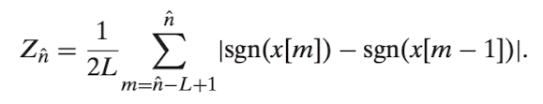
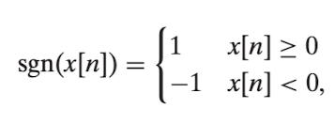
Zero-crossing rate

Slide 4
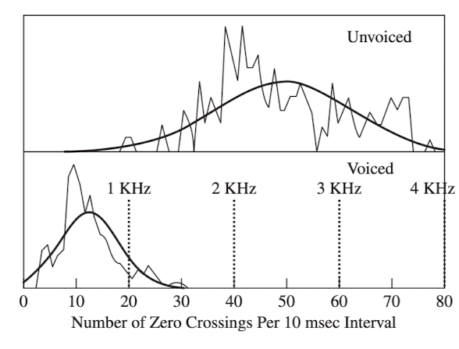
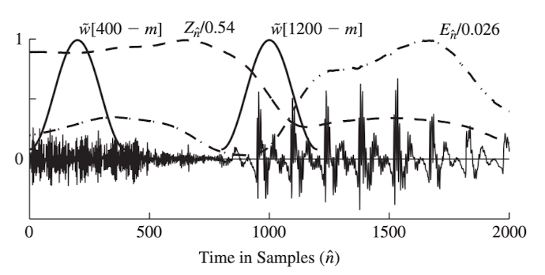
Zero-crossing rate

Slide 5
Outline
Zero-crossing rate (ZCR)
Autocorrelation
Modified short-time autocorrelation
Average magnitude difference function (AMDF)
Example

Slide 6
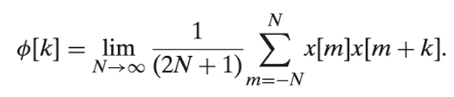
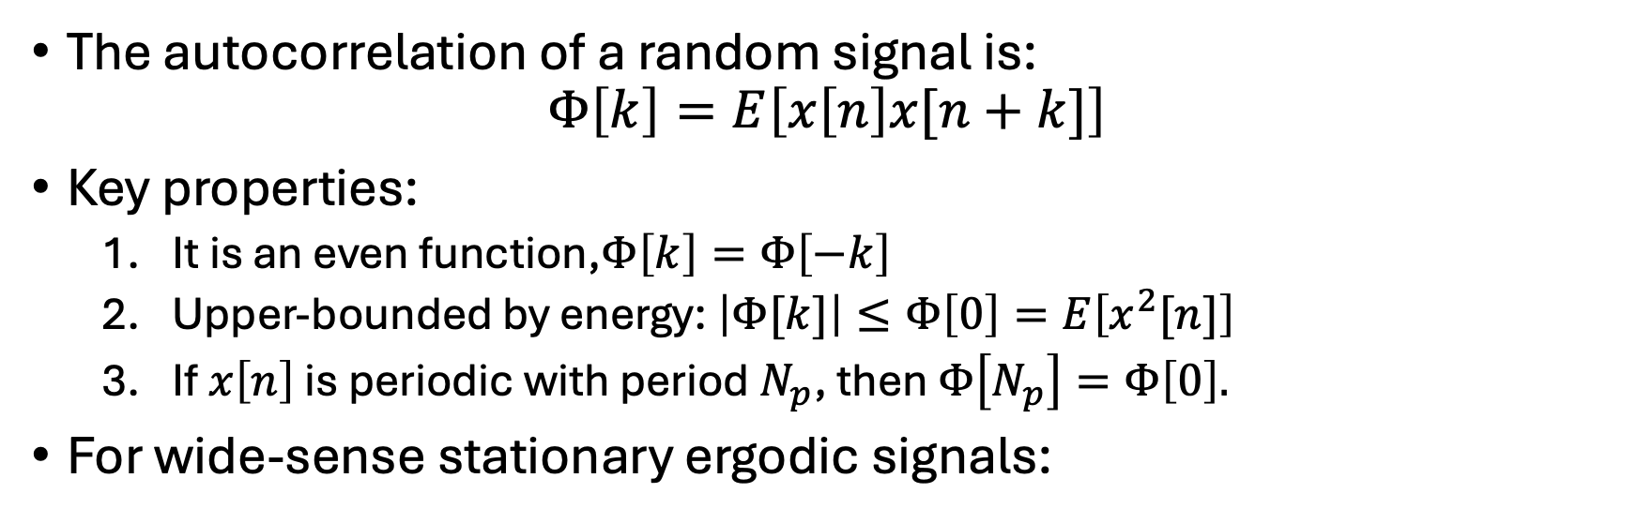
Autocorrelation
The autocorrelation of a random signal is:
$$Φ\left[k\right]=E\left[x\left[n\right]x[n+k]\right]$$
Key properties:
  It is an even function,$Φ\left[k\right]=Φ\left[−k\right]$
  Upper-bounded by energy: $\left|Φ[k]\right|≤Φ\left[0\right]=E\left[x^{2}[n]\right]$
  If $x\left[n\right]$ is periodic with period $N_{p}$, then $Φ\left[N_{p}\right]=Φ\left[0\right].$
For wide-sense stationary ergodic signals:

Slide 7
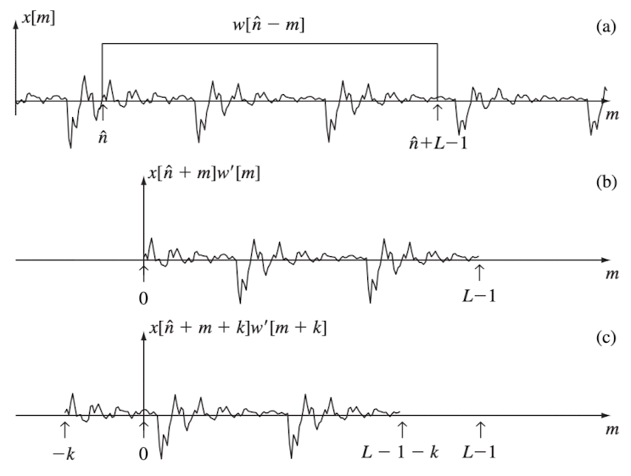

Short-time autocorrelation

Slide 8
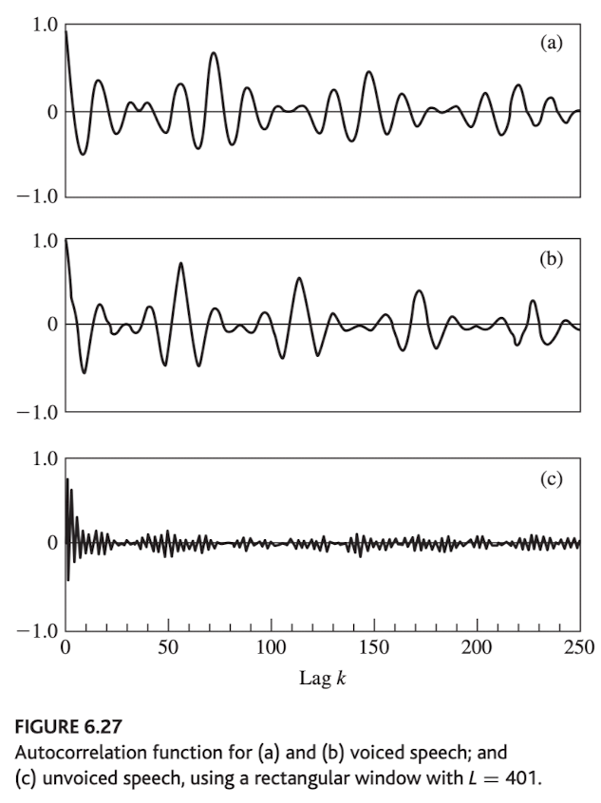
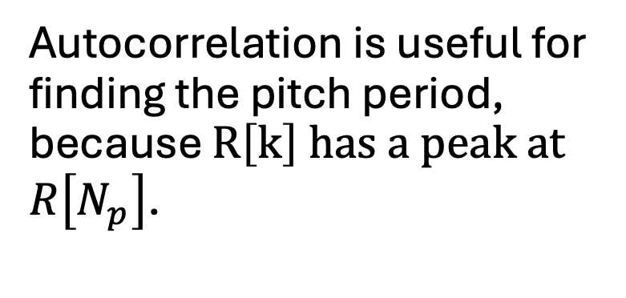
Short-time autocorrelation
Autocorrelation is useful for finding the pitch period, because $R\left[k\right]$ has a peak at $R\left[N_{p}\right]$.

Slide 9
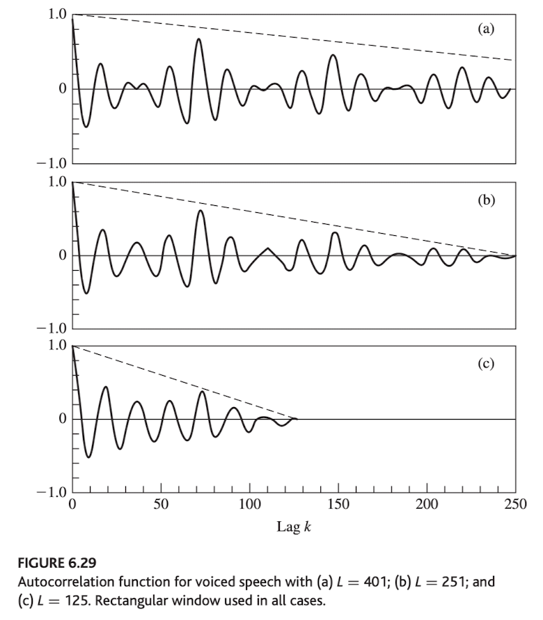
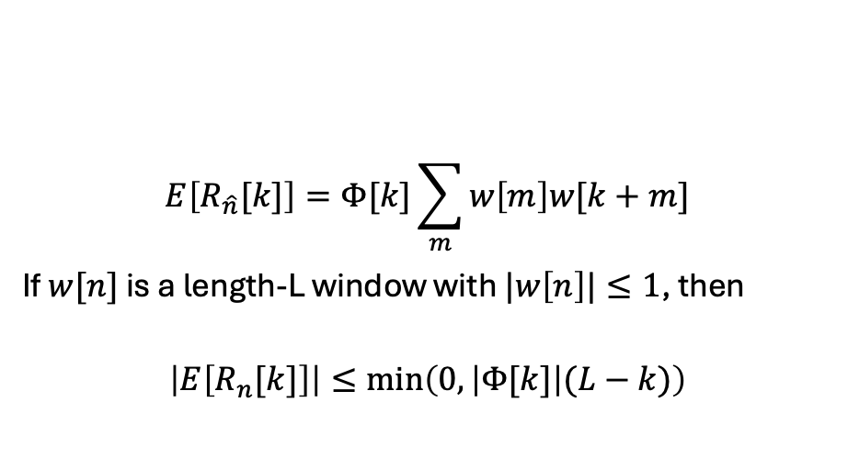
$$E\left[R_{\hat{n}}[k]\right]=Φ[k]\sum_{m}{w\left[m\right]w[k+m]}$$
If $w[n]$ is a length-L window with $|w\left[n\right]|≤1$, then
$$\left|E\left[R_{n}[k]\right]\right|≤\min\left(0,\left|Φ[k]\right|(L−k)\right)$$

Slide 10
Outline
Zero-crossing rate (ZCR)
Autocorrelation
Modified short-time autocorrelation
Average magnitude difference function (AMDF)
Example

Slide 11
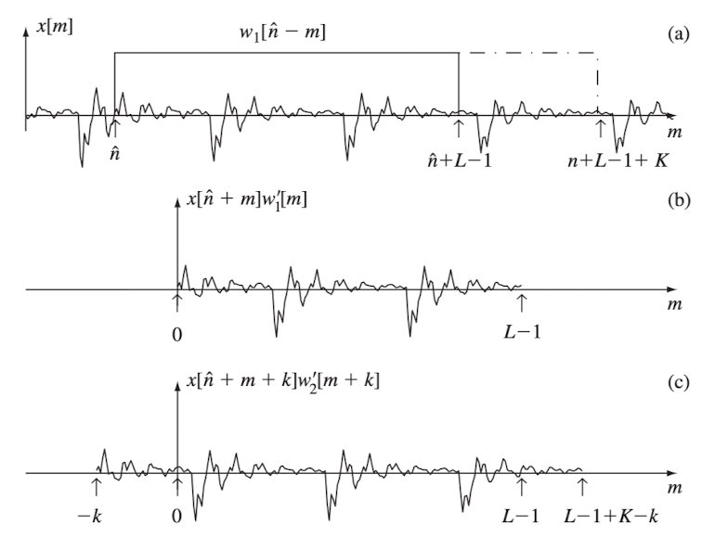

Modified short-time autocorrelation

Slide 12
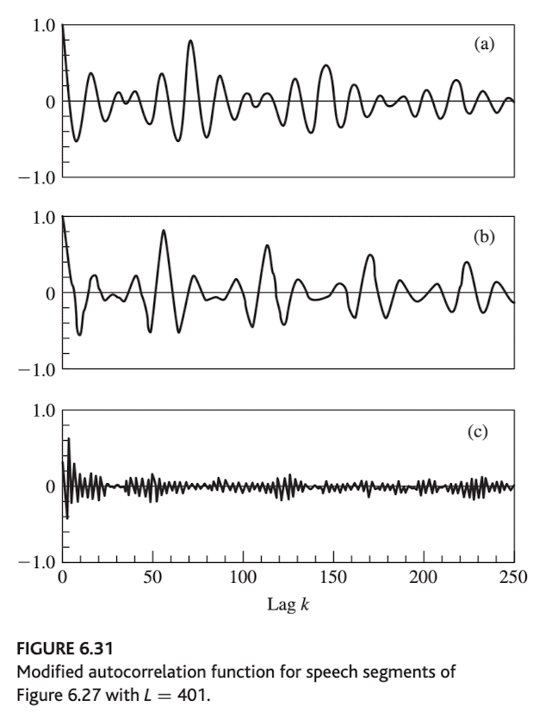
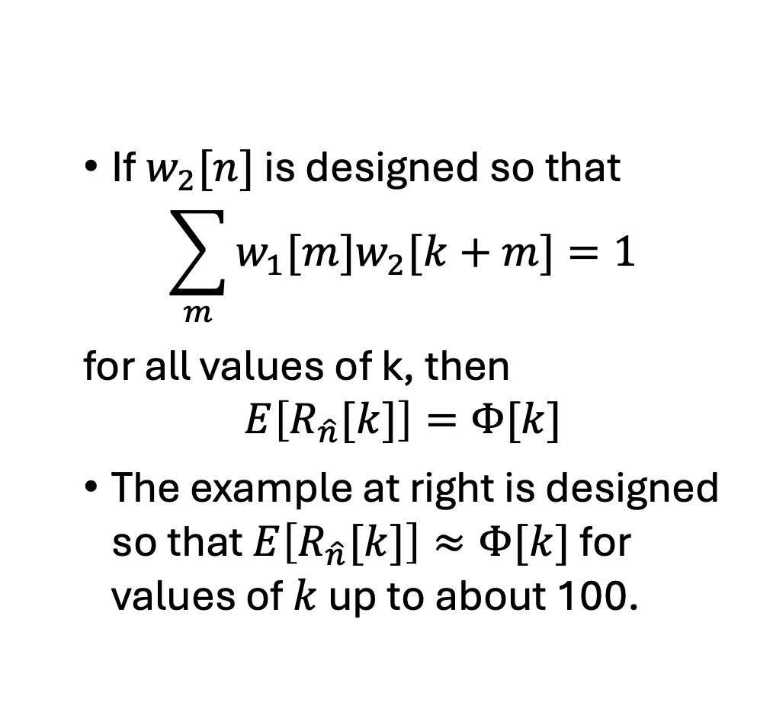
Modified short-time autocorrelation
If $w_{2}[n]$ is designed so that
$$\sum_{m}{w_{1}[m]w_{2}[k+m]}=1$$
for all values of k, then
$$E\left[R_{\hat{n}}[k]\right]=Φ[k]$$
The example at right is designed so that $E\left[R_{\hat{n}}[k]\right]≈Φ[k]$ for values of $k$ up to about 100.

Slide 13
Outline
Zero-crossing rate (ZCR)
Autocorrelation
Modified short-time autocorrelation
Average magnitude difference function (AMDF)
Example

Slide 14

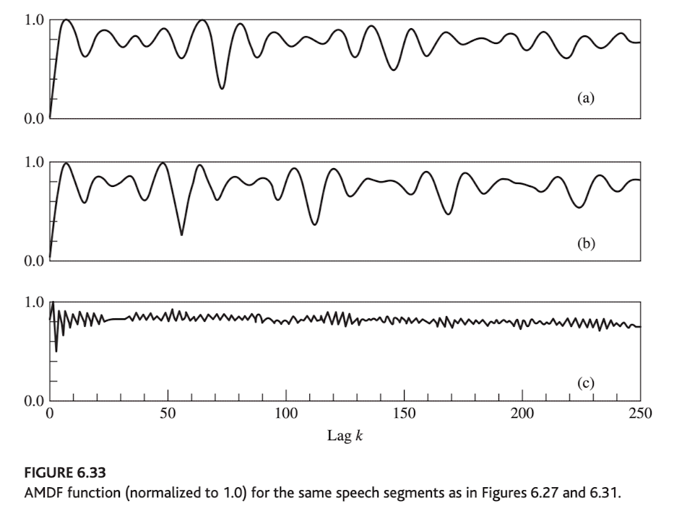
Average magnitude difference function (AMDF)
The AMDF is just the average (over a window) of the magnitude of the difference between samples.
Whereas the autocorrelation has a peak at the pitch period, the AMDF has a valley.

Slide 15

Average magnitude difference function (AMDF)
AMDF is useful for two reasons:
On some processors, subtracting is less computationally expensive than multiplying.
The AMDF is roughly the square root of energy minus autocorrelation. The square root operation “sharpens” the valley, making it possible to locate the pitch period more precisely.

Slide 16
Outline
Zero-crossing rate (ZCR)
Autocorrelation
Modified short-time autocorrelation
Average magnitude difference function (AMDF)
Example

Slide 17
Example
Suppose x[n] is a random signal composed of two sinusoids with random phase, one at 400Hz, one at 500Hz. Find the autocorrelation.
Show that the expected value of the short-time autocorrelation is proportional to the autocorrelation.

