Slide 1
ECE 417 Lecture 8: Gaussians
Mark Hasegawa-Johnson
9/21/2021
CC-BY 4.0: You may remix or redistribute if you cite the source.

Slide 2
Contents
Gaussian pdf; Central limit theorem, Brownian motion
White Noise
Vector of i.i.d. Gaussians
Vector of Gaussians that are independent but not identical
Facts about linear algebra
Vector of Gaussians that are neither independent nor identical

Slide 3
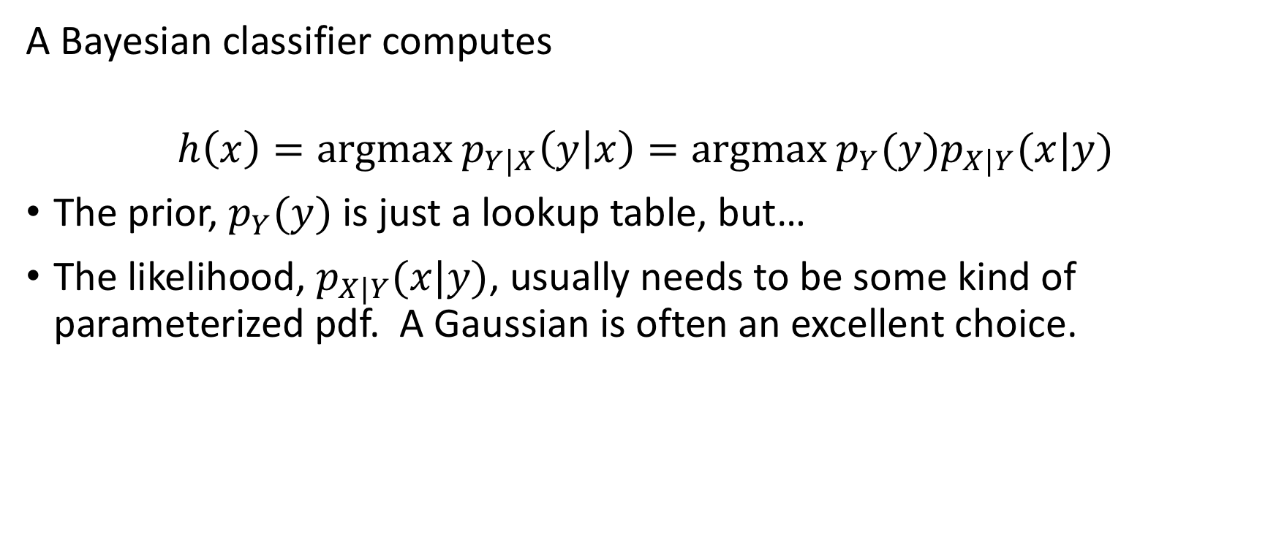
Review: Bayesian Classifier
A Bayesian classifier computes
$$h\left(x\right)=argmax p_{Y|X}\left(y | x\right)=argmax p_{Y}(y)p_{X|Y}(x|y)$$
The prior, $p_{Y}(y)$is just a lookup table, but…
The likelihood, $p_{X|Y}(x|y)$, usually needs to be some kind of parameterized pdf. A Gaussian is often an excellent choice.

Slide 4
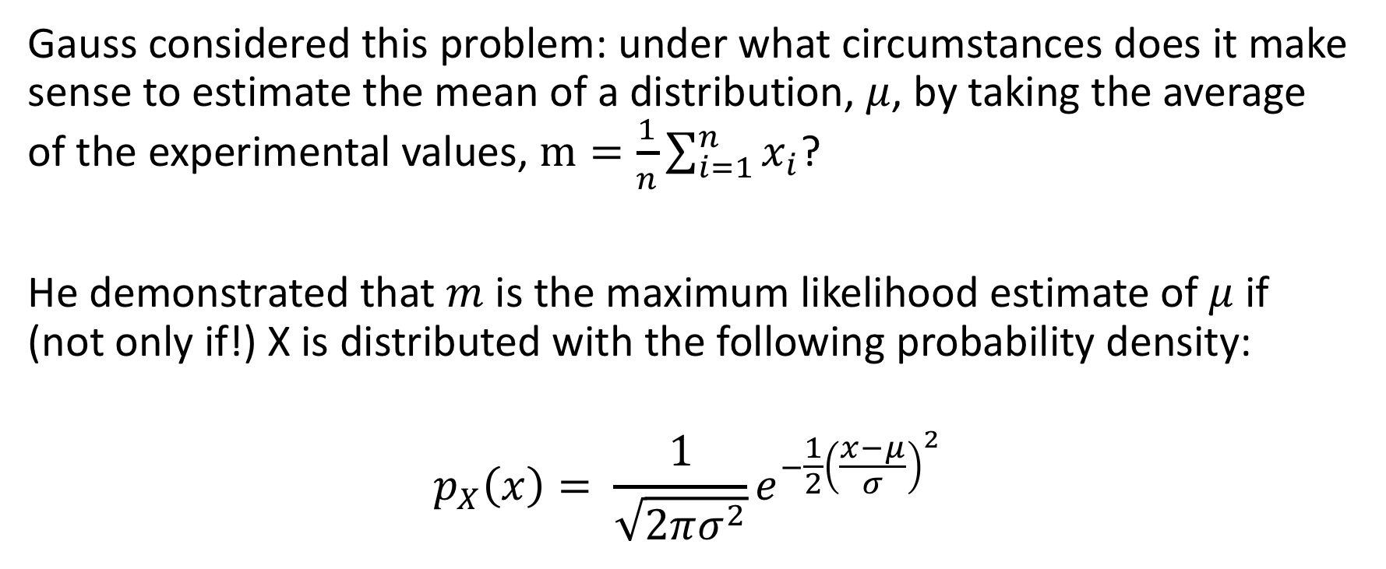
Gaussian (Normal) pdf
Gauss considered this problem: under what circumstances does it make sense to estimate the mean of a distribution, $μ$, by taking the average of the experimental values, $m=\frac{1}{n}\sum_{i=1}^{n}{x_{i}}$?
He demonstrated that $m$ is the maximum likelihood estimate of $μ$ if (not only if!) X is distributed with the following probability density:
$$p_{X}\left(x\right)= \frac{1}{\sqrt{2πσ^{2}}}e^{−\frac{1}{2}{\left(\frac{x−μ}{σ}\right)}^{2}}$$

Slide 5
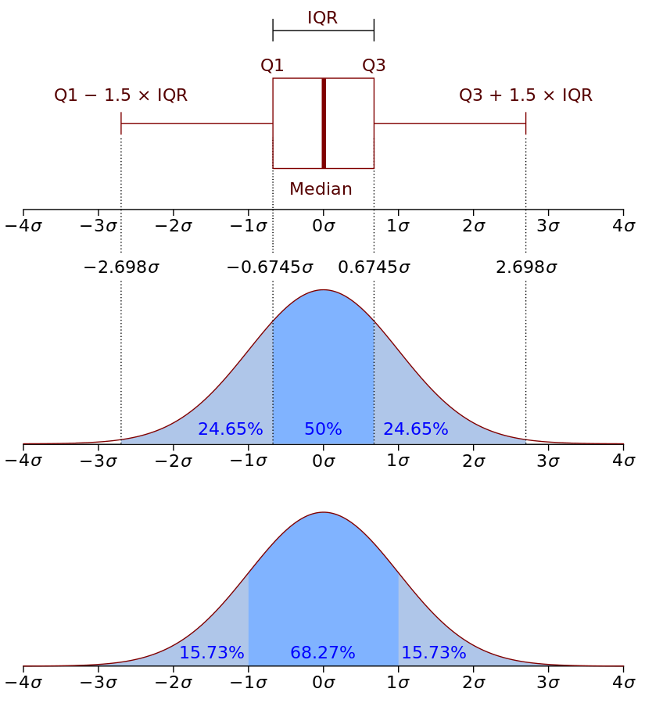
Gaussian pdf
Attribution: jhguch, https://commons.wikimedia.org/wiki/File:Boxplot_vs_PDF.svg

Slide 6
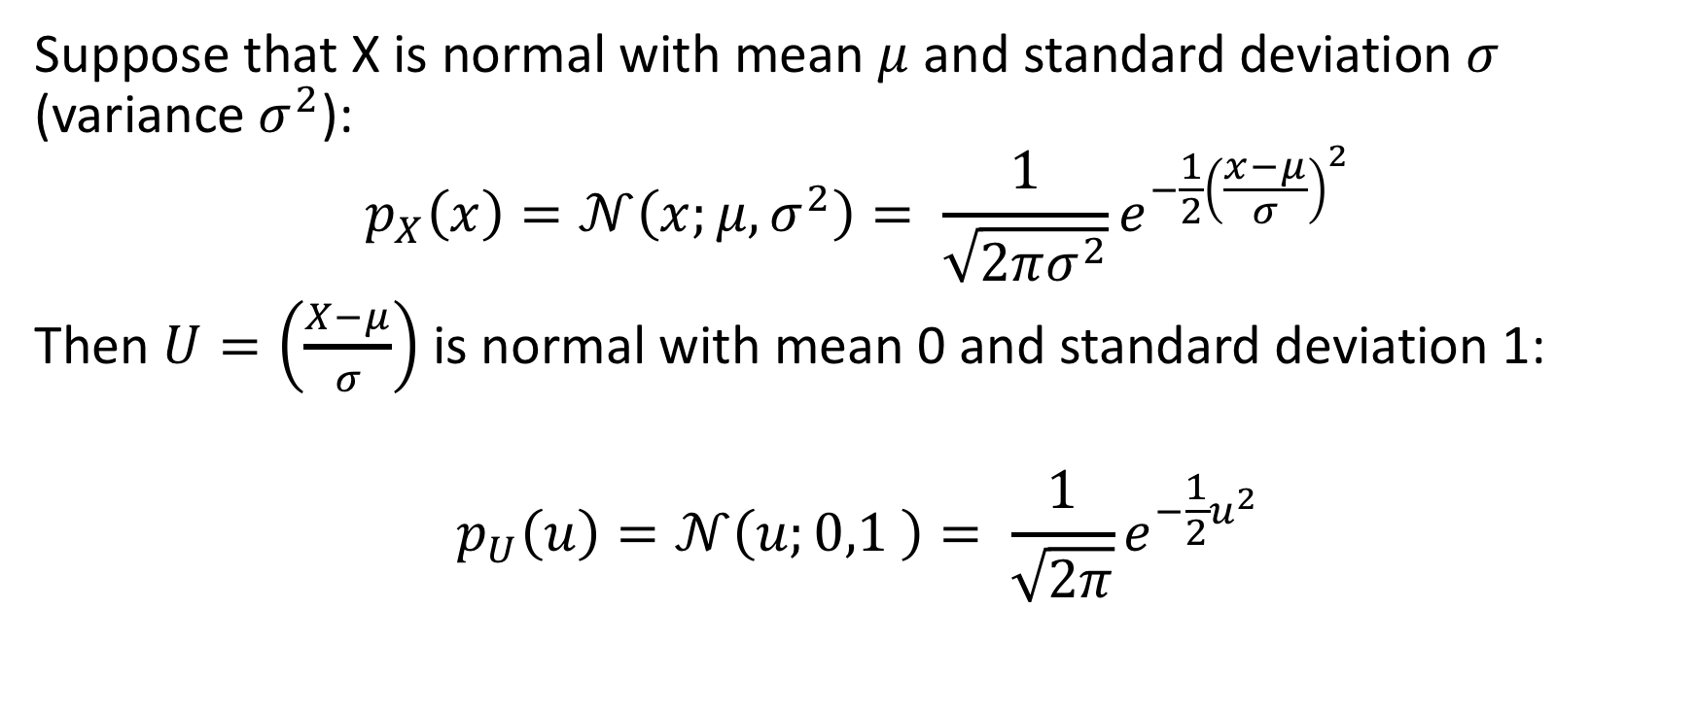
Unit Normal pdf
Suppose that X is normal with mean $μ$ and standard deviation $σ$ (variance $σ^{2}$):
$$p_{X}\left(x\right)=𝒩\left(x;μ,σ^{2}\right)= \frac{1}{\sqrt{2πσ^{2}}}e^{−\frac{1}{2}{\left(\frac{x−μ}{σ}\right)}^{2}}$$
Then $U=\left(\frac{X−μ}{σ}\right)$ is normal with mean 0 and standard deviation 1:
$$p_{U}\left(u\right)=𝒩\left(u;0,1 \right)= \frac{1}{\sqrt{2π}}e^{−\frac{1}{2}u^{2}}$$

Slide 7
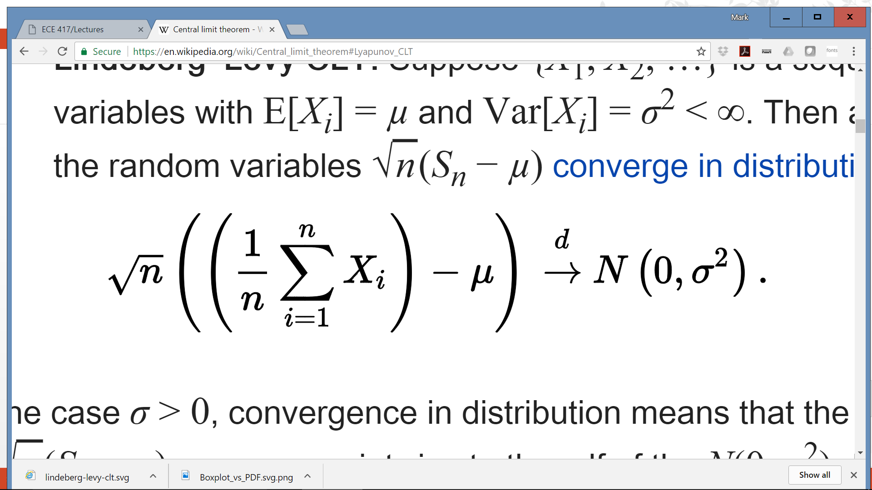

Central Limit Theorem
The Gaussian pdf is important because of the Central Limit Theorem. Suppose $X_{i}$ are i.i.d. (independent and identically distributed), each having mean $μ$ and variance $σ^{2}$. Then

Slide 8
Brownian motion
The Central Limit Theorem matters because Einstein showed that the movement of molecules, in a liquid or gas, is the sum of n i.i.d. molecular collisions.
In other words, the position after t seconds is Gaussian, with mean 0, and with a variance of Dt, where D is some constant.
Attribution: lookang, https://commons.wikimedia.org/wiki/File:Brownianmotion5particles150frame.gif

Slide 9
Contents
Gaussian pdf; Central limit theorem, Brownian motion
White Noise
Vector of i.i.d. Gaussians
Vector of Gaussians that are independent but not identical
Facts about linear algebra
Vector of Gaussians that are neither independent nor identical

Slide 10
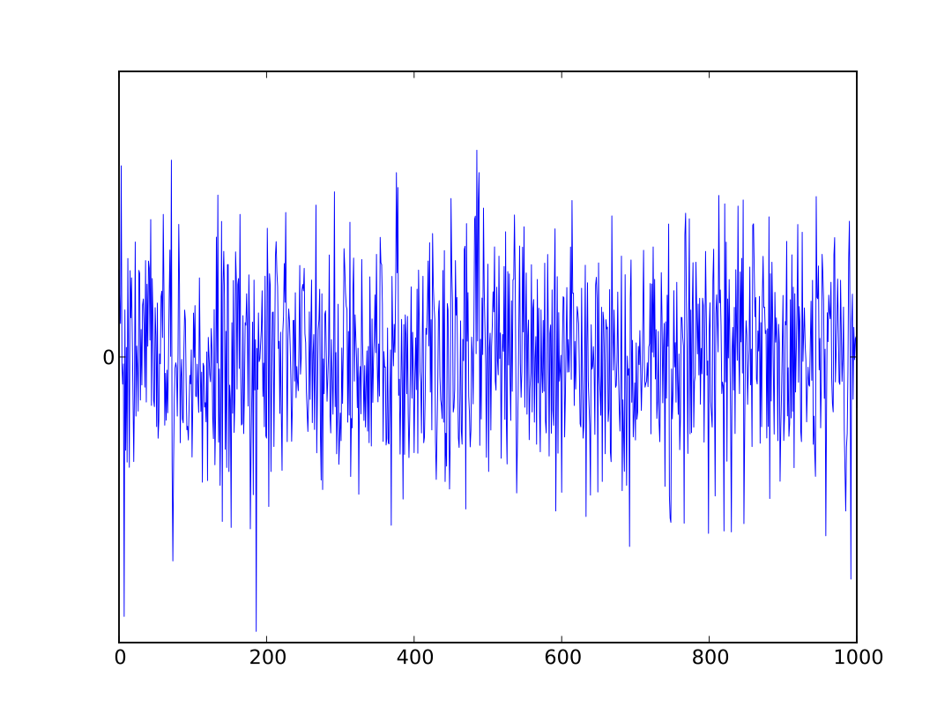
Gaussian Noise
Sound = air pressure fluctuations caused by velocity of air molecules
Velocity of warm air molecules without any external sound source = Gaussian
Therefore:
Sound produced by warm air molecules without any external sound source = Gaussian noise
Electrical signals: same.
Attribution Morn, https://commons.wikimedia.org/wiki/File:White_noise.svg

Slide 11
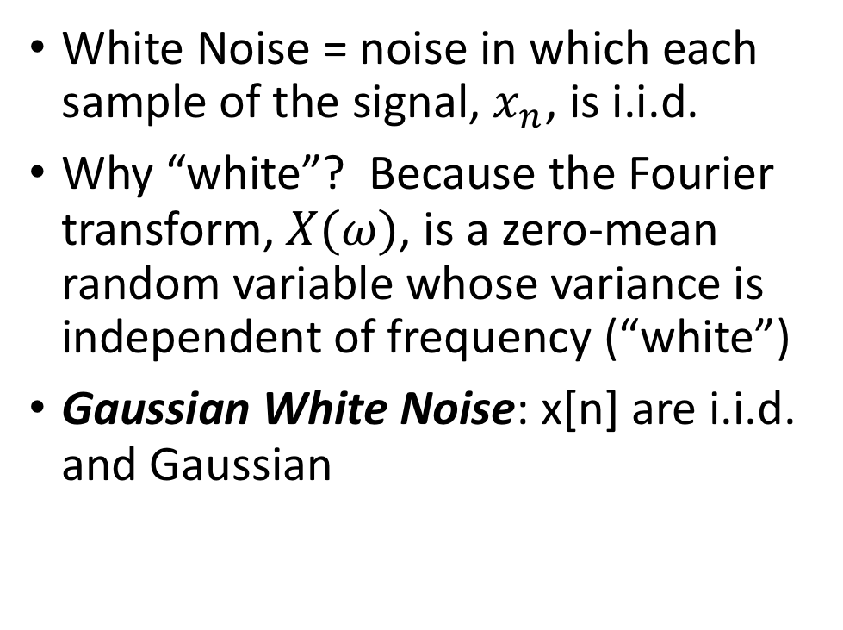
White Noise
White Noise = noise in which each sample of the signal, $x_{n}$, is i.i.d.
Why “white”? Because the Fourier transform, $X(ω)$, is a zero-mean random variable whose variance is independent of frequency (“white”)
Gaussian White Noise: x[n] are i.i.d. and Gaussian
Attribution Morn, https://commons.wikimedia.org/wiki/File:White_noise.svg

Slide 12
Contents
Gaussian pdf; Central limit theorem, Brownian motion
White Noise
Vector of i.i.d. Gaussians
Vector of Gaussians that are independent but not identical
Facts about linear algebra
Vector of Gaussians that are neither independent nor identical

Slide 13
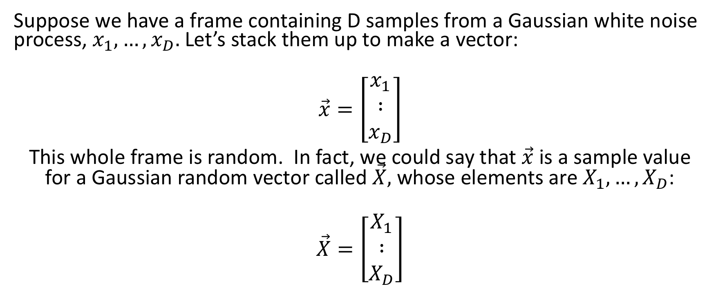
Vector of Independent Gaussian Variables
Suppose we have a frame containing D samples from a Gaussian white noise process, $x_{1},…,x_{D}.$Let’s stack them up to make a vector:
$$\vec{x}=\left[\begin{matrix}x_{1} \\ ∶ \\ x_{D}\end{matrix}\right]$$
This whole frame is random. In fact, we could say that $\vec{x}$ is a sample value for a Gaussian random vector called $\vec{X},$ whose elements are $X_{1},…,X_{D}$:
$$\vec{X}=\left[\begin{matrix}X_{1} \\ ∶ \\ X_{D}\end{matrix}\right]$$

Slide 14
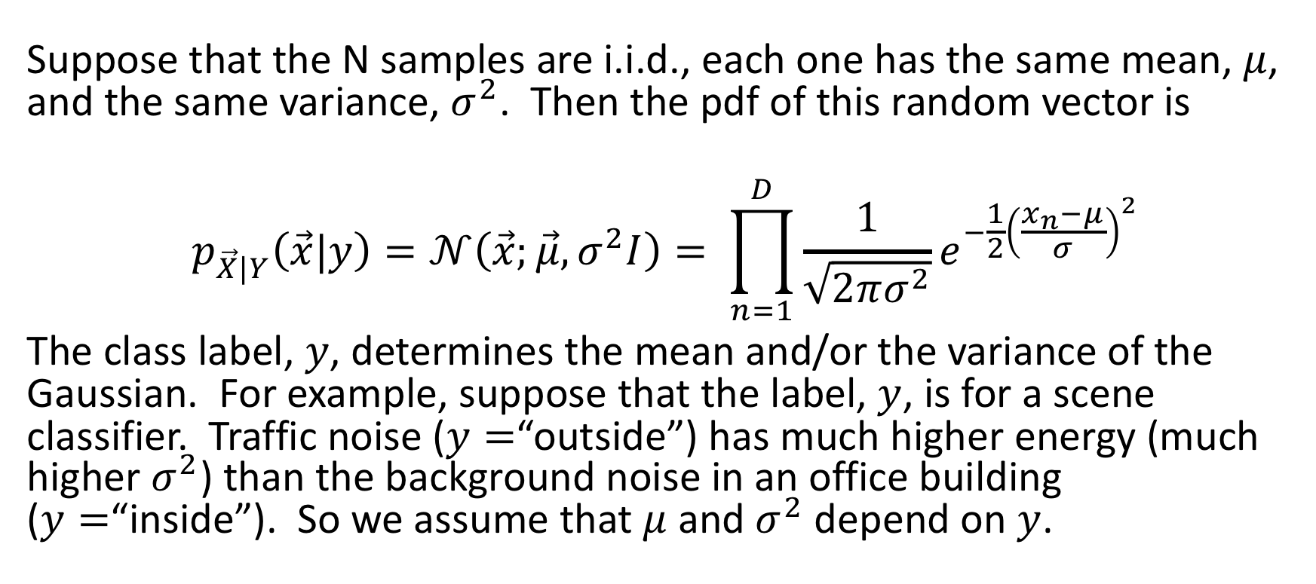
Vector of Independent Gaussian Variables
Suppose that the N samples are i.i.d., each one has the same mean, $μ$, and the same variance, $σ^{2}$. Then the pdf of this random vector is
$$p_{\vec{X}|Y}\left(\vec{x}|y\right)=𝒩\left(\vec{x};\vec{μ},σ^{2}I\right)= \prod_{n=1}^{D}{\frac{1}{\sqrt{2πσ^{2}}}e^{−\frac{1}{2}{\left(\frac{x_{n}−μ}{σ}\right)}^{2}}}$$
The class label, $y$, determines the mean and/or the variance of the Gaussian. For example, suppose that the label, $y$, is for a scene classifier. Traffic noise ($y=$“outside”) has much higher energy (much higher $σ^{2}$) than the background noise in an office building ($y=$“inside”). So we assume that $μ$ and $σ^{2}$ depend on $y$.

Slide 15
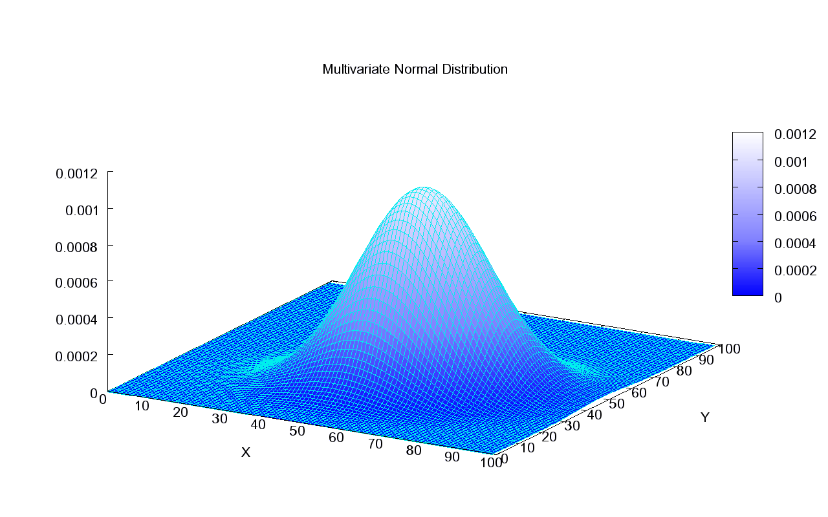
Vector of Independent Gaussian Variables
For example, here’s an example from Wikipedia with mean of 50 and standard deviation of about 12.
Attribution: Piotrg, https://commons.wikimedia.org/wiki/File:Multivariate_Gaussian.png

Slide 16
Contents
Gaussian pdf; Central limit theorem, Brownian motion
White Noise
Vector of i.i.d. Gaussians
Vector of Gaussians that are independent but not identical
Facts about linear algebra
Vector of Gaussians that are neither independent nor identical

Slide 17
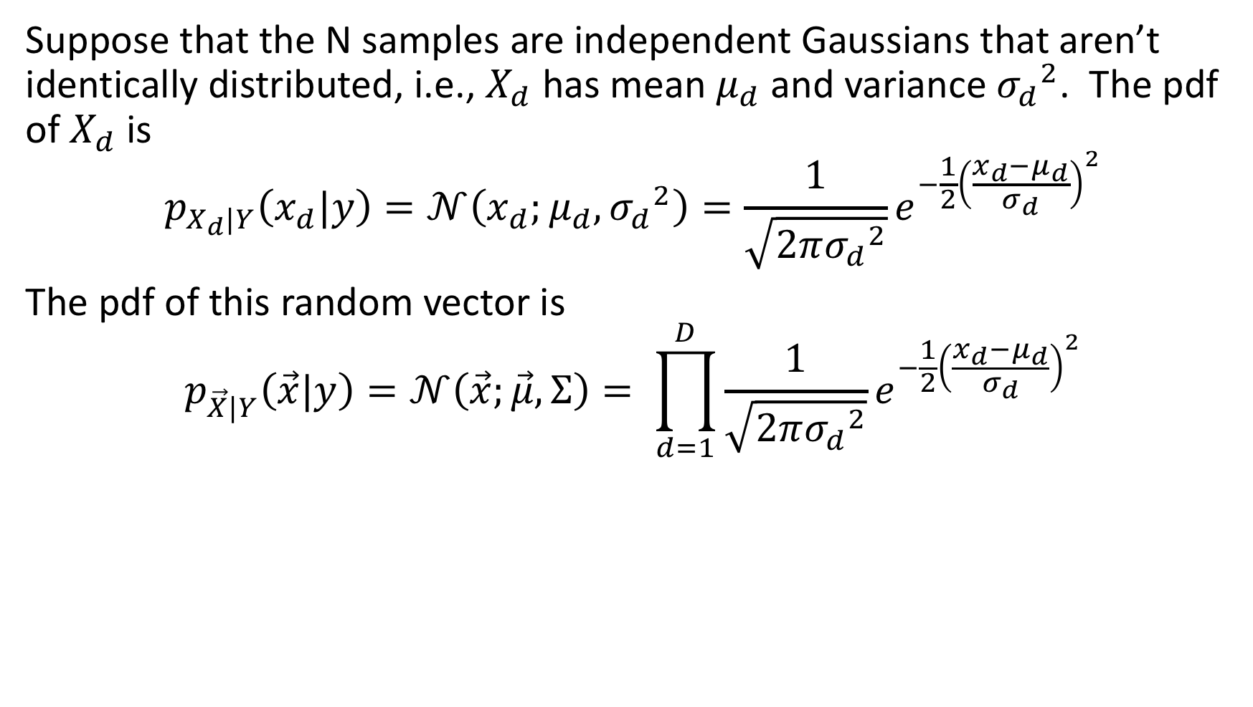
Independent Gaussians that aren’t identically distributed
Suppose that the N samples are independent Gaussians that aren’t identically distributed, i.e., $X_{d}$ has mean $μ_{d}$ and variance ${σ_{d}}^{2}$. The pdf of $X_{d}$ is
$$p_{X_{d}|Y}\left(x_{d}|y\right)=𝒩\left(x_{d};μ_{d},{σ_{d}}^{2}\right)=\frac{1}{\sqrt{2π{σ_{d}}^{2}}}e^{−\frac{1}{2}{\left(\frac{x_{d}−μ_{d}}{σ_{d}}\right)}^{2}}$$
The pdf of this random vector is
$$p_{\vec{X}|Y}\left(\vec{x}|y\right)=𝒩\left(\vec{x};\vec{μ},Σ\right)= \prod_{d=1}^{D}{\frac{1}{\sqrt{2π{σ_{d}}^{2}}}e^{−\frac{1}{2}{\left(\frac{x_{d}−μ_{d}}{σ_{d}}\right)}^{2}}}$$

Slide 18

Independent Gaussians that aren’t identically distributed
Another useful form is:
$$\prod_{d=1}^{D}{\frac{1}{\sqrt{2π{σ_{d}}^{2}}}e^{−\frac{1}{2}{\left(\frac{x_{d}−μ_{d}}{σ_{d}}\right)}^{2}}}=\frac{1}{{\left(2π\right)}^{D/2}\prod_{d=1}^{D}{σ_{d}}}e^{−\frac{1}{2}{\sum_{d=1}^{D}{\left(\frac{x_{d}−μ_{d}}{σ_{d}}\right)}}^{2}}$$

Slide 19
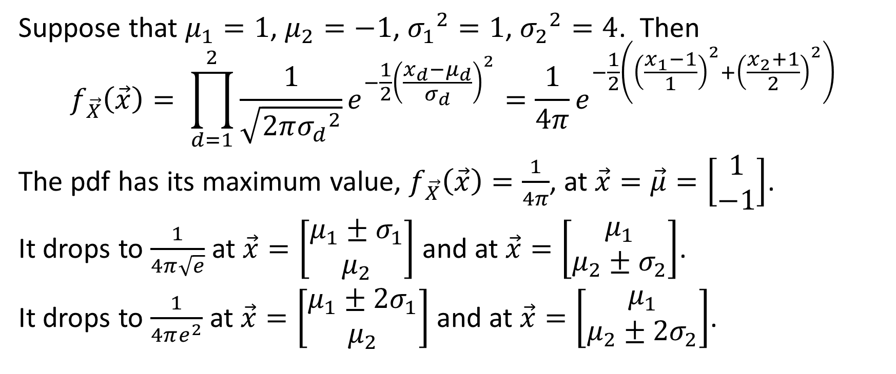
Example
Suppose that $μ_{1}=1$, $μ_{2}=−1$, ${σ_{1}}^{2}=1$, ${σ_{2}}^{2}=4$. Then
$$f_{\vec{X}}\left(\vec{x}\right)= \prod_{d=1}^{2}{\frac{1}{\sqrt{2π{σ_{d}}^{2}}}e^{−\frac{1}{2}{\left(\frac{x_{d}−μ_{d}}{σ_{d}}\right)}^{2}}=\frac{1}{4π}e^{−\frac{1}{2}\left({\left(\frac{x_{1}−1}{1}\right)}^{2}+{\left(\frac{x_{2}+1}{2}\right)}^{2}\right)}}$$
The pdf has its maximum value, $f_{\vec{X}}\left(\vec{x}\right)=\frac{1}{4π}$, at $\vec{x}=\vec{μ}=\left[\begin{matrix}1 \\ −1\end{matrix}\right]$.
It drops to $\frac{1}{4π\sqrt{e}}$ at $\vec{x}=\left[\begin{matrix}μ_{1}±σ_{1} \\ μ_{2}\end{matrix}\right]$ and at $\vec{x}=\left[\begin{matrix}μ_{1} \\ μ_{2}±σ_{2}\end{matrix}\right]$.
It drops to $\frac{1}{4πe^{2}}$ at $\vec{x}=\left[\begin{matrix}μ_{1}±{2σ}_{1} \\ μ_{2}\end{matrix}\right]$ and at $\vec{x}=\left[\begin{matrix}μ_{1} \\ μ_{2}±{2σ}_{2}\end{matrix}\right]$.

Slide 20
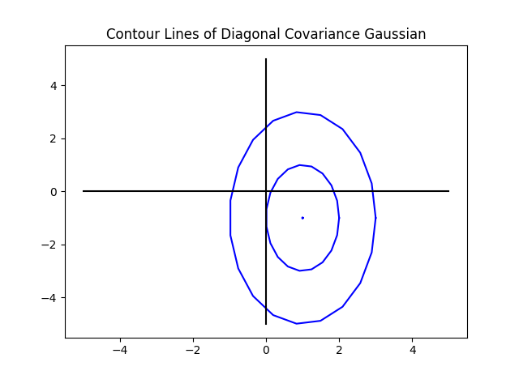
Example

Slide 21
Contents
Gaussian pdf; Central limit theorem, Brownian motion
White Noise
Vector of i.i.d. Gaussians
Vector of Gaussians that are independent but not identical
Facts about linear algebra
Vector of Gaussians that are neither independent nor identical

Slide 22
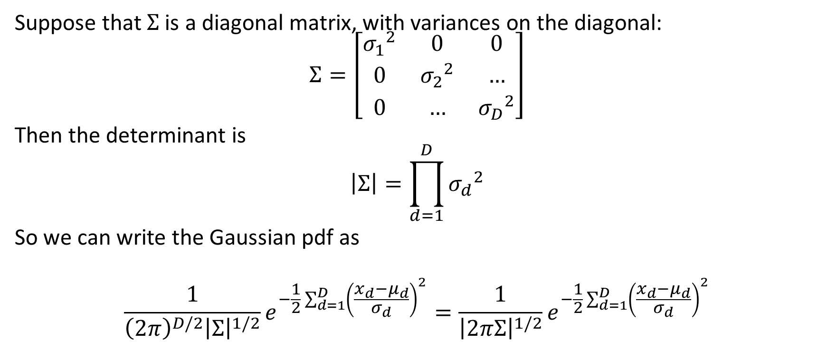
Facts about linear algebra #1: determinant of a diagonal matrix
Suppose that $Σ$ is a diagonal matrix, with variances on the diagonal:
$$Σ=\left[\begin{matrix}{σ_{1}}^{2} & 0 & 0 \\ 0 & {σ_{2}}^{2} & … \\ 0 & … & {σ_{D}}^{2}\end{matrix}\right]$$
Then the determinant is
$$\left|Σ\right|=\prod_{d=1}^{D}{{σ_{d}}^{2}}$$
So we can write the Gaussian pdf as
$$\frac{1}{{\left(2π\right)}^{D/2}{\left|Σ\right|}^{1/2}}e^{−\frac{1}{2}{\sum_{d=1}^{D}{\left(\frac{x_{d}−μ_{d}}{σ_{d}}\right)}}^{2}}=\frac{1}{{\left|2πΣ\right|}^{1/2}}e^{−\frac{1}{2}{\sum_{d=1}^{D}{\left(\frac{x_{d}−μ_{d}}{σ_{d}}\right)}}^{2}}$$

Slide 23

Facts about linear algebra #2: inner product
Suppose that
$\vec{x}=\left[\begin{matrix}x_{1} \\ ∶ \\ x_{D}\end{matrix}\right]$ and $\vec{μ}=\left[\begin{matrix}μ_{1} \\ ∶ \\ μ_{D}\end{matrix}\right]$
Then
$${ \left(\vec{x}−\vec{μ}\right)}^{T}\left(\vec{x}−\vec{μ}\right)={\left(x_{1}−μ_{1}\right)}^{2}+…+{\left(x_{D}−μ_{D}\right)}^{2}$$

Slide 24
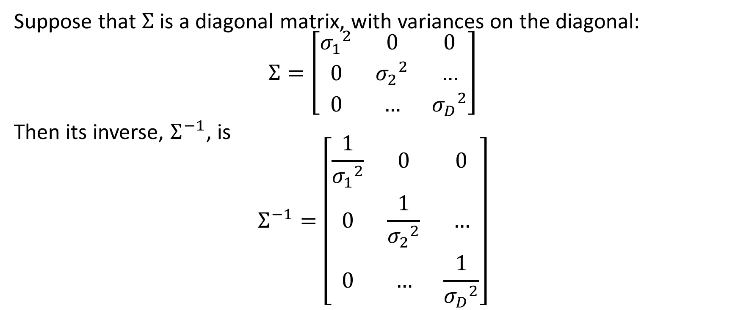
Facts about linear algebra #3: inverse of a diagonal matrix
Suppose that $Σ$ is a diagonal matrix, with variances on the diagonal:
$$Σ=\left[\begin{matrix}{σ_{1}}^{2} & 0 & 0 \\ 0 & {σ_{2}}^{2} & … \\ 0 & … & {σ_{D}}^{2}\end{matrix}\right]$$
Then its inverse, $Σ^{−1}$, is
$$Σ^{−1}=\left[\begin{matrix}\frac{1}{{σ_{1}}^{2}} & 0 & 0 \\ 0 & \frac{1}{{σ_{2}}^{2}} & … \\ 0 & … & \frac{1}{{σ_{D}}^{2}}\end{matrix}\right]$$

Slide 25
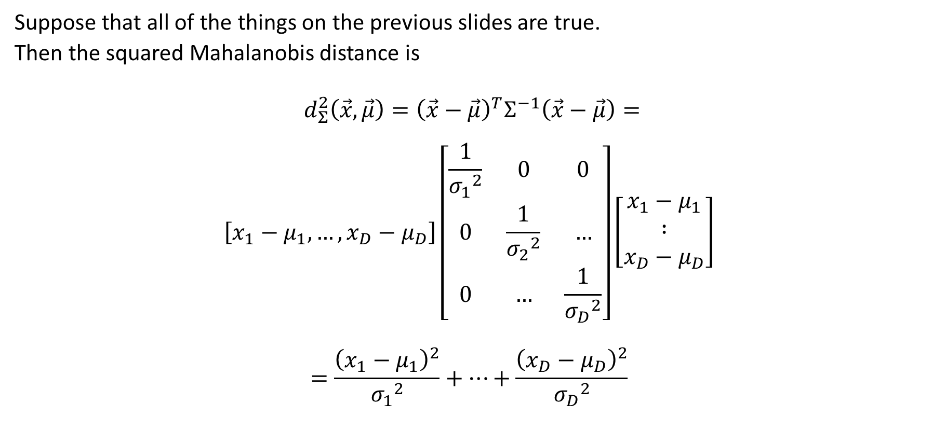
Facts about linear algebra #4: squared Mahalanobis distance with a diagonal covariance matrix
Suppose that all of the things on the previous slides are true.
Then the squared Mahalanobis distance is
$${ d_{Σ}^{2}\left(\vec{x},\vec{μ}\right)=\left(\vec{x}−\vec{μ}\right)}^{T}Σ^{−1}\left(\vec{x}−\vec{μ}\right)=$$
$$\left[x_{1}−μ_{1}, …,{x_{D}−μ}_{D}\right]\left[\begin{matrix}\frac{1}{{σ_{1}}^{2}} & 0 & 0 \\ 0 & \frac{1}{{σ_{2}}^{2}} & … \\ 0 & … & \frac{1}{{σ_{D}}^{2}}\end{matrix}\right]\left[\begin{matrix}x_{1}−μ_{1} \\ ∶ \\ {x_{D}−μ}_{D}\end{matrix}\right]$$
$$=\frac{{\left(x_{1}−μ_{1}\right)}^{2}}{{σ_{1}}^{2}}+…+\frac{{\left(x_{D}−μ_{D}\right)}^{2}}{{σ_{D}}^{2}}$$

Slide 26
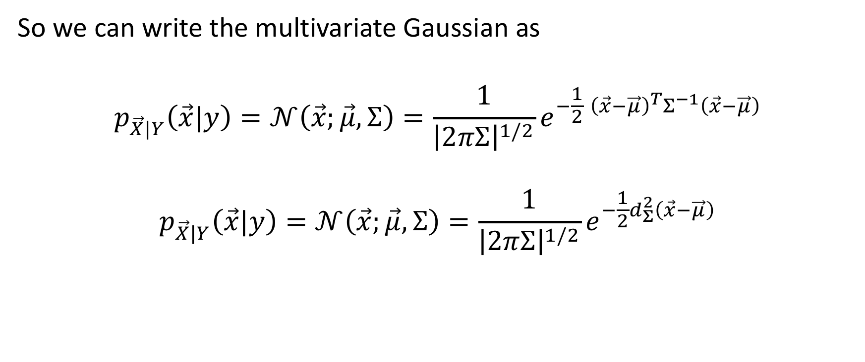
Mahalanobis form of the multivariate Gaussian, independent dimensions
So we can write the multivariate Gaussian as
$$p_{\vec{X}|Y}\left(\vec{x}|y\right)=𝒩\left(\vec{x};\vec{μ},Σ\right)=\frac{1}{{\left|2πΣ\right|}^{1/2}}e^{−\frac{1}{2}{ \left(\vec{x}−\vec{μ}\right)}^{T}Σ^{−1}\left(\vec{x}−\vec{μ}\right)}$$
$$p_{\vec{X}|Y}\left(\vec{x}|y\right)=𝒩\left(\vec{x};\vec{μ},Σ\right)=\frac{1}{{\left|2πΣ\right|}^{1/2}}e^{−\frac{1}{2}d_{Σ}^{2}\left(\vec{x}−\vec{μ}\right)}$$

Slide 27
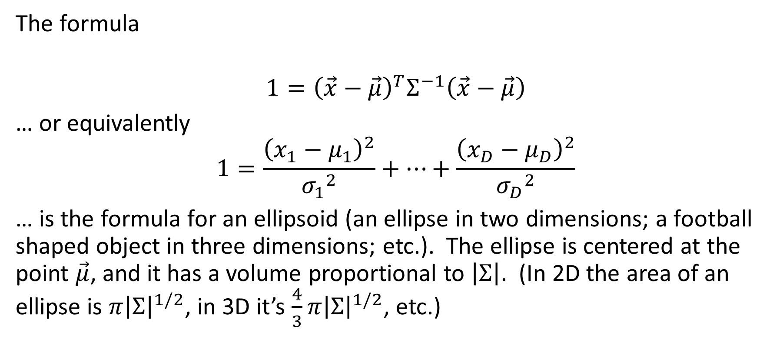
Facts about linear algebra #5: ellipses
The formula
$${1=\left(\vec{x}−\vec{μ}\right)}^{T}Σ^{−1}\left(\vec{x}−\vec{μ}\right)$$
… or equivalently
$$1=\frac{{\left(x_{1}−μ_{1}\right)}^{2}}{{σ_{1}}^{2}}+…+\frac{{\left(x_{D}−μ_{D}\right)}^{2}}{{σ_{D}}^{2}}$$
… is the formula for an ellipsoid (an ellipse in two dimensions; a football shaped object in three dimensions; etc.). The ellipse is centered at the point $\vec{μ}$, and it has a volume proportional to $\left|Σ\right|$. (In 2D the area of an ellipse is $π{\left|Σ\right|}^{1/2}$, in 3D it’s $\frac{4}{3}π{\left|Σ\right|}^{1/2}$, etc.)

Slide 28
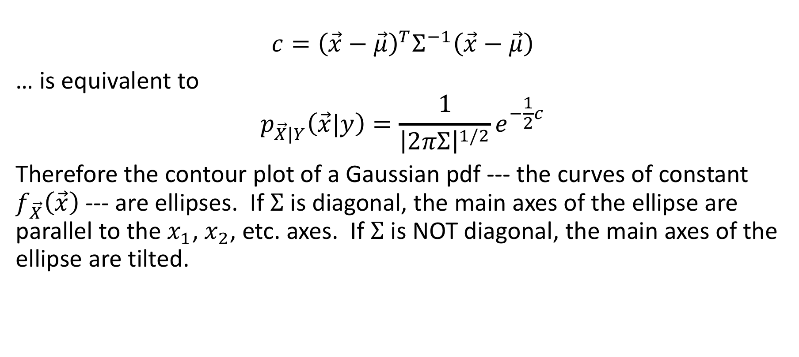
Gaussian contour plots = ellipses
$${c=\left(\vec{x}−\vec{μ}\right)}^{T}Σ^{−1}\left(\vec{x}−\vec{μ}\right)$$
… is equivalent to
$$p_{\vec{X}|Y}\left(\vec{x}|y\right)=\frac{1}{{\left|2πΣ\right|}^{1/2}}e^{−\frac{1}{2}c}$$
Therefore the contour plot of a Gaussian pdf --- the curves of constant $f_{\vec{X}}\left(\vec{x}\right)$ --- are ellipses. If $Σ$ is diagonal, the main axes of the ellipse are parallel to the $x_{1}$, $x_{2}$, etc. axes. If $Σ$ is NOT diagonal, the main axes of the ellipse are tilted.

Slide 29
Example

Slide 30
Contents
Gaussian pdf; Central limit theorem, Brownian motion
White Noise
Vector of i.i.d. Gaussians
Vector of Gaussians that are independent but not identical
Facts about linear algebra
Vector of Gaussians that are neither independent nor identical

Slide 31
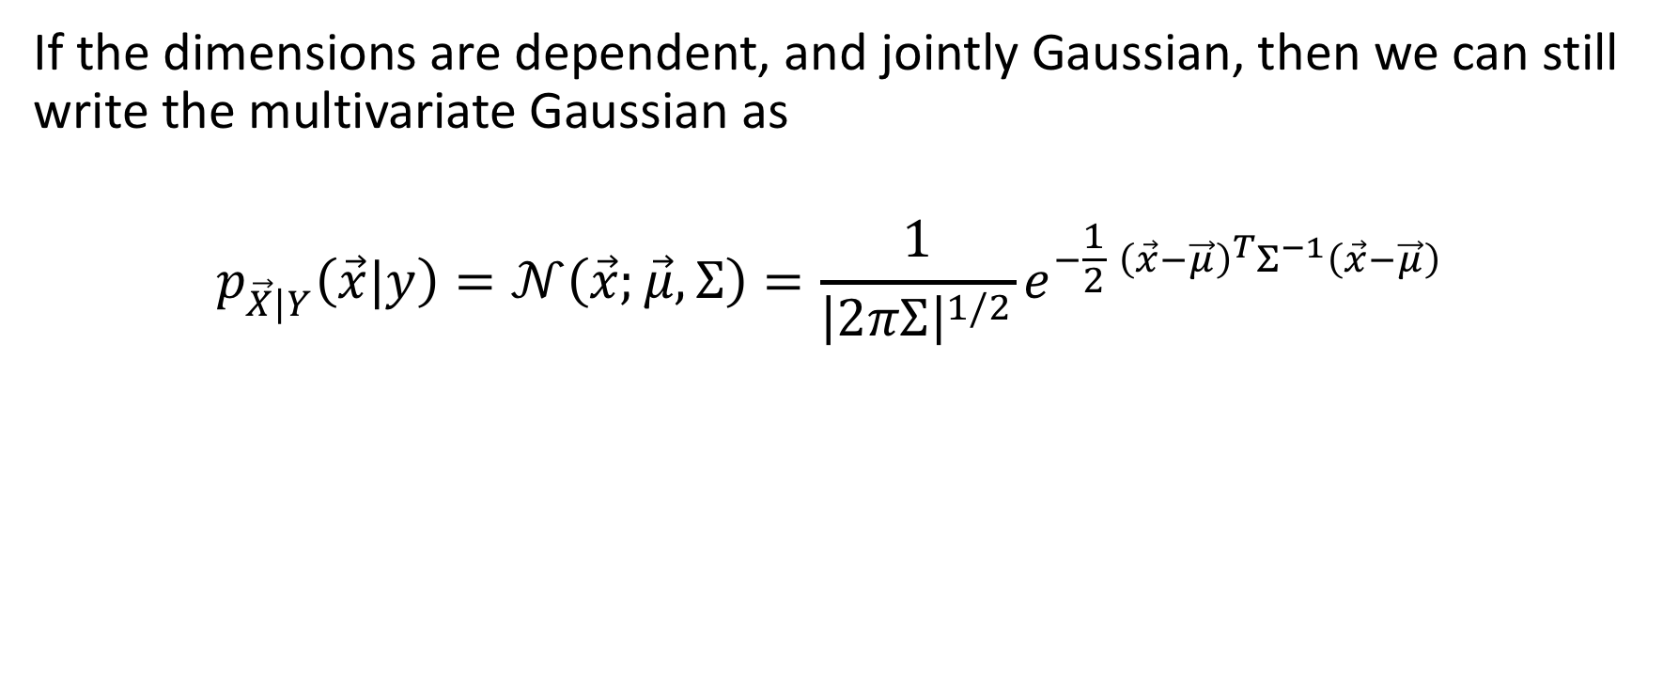
Mahalanobis form of the multivariate Gaussian, dependent dimensions
If the dimensions are dependent, and jointly Gaussian, then we can still write the multivariate Gaussian as
$$p_{\vec{X}|Y}\left(\vec{x}|y\right)=𝒩\left(\vec{x};\vec{μ},Σ\right)=\frac{1}{{\left|2πΣ\right|}^{1/2}}e^{−\frac{1}{2}{ \left(\vec{x}−\vec{μ}\right)}^{T}Σ^{−1}\left(\vec{x}−\vec{μ}\right)}$$

Slide 32
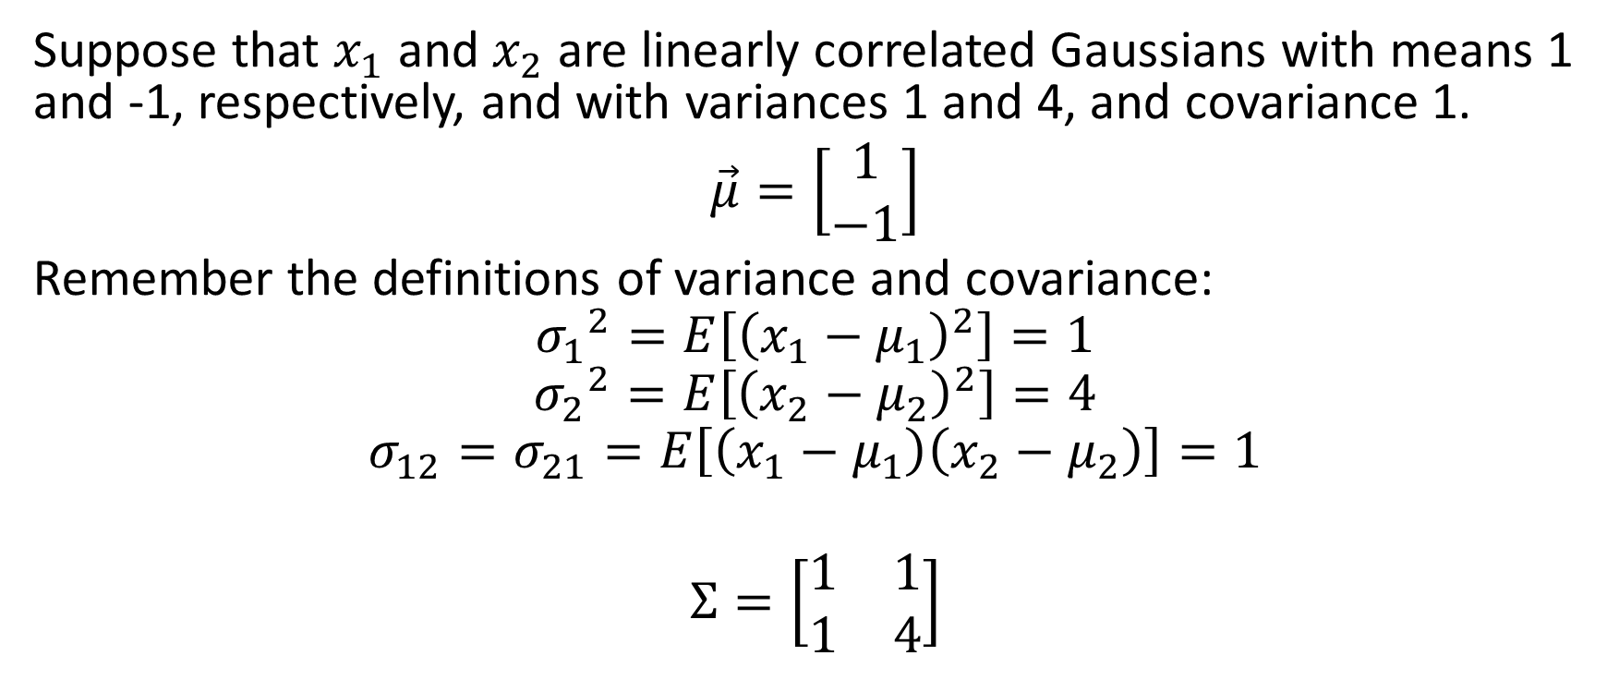
Example
Suppose that $x_{1}$ and $x_{2}$ are linearly correlated Gaussians with means 1 and -1, respectively, and with variances 1 and 4, and covariance 1.
$\vec{μ}=\left[\begin{matrix}1 \\ −1\end{matrix}\right]$
Remember the definitions of variance and covariance:
$${σ_{1}}^{2}=E\left[{\left(x_{1}−μ_{1}\right)}^{2}\right]=1$$
$${σ_{2}}^{2}=E\left[{\left(x_{2}−μ_{2}\right)}^{2}\right]=4$$
$$σ_{12}=σ_{21}=E\left[\left(x_{1}−μ_{1}\right)\left(x_{2}−μ_{2}\right)\right]=1$$
$$Σ=\left[\begin{matrix}1 & 1 \\ 1 & 4\end{matrix}\right]$$

Slide 33
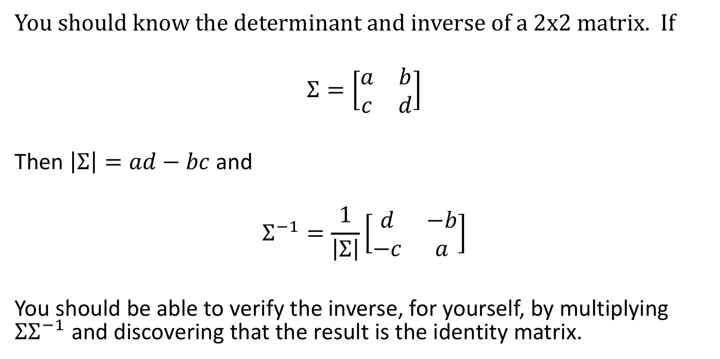
Determinant and inverse of a 2x2 matrix
You should know the determinant and inverse of a 2x2 matrix. If
$$Σ=\left[\begin{matrix}a & b \\ c & d\end{matrix}\right]$$
Then $\left|Σ\right|=ad−bc$ and
$$Σ^{−1}=\frac{1}{\left|Σ\right|}\left[\begin{matrix}d & −b \\ −c & a\end{matrix}\right]$$
You should be able to verify the inverse, for yourself, by multiplying ${ΣΣ}^{−1}$ and discovering that the result is the identity matrix.

Slide 34
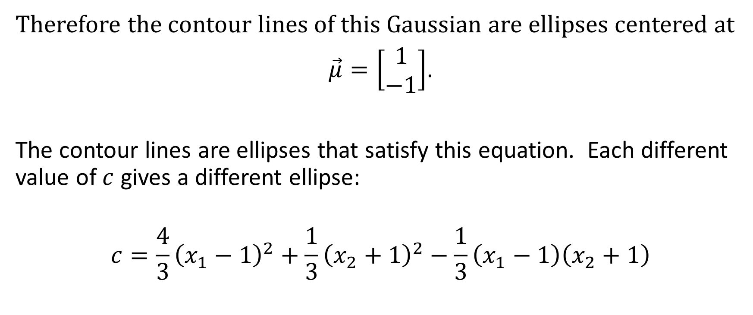
Example
Therefore the contour lines of this Gaussian are ellipses centered at
$\vec{μ}=\left[\begin{matrix}1 \\ −1\end{matrix}\right]$.
The contour lines are ellipses that satisfy this equation. Each different value of $c$ gives a different ellipse:
$$c={\frac{4}{3}\left(x_{1}−1\right)}^{2}+{\frac{1}{3}\left(x_{2}+1\right)}^{2}−\frac{1}{3}\left(x_{1}−1\right)\left(x_{2}+1\right)$$

Slide 35
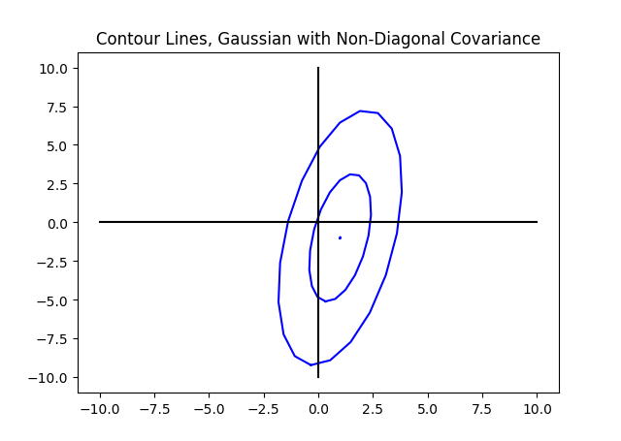
Example

Slide 36
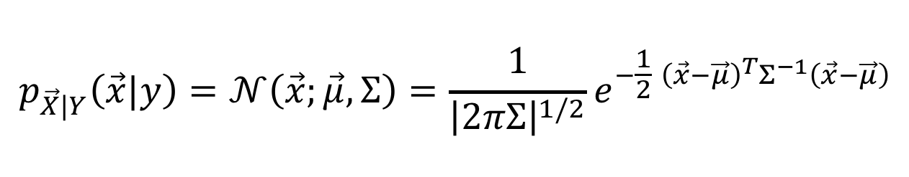
Conclusion: Summary of Today’s Lecture
$$p_{\vec{X}|Y}\left(\vec{x}|y\right)=𝒩\left(\vec{x};\vec{μ},Σ\right)=\frac{1}{{\left|2πΣ\right|}^{1/2}}e^{−\frac{1}{2}{ \left(\vec{x}−\vec{μ}\right)}^{T}Σ^{−1}\left(\vec{x}−\vec{μ}\right)}$$

