Slide 1

Notes:
-We are an app, but we are also a business

Slide 2
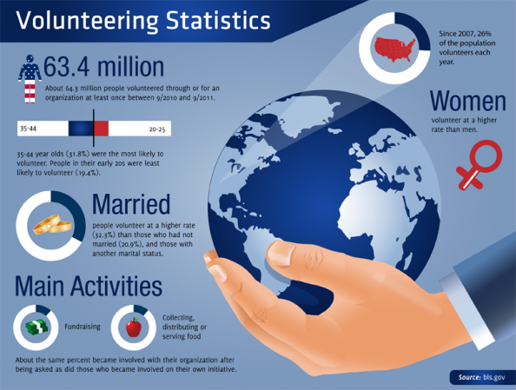

Slide 3

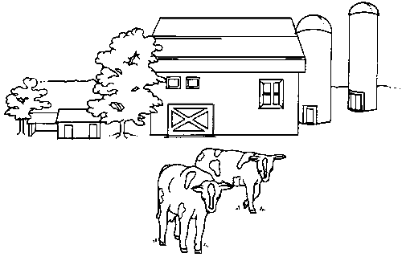


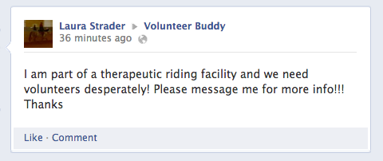




Organization
Volunteer

Slide 4

Volunteers
Organizations
“Volunteer Buddy, the heart of volunteering”

Slide 5
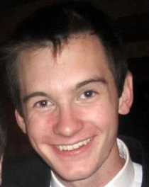

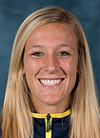

The Team
Jake Hash
Robby Greenfield
Chloe Prince
Josh Upfal
App Development
Web Development
Graphic Design
Management
Notes:
We all love volunteering, and community service. As a college student I often found it hard to find volunteer opportunities. As I sat there, thinking of places to volunteer, it hit me. Why not create a mobile app to simplify the volunteer experience. Here we are 3 months later with a hardworking, passionate team. We all bring a different piece to the puzzle, just like volunteers at non-profit organizations and events.
We are all social entrepreneurs who want to change the world. We believe that Volunteer Buddy is the key to endless doors of volunteer opportunities. It will increase volunteering across the board, thus increasing the help provided for many people.
Joshua Upfal
Communication Studies, Entrepreneurship, & Performing Arts Management/Pre-Law
Chloe Prince
Informatics & Computing Services, Entrepreneurship
Robby Greenfield
Computer Science & IOE
Jake Hash
Computer Science & Entrepreneurship

Slide 6
The Application
1
2
3
4
Find
Share
Match
Validate

Slide 7
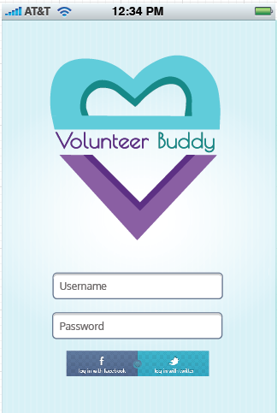

Slide 8
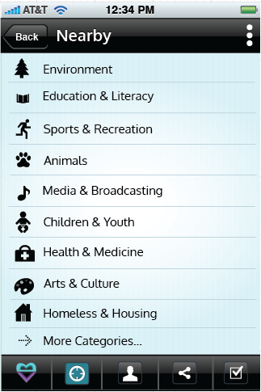
1
Find

Slide 9
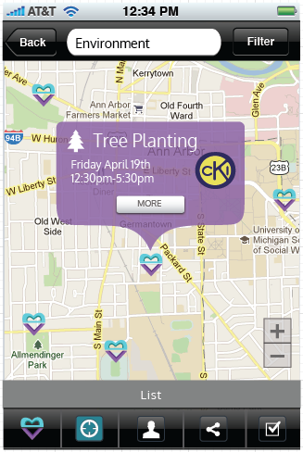
1
Find

Slide 10
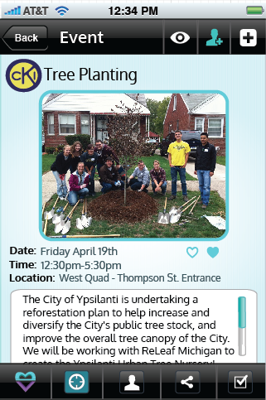
2
Share

Slide 11
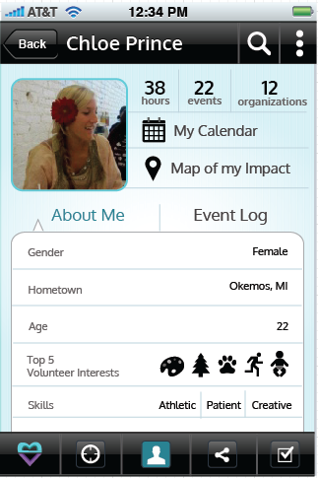
3
Match

Slide 12
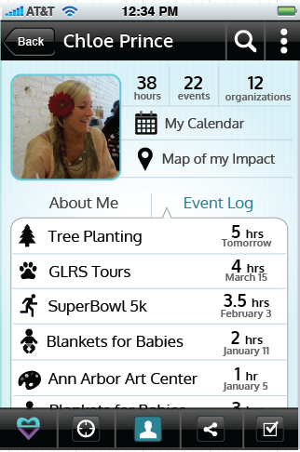
3
Match

Slide 13
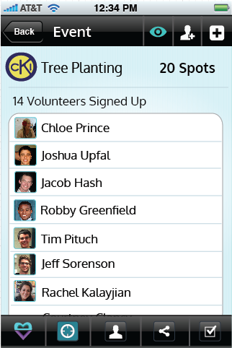
4
Validate

Slide 14

Our Mission
To increase community involvement by helping volunteers find opportunities to give back, and provide the go-to for volunteers and all types of organizations to create an even greater impact on the community by matching the perfect volunteers to the perfect opportunities.
Notes:
Our mission is to encompass the entire volunteer experience, in a mobile app, making it an easy, rewarding, and social experience.
-We are an app, but we are also a business
We will revolutionize the volunteering experience, helping organizations find the best possible volunteers that they need, and helping volunteers find the opportunities that they want to pursue.

Slide 15










Non-Profits
Probation Departments
Festivals & Fairs
High schools & Colleges
Notes:
High School Students would use our app because…
College applications, build friendships, giving back, High School requirement
More volunteers, trouble with accessibility, narrow opportunities down, make friends, easier access, easier to keep track of hours, group experiences

Slide 16




Features
Mobile App | ✓ | ✓ | ✓ ios only | ✓
Calendar | ✓ |  |  | ✓ | ✓
Geo Location | ✓ |  |  | ✓
Public | ✓ | ✓ | ✓ | Students | Palm Beach & Broward Counties (FL)
Profiling | ✓
Map View | ✓ | ✓
Social Aspect | ✓ |  | ✓
Gamification | ✓ |  | ✓ | ✓
Reviews | ✓ | ✓
Notes:
Rewards

Slide 17

Our Revenue Stream
Subscription Model

Slide 18
5
Projected
- year Timeline
2017
Cash-flow Positive
2016
National expansion, help more organizations
2015
Make VB the standard in high schools and non-profits
2014
Expand to rest of Michigan and various festivals across the nation, SXSW
2013
Launch Volunteer Buddy in Ann Arbor

Slide 19
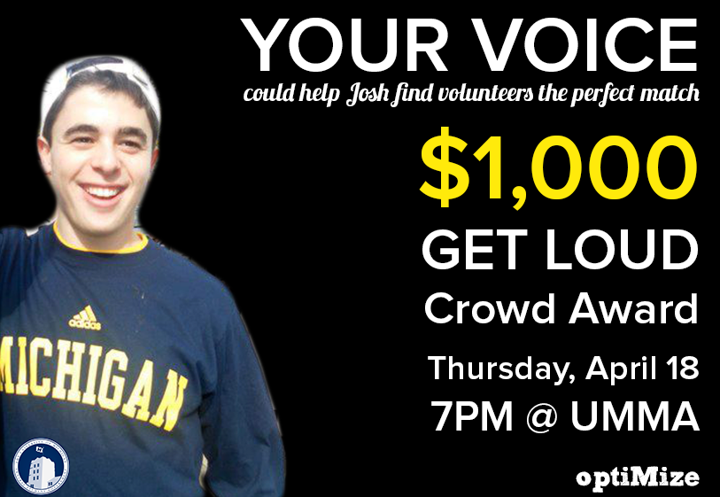

Slide 20


Thank you!

