Slide 1

Notes:
-We are an app, but we are also a business

Slide 2
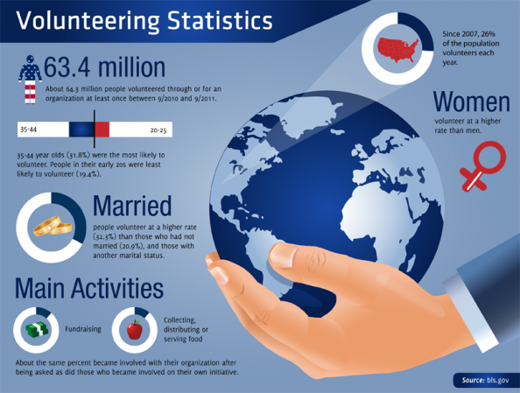

Slide 3

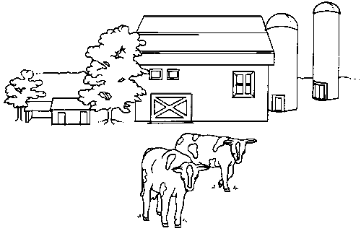


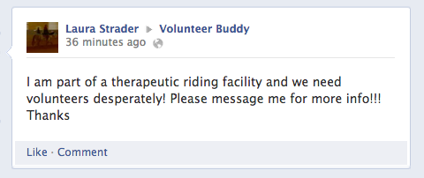

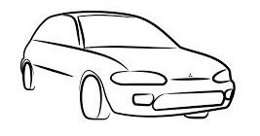


Organization
Volunteer

Slide 4

Volunteers
Organizations
“Volunteer Buddy, the heart of volunteering”

Slide 5
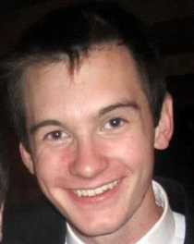

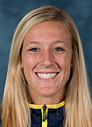

The Team
Jake Hash
Robby Greenfield
Chloe Prince
Josh Upfal
Notes:
We all love volunteering, and community service. As a college student I often found it hard to find volunteer opportunities. As I sat there, thinking of places to volunteer, it hit me. Why not create a mobile app to simplify the volunteer experience. Here we are 3 months later with a hardworking, passionate team. We all bring a different piece to the puzzle, just like volunteers at non-profit organizations and events.
We are all social entrepreneurs who want to change the world. We believe that Volunteer Buddy is the key to endless doors of volunteer opportunities. It will increase volunteering across the board, thus increasing the help provided for many people.
Joshua Upfal
Communication Studies, Entrepreneurship, & Performing Arts Management/Pre-Law
Chloe Prince
Informatics & Computing Services, Entrepreneurship
Robby Greenfield
Computer Science & IOE
Jake Hash
Computer Science & Entrepreneurship

Slide 6

The Team
Joshua Upfal
Communication Studies, Entrepreneurship, & Performing Arts Management/Pre-Law
Chloe Prince
Informatics & Computing Services, Entrepreneurship
Robby Greenfield
Computer Science & IOE
Jake Hash
Computer Science & Entrepreneurship
Notes:
We all love volunteering, and community service. As a college student I often found it hard to find volunteer opportunities. As I sat there, thinking of places to volunteer, it hit me. Why not create a mobile app to simplify the volunteer experience. Here we are 3 months later with a hardworking, passionate team. We all bring a different piece to the puzzle, just like volunteers at non-profit organizations and events.
We are all social entrepreneurs who want to change the world. We believe that Volunteer Buddy is the key to endless doors of volunteer opportunities. It will increase volunteering across the board, thus increasing the help provided for many people.

Slide 7
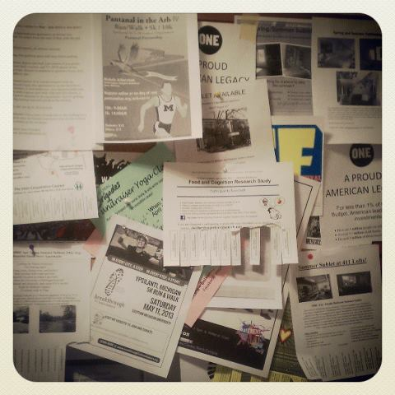
1
2
3
4
Find
Match
Share
Validate

Slide 8
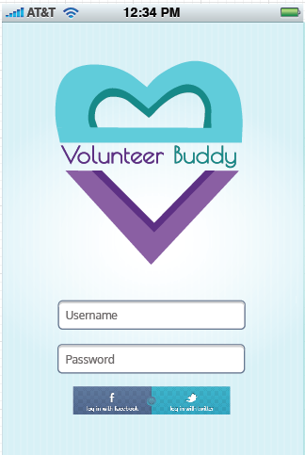

Slide 9
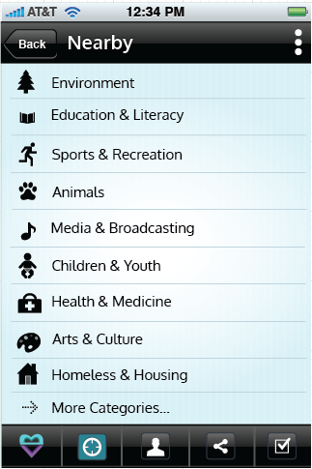
1
Find

Slide 10
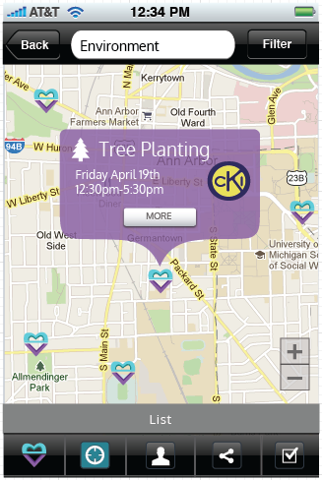
1
Find

Slide 11
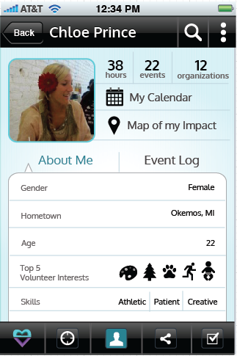
2
Match

Slide 12
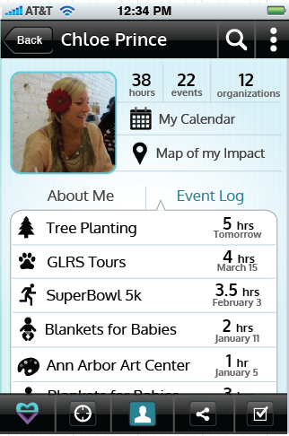
2
Match

Slide 13
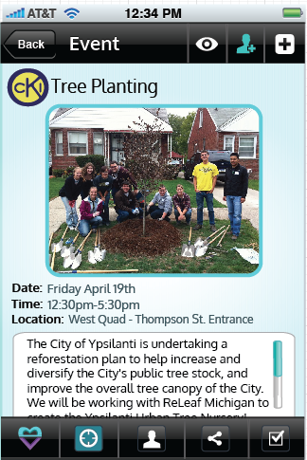
3
Share

Slide 14
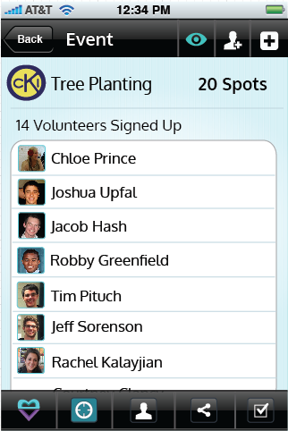
4
Validate

Slide 15

Our Mission
Increase community involvement by helping volunteers find opportunities to give back, provide the go-to for volunteers and all types of organizations to have an even greater impact on the community by matching the perfect volunteers to the perfect opportunities.
Notes:
Our mission is to encompass the entire volunteer experience, in a mobile app, making it an easy, rewarding, and social experience.
-We are an app, but we are also a business
We will revolutionize the volunteering experience, helping organizations find the best possible volunteers that they need, and helping volunteers find the opportunities that they want to pursue.

Slide 16










Customer Discovery
Non-Profits
PO Offices
Festivals & Fairs
High schools
Notes:
-We are still still working on customer discovery. It is a continuous process
United Way, The Friendship Circle,, The Ann Arbor Arts Center, The Food Gatherers
Dexter High School, Pioneer High School, Skyline High School
PO Officer
The St. Mary’s Fair
-Mention how we started as an app for gamifying volunteering and rewards,
But through customer discovery we recognized that people do not volunteer for rewards,
But more so for the social benefit of volunteering, and helping others, and also for school requirements
-Also organizations are not thrilled about volunteers coming just to get coupons, they would
Rather volunteers be sincere, high quality and authentic, which is something that Volunteer Buddy can provide,
As well as large amounts of valuable information
High School Students, initially students in National Honors Society
Students and people involved in community service based organizations
Anyone who wants/needs community service hours
Non-profit organizations
Festivals and events

Slide 17

Our Revenue Stream
Subscription Model
Notes:
Our primary focus is to create the app, then we will test it with certain organizations, to validate that we can bring more volunteers to organizations through the app

Slide 18




Features
Mobile App | ✓ | ✓ | ✓ ios only | ✓
Calendar | ✓ |  |  | ✓ | ✓
Geo Location | ✓ |  |  | ✓
Public | ✓ | ✓ | ✓ | Students | Palm Beach & Broward Counties (FL)
Profiling | ✓
Map View | ✓ | ✓
Social Aspect | ✓
Gamification | ✓ |  | ✓
Reviews
Notes:
Rewards

Slide 19
Projected Five-year Timeline
2013
Launch Volunteer Buddy in Ann Arbor
2014
Expand to rest of Michigan and various festivals across the nation, SXSW
2015
Expand across nation, making VB the standard in high schools and non-profit organizations
2016
Expand to more festivals
2017
Cash-flow Positive

Slide 20
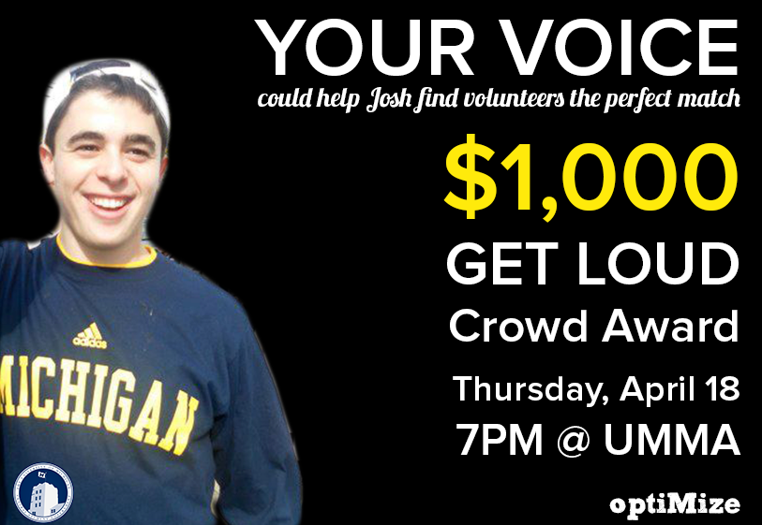

Slide 21


Thank you!

