Slide 1

DATA Mining Presentation- group 8
Group Members:-
Anjul Jain
Moumita Bhattacharya
Richa Arora
Shilpa Jha
Shruti Saraswat

Slide 2
Big mart dataset
Problem statement :-
By using big mart data, we intent to analyze the sales and its fluctuation for different stores
Research Questions:-
Which attributes are significant in predicting sales?
How does a store location, type and size play a role in sales?
Which items have the highest sales in each category?
Dimensions of the dataset: Rows - 14204, Columns - 12
Item Identifier: Unique identification code for the sold item
Item_Weight: Weight of the item
Item_Fat_Content: Whether item has low fat or regular fat content
Item_Visibility: Visibility in terms of percentage of total display area of the item
Item_Type: Category of the item
Item_MRP: Maximum retail price of the item
Outlet Identifier: Unique identification code for the outlet
Outlet_Establishment_Year: The year outlet was established
Outlet_Size: Ground area covered by the outlet
Outlet_Location_Type: Type of city where outlet is located
Outlet_Type: Whether outlet is supermarket or grocery outlet
Item_Outlet_Sales: Total sales of the item at the outlet

Slide 3
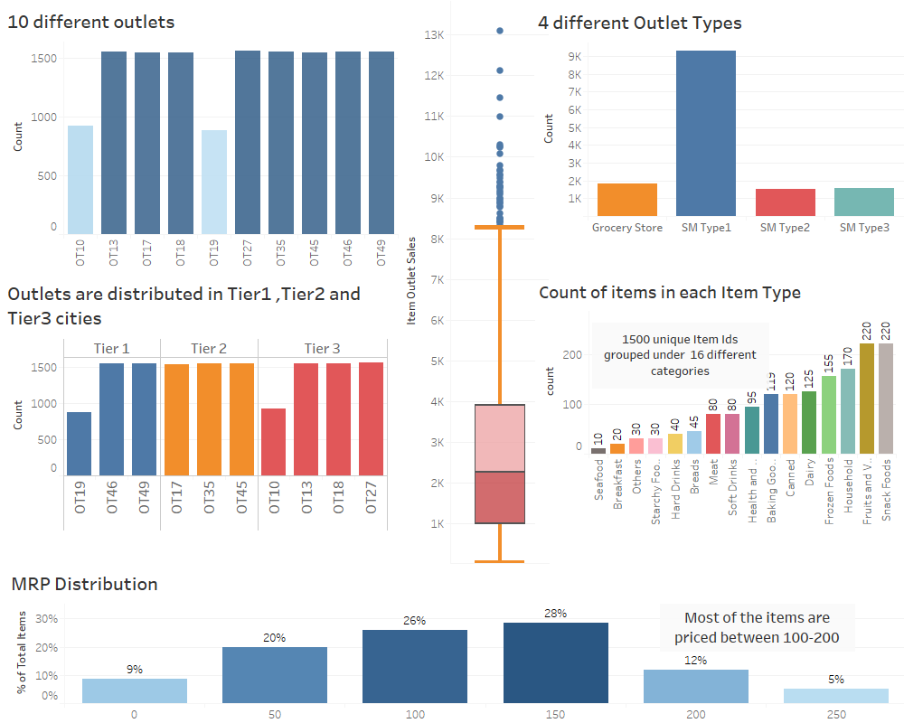
DESCRIPTION OF DATA SET- spelling

Slide 4
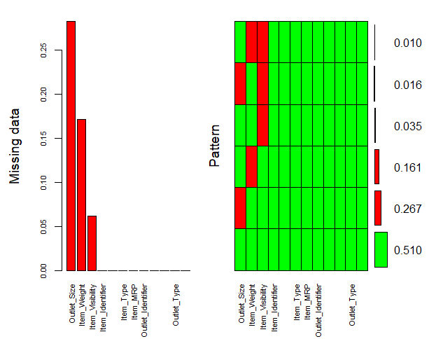
Pre- processing of data
Assign
Assign NA values to the missing attributes
Calculate
Calculate no of NA items for each variable
Impute
Analyze missing data and Impute .
Group
Group item identifiers ,item types, and item fat content
Create
Create dummies

Slide 5
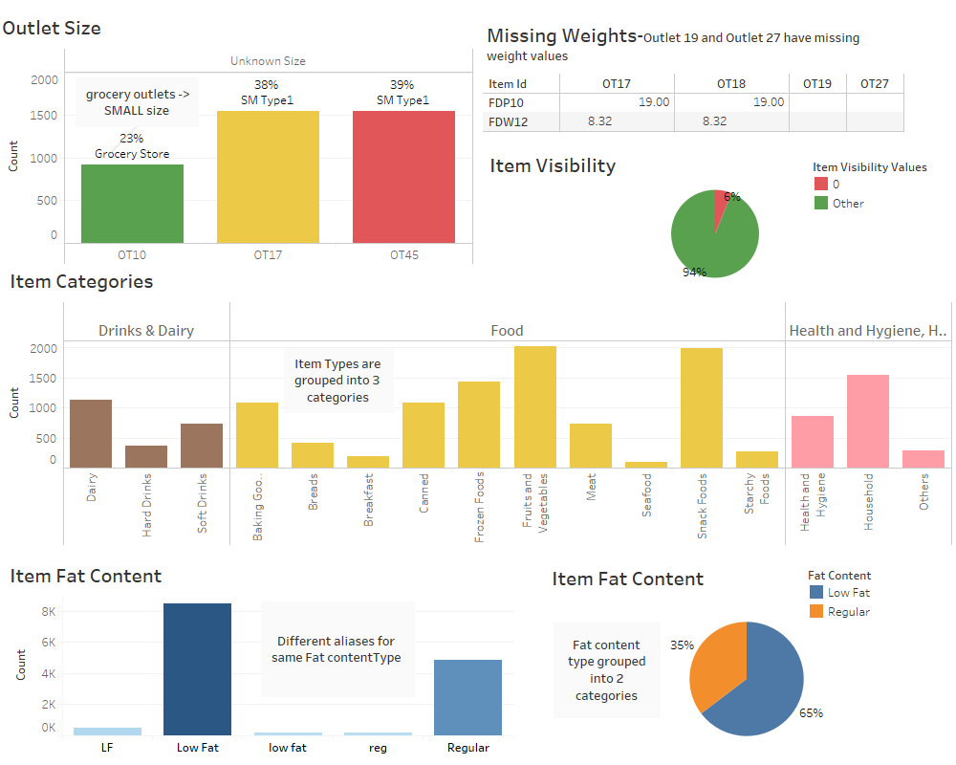

Slide 6
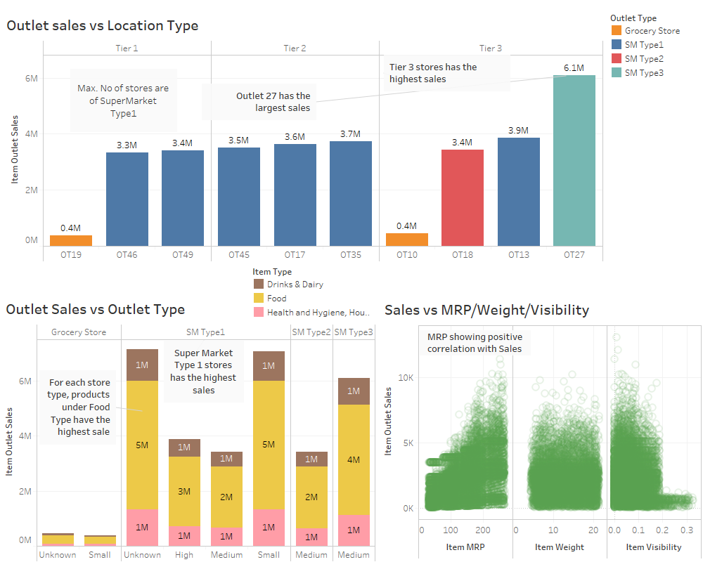
ANALYSIS AND RESULTS

Slide 7
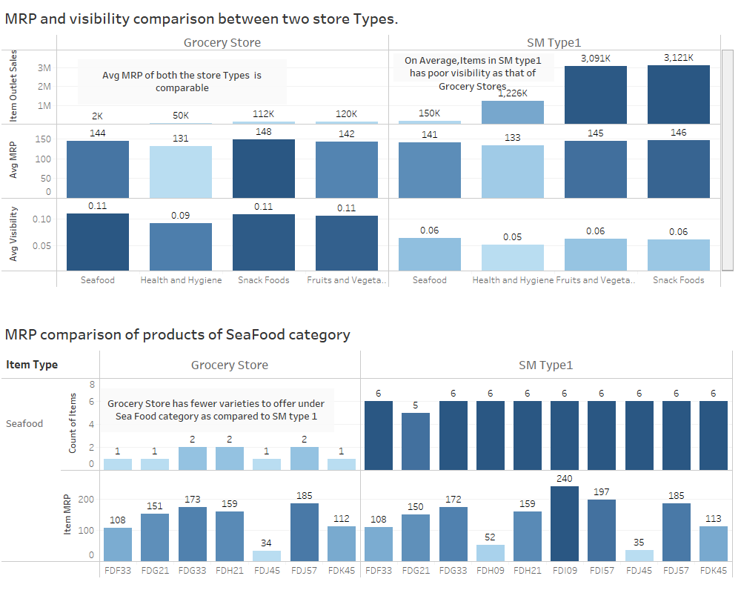

Slide 8
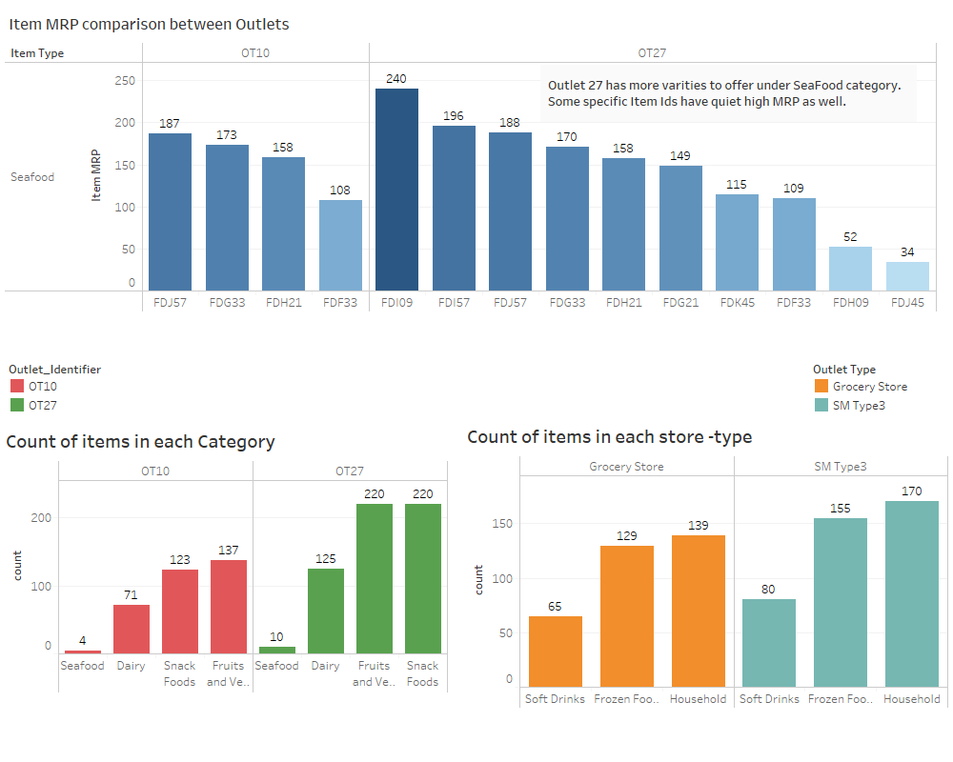

Slide 9
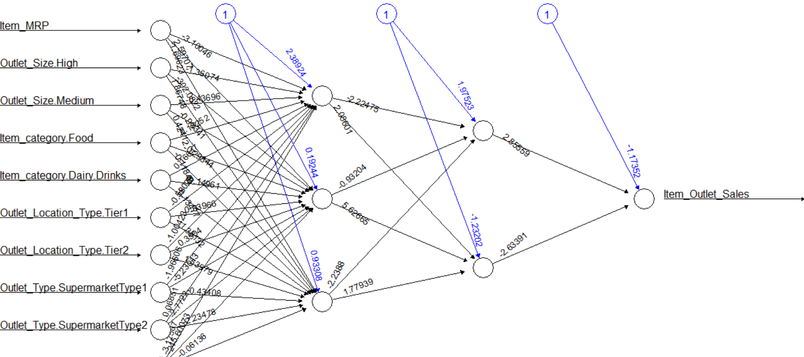
COMPARISON OF DIFFERENT MODELS
Partition the dataset
Select significant predictors
Prepare the dataset according to the Model
Create ML models
Compare Models over accuracy metrics
Select the best model with highest accuracy
Test the model on the test dataset
MODEL NAME | RMSE
Multi Linear Regression | 2681
K - Nearest Neighbors | 984
Neural Nets | 938
Classification Tree | 966

Slide 10
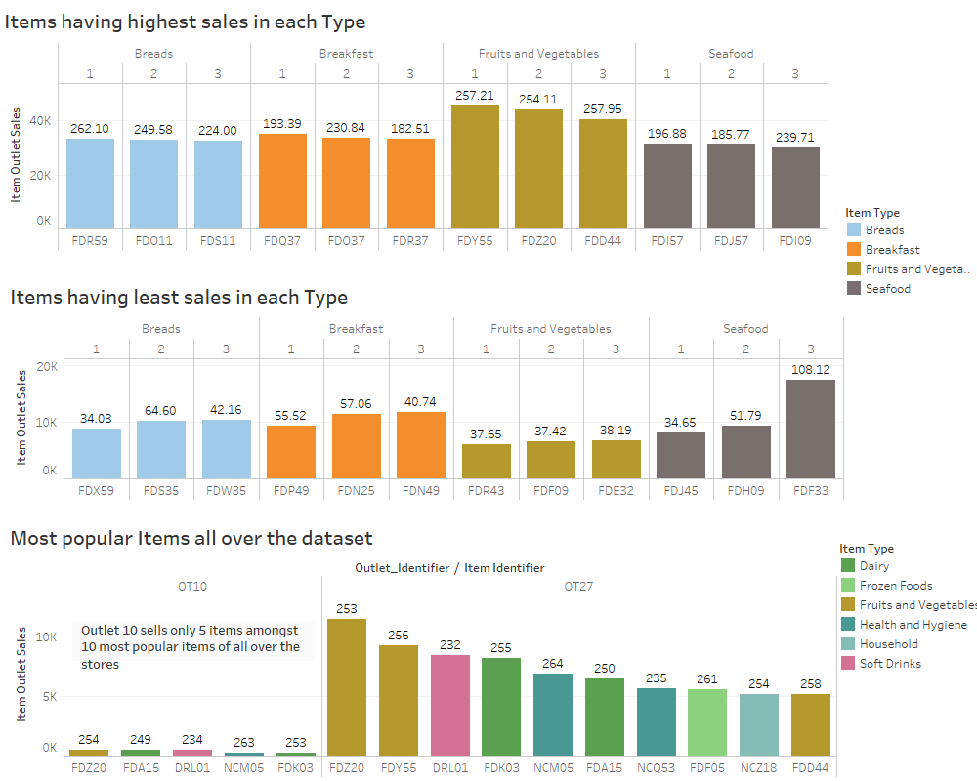
Conclusion and recommendations
Stores with low sales should stock similar kind of items as that of Supermarket stores at a competitive price.
Stores with low sales should offer more product lines under each category to attract more customers.
Grocery Stores in Tier 3 cities can increase the MRP of certain products to have better sales.

