Slide 1
Data Analytics Project
By
Shilpa Jha

Slide 2
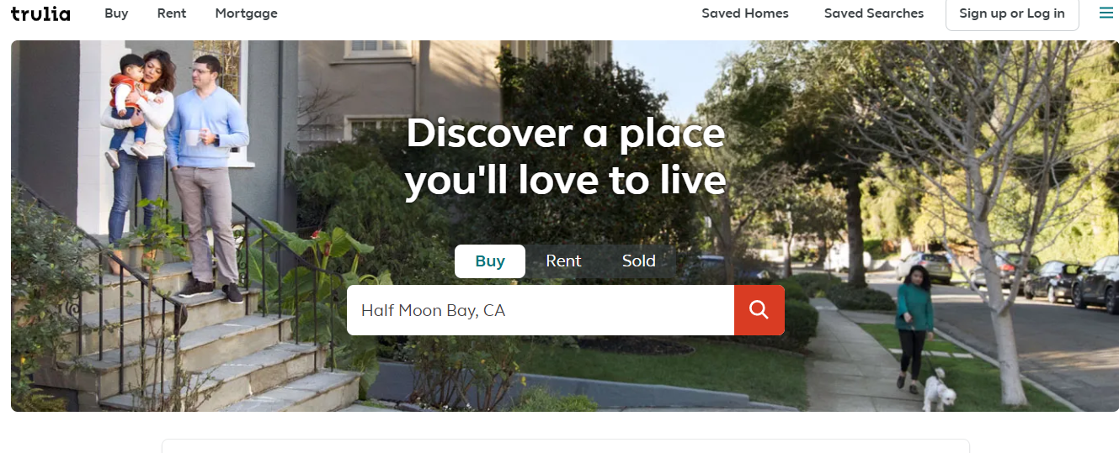
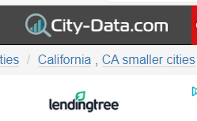
Data Collection
Following attributes has been collected from this site :
Following attributes has been collected from this site :
Price
Bed
Bath
Floor Size
City
Zip Code
Agent Details
Year Built& Year Updated
No of Groceries and Schools
HOA Fees
Lot Size
School
Crime History
Property Type
Consumer Life Index
Population Density
Median Age
Median Income
Median rent
Percentage of People Below Poverty Line

Slide 3
Libraries/Tools used for Web Scraping
Beautiful Soup : It is a python library to extract HTML content of a webpage and then using it to extract the required data.
Selenium and Chrome Driver: Selenium is a browser automation tool. With the help of Chrome Driver user can automate various operations like submitting POST requests, triggering click events ,opening/closing pop-ups etc.
Other libraries/packages like Requests ,pandas ,re , Matplotlib ,Seaborn time etc.

Slide 4
Research questions
Which City is the most expensive place to live?
What attributes affect House Prices?
What type of Houses are most expensive?
How best We can predict the House Price?

Slide 5
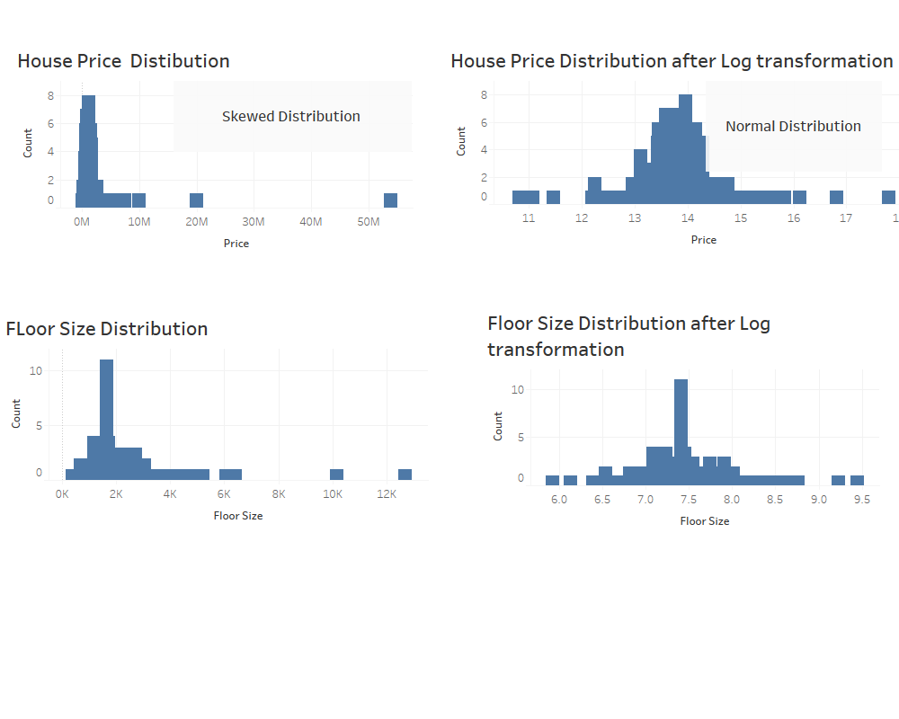

Slide 6
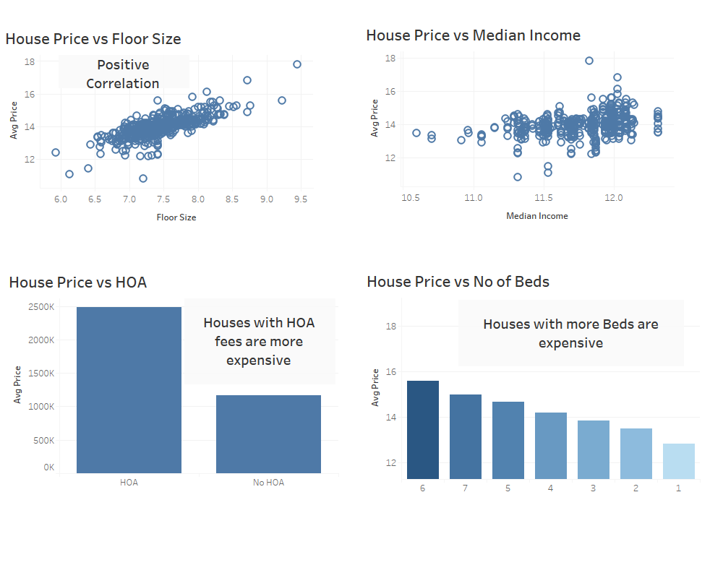

Slide 7
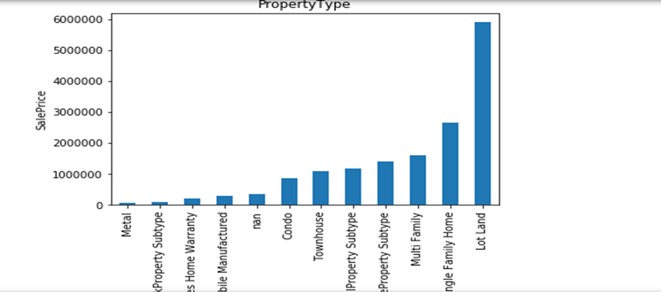
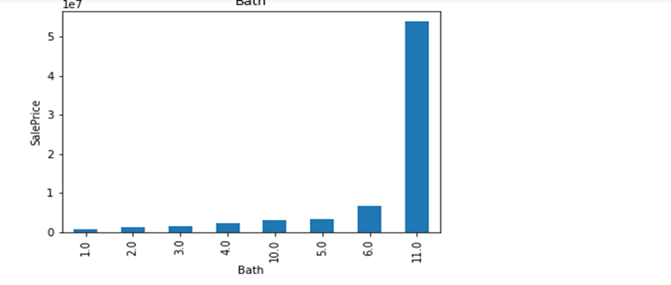
House Price vs Property Type & No of Baths
Property of type “Lot Land” are the most expensive
Houses having more no of baths are more expensive

Slide 8
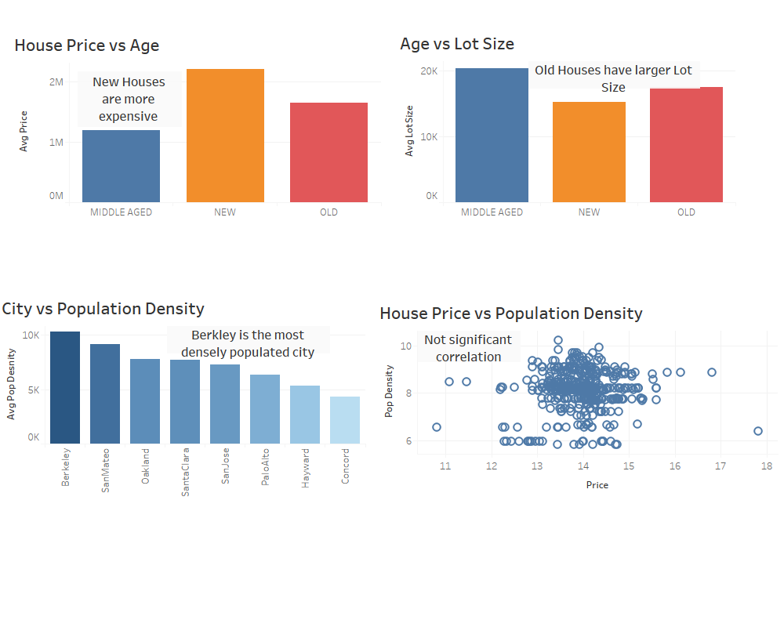

Slide 9
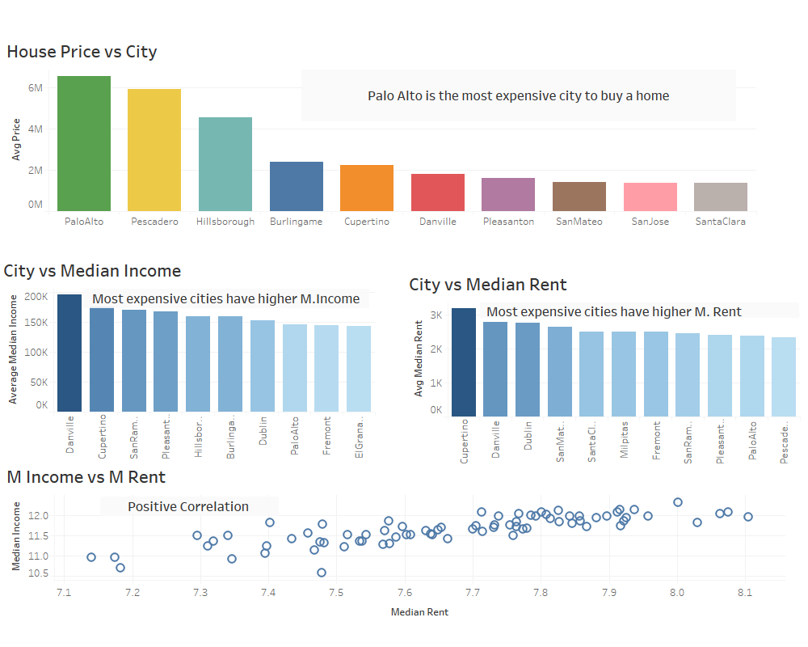

Slide 10
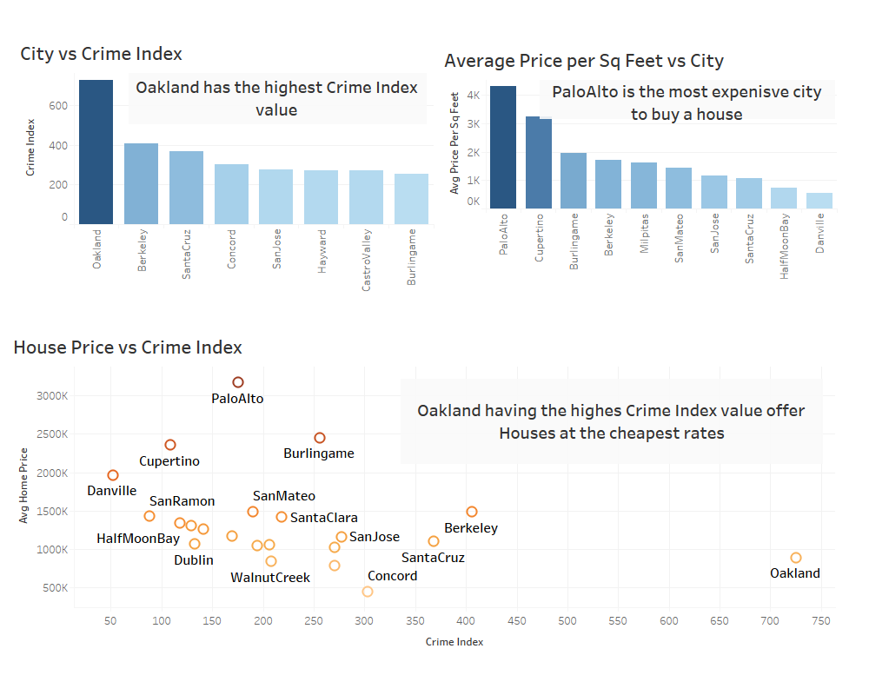

Slide 11
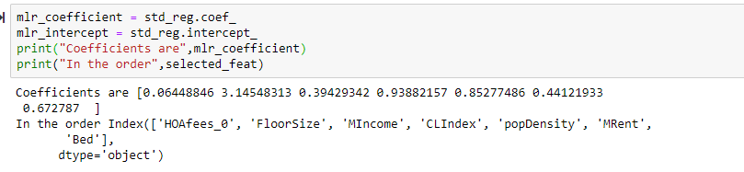
Regression Model to predict Price
Used Lasso Regression method for Feature Selection to get a simple and sparse Model.
Features used in Model : HOA Status , Median Income, Floor Size , Cost of Living Index ,Pop. Density , Median Rent and No of Beds.

Slide 12
Conclusion
HOA Status , Median Income, Floor Size, Cost of Living Index ,Pop Density , Median Rent and No of Beds are the most important features in predicting the Price of Houses.
Age also plays a role in determining the price as New houses are the most expensive ones.
New Houses have smaller Lot size than that of Old and Middle -aged Houses.
Cities with high Crime Index values are comparatively cheaper that the cities with lower values
Palo Alto is the most expensive city to buy House.

