Slide 1

Shri Ramdeobaba College of Engineering & Management, Nagpur
Department of Computer Science and Engineering VII Semester CSE (Section B) Session : 2017-18
Project Guide : Dr.T. Diwan

Slide 2
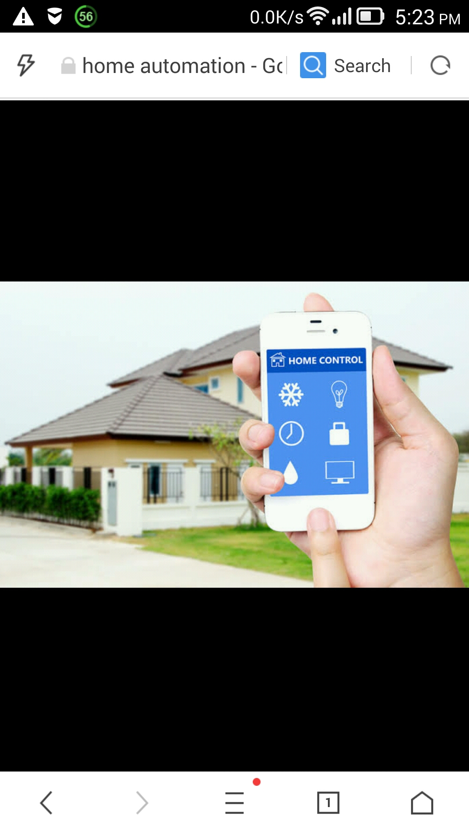
Voice Controlled Home Automation
Group Members :
Ekta Chawda (36)
Akshay Rathi (44)
Kanak Kaushik (51)
Samarth Sanghi (63)
Shubham Jha (69)

Slide 3
WHAT IS HOME AUTOMATION?
“Home Automation is the way that all of our devices and appliances will be networked together to provide us with a seamless control over all aspects of our home and more.”

Slide 4
PROBLEM DEFINITION:
In the proposed system we are implementing the next generation technology i.e. “Voice operated device Controlling”.

Slide 5
AIMS AND OBJECTIVES:
To develop an automated home automation that works on speech recognition and processing.
System eases the home automation task by listening to user’s speech and controlling appliances as per user voice commands.

Slide 6
PROPOSED PLAN OF WORK:
Sr. no | Activity | Estimated Time
1. | Planning user interface and modules of the project. | 1 week
2. | Development of the project. | 4-5 week
3. | Debugging and testing the project. | 2 weeks
4. | Approval by project guide and implementing the suggested changes. | 2-3 weeks
5. | Documentation | 1 week

Slide 7
METHODOLOGY:
Recording User’s Speech.
Extracting Keywords from the speech.
Analyzing and Understanding.
If the system detects a command in user’s sentence, it analyses which load is referred to and what command is issued.

Slide 8
On processing of user spoken keywords the board operates a relay based circuit to switch loads on/off.
The relay based circuit is used to switch AC supply loads easily using user commands.

Slide 9
HARDWARE SPECIFICATIONS:
Raspberry Pi model B with memory card preloaded with an OS.
Ethernet Cable(CAT5).
Micro-USB Power supply.
Relay Circuit (4-way switch).
USB keyboard.
HDMI monitor.
Lamps.

Slide 10
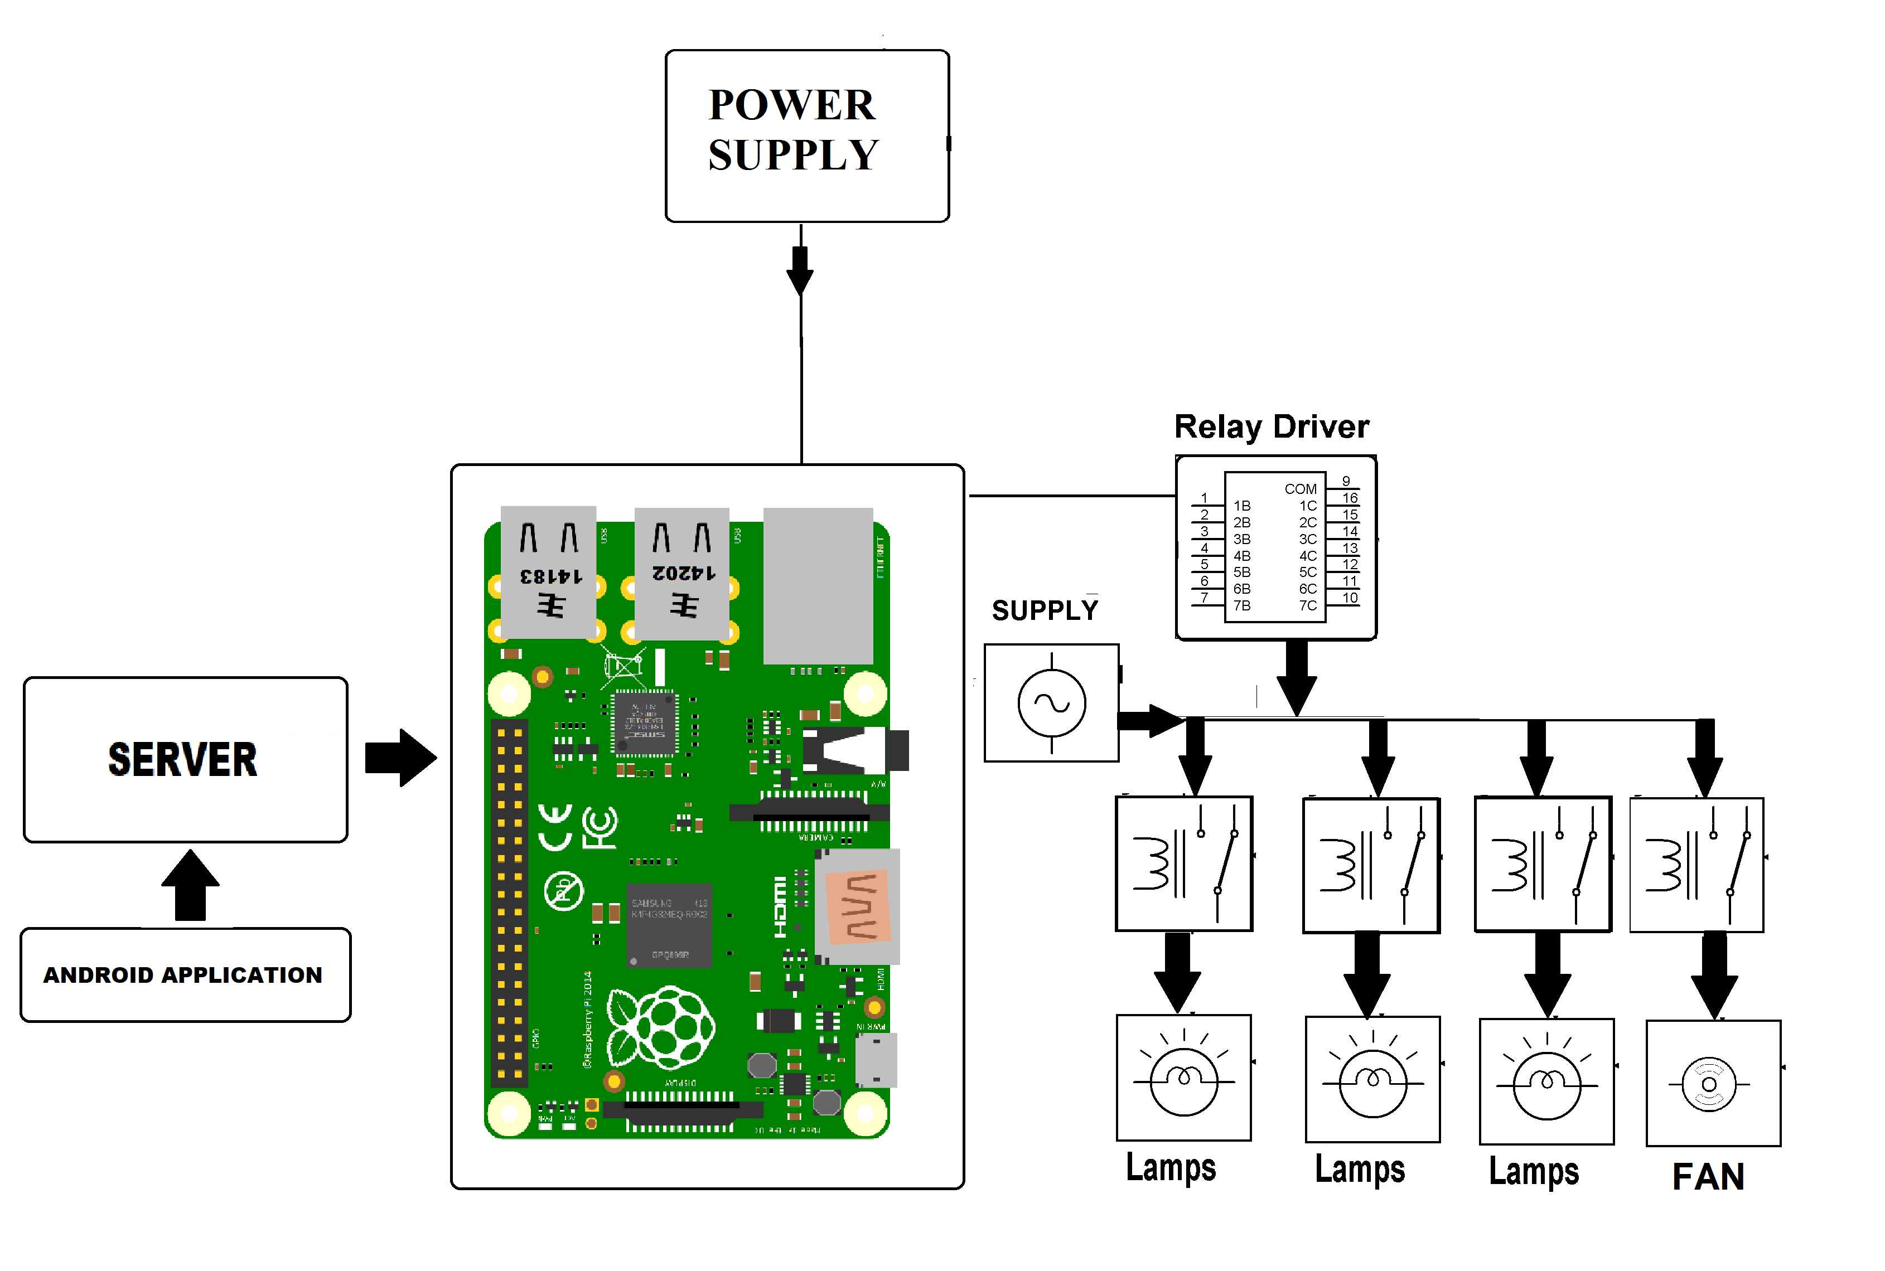

Slide 11
SOFTWARE SPECIFICATIONS :
Android SDK.
PUTTY and Xming Server.
RASPBIAN OS.
Apache server.
MYSQL.
C++/Python.

Slide 12
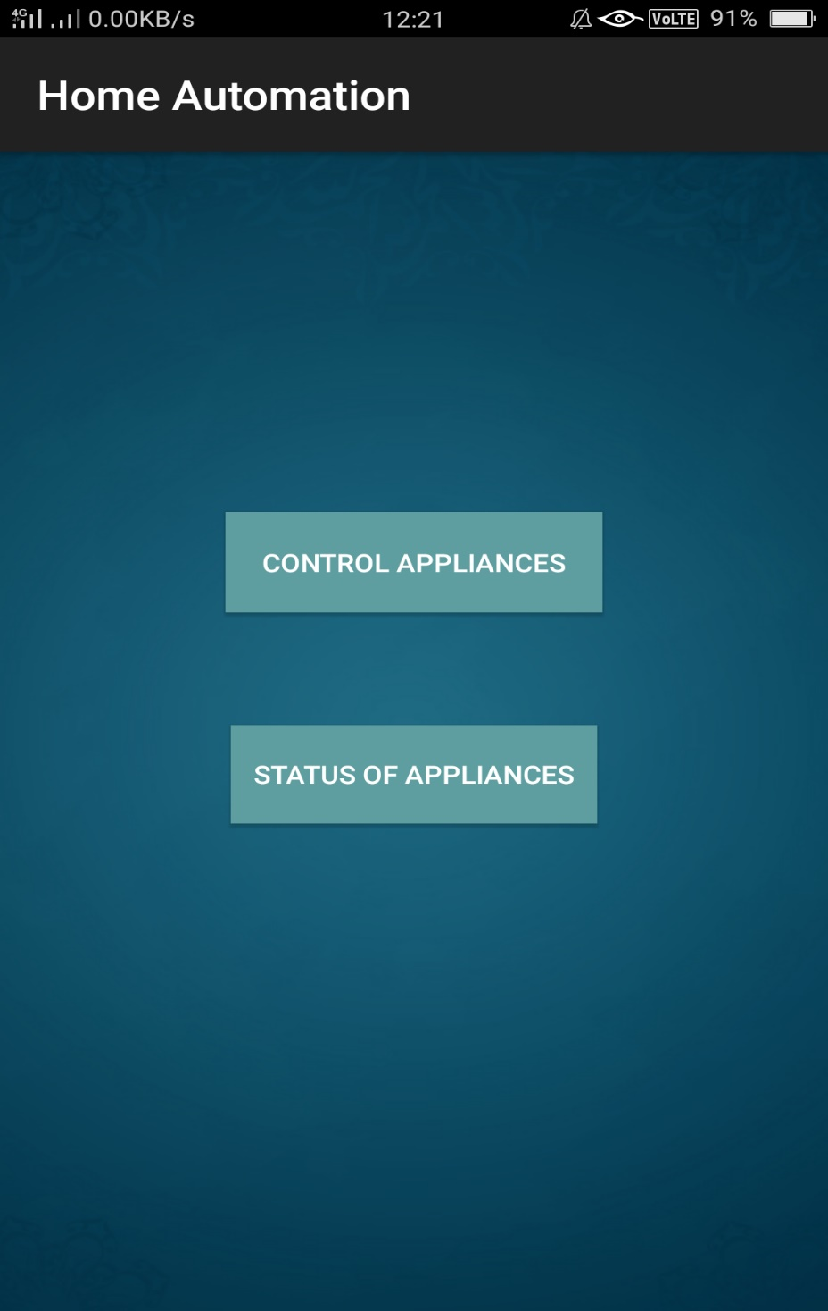
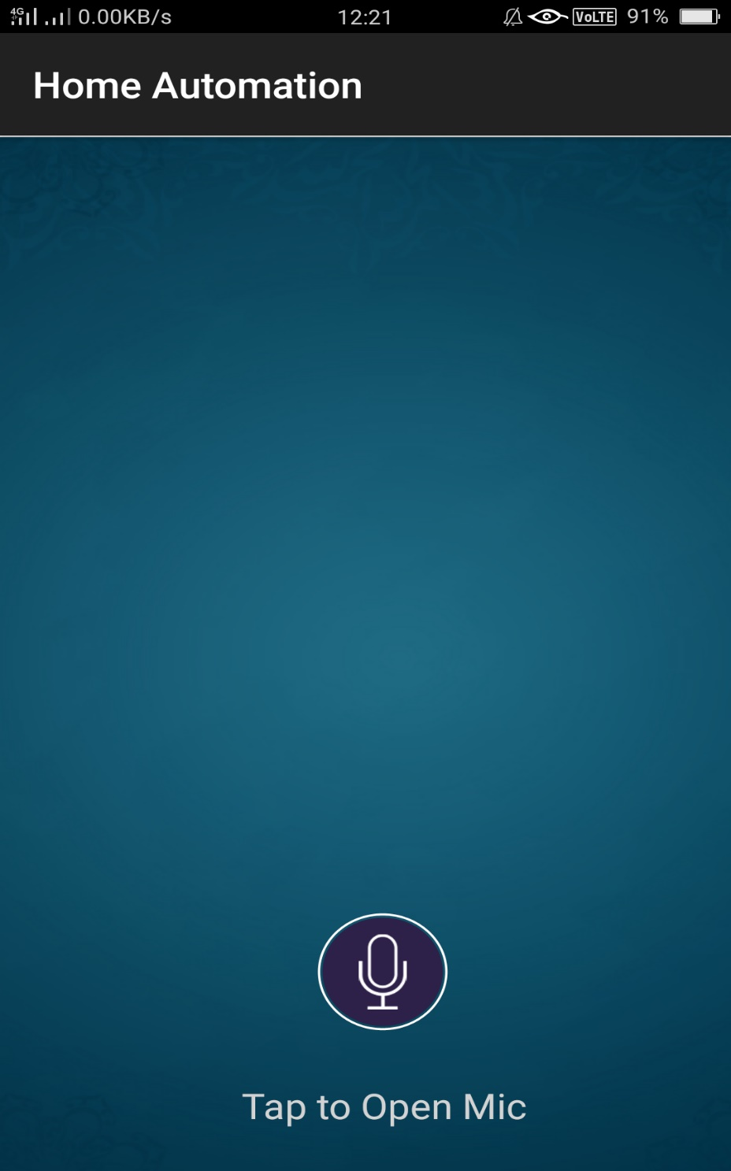

Slide 13
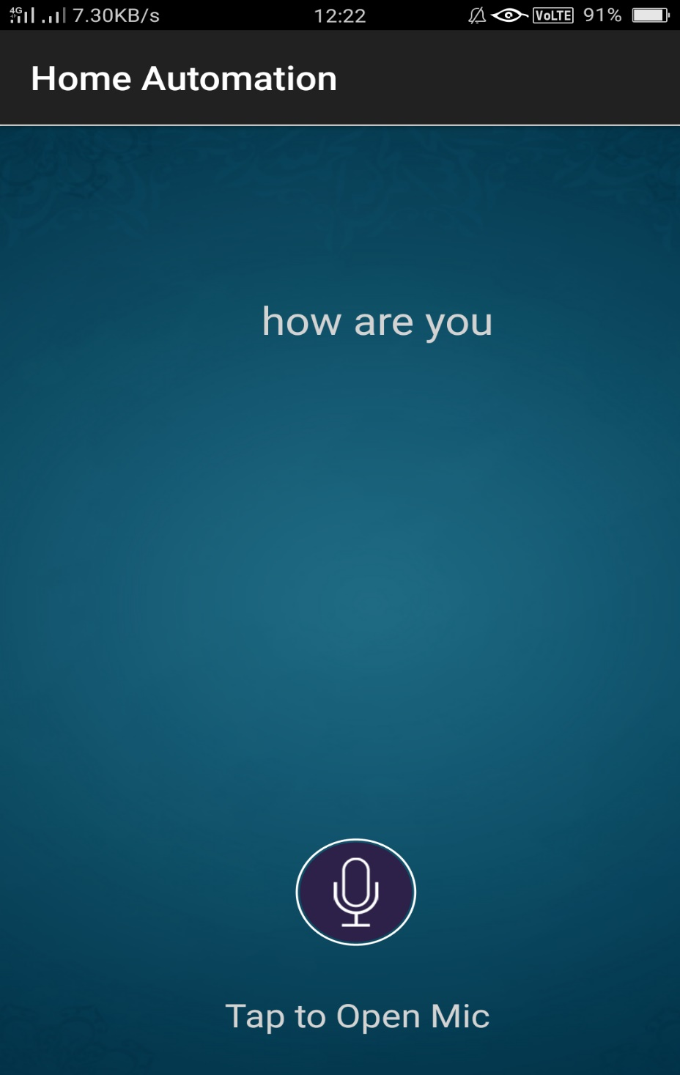
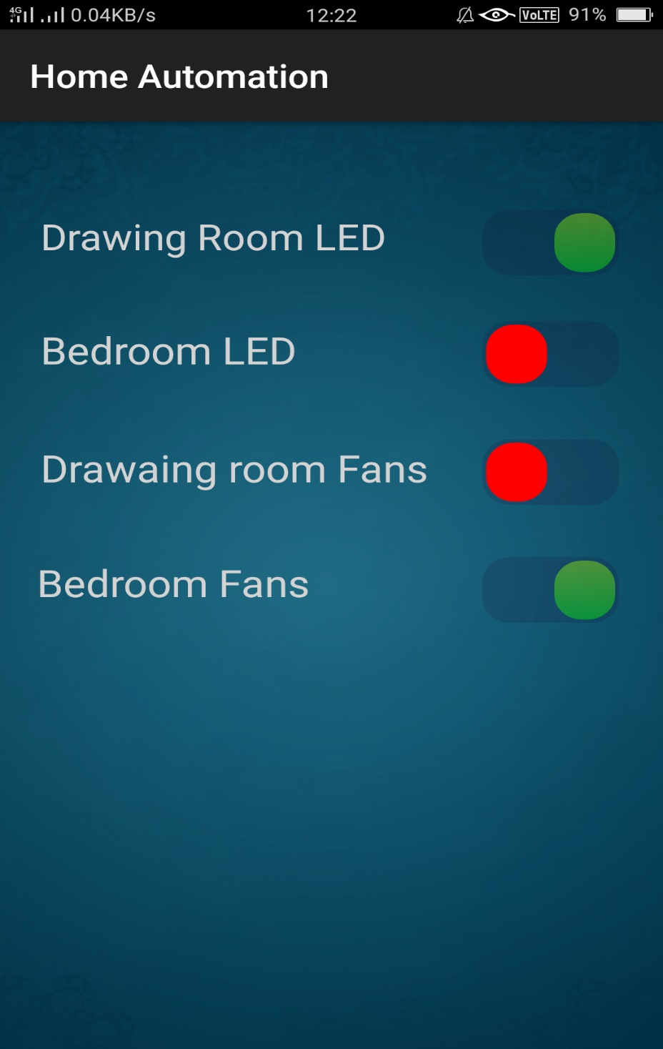

Slide 14
ADVANTAGES:
Easy to install and use.
Managing all of your home devices from remote location.
Able to know the status of the appliances.
Energy-efficient and Saves Money.
Convenience.
Security.
No hassle of ever switching the lights, fans, etc.

Slide 15
APPLICATIONS:
It can also be used in Industries.
Important application for physically handicapped people and elderly people.

Slide 16
THANK YOU

