Slide 1
Introduction to Python

Slide 2
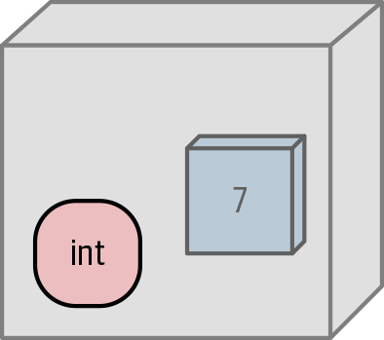
Python Data are Objects
In Python , an object is a chunk of data that contains at least the following:
A type that defines what it can do
A unique id to distinguish it from other objects
A value consistent with its type
A reference count that tracks how often this object is used
Python is Strongly typed language, means type of the object does not change.
Reference: Introducing python 2nd Edition by Bill Lubanovic, O’reilly

Slide 3
Python Data types
Numbers
Strings
Boolean
Sequence Types
Mapping Types
Set types
Binary types

Slide 4
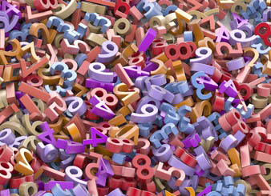
Numbers

Slide 5
Numbers
Numbers
int
float
complex
Numbers are divided into int, float and complex numbers.
Cont..

Slide 6
Numbers: integers
Literal Integers :
Any sequence of digits in Python represents a literal integer
>>> 5
5
>>> 0
0

Slide 7
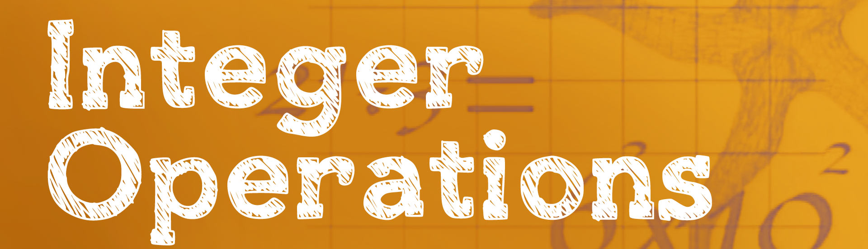
Operator | Description | Example | Result
+ | Addition | 5+8 | 13
- | Subtraction | 90-10 | 20
* | Multiplication | 4*7 | 28
/ | Floating-point division | 7/2 | 3.5
// | Integer(truncating) division | 7//2 | 3
% | Modulus(reminder) | 7%3 | 1
** | Exponentiation | 3**4 | 81

Slide 8
Operator Precedence: Numbers perspective
Operator | Description
() | Parenthesized expression
** | Exponentiation
+n,-n | Positive, Negative
*,/,//,% | Multiplication, float division, int division, remainder
+, - | Addition, subtraction
<, <=,>, >=, !=, == | Comparison operators

Slide 9

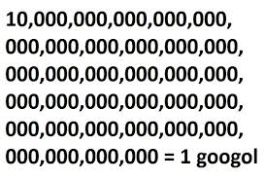
int size
Python 2.x:
Int could be limited to 32 or 64 bits, depending on your CPU.
32 bit: –2,147,483,648 to 2,147,483,647
long 64 bit: –9,223,372,036,854,775,808 to 9,223,372,036,854,775,807
Python 3.x:
Int can be any size >64 bits

Slide 10
Bases :
In Python, you can express literal integers in three bases besides decimal with these integer prefixes:
0b or 0B for binary (base 2)
0o or 0O for octal (base 8)
0x or 0X for hex (base 16)
value=64
bin(value)
oct(value)
hex(value)

Slide 11
Float:
Integers are whole numbers, but floating point numbers have decimal points.
Floats can include a decimal integer exponent after the letter e.
>>> 5.0
5.0
>>>05.0
5.0
>>> 5e0
5.0
>>>5e1
50.0
>>>5.0e1
50.0
>>>5.0 * (10**1)
>>> 1_000_000.0
1000000.0
>>>1.0_0_1
1.001

Slide 12
Complex Numbers:
In python, you can put ‘j’ or ‘J’ after a number to make it imaginary, so you can write complex literals easily:
>>> z=x*y
>>> print z
(-5+10j)
>>> z=x/y
>>> print z
(0.44+0.08j)
>>> print x.conjugate()
(1-2j)
>>> print x.imag
2.0
>>> print x.real
1.0
>>> x=complex(1,2)
>>> print x
(1+2j)
>>> y=complex(3,4)
>>> print y
(3+4j)
>>> z=x+y
>>> print x
(1+2j)
>>> print z
(4+6j)
>>> 1j
1j
>>> 1J
1j
>>> 1j * 1j
(-1+0j)

Slide 13
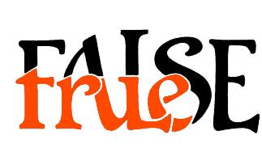
Boolean Datatypes :

Slide 14

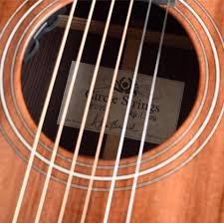
Strings

Slide 15
>>> 'Snap’
'Snap’
>>> "Crackle“
'Crackle'
The main purpose is to create strings containing quote characters. You can have single quotes inside double-quoted strings, or double quotes inside single-quoted strings.

Slide 16
>>> "'Nay!' said the naysayer. 'Neigh?' said the horse."
"'Nay!' said the naysayer. 'Neigh?' said the horse."
>>> 'The rare double quote in captivity: ".'
'The rare double quote in captivity: ".'
>>> 'A "two by four" is actually 1 1⁄2" × 3 1⁄2".'
'A "two by four" is actually 1 1⁄2" × 3 1⁄2".'
>>> "'There's the man that shot my paw!' cried the limping hound."
"'There's the man that shot my paw!' cried the limping hound."

Slide 17
You can also use three single quotes (''')or three double quotes ("""): Their most common use is to create multiline strings
>>> poem = '''There was a Young Lady of Norway,
... Who casually sat in a doorway;
... When the door squeezed her flat,
... She exclaimed, "What of that?"
... This courageous Young Lady of Norway.'''
>>>

Slide 18

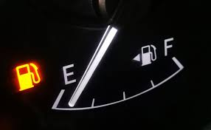
By the way, there’s a difference between the output of print() and the automatic echoing done by the interactive interpreter:
print() strips quotes from strings and prints their contents. It’s meant for human output. It helpfully adds a space between each of the things it prints, and a newline at the end:
>>> print('Give', "us", '''some''', """space""")
Give us some space
>>> ‘’
‘’
>>> "“
‘’
>>>''‘’’’
‘’
>>>"""""“
‘’
>>>

Slide 19
Create with str()
You can make a string from another data type by using the str() function:
>>> str(98.6)
'98.6'
>>> str(1.0e4)
'10000.0'
>>> str(True)
'True'
Python uses the str() function internally when you call print() with objects that are not strings and when doing string formatting, which you’ll see later in this chapter.

Slide 20
Escape with \ :
Python lets you escape the meaning of some characters within strings to achieve effects that would otherwise be difficult to express. By preceding a character with a backslash (\),you give it a special meaning.
>>> palindrome = 'A man,\nA plan,\nA canal:\nPanama.’
>>> print(palindrome)
A man,
A plan,
A canal:
Panama.

Slide 21
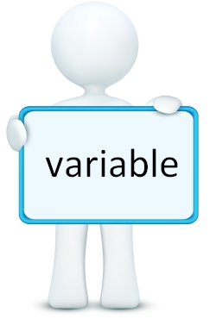
Variables in Python
Variable—name for values in your computers memory that you want to use in a program.
Python variable names have some rules:
They can contain only these characters:
Lowercase letters (a through z)
Uppercase letters (A through Z)
Digits (0 through 9)
Underscore (_)
They are case-sensitive: thing, Thing, and THING are different names.
Cont..

Slide 22
Variables in Python
They must begin with a letter or an underscore, not a digit.
Names that begin with an underscore are treated specially
They cannot be one of Python’s reserved words (also known as keywords).
False await else import pass None break except in raise True class finally is return and continue for lambda try as def from nonlocal while assert del global not with async elif if or yield
Cont..

Slide 23
Python Built-in Data types:
Text type: str
Numeric Types: int,float,complex
Sequence Types: list, tuple, range
Mapping Types: dict
Set Types: set
Boolean Type: bool
Binary Types: bytes, bytearray, memoryview

