Slide 1


Karime Salomon Z.

Slide 2
Welcome
What are you expecting from this course.
Do you have knowledge about ruby or cucumber?

Slide 3
Objectives
Learn basic concepts to start programing in ruby
BDD – BDT Basics
Learn cucumber in order to be ready to start working with any automation framework
Be ready to apply this approach even for Services / Backend / UI testing

Slide 4
Plan
Ruby
Operators
Class
Variables
If, else, case, unless
Loops
Method
Modules and Mixing
Arrays / Hashes
Iterators
Cucumber
BDD & BDT
Gem installation
Structure
Gherkin
Features
Scenarios
Steps definitions
Hooks
Base framework definition

Slide 5





Rules

Slide 6
Ruby
What is ruby
Ruby is a cross-platform interpreted language which has many features in common with other ‘scripting’ languages such as Perl and Python. The Ruby language was created by Yukihiro Matsumoto (commonly known as ‘Matz’) and it was first released in 1995

Slide 7
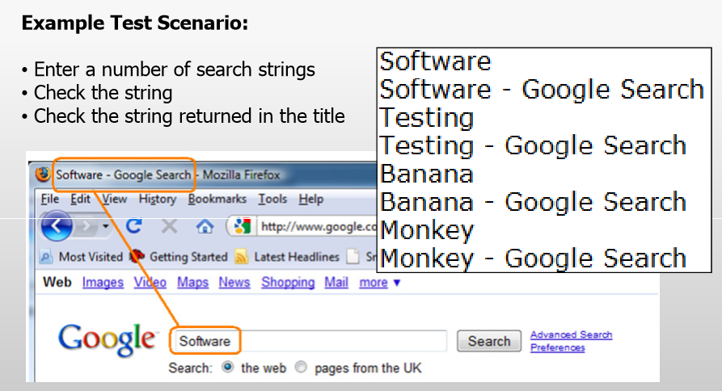
Ruby, why do testers prefer it?

Slide 8
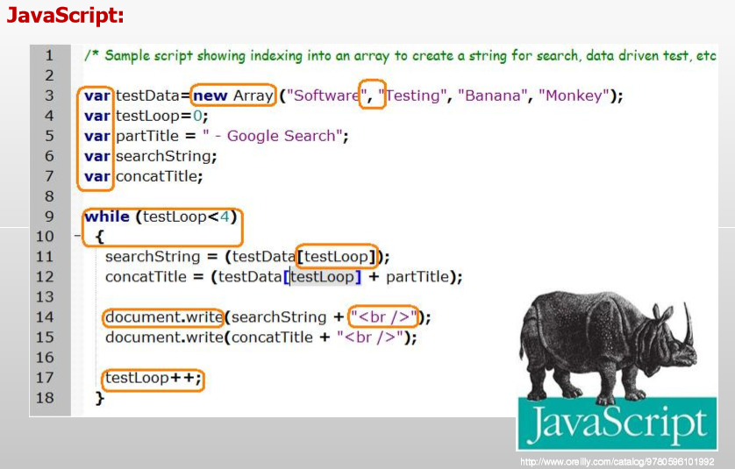

Slide 9
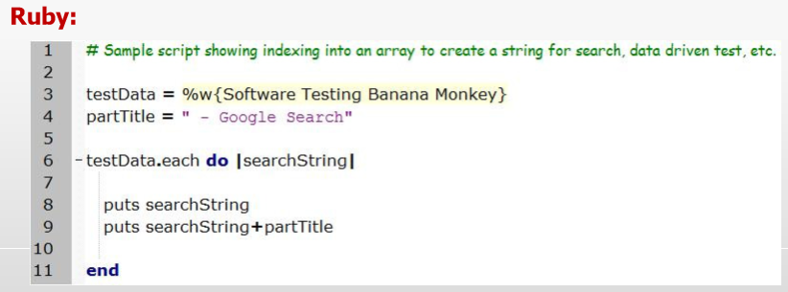

Slide 10

Ruby, why do testers prefer it?
Testers don’t get time to code constantly, the chosen language must:
be easy to learn
flexible in use
Powerful
Ruby is a fully fledged, programmatic language
It can be used to test GUI
Extended to test mid-tier applications
and is growing in popularity
Mark Crowther

Slide 11
Ruby’s PROS / CONS
PROS
No too much code conditions
No more import files or classes to be used
No need to include files/libraries
No more ;
New simple way to define code
Many code already created to implement the options that you need
CONS
No Multiple Inheritances
You should define the guideline of your own code according the rules defined in the team

Slide 12
Let’s start installing Ruby
Install ruby according your SO.
ruby –v #ruby version
Install compatible dev kit
Why ?
Some gems has dependencies which, out of the box, only provide raw source code. To make them into fully functional executables, you’ll need to install the Development Kit.
How?
Open a CMD and go to your devkit path :
ruby dk.rb init
ruby dk.rb install

Slide 13
Git ?
Fork the Repository : https://github.com/karimeSalomon/QE_training_BDT_ruby.git
To get the code : git clone <URL_of_fork_repo>
Add your changes : git add .
All changes (.) or give some specific file : git add <file>
Commit your changes : git commit –m “any commit comment”
Push your code: git push
All changes need to be pushed to your local repository, send a pull request to merge them into the main repository.

Slide 14
Sync fork repo
git remote –v
Will display current configured remote repository
git remote add upstream <original_repo>
Will add the synchronization form your fork with original repository.
git fetch
git pull
git status
git push

Slide 15
Practice
Fork the repository
Add a text file with the answers to :
What is ruby?
What pros/cons you considered from the point explained in the class
According what we talked today, what are the 3 testing tiers?

Slide 16

Questions?

Slide 17
Thanks!

