Slide 1
First page

Slide 2
Principals page

Slide 3
Academic achievements

Slide 4
Sport’s achievements

Slide 5
Teachers pages

Slide 6
English articles(stories→poems)

Slide 7

Climate Change
A Global CRISIS Climate change, driven by human activities, represents one of the most urgent challenges the world is facing today. Primarily caused by the emission of greenhouse gases like carbon dioxide (CO₂) and methane (CH₄) from burning fossil fuels, deforestation, and industrial processes, it leads to significant and lasting changes in global weather patterns and temperatures. #Causes 1. Greenhouse Gas Emissions: Burning fossil fuels for energy and transportation is the largest source of CO₂. 2. Deforestation: Reduces the capacity of forests to absorb CO₂, leading to higher atmospheric levels. 3. Industrial Activities: Release various greenhouse gases and pollutants. #Impacts 1. Rising Temperatures: Increases in global temperatures lead to more frequent and severe heat waves. 2. Melting Ice caps and Rising Sea Levels: Accelerated melting of polar ice caps and glaciers contributes to sea-level rise, threatening coastal areas. 3. Extreme Weather Events: Increased frequency and severity of hurricanes, floods, and droughts. 4. Ocean Acidification: Absorption of CO₂ by oceans harms marine life, particularly shellfish and coral reefs. #Solutions 1. Mitigation: Reducing emissions through renewable energy sources, energy efficiency, and carbon capture technologies. 2. Adaptation: Building resilient infrastructure, developing early warning systems, and adopting sustainable agricultural practices. # Global Efforts The Paris Agreement, adopted in 2015, aims to limit global warming to well below 2 degrees Celsius above pre-industrial levels. Countries commit to setting and achieving national targets for reducing emissions. # Conclusion Climate change demands immediate and sustained action from all sectors of society. By transitioning to a low-carbon economy and implementing adaptive measures, we can mitigate its effects and ensure a sustainable future. Collective action is essential to address this global crisis effectively.
–Awijeet Sharma X

Slide 8



AMAZING FACTS ABOUT JAGANNATH TEMPLE
Puri Jagannath Temple, located in the eastern state of Odisha, India, is one of the most revered Hindu temples in the country. Dedicated to Lord Jagannath (a form of Lord Vishnu), the temple is renowned for its rich history, architectural grandeur, and religious significance. Here are some fascinating facts about the Puri Jagannath Temple that highlight its uniqueness and cultural importance: 1. Ancient Origins: The Puri Jagannath Temple dates back to ancient times, with records suggesting its existence since at least the 12th century CE. It is believed to have been built by King Anantavarman Chodaganga Deva of the Eastern Ganga Dynasty. 2. Deities: The main deities worshipped in the temple are Lord Jagannath (Krishna), his elder brother Lord Balabhadra, and their sister Devi Subhadra. The idols are made of wood and are replaced every 12 or 19 years during the famous Rath Yatra festival. 3. Mystery of the Sudarshana Chakra: The temple's flag atop the spire (called Neela Chakra) is adorned with a unique feature: the Sudarshana Chakra, a disc-like weapon associated with Lord Vishnu. Legend has it that the Chakra miraculously appeared during the temple's construction and has since been a symbol of divine protection. 4. Non-discrimination: The Puri Jagannath Temple is notable for its tradition of inclusiveness. Unlike many Hindu temples where entry is restricted based on caste or religion, the Puri temple allows entry to all devotees, regardless of their background.

Slide 9
5. Annual Rath Yatra: The Rath Yatra, or Chariot Festival, held annually in Puri, is one of the most spectacular religious processions in the world. During this festival, the idols of Lord Jagannath, Balabhadra, and Subhadra are placed on grand chariots and pulled through the streets by thousands of devotees.
6. Unique Kitchen: The temple operates a massive kitchen, known as the Ananda Bazaar or Mahaprasad Bhandar, where food is prepared for thousands of devotees daily. It is believed that the food, offered as Prasad (blessed food), becomes spiritually sanctified. 7. Magnetic Phenomenon: An intriguing aspect of the temple's architecture is its unique magnetic properties. It is said that the main spire of the temple produces a magnetic field that is capable of attracting compass needles from a distance. 8. Nabakalebara Ritual: Every 12 to 19 years, the idols of Lord Jagannath, Balabhadra, and Subhadra are ceremonially replaced with new ones in a ritual known as Nabakalebara (literally, "new body"). This elaborate ritual involves elaborate preparations and is considered highly auspicious. 9. Global Influence: The Puri Jagannath Temple has inspired similar temples and Rath Yatra festivals in various parts of the world, including in countries where Hinduism is practiced by diaspora communities. 10.Spiritual Significance: For millions of devotees, the Puri Jagannath Temple is not just a place of worship but a symbol of divine grace and spiritual fulfillment. Pilgrims from all corners of India and abroad visit the temple to seek blessings and witness its grandeur. The Puri Jagannath Temple stands as a testament to India's rich cultural heritage and spiritual traditions. Its architectural splendor, religious practices, and inclusive ethos continue to captivate visitors and devotees alike, making it a cherished icon of Hindu devotion and unity.
PRIYANSHU KUMAR CLASS – XI ‘A’

Slide 10

ARTIFICIAL INTELLIGENCE
Artificial intelligence (AI) is a process of making computers, robots and software that can think intellectually like a human mind. The artificially intelligent system of software runs on the same basis on which the human brain works. It started to develop in the 1950s, John McCarthy is considered the father of artificial intelligence. Automated cars, 3D printers, electric drones, ticket vending machine, robotic surgery machines, robots, voice assistant are some vivid examples of artificial intelligence. For the past 20 years, artificial intelligence has brought the fastest development in many countries and it is highly effective in military, law, finance, etc . In addition, many experts believe that AI can solve major challenges and crisis situations. Currently many big companies are engaged in the task of improving their platform with the help of artificial intelligence and many of them are making large investments in this technology. In many research centres around the World studies on this technology is going on AI has been in the discussion for the past several years. Scientists from all over the world discuss from time to time about its good and bad results. This technology is being used in every field to develop and speed up human life. The need of the hour is to take necessary steps to balance both the profit and loss of artificial intelligence before it is used by the people.
---Revathy Rajesh
XI ‘Science’

Slide 11

Understanding Phone Addiction and How to Manage It
In today’s world, smartphones have become a big part of our lives. While they help us stay connected and entertained, using them too much can lead to phone addiction. Here’s how you can understand and avoid it: What Causes Phone Addiction? Phone addiction happens for a few reasons: 1. Instant Gratification: Apps and social media give us instant rewards, like likes and messages, which can be addictive. 2. Fear of Missing Out (FOMO): We worry about missing important updates or news if we don’t check our phones constantly.
Tips to Avoid Phone Addiction:Here are simple ways to manage phone use better: 1. Set Time Limits: Decide how much time you’ll spend on your phone each day and stick to it. 2. Use Do Not Disturb: Turn on this feature during study time or family meals to avoid distractions. 3. Find Offline Activities: Discover hobbies like reading, playing sports, or drawing that don’t involve screens.
Conclusion:By being aware of how much time we spend on our phones and making small changes, we can avoid phone addiction. It’s about finding a balance between staying connected and enjoying other parts of life offline. Start with these tips and see how they can make a difference in your daily life

Slide 12

My Dear Mathematics
My dear mathematics
why did you play with tricks.
We say you are very hard
but teachers say you are worlds god
Math is full of operations
and math is full of equations
math is time taking but it
is the practice of IQ ,
making everybody say to learn tables.
I felt tables were fables
Math is very easy when you
understand the concept,
If u didn’t, in your exam you will be definitely wept.
To understand the properties of numbers,
I think we don’t need the help of plumber

Slide 13

Strategies to Crack Board Exams, JEE Mains, and Advanced
Hey there! I'm Prabhav Pradeep, a Senior from Kendriya Vidyalaya Kanchanbagh, Hyderabad. Today, I want to share some strategies that can help in tackling both board exams and the JEE Mains and Advanced. I promise I won't sound like a know it-all guru because I am just another ordinary student. Instead, I'll keep it light, humorous, and backed by some solid research and explain them with the help of two students, “BATBOY”AND “SUPER BOY”, yes, they are inspired from Super man and Batman….
Consistency is Key • First things first, consistency is crucial. It's not about studying for hours on end right from the beginning. Instead, start small and gradually increase your study time. • It's like building stamina for a marathon—start with a jog before you start sprinting. • Trust me, even Usain Bolt didn’t start off with 100-meter dashes
Active Recall and Spaced Repetition • Let's dive into some scientifically proven techniques that really work wonders. Ever heard of active recall? • It's an awesome technique where you actively try to remember the information rather than just passively reading it. • Picture this: after studying a topic, close your books and try to write down everything you remember. • This helps reinforce your memory and identify areas that need more work. It’s like trying to recall where you left your phone – except here, you’re supposed to know the answer.

Slide 14
Super boy vs. Batboy: Active Recall Edition
Super boy studies diligently. After reading a chapter, he closes his book and writes down everything he remembers, ensuring he can recall key points. This technique helps him reinforce his memory and pinpoint what he needs to revisit.
Batboy, on the other hand, makes it a bit more interactive. He quizzes himself using flashcards, sometimes even teaching the concept to his younger brother or his pet. This active engagement helps him solidify his understanding and keeps study sessions lively. Pairing active recall with spaced repetition is a don't want to drown it with water all at once, but a little bit every now and then keepsgame-changer. Use tools like Anki to review material at increasing intervals. Think of it as watering a plant regularly—you it healthy.
The Pomodoro Technique:To avoid burnout and maintain focus, use the Pomodoro Technique. This involves studying for 25 minutes and then taking a 5-minute break. After four such sessions, take a longer break of about 15-30 minutes. It's like giving your brain a power nap, keeping it fresh and alert. Plus, it gives you a chance to grab a snack and pretend you're on a cooking show during the break.
Superboy vs. Batboy: Pomodoro Edition Super boy sticks strictly to the Pomodoro timer, focusing intensely for 25 minutes and then taking a short break. This disciplined approach helps him maintain high levels of concentration. Batboy, however, tweaks the method slightly. He uses the breaks to do something physically active, like a quick set of push-ups or a walk around the house. This not only refreshes his mind but also keeps him physically active.
Mind Mapping:Mind maps are another nifty trick. They help visualize concepts and their interconnections, especially for subjects like Organic Chemistry and Physics. Drawing out mind maps makes studying feel a bit like doodling, which is a welcome break from plain old reading. It’s like creating a visual diary of your learning journey.

Slide 15
Super boy vs. Batboy: Mind Mapping Edition Super boy creates detailed mind maps with every chapter, ensuring all connections are clear and easy to review. Batboy uses colourful pens and drawings, making his mind maps visually engaging and memorable. This creative approach helps him recall information more easily.
The SQ3R Method:The SQ3R method stands for Survey, Question, Read, Recite, and Review. Start by surveying the chapter to get an overview, then create questions based on the headings. As you read, look for answers to those questions. After reading, recite the main points from memory, and finally, review everything to reinforce your understanding.
Super boy vs. Batboy: SQ3R Edition
Super boy follows the SQ3R method rigorously, ensuring he comprehends and retains information effectively.
Batboy makes it more engaging by turning it into a game. He challenges himself to answer questions before he reads the section, making it a fun competition with himself.
Timetable and Routine Having a structured timetable is a lifesaver. Dedicate specific hours to each subject and stick to the schedule as much as possible. Consistency and discipline are allies here. But hey, flexibility is important too. Sometimes, life happens, and it's okay to adjust the schedule. Think of your timetable as a rubber band – it’s flexible, but still snaps you back to shape.
Mock Tests and Analysis Mock tests are like rehearsals before the big performance. They help manage time and understand the exam pattern. After each test, spend time analyzing mistakes. This helps avoid repeating the same errors and improves performance over time. Imagine taking a wrong turn on a road trip; better to learn the correct route during practice than on the actual journey.

Slide 16
Balanced Lifestyle Maintaining a balance between study and relaxation is crucial. Make sure to take breaks, pursue hobbies, and engage in physical activities. A healthy mind resides in a healthy body, after all. Plus, taking breaks rejuvenates the mind and keeps stress at bay. Remember, even superheroes need downtime – nobody can study 24/7 without turning into a zombie.
Resources
Books and Material 1. NCERT Textbooks: These are your best friends for boards and a good starting point for JEE. 2. Coaching Material: Good Coaching is subjective and a choice to be taken according to personal convenience. 3. Reference Books: Books like H.C. Verma for Physics, I.E. Irodov for advanced problems, and O.P. Tandon for Chemistry are invaluable, but in most cases sticking to 1 material per subject is the key.
Staying Positive and Motivated Preparation for board exams and JEE is a marathon, not a sprint. There are times when it feels overwhelming, but staying positive and motivated is key. Surrounding yourself with supportive friends and family, and reminding yourself of your goals, keeps you going. Motivation can be like a seesaw – sometimes you're up, sometimes you're down, but staying balanced is what matters.
Prabhav Pradeep
2023-24 Batch

Slide 17

How to defeat a helium man
Defeating a helium man
Isn't a child's play.
Cuz he is an Aurum puppet
Made of boron clay.
But you can If you follow my words.
Then you won't need
Weapons and swords.
Waves and the nature,
Are your tools.
Aren't these taught
In the schools?
Send the man
To the waves.
Rather than sending
To the caves.
The waves completely
Shatters the man.
Absorbs in it
The poor man.
If this doesn't works,
Put him in the nature.
Cuz nature rather gives it a break
Or destroys his structure.
Leave it all to the nature and waves.
They will manipulate.
Just wait and watch,
He will eliminate.
Use these as your weapons,
As your tools.
You do not need the bombs,
Understand you fools!
Now go and use these
And become the greatest.
Now go and defeat
The so called smartest!
-- Divyanshi Nayak XII
‘Science’

Slide 18
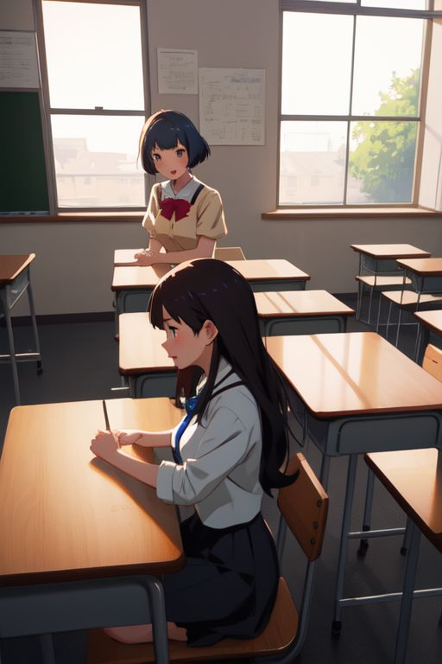

Those were the days
The mid-month of August,
My introduction in school was disgust
I had no space and stood still,
She called me to sit with a thrill.
My place was vacant for her in a blind wind
But, her thoughts are enwind like a day wind
The time sprinted for a moment,
I jumped up my bench.
Yes, it's her standing out,
My heart and tears broke,
My words and breathe choke,
We hugged and collected
Those memoirs back.
I stammer to talk, she too
Those were the days we never stopped to talk.
By K. Medha
12 A

Slide 19


Slide 20
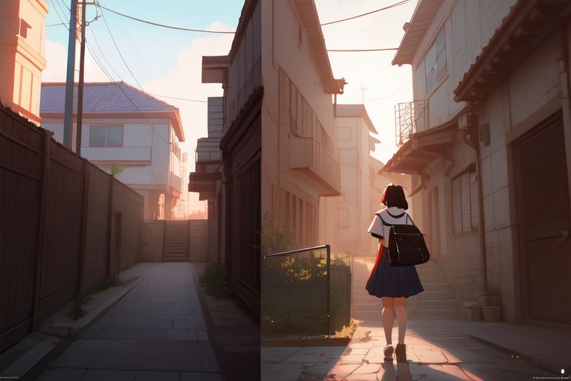

Slide 21


Slide 22


Slide 23
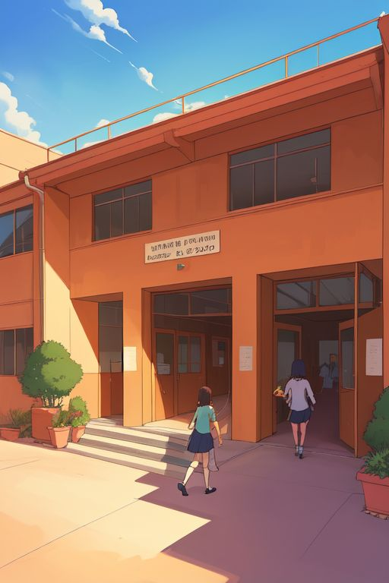

Slide 24


Slide 25


Slide 26


Slide 27


Slide 28


Slide 29


Slide 30
Echoes of KV: Forever in Heartbeats
In KV halls where dreams take flight, Students shine, hearts pure and bright.
Teachers guide with wisdom’s light, Friendships bloom, memories tight.
On playgrounds, laughter rings, We chase dreams on eager wings. Friendships bloom in moments sweet, In our hearts, a rhythmic beat.
Exams pass, lessons stay, In KV's light, we find our way. Years may pass, but bonds remain, KV’s spirit in our veins.
Forever bound by ties so sweet, In every heart,KV beats. By-Aashna.s

Slide 31
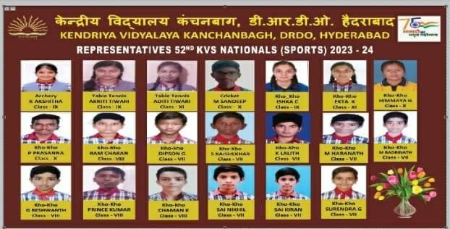
SPORTS ACHIEVEMENTS
KVS believes in all round development of a child. Along with physical, sports athletics also plays an important role.
Students of KV Kanchanbagh always show their efficiency in Games and Sports. We are telling you all the special achievements of our school in the year 2023-24. One of our student Rajashekhar of class VIII attended Summer Camp in Football and he got Gold Boot award after his tremendous performance. In KVS Sports Competitions. Also many of our students performed very well. One of our student named Akshitha of Class IX got Gold Medal in Archery in KVS (HR) Regional Sports
Meet, and also got selected for KVS National Sports Meet. In continuation our two girls students name Adity Tiwari and Akrity Tiwary of Classes 11 and 8 are also got selected for KVS Nationals in Table Tennis. Our 12 Boys Students also Got selected for KVS National Sports Meet in Kho-Kho, 2 Girls Also Got Selected for KVS National in Kho-Kho Game. Two Students Akshitha and Prasanna got cash award of amount 5000/- and 3000 for best performance in the 53rd KVS National Sports Meet-2023.

Slide 32
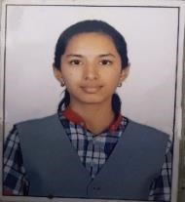
G R A T I T U D E T O WA R D S T H E M O T H E R O F A L L THE NATURE
If humanity is to be revived in the 21st century, then it must undertake a great shift in our
consciousness. There is so much going on globally at the moment in terms of pollution, terrorism, and diseases among many other unfortunate events. Each one of us first needs to realize the eternal relationship that exists between us and our planet. To revive our ailing environment, each of us needs to spread the healing energy, compassion and love in our society. We must do whatever help we can do to save our earth and earthlings. This is the only way we can express our deep gratitude for all the blessings we have while we inhabit this planet. As we strive to realize the oneness with all life on earth, each will come to know what it truly means to make the most of our own lives and feel the gratitude for the same.
You can start by planting a tree in your backyard, donating books and clothes that you no longer use, educating a child, and cleaning the street. You can even visit orphanages and old age homes and spend some of your time with the underprivileged. There are many ways in which you can show gratitude towards your environment. Feed even one stomach that aches out of hunger and see the happiness that it brings to you and to the person at the receiving end. The list is endless. Like a garden that requires nurturing for seeds to grow into trees, we need to nurture our environment, until love and gratitude comes streaming out from our hearts naturally. We shouldn’t have to think to pick up a piece of garbage on the street and dispose it properly. It should come naturally and be the very essence of our being.
Name: T. Saanvi Class: XI

Slide 33
Experience of a PRAYAAS Participant
Warm greetings from Divyanshi Nayak of XII science to all reading my journey of participating in PRAYAAS program. I wish that this story will inspire you to push yourself out of your comfort zone and bring your inner amazing creativity out in front of the world and the problem solver that resides within you. I pay a huge tribute and my heartfelt gratitude to my guide teacher Mr. Sunil Vodela sir for his guidance and support and a special mention to Dr. K Prabahar sir.
Participating in the PRAYAAS program was a transformative experience for me. Initially, I joined the program with the hope of expanding my knowledge and skills, but it ended up being so much more than that. The journey started with workshops and sessions with Sunil sir that focused on various aspects such as leadership, innovation, and community service. Each session was meticulously designed to get me of my comfort zones and encourage me to think critically and creatively.
The regional level competition was my first major challenge. Competing with so many talented students was daunting, but it also fueled my determination. My project was to integrate laser technology with manhole safety. This primarily aimed on informing people about open manholes to prevent any mishap. My Guide and HEI provided invaluable guidance, helping me refine the idea and improve my presentation skills. When I was announced as one of the finalists for the national level, it felt like all the hard work had paid off.
The national level competition was on a whole new scale. The stakes were higher, and the competition was fiercer. It was inspiring to see how far everyone had come and how innovative their projects were. The atmosphere was electric, filled with a mix of nervousness and excitement.
When I was in front of the judges to present my project at the national level, I felt a mix of nerves and confidence. The feedback from the judges was incredibly positive, and I could see the appreciation for the hard work and innovation behind my project. Although getting qualified till the national level was an incredible achievement, the real reward was the journey itself – the skills I acquired and the confidence I gained.
Participating in PRAYAAS has been a cornerstone in my academic and personal development. It taught me the value of perseverance, the importance of community, and the power of innovation. This experience has ignited a passion in me to continue working on solutions that can make a difference in the world.
--- Divyanshi Nayak

Slide 34
NATURE
Oh! nature
I am small child
Belonging to a city By the irritation
I'm here to find the peace.
You are so different
From others,
For that I think
You are called nature
You have all the facilities
Like a city does;
But people think
"City is better than nature"
But I think nature is beat from Other; and I will prove it...
You are quite
Like a library"
"At night , you are noisy
Like a street "
"You are tame
Like a house"
"You are wild
Like a zoo"
"You make me happy
Like a man-made garden You make me sad, sometimes
Like a desert"
You are my holy place
You have everything
You have trees, plants, water, animal, birds, food, etc.
One day will come
Human will understand;
" The importance of nature"
And I will wait for that
"

Slide 35
RAIN
Oh Rain!
Oh my dear Rain!
You're so marvelous!
Making our lives fabulous!
The sound of the pitter-patter, there's a pleasant feeling which you scatter.
You bring the rainbow, which grows the plant of happiness, which you sow.
Somewhere peace and harmony, and somewhere love.
Then somewhere disasters!
You are truly a master!
Whenever I'm sad, you hide my tears. Whenever I'm afraid, you smash all my fears.
Dear Rain, you're so plain, yet wash out, all my pain!
I love in you to drench,
'cause of the thirst you quench!
Until the next rain, I won't forget you and keep loving you!
Oh Rain!
Oh my dear Rain!
-- Debashish Nayak

Slide 36
WOMEN EMPOWERMENT : WINDS OF CHANGE
Women empowerment has become the buzzword today with women working along side men in all spheres . They profess an independent outlook whether they are living inside their home or working outside . they are increasingly gaining control over their lives and taking their own decisions with regard to their education , career, profession , and life style . With steady increase in the number of working women , they have gained financial independence , which has given then confidence to lead their life and build their own identity . They are successfully taking up jobs to prove that they are second to none in any respect. But while doing so , women also take care to strike a balance between their profession as well their home and family . They are also playing multiple roles of a mother, sister, wife and a working professional with remarkable harmony and ease .With equal opportunities to work, they are functioning with a sprit of team work to render all possible cooperation to their male counterparts in meeting the deadlines and targets set in their respective professions.
Women empowerment is not limited to urban working women but women in remote towns and villages are now heard loud and clear in society. They are no longer willing to play second fiddle to their male counterparts . Educated or not , they are asserting their social and political rights and making their presence felt , regardless of their socio economic backgrounds. While it is true that , by and large, don’t face discrimination in society today , unfortunately ,many of them face exploitation and harassment which can be of diverse types:
Emotional 2)Physical 3)Mental4) sexual.
They are often subjected to abuse and other physical and intellectual violence . women empowerment , in the truest sense will be achieved only when there is attitudinal change in society with regard to womenfolk , treating them with proper respect, dignity , fairness, and equality. The rural areas of the country are , by and large steeped in a feudal and medieval , outlook, refusing to grant women equal say in the matters of their education , marriage , dress code, profession, and social interactions .
Let us work together so that women empowerment spreads to progressive as well as backward areas of our vast country
THANK YOU
NAME: SANIKA CHAKRABORTY CLASS 11TH

Slide 37
Life Is Now…
I know not what lies ahead.
But, fearlessly I forge my way,
Into the unknown path of life,
Leaving behind all fears at bay.
True! Life’s all hopes and despair.
Yet, I wish it to be just and fair.
Well! With roses come a few thorns.
And that is something I must bear.
Who has seen the future?
Surely, it’s neither you nor I.
So, only now is the real hour,
or all things that I can try.
Why wait for a grand tomorrow,
When I may have only a today?
Then it must be certainly now,
And in no other way, a later day.
Oh! Beauty of life is incredible.
It’s treading the untrodden path.
The onus lies in me to make or mar.
And dare life’s fury and wrath.
Hey! Worry not about tomorrow.
Never cry and regret the past.
That is the true secret of life,
For, life is now, so make it last.
Shamim Banu
HM, KV Kanchanbagh

