Slide 1
BDS-06: Campus Occupancy Forecasting
T.Y. B.Sc. Data Science | Capstone Presentation
Project Code: BDS-06
Academic Level: T.Y. B.Sc. Data Science
Scope: Verified local startup MVP
Prototype: FastAPI + Streamlit + Docker
Verified runtime
Docker + API + Dashboard active
Verified scope
1-room, 1-hour, point forecast
Student Name: [Insert student name]
Guide / Institution: [Insert guide name and institution]
BDS-06 | Verified local capstone prototype | 2026-10-02

Slide 2
Problem Statement
Why campus space planning needs better visibility
Nominal schedules and enrollment alone do not show actual room usage.
Facilities teams need better visibility into utilization, wasted capacity, and near-term demand.
This project addresses the problem on a synthetic campus dataset with a verified local prototype.
The scope is decision support, not deployment to a live institutional environment.
Key issue
Room occupancy is not the same as timetable availability.
BDS-06 | Verified local capstone prototype

Slide 3
Objectives
What the project set out to demonstrate
Build a reproducible campus occupancy analytics workflow.
Forecast one-room occupancy for a one-hour horizon using a causal feature pipeline.
Measure utilization using verified metrics: SUR, RFU, and WSH.
Explore room grouping behavior through analytical clustering.
Compare heuristic and optimization-based allocation on synthetic data.
Deliver a secure, local dashboard and API for read-only operational review.
Verified scope
Read-only local MVP
BDS-06 | Verified local capstone prototype

Slide 4
Proposed Solution
Modular analytics and decision support pipeline
1. Data intake
Synthetic room, timetable, event, and occupancy data
2. Cleaning & validation
Schema checks, timestamps, and data integrity validation
3. Feature engineering
Calendar, lags, room context, rolling behavior, causal features
4. Forecasting
XGBoost one-hour point forecast with chronological holdout
5. Analytics
SUR, RFU, WSH, clustering, scenario comparisons
6. API
FastAPI health, metrics, forecast, security, and robust errors
7. Dashboard
Overview + Forecast Explorer for local operational review
8. Decision support
Analytical recommendations, bounded by synthetic scope
BDS-06 | Verified local capstone prototype

Slide 5

System Architecture
Verified project architecture
Figure: Verified local architecture showing the FastAPI backend, Streamlit dashboard, and data/model dependencies.
BDS-06 | Verified local capstone prototype

Slide 6

Data Flow and Methodology
Synthetic data to forecast and dashboard
Figure: Data generation, validation, model inference, and dashboard delivery pipeline.
BDS-06 | Verified local capstone prototype

Slide 7
Forecasting Approach
Supported local forecasting boundary
Model: XGBoost regressor trained on synthetic room and scheduling data.
Scope: verified one-room, one-hour forecast only.
Semantics: point estimate; no calibrated uncertainty intervals are claimed.
Leakage control: chronological train/validation/test split and causal feature logic.
Example: room B01-R101, forecast horizon 1 hour, output around 0.6201575398445129.
This is a short-term operational estimate, not a broad multi-horizon system.
Verified forecast
Room B01-R101
1-hour horizon
Point estimate
BDS-06 | Verified local capstone prototype

Slide 8
Analytics and Optimization
Local analytical capabilities and bounded comparisons
Analytics: SUR, RFU, and WSH are implemented and verified through the API for campus/building/room views.
Clustering: seeded room behavior clustering is implemented as an analytical capability, not a live dashboard page.
Optimization: greedy baseline compared with CBC MILP on synthetic assignment data.
Evidence: feasible solutions were produced; the same objective value was observed in one local trial.
These are analytical decision-support functions, not unsupported public operational guarantees.
Important
Not a separate live dashboard page
BDS-06 | Verified local capstone prototype

Slide 9
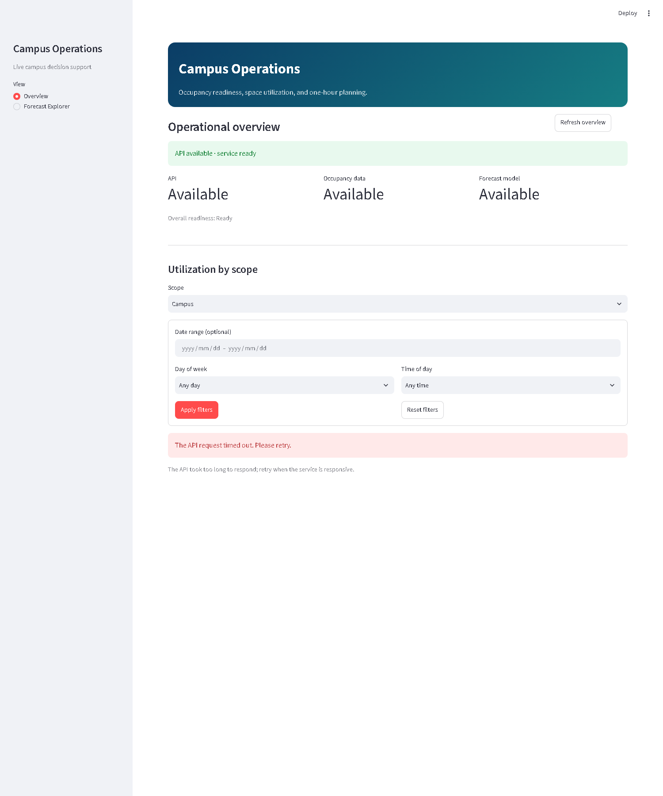
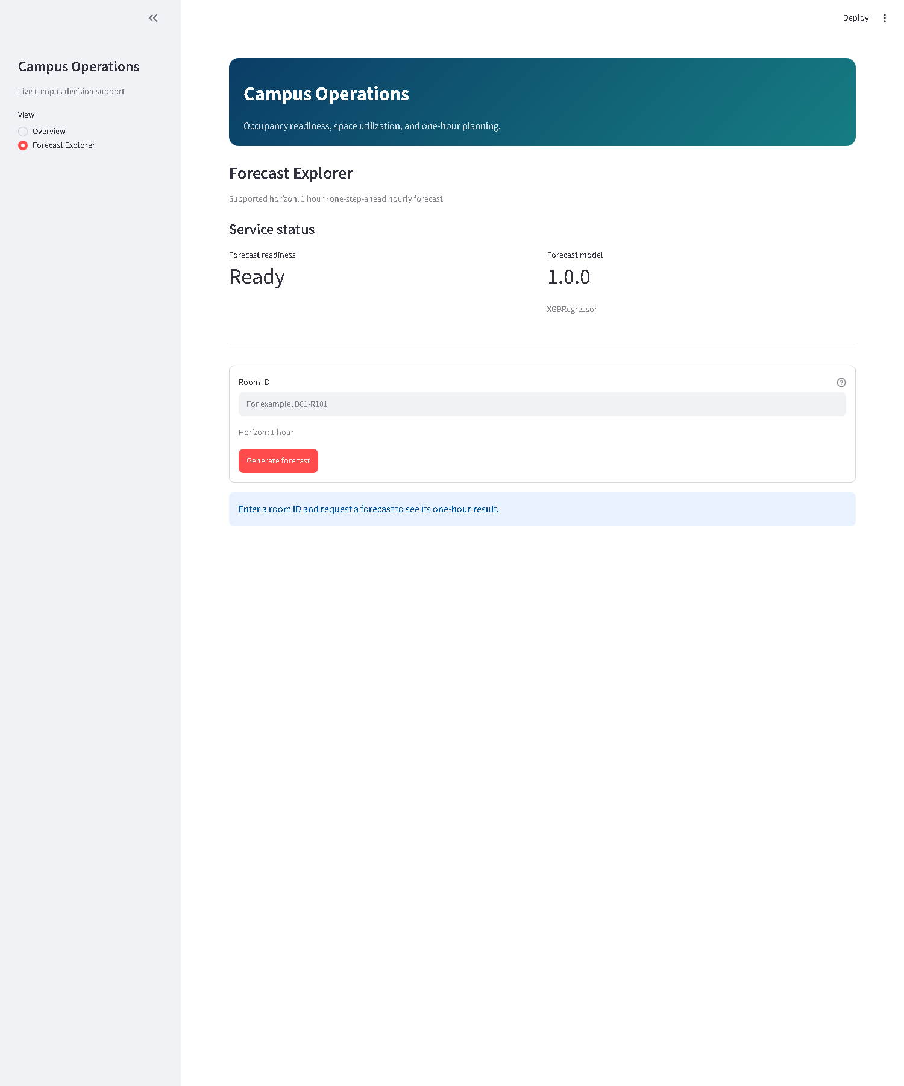
Dashboard
Overview and Forecast Explorer as the user-facing MVP
Verified dashboard evidence: Overview page, KPI summary, and Forecast Explorer request flow.
BDS-06 | Verified local capstone prototype

Slide 10
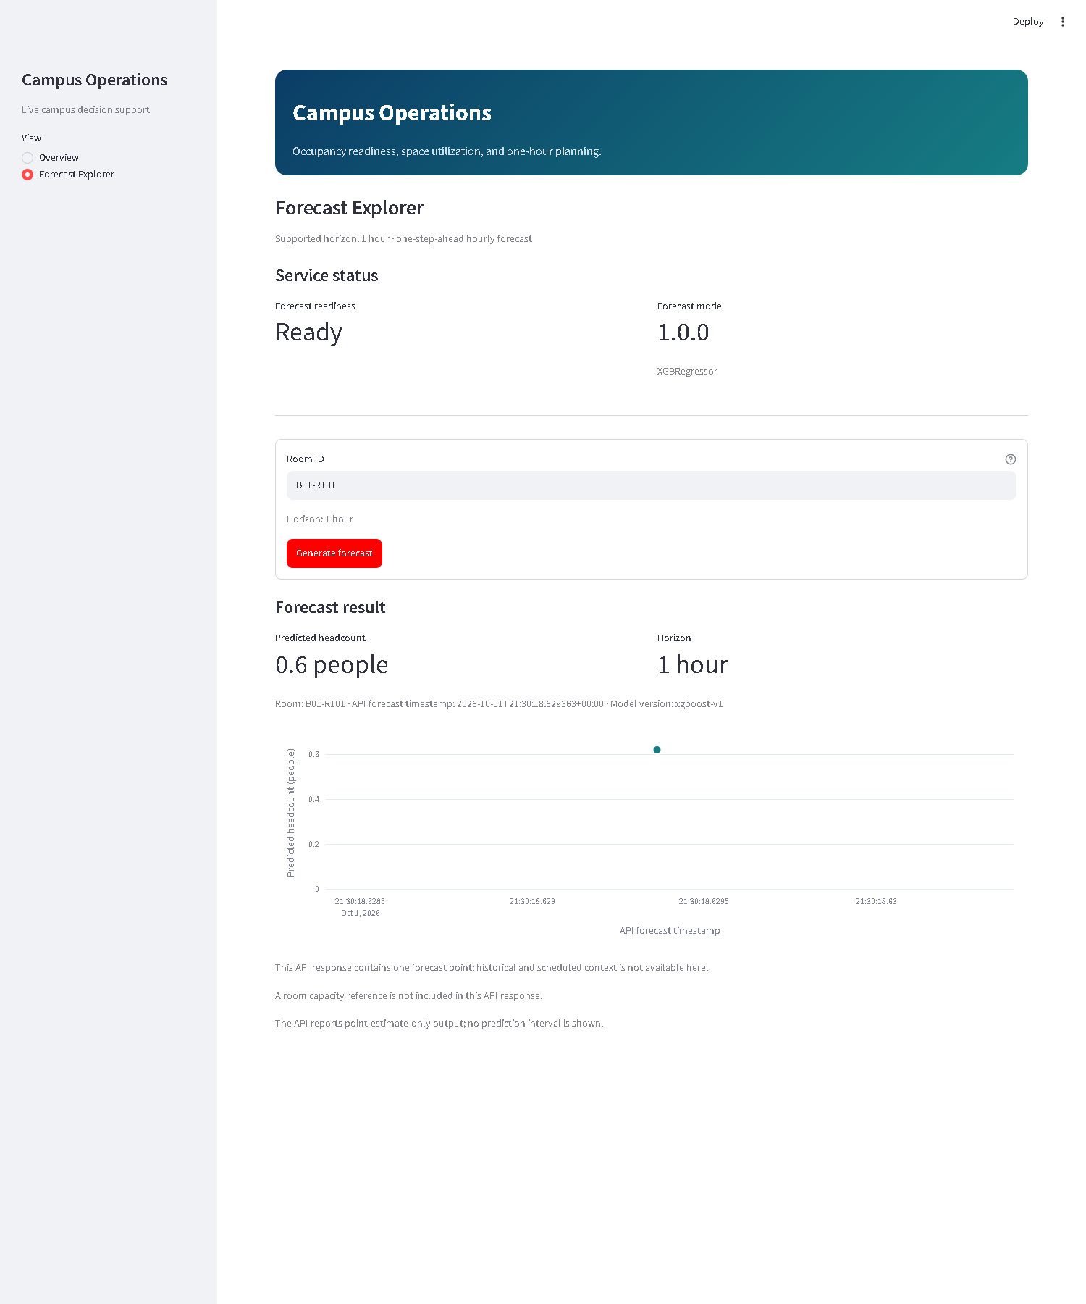
Live Forecast Demonstration
Verified local forecast output
Room B01-R101 | Horizon: 1 hour | Prediction: point estimate only | Verified local runtime evidence.
BDS-06 | Verified local capstone prototype

Slide 11
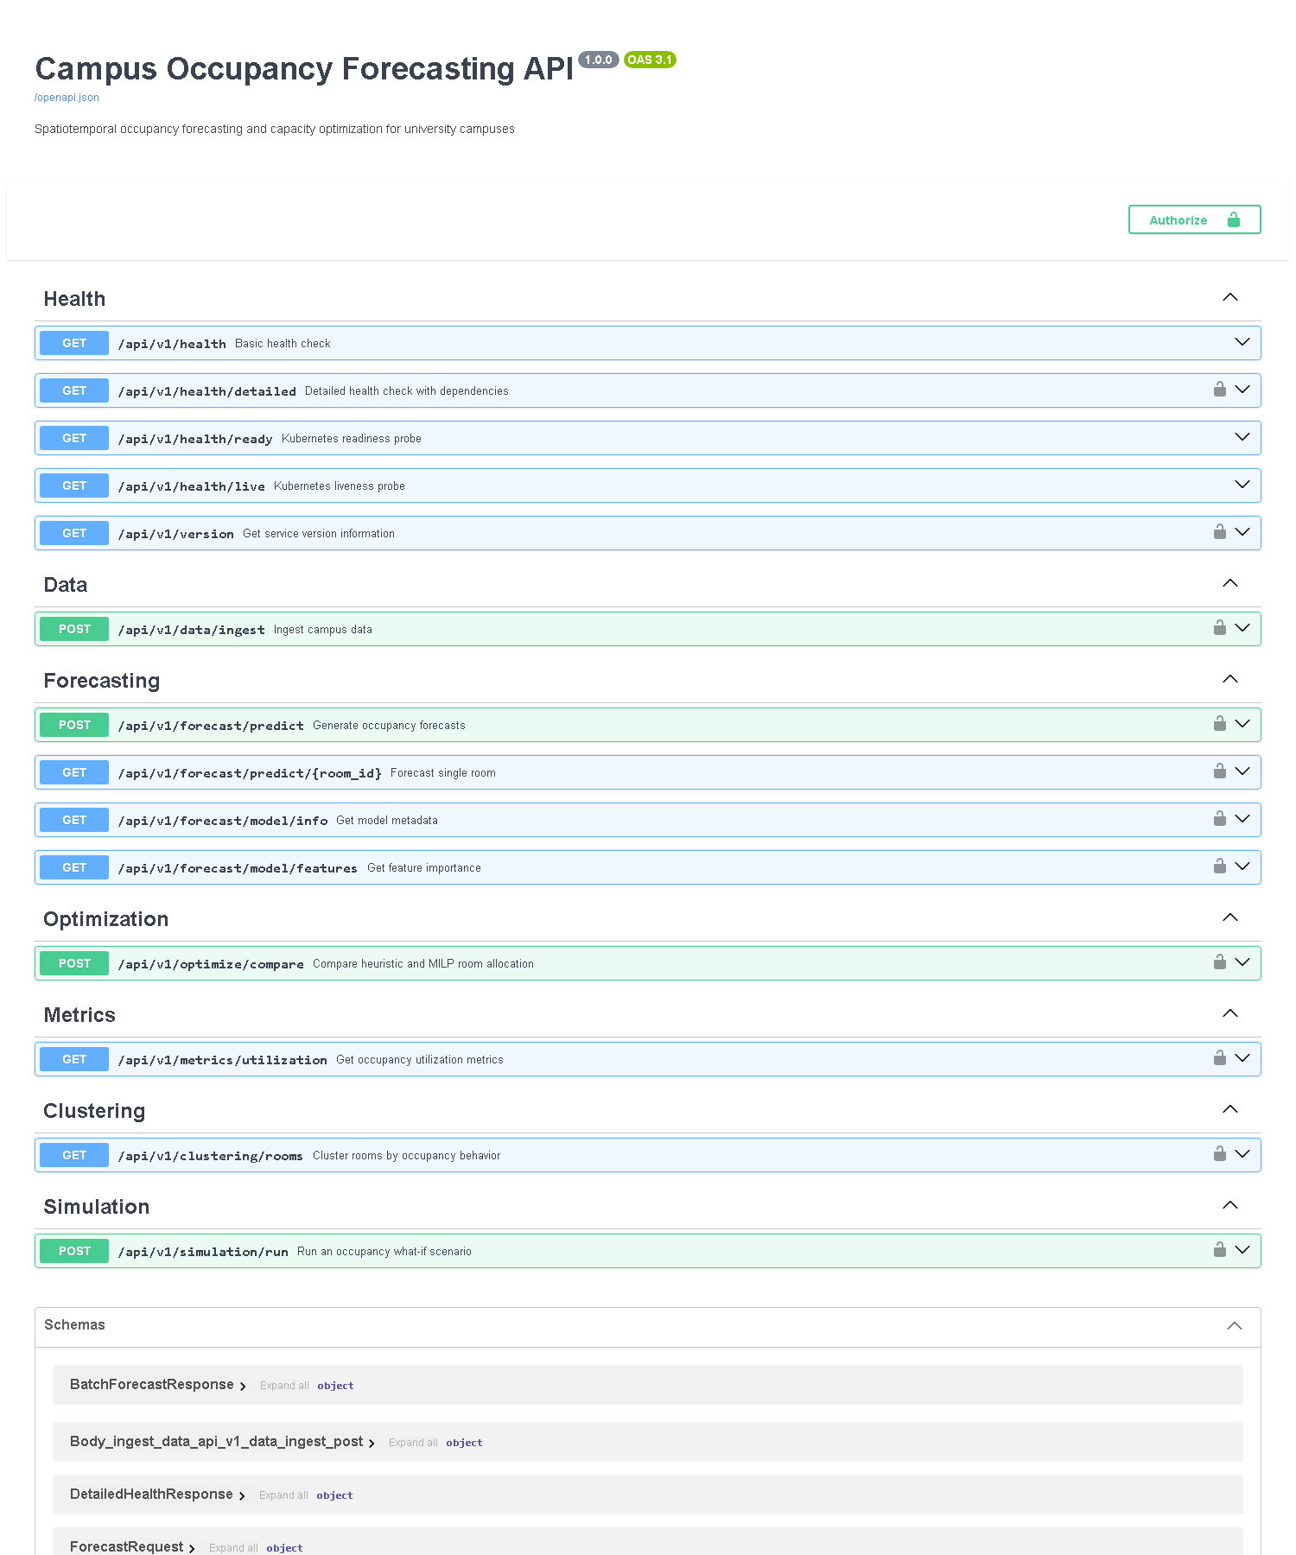
Security and Robustness
Verified boundaries for the local MVP
API key enforcement is active for protected routes.
Missing/invalid credentials return safe 401 responses.
A read-only key was denied optimizer access with a 403 response.
Unknown room and invalid input are handled without exposing tracebacks.
Health and readiness checks confirm the service is operational.
This is a controlled local prototype boundary, not a public production identity system.
BDS-06 | Verified local capstone prototype

Slide 12


Testing and Reproducibility
Verified runtime and validation evidence
Evidence: Docker local runtime running, and automated validation reported 178 passed with 1 warning in 53.36 seconds.
BDS-06 | Verified local capstone prototype

Slide 13
Results
What the verified project actually demonstrates
Verified runtime: Docker Compose stack, API health, dashboard readiness, and dashboard-to-API communication all succeeded locally.
Forecast capability: one-room, one-hour, point-estimate forecast works in the checked-in runtime.
Dashboard functionality: Overview and Forecast Explorer operate with real API-backed data and safe error states.
Security boundaries: access control and dependency checks are implemented and tested.
Leakage controls: the project includes chronological validation and causal feature checks.
Known limitation: the result is a synthetic, local prototype rather than a production campus deployment.
Verified result
Local prototype works
BDS-06 | Verified local capstone prototype

Slide 14
Limitations and Future Work
What is not yet evidenced and what could follow
Synthetic data only; no real campus sensor or schedule integration is proven in this repository.
Forecast scope is intentionally limited to one-hour point estimates; multi-horizon and interval forecasts are deferred.
The optimizer and clustering are analytical capabilities, not separate dashboard pages or validated production workflows.
No public cloud deployment or institutional approval is claimed.
Future work would require real-data validation, broader forecasting, stronger calibration, and full operational security review.
Limitation
Evidence remains bounded
BDS-06 | Verified local capstone prototype

Slide 15
Conclusion
Academic and engineering value of the project
The project demonstrates a credible local campus occupancy analytics workflow and a working decision-support prototype.
From a software engineering perspective, it shows a clean modular architecture, operational API health checks, secure boundaries, and reproducible local startup.
From the data science perspective, it demonstrates causal forecasting logic, leakage-aware validation, and meaningful utilization analytics.
The core value is evidence-based local planning support within a clearly bounded prototype scope.
Thank You
Questions & Discussion
Final message
Verified local evidence
Academic prototype
BDS-06 | Thank You | Questions & Discussion

