Slide 1
Face Recognition
Vishal jha
08215002716

Slide 2
Organisation
I have completed my summer training in MACHINE LEARNING with PYTHON from AKATVA TCSion.
They teach many courses here, android,java ,big data Hadoop,PHP etc.
ION digital learning hub is a complete learning solution for all they have good atmosphere and mentors have high qualification.
Throughout my training I learnt many technical skills

Slide 3
Introduction
In everyday life humans are more depoendent to electronic devices , instead of pen and paper people are more attracted towards face to face .
This growth in electronic transactions results in great demand for fast and accurate user identification and authentication .
Access codes for buildings, bank accounts and computer systems often use PIN's for identification and security clearences.
FACE RECOGNITION technology may solve this problem since a face is undeniably connected to its owner expect in the case of identical twins

Slide 4
biometrics
A biometric is unique, measurable characteristic of human being that can be used to automatically recognize an individual .
Types of biometrics:-
PHYSIOLOGICAL | BEHAVIORAL
a. Finger scan b. Facial Recognition c. Iris-scan d. Retina scan e. Hand scan | a. Voice-scan b. Signature scan c. Keystroke-scan

Slide 5
TOOLS & technology USED
PYTHON 3.6
ANACONDA
SPYDER
IDLE

Slide 6
LIBRARIES & MODULES USED
NUMPY
PANDAS
MATPLOTLIB
OS
PIL
IMAGE
SCIKIT LEARN

Slide 7
objective
Modern devices are having more security in less time for which recognizing faces to recignize person will be a efficient way .
Recognizing face can be used in devices, cars , house security .
Purpose of this project is to create a face recognized attendance system in education institutions.

Slide 8
Advantages
Less time consumption for attendance
Mare time for lecture
Accuracy of attendance
No more proxy in classes
No need of paper works in attendance
Automated system easy to use .

Slide 9
How does it work
This project work in 4 steps:-
Image creater
Image trainner
Creating datasets
Image detection

Slide 10
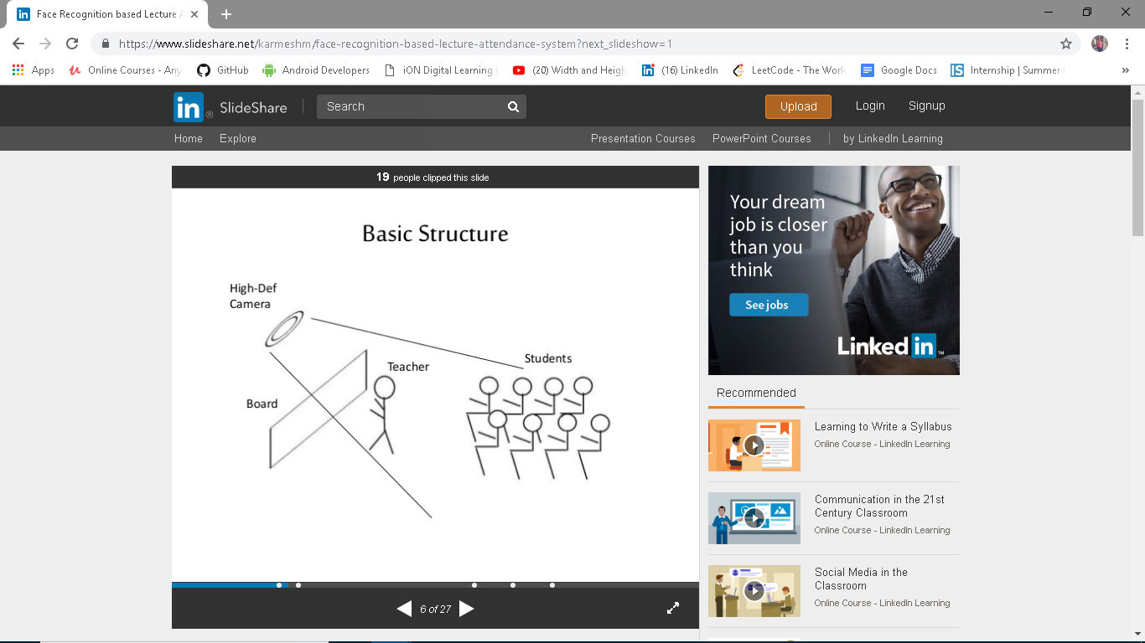
Implementation Step-1

Slide 11
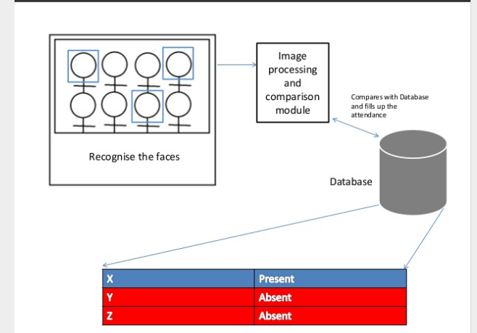
PROCESSING

Slide 12
THINGS I LEARNT
I LEARNT VARIOUS PROGRAMMING SKILLS HERE I was not familiar with python I learn that in this summer trainning program .
I learn how machine learning is an advatage to programmers .
Machine learning is the future of programming world.

Slide 13
THANKYOU

