Slide 1






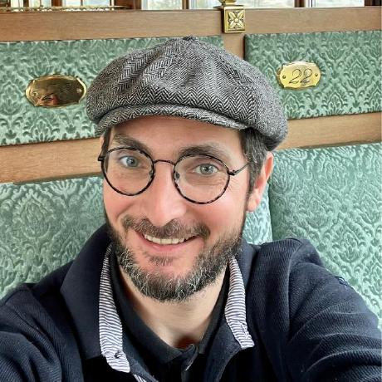



Functional annotation
22/09/2025
Jacques.dainat@ird.fr
Juke34
@Jacquesdainat.bsky.social
Jacques Dainat Ph.D.
Notes:
Question: Avez-vous une idée de comment procéder?
Je ne vais malheureusement pas aborder la thématique de comment coder de manière reproductible en R

Slide 2
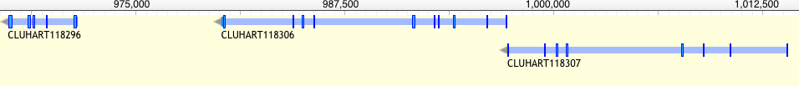
Functional annotation – why?
Understanding the function of gene product is key to understanding how a limited number of interacting gene products can generate life, from simple unicellular organisms to the incredibly complex multi-cellular Homo sapiens.
Rison,S.C., Hodgman,T.C. and Thornton,J.M. (2000) Comparison of functional annotation schemes for genomes. Funct. Integr. Genomics, 1, 56–69.
Proteins vary in structure as well as function
?
?
?
Antibodies?
Energy?
Enzyme?
Contractile protein?
Transport Protein?
Storage Protein?
Structural Protein?
Hormone?
Notes:
Metabolic reconstruction. What can an organism do and how?
Evolutionaly analysis. How does an organism compare to the rest?

Slide 3
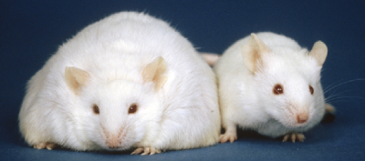
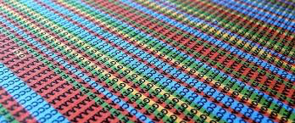
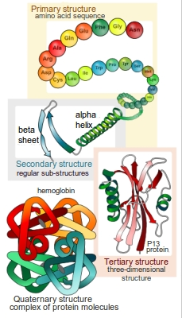
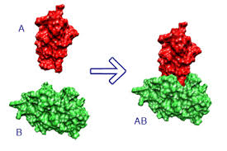
Functional annotation – how?
Experimentally (accurate)
- Mutants, knockout, etc.
Computationally (limited accuracy)
  Sequence-based
  Structure based
  Protein-protein interaction
Mice homozygous for the diabetes 3J spontaneous mutation

Slide 4
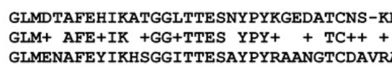
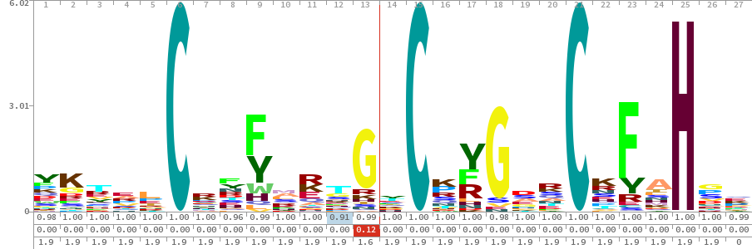
Methods - Sequence-based
Based on similarity
  => Best blast hit
Based on Motif
  => Proscan, MEME, QuasiMotiFinder
Based on Profile
  => HMM or other statistical signature
Q
S
D-X-[KR]-P-{WYF}-X5
Whole sequence
e.g. Psi-BLAST*, PIRSF
…
structural classification
e.g. SUPERFAMILY
domain
e.g. PFAM
Localization (e.g membrane, golgi, secreted)
e.g. SignalP, TMHMM
Notes:
Clustering => How choose the representative in the cluster ? Need to prioritize … by organism model as example.
Motif = pattern = regular expression: basic because there is no weight for each position.
Signatures are predictive models, provided by several different databases,
In genetics, a sequence motif is a nucleotide or amino-acid sequence pattern that is widespread and has, or is conjectured to have, a biological significance. For proteins, a sequence motif is distinguished from a structural motif, a motif formed by the three-dimensional arrangement of amino acids which may not be adjacent.
Multiple EM for Motif Elicitation (MEME) is a tool for discovering motifs in a group of related DNA or protein sequences.
The term motif is use to refer to a part of a protein sequence that is associated with a particular biological function.
The presence of a particular motif within a protein sequence can be used to suggest functions for uncharacterised proteins.

Slide 5
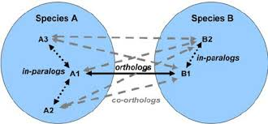
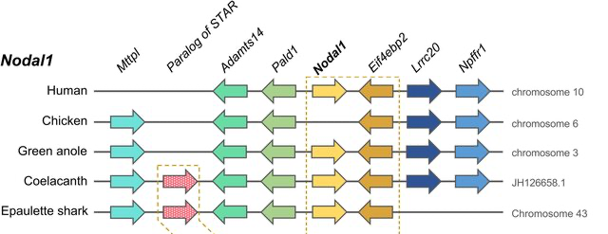
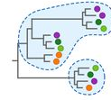
Methods - Sequence-based
Use of evolutionary relationship (Orthology)
  Based on Clustering
  => KOG (Eukaryotic) / COG(Prokaryotic)
  Based on synteny
    => conservation of gene order/organization across species
  Based on phylogeny
  => Quite complicated at large scale

Slide 6
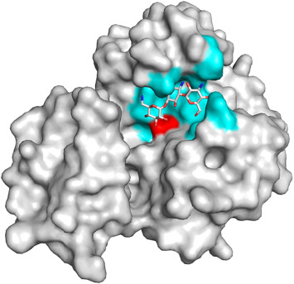
Methods - Structure-based
Focuses on the 3D conformation of a single protein and similarity to know structures to infer function.
  Global structure
  Classification of overall protein folds and domain (e.g. SCOP, CATH, FSSP)
  local structure
  Functionally relevant parts of the structure e.g. clefts, ligand-binding pockets, interfaces, surfaces.
  It often suggests where ligands, cofactors, or partner proteins may interact (e.g. CASTp, fpocket, ProFunc).
  active-site residues (atomic level)
    Specific catalytic or ligand-binding residues. Residues are often more conserved than the overall fold (e.g. PDBSiteScan, Catalytic Site Atlas)

Slide 7
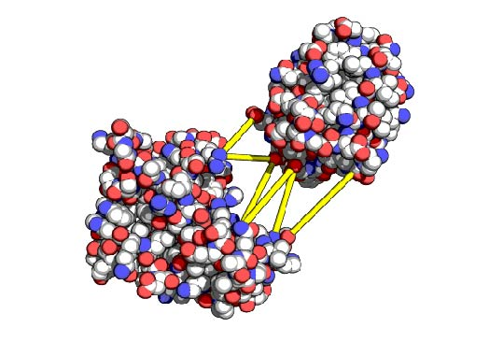
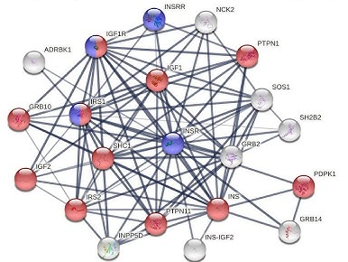
Methods – Protein-Protein interaction
  Structure-guided interaction prediction (who interacts)
  Docking and modeling of protein complexes (e.g. HADDOCK, ClusPro)
  Identifies potential interaction partners and functional interfaces.
  Pathway and network context (what role)
  Integration of predicted PPIs into biological networks (e.g. STRING).
  Guilt-by-association: uncharacterized proteins may inherit function from well-annotated neighbors.
  Supports placement of proteins into pathways and complexes.

Slide 8

Functional annotation is actually kind of complex…
  Multidimensional problem:
  A protein can have a molecular function, a cellular role, and be part of a functional complex or pathway
  Descriptive levels
  Molecular function can be illustrated at multiple levels e.g. 'enzyme' category versus a more specific 'protease' assignment
  Similarities (structural or in sequence) function.
  - Similar sequences but different functions (new domain => new combination => different function)
  - Different sequences may have same function (convergence) : Profiles helpful
  - Two proteins may have a similar fold but different functions
  Looks for conserved domains more reliable than whole sequence ?
  How to go from conserved domains to assigning a function to your protein?
=> Importance is to gather as much information as possible

Slide 9
Sequence-based methods – WHY?
The most used (popular)
Quick
Easy to use
Accurate (>70%)
Many resources: even structural domains information
Less computationally demanding
Watson JD, Sanderson S, Ezersky A, Savchenko A, Edwards A, Orengo C, Joachimiak A, Laskowski RA, Thornton JM: Towards fully automated structure-based function prediction in structural genomics: a case study. J Mol Biol. 2007, 367: 1511-1522. 10.1016/j.jmb.2007.01.063.

Slide 10
Sequence-based methods – HOW?
The most used (popular)
Quick
Easy to use
Accurate (>70%)
Many resources: even structural domains information
Less computationally demanding
Watson JD, Sanderson S, Ezersky A, Savchenko A, Edwards A, Orengo C, Joachimiak A, Laskowski RA, Thornton JM: Towards fully automated structure-based function prediction in structural genomics: a case study. J Mol Biol. 2007, 367: 1511-1522. 10.1016/j.jmb.2007.01.063.

Slide 11
Sequence-based methods – HOW?
Protein
Name and function
domains
(e.g. Pfam, SignalP)
Pathways
(e.g KEGG, MetaCyc, Reactome)
Controlled vocabulary
(GO)
BlastP

Slide 12
Annotate the sequences functionally using Blast
Fasta
aa
Choose database
Uniprot | Swissprot
exhaustive | reliable
BlastP
Tabulated output
Of blast hit
How to filter ?
- Minimum e-value
- Best blast hit or prioritized by species
AGAT
Extract information from selected hit + Add annotation to structural annotation (GFF)
Structural annotation with function (GFF)

Slide 13
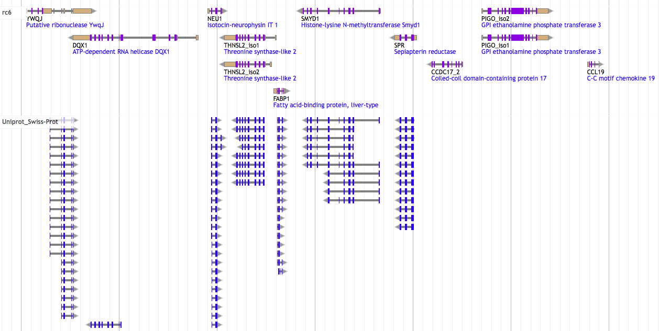
Annotate the sequences functionally using Blast

Slide 14
Annotate the sequences functionally using Blast

Slide 15
Annotate the sequences functionally using Blast
Strengths
Fairly fast and easy
Allow gene naming (e.g. plip)
Overall function (e.g. Phosphatidylglycerophosphatase and protein-tyrosine phosphatase 1)
Limits
Orthology not certain - best blast-hit does not equal orthologous!
Bias due to well conserved domains
Best Hit ( use as template) is not necessary the best annotated sequence to use => Could apply a prioritization rule (Human first, then mouse, etc).

Slide 16
Sequence-based methods – HOW?
Protein
Name and function
domains
(e.g. Pfam, SignalP)
Pathways
(e.g KEGG, MetaCyc, Reactome)
Controlled vocabulary
(GO)
BlastP
Interproscan

Slide 17
Databases
Database | Information | Comment
KEGG | Pathway | Kyoto Encyclopedia of Genes and Genomes
MetaCyc | Pathway | Curated database of experimentally elucidated metabolic pathways from all domains of life (NIH)
Reactome | Pathway | Curated and peer reviewed pathway database
GO | Gene Ontology | Three structured, controlled vocabularies (ontologies) : biological processes, cellular components and molecular functions
Pfam | Protein families | Multiple sequence alignments and hidden Markov models
Interpro | Protein families, domains and functional sites | Run separate search applications, and create a signature to search against Interpro.
Have a look on the Interpro web page: All the database they search into are listed. It gives a nice overview of different types of databases available.

Slide 18
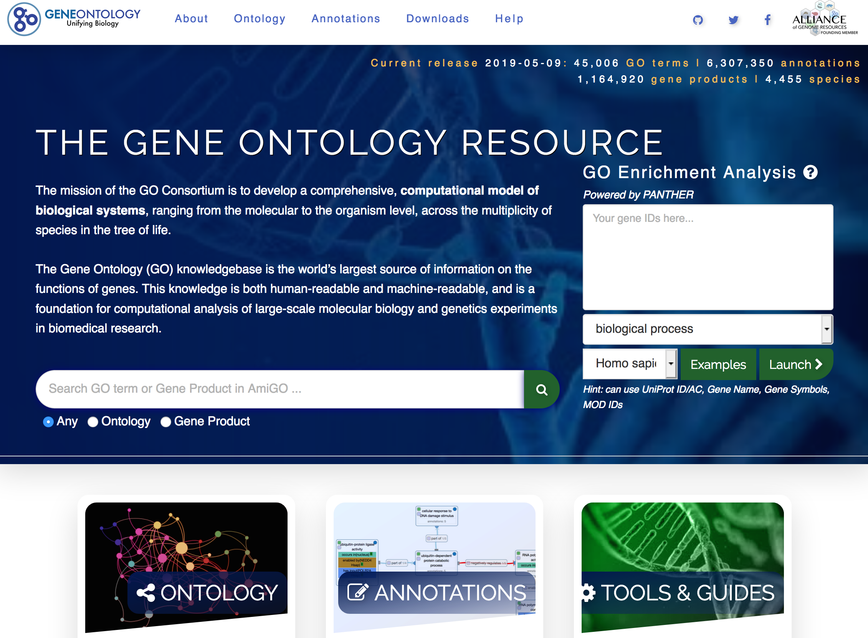
Gene Ontology
Gene Ontology (GO) is a major bioinformatics initiative that uses a controlled vocabulary (> 60 000 terms) to standardize the representation of gene and gene product attributes across all species.
http://www.geneontology.org/

Slide 19
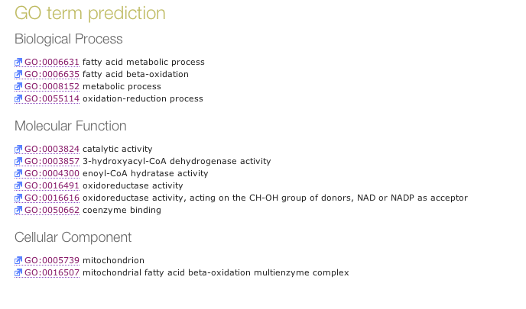
Gene Ontology
Gene Ontology (GO) organizes function into three complementary aspects:
pathways and larger processes
made up of the activities
of multiple gene products.
molecular activities
of gene products
where gene products are active

Slide 20
Tools
Tool | Approach | Comment
Trinotate | Best blast hit + protein domain identification (HMMER/PFAM) + protein signal peptide and transmembrane domain prediction (signalP/tmHMM), and leveraging various annotation databases (eggNOG/GO/Kegg databases). | Partially automated
Annocript | Best blast hit | Collects the best-hit and related annotations (proteins, domains, GO terms, Enzymes, pathways, short)
Annot8r | Best blast hits | A tool for Gene Ontology, KEGG biochemical pathways and Enzyme Commission EC number annotation of nucleotide and peptide sequences.
Sma3s | Best blast hit + Best reciprocal blast hit + clusterisation | 3 annotation levels
afterParty | BLAST, InterProScan | web application
Interproscan | Run separate search applications HMMs, fingerprints, patterns => InterPro | Created to unite secondary databases
Blast2Go | Best* blast hits (picks out GO terms based on blast hits and uniprot with statistical significance test ) | Commercial ! Contain nice downstream analysis/visualization components Plugin for Geneious or CLC bio Workbench
Notes:
Adapted to transcriptome: Trinotate, Annocript

Slide 21
Interpro/Interproscan
InterPro
is an integrative database that combines the main protein signature databases (Pfam, PROSITE, SMART, CATH, SUPERFAMILY, etc.).
A signature
is a motif, a profile, or an HMM (Hidden Markov Model) that describes a protein family, a domain, an active site, or another functional region.
InterProScan
is the software that compares a given protein sequence against all these signature databases to assign potential functions.

Slide 22
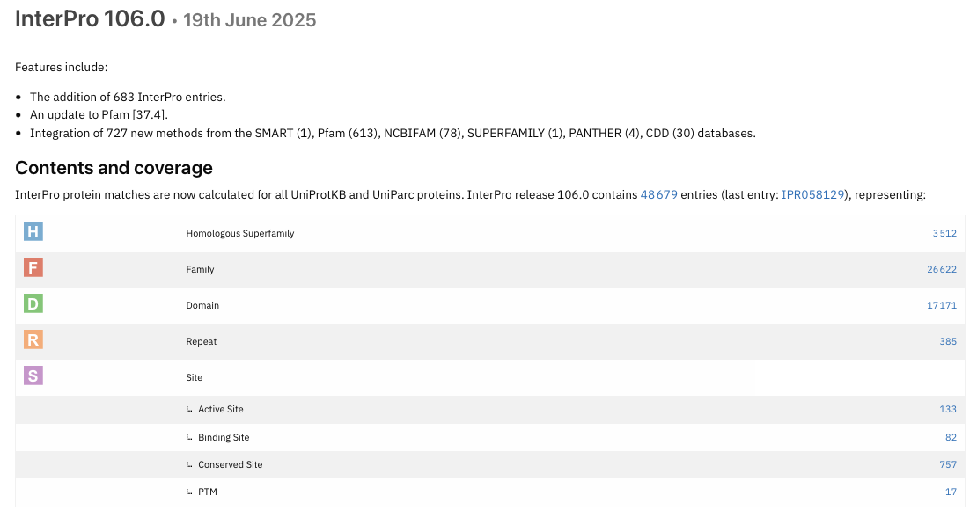
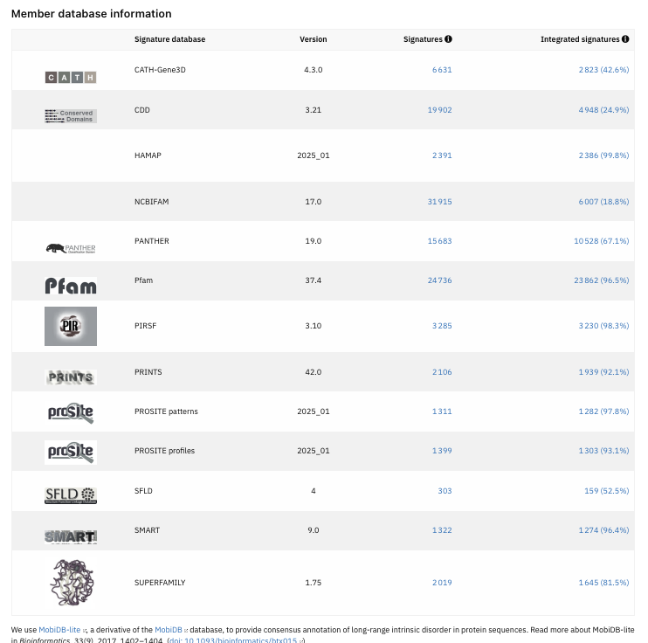

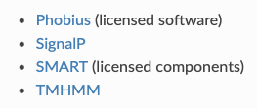
Interpro
pathway :
- MetaCyc
- Reactome
other licensed analysis available:
Notes:
Not integrated signatures = signature not yet curated or do not reach InterPro's standards for integration

Slide 23
Interproscan
Search against signature databases
InterProScan runs searches in parallel (Each database uses its own search engine:
    Pfam → HMMER (HMM profiles).
    PROSITE → regular expressions or profiles.
    SUPERFAMILY → structural HMMs.
    COILS → prediction of coiled-coil regions.
Result aggregation
All matches are collected and for each match, InterProScan adds:
The InterPro ID (if available, e.g. IPR002568).
Associated GO terms (if --goterms is used).
Associated pathways (if -pa is used).
“iprlookup” option (default: enabled)
Links matches from member databases (e.g. Pfam: PF01623) to the corresponding InterPro entry (e.g. IPR002568).
This unifies results coming from different databases.

Slide 24
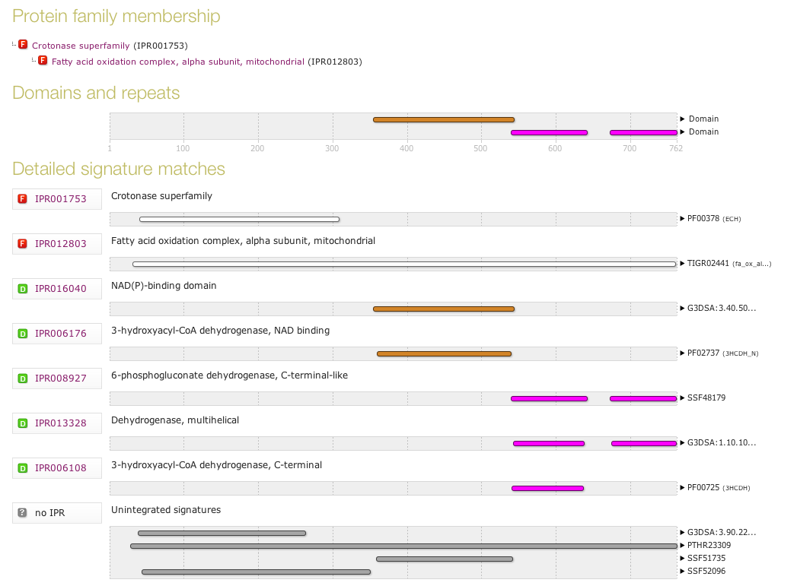
Interproscan

Slide 25
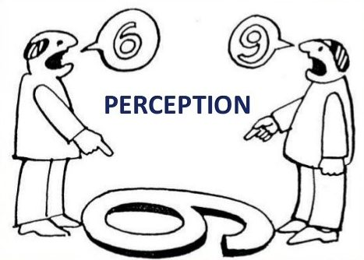
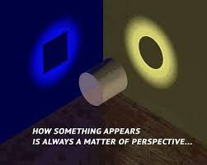
One word about network
Categorizations of gene function (e.g GO) in a hierarchy of categories is helpful
BUT
gene has no function alone
Pathways / regulatory networks explain how genes interact so what they are doing!
E.g. databases for pathway :
    KEGG
    MetaCyc
    Reactome
    UniPathway
Notes:
Categorizations of gene function, such as those used in theGene Ontology Project slot each gene into one category in a hierarchy of categories. They are helpful, but they ignore the fact that an individual gene has no function in isolation.
Gene function prediction is a stepping stone to the more important problem of inferring regulatory networks that explain how genes interact so as to enable cellular processes.
Put in perspective of PATWAY is better !
There is more information in a network compared to sequence or structure alone. A network provides a global view of the context of each gene.

Slide 26
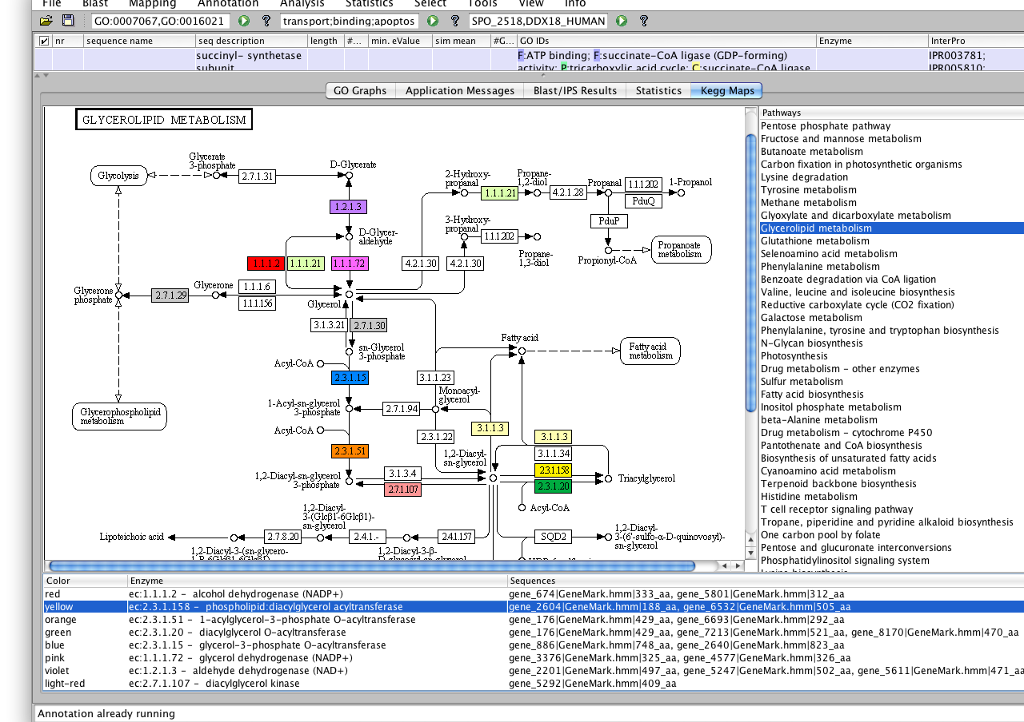
KEGG

Slide 27

Closing remarks
Structural annotation matters
Functional annotation depends strongly on the quality of structural annotation
Common issues: gene fusions, gene splits, partial genes, over-predictions, wrong ORFs
Limits of functional annotation
  Errors can propagate from databases => experimental validation is essential
  Annotation quality depends on the database used
  Many proteins remain hypothetical or uncharacterized (Depends largely on conventional experiments)
Beyond sequence similarity
  High sequence similarity ≠ identical function
  Functional understanding requires additional context:
                Pathway integration
                Spatial/temporal regulation
                Biological networks

Slide 28

Thank you for your attention

