Slide 1






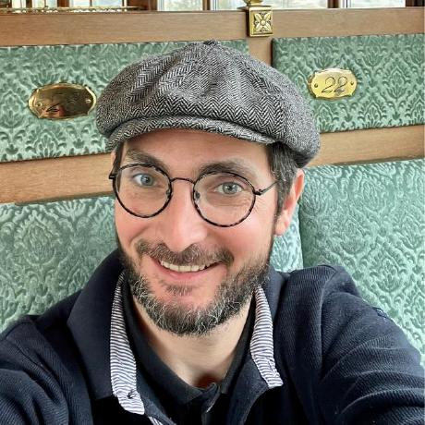



Introduction to genome annotation
22/09/2025
Jacques.dainat@ird.fr
Juke34
@Jacquesdainat.bsky.social
Jacques Dainat Ph.D.
Notes:
Question: Avez-vous une idée de comment procéder?
Je ne vais malheureusement pas aborder la thématique de comment coder de manière reproductible en R

Slide 2
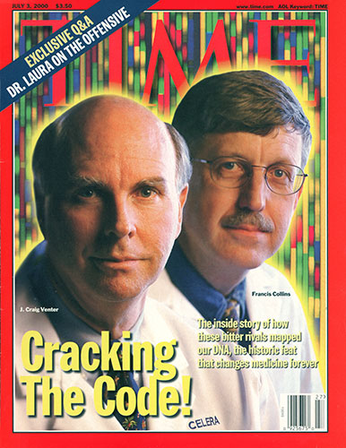
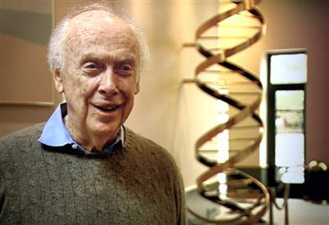
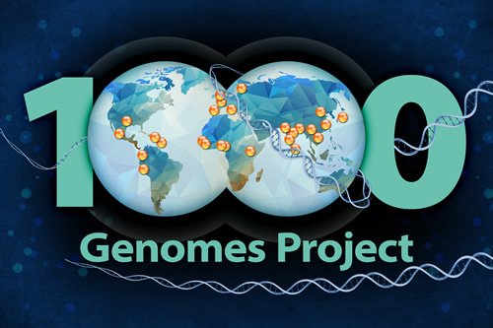
perspective
… prices go down
Human genome sequencing:
  2004: Genome of Craig Wenter costs 70 mln $
    Sanger’s sequencing
  2007: Genome of James Watson costs 2 mln $
    454 pyrosequencing
  2014: Ultimate goal: 1000 $ / individual
  2016: Illumina Xten: Almost there! (1200 $)
  2017: NovaSeq: ”Hold my beer…” (100 $)

Slide 3

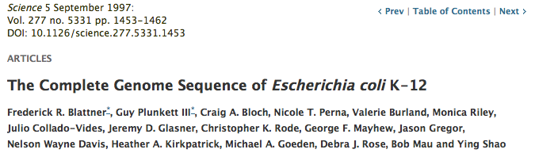
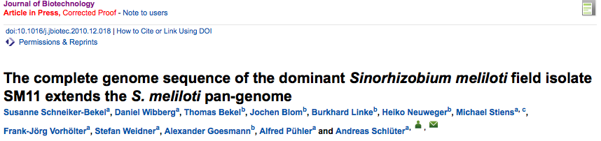
perspective
… scientific value diminishes
IF 31.6
IF 2.9

Slide 4

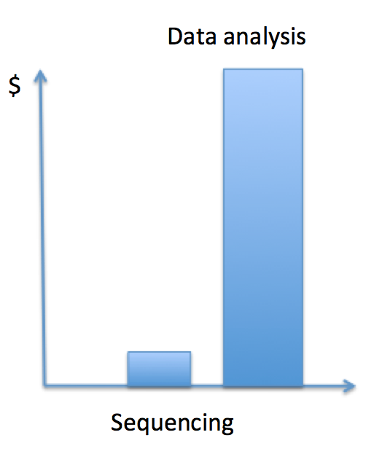

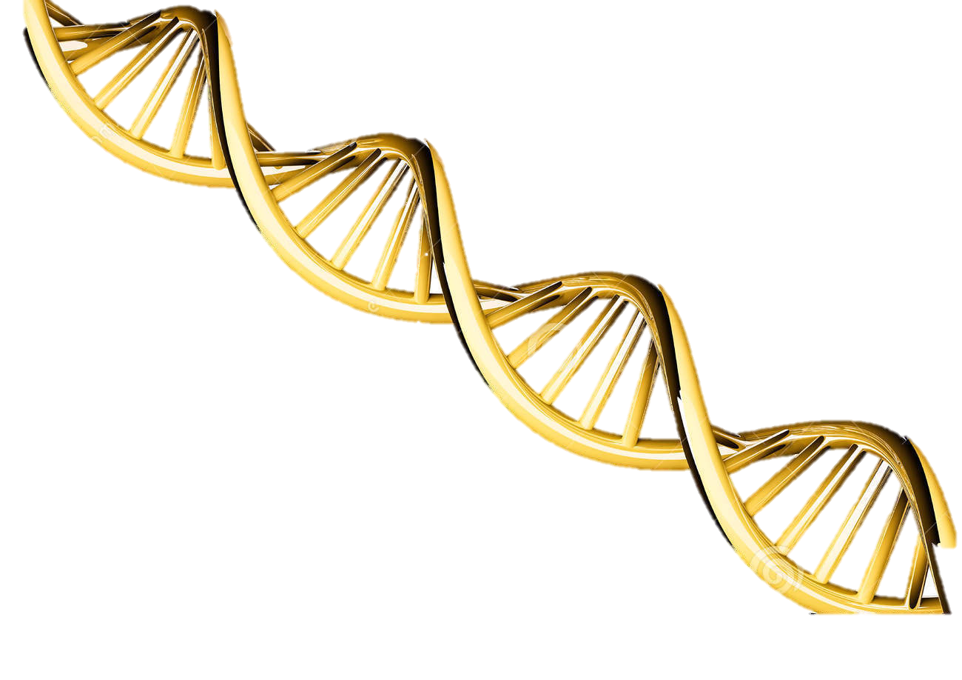
perspective
It is the annotation that bridges the gap from the sequence to the biology of the organism
Notes:
Raw sequence data is not useful for most biologist, to be meaningful to them it has to be converted into biological significant knowledge => Gene, mRNAs etc… which are the GOLDEN NUGGETS in the middle of this hugue montain of data !!
So annotation is the first step toward the knowledge acquisition (i.e. Leuven)

Slide 5
Introduction to annotation
What is annotation ?
Structural annotation:
Find out where the regions of interest (usually genes) are in the sequence data and what they look like.
functional annotation:
Find out what the regions do. What do they code for?
VS

Slide 6
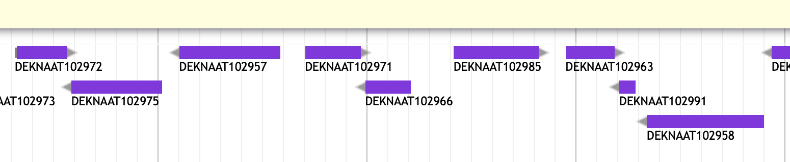
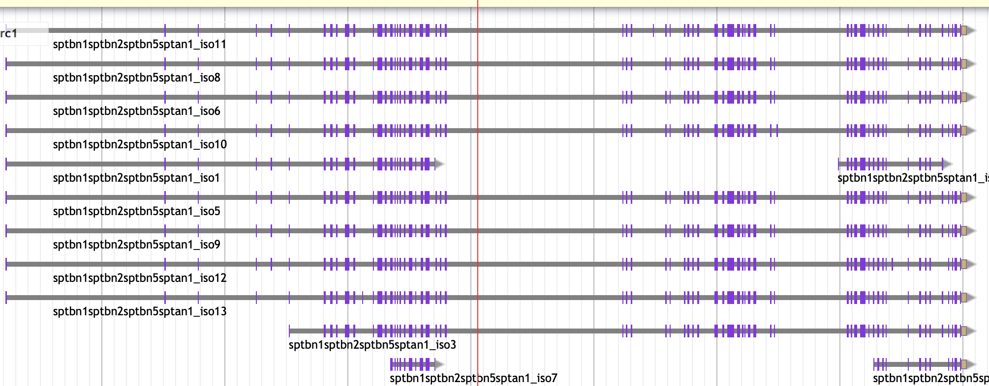
Introduction to annotation
Organisms differ in genomic complexity
A yeast
A crustacean

Slide 7
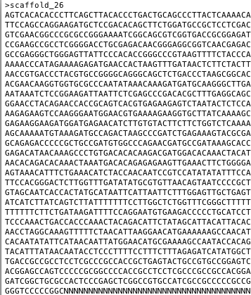
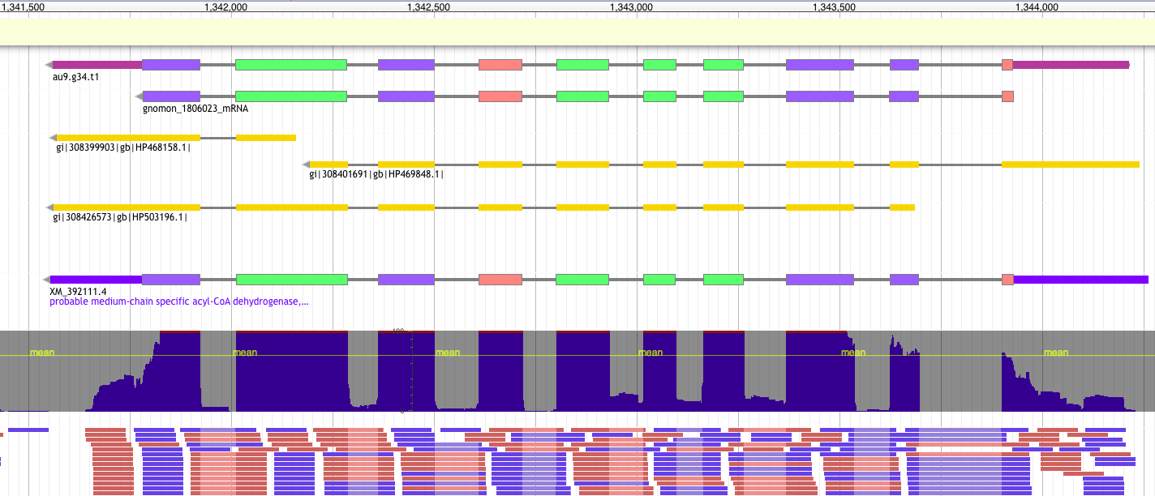
Introduction to annotation
From a genome…
FASTA
…to an annotated gene
GTF/GFF
9 columns
1 feature = 1 line
2. source
4. start
6. score
8. phase
Ctg123 maker Gene 1000 9000 . + . ID=gene1; Name=EDEN
1. sequence id
3. feature type
5. end
7. strand
9. attribute(s)
tag=value

Slide 8

Introduction to annotation
GFF / GTF formats
Gene Transfer Format
GTF
GTF2
GTF2.1
GTF2.2
GTF2.X
GFF
Richard Durbin and David Haussler
2005
2007
1997
2000
2003
Nowadays
General Feature Finding
2004
2013
GFF2
GFF2.5
GFF3 v1
GFF3 v1.23
General Feature Format
https://agat.readthedocs.io/en/latest/gxf.html
Notes:
﻿In top of that the format has changed a lot through time.
Indeed, the development of this format has not been an easy task.
Facing some limitation using the original specification, GFF has evolved into different flavors depending on the different needs of different laboratories.
In 10 years (97-2007) the format has evolved a lot. The GFF3 is stable stable since many years (2004).

Slide 9
Introduction to annotation: GFF3
##gff-version 3.2.1
##sequence-region ctg123 1 1497228
ctg123 . Gene 1000 9000 . + . ID=gene1;Name=eden
ctg123 . mRNA 1050 9000 . + . ID=mRNA1;Parent=gene1;Name=eden
ctg123 . mRNA 1050 9000 . + . ID=mRNA2;Parent=gene1;Name=eden
ctg123 . exon 1300 1500 . + . ID=exon1;Parent=mRNA2;Name=eden
ctg123 . exon 1050 1500 . + . ID=exon2;Parent=mRNA1,mRNA2;Name=eden
ctg123 . exon 3000 3902 . + . ID=exon3;Parent=mRNA1;Name=eden
ctg123 . exon 5000 5500 . + . ID=exon4;Parent=mRNA1,mRNA2;Name=eden
ctg123 . exon 7000 9000 . + . ID=exon5;Parent=mRNA1,mRNA2;Name=eden
ctg123 . CDS 1201 1500 . + 0 ID=cds1;Parent=mRNA1;Name=eden
ctg123 . CDS 3000 3902 . + 0 ID=cds1;Parent=mRNA1;Name=eden
ctg123 . CDS 5000 5500 . + 0 ID=cds1;Parent=mRNA1;Name=eden
ctg123 . CDS 7000 7600 . + 0 ID=cds1;Parent=mRNA1;Name=eden
Ctg123 . CDS 1201 1500 . + 0 ID=cds2;Parent=mRNA2;Name=eden
ctg123 . CDS 5000 5500 . + 0 ID=cds2;Parent=mRNA2;Name=eden
Ctg123 . CDS 7000 7600 . + 0 ID=cds2;Parent=mRNA2;Name=eden
Header
9 columns
1 feature = 1 line
1 record = features with relationship
2 - source
4 - start
6 - score
8 - phase
9 - attributes
tag=value
1 - sequence id
5 - end
3 - feature type
7 - strand
Notes:
How look a GFF3 file ?
Here One gene
parent / children relationship provides a mechanism allowing to group features at several hierarchical level allowing representing complex entities like here.
The content can differ a lot according to the tool/group producing the file.
About the feature: One can write transcript instead of mRNA, or say UTR instead of 3’UTR and 5’UTR or the 3/5 number could also be written with letter and so one.
About the attributes: There is actually no limit for naming the tag. You can use what ever you want.

Slide 10
Introduction to annotation: GTF
#!genome-build GRCz11
#!genome-date 2017-05
ctg123 . Gene 1000 9000 . + . gene_id gene1; name eden;
ctg123 . Transcript 1050 9000 . + . gene_id gene1; transcript_id=t1; name eden;
ctg123 . Transcript 1050 9000 . + . gene_id gene1; transcript_id=t2; name eden;
ctg123 . exon 1300 1500 . + . gene_id gene1; transcript_id=t1; name eden;
ctg123 . exon 1050 1500 . + . gene_id gene1; transcript_id=t1; name eden;
ctg123 . exon 1050 1500 . + . gene_id gene1; transcript_id=t2; name eden;
ctg123 . exon 3000 3902 . + . gene_id gene1; transcript_id=t1; name eden;
ctg123 . exon 5000 5500 . + . gene_id gene1; transcript_id=t1; name eden;
ctg123 . exon 5000 5500 . + . gene_id gene1; transcript_id=t2; name eden;
ctg123 . exon 7000 9000 . + . gene_id gene1; transcript_id=t1; name eden;
ctg123 . exon 7000 9000 . + . gene_id gene1; transcript_id=t2; name eden;
ctg123 . CDS 1201 1500 . + 0 gene_id gene1; transcript_id=t1; name eden;
ctg123 . CDS 3000 3902 . + 0 gene_id gene1; transcript_id=t1; name eden;
ctg123 . CDS 5000 5500 . + 0 gene_id gene1; transcript_id=t1; name eden;
ctg123 . CDS 7000 7600 . + 0 gene_id gene1; transcript_id=t1; name eden;
ctg123 . CDS 1201 1500 . + 0 gene_id gene1; transcript_id=t2; name eden;
ctg123 . CDS 5000 5500 . + 0 gene_id gene1; transcript_id=t2; name eden;
ctg123 . CDS 7000 7600 . + 0 gene_id gene1; transcript_id=t2; name eden;
Header
9 columns
1 feature = 1 line
1 record = features with relationship
2 - source
4 - start
6 - score
8 - phase
9 - attributes
tag=value
1 - sequence id
5 - end
3 - feature type
7 - strand

Slide 11
GFF/GTF interoperability issues
GTF and GFF formats are similar but very different:
Different ways
to establish the relationships between the features
  to deal with features types
  to deal with concepts (stop codon vs CDS)
  …
ctg123 . gene 1000 9000 . + . ID=gene1
Level1
GFF
ctg123 . mRNA 1000 9000 . + . ID=mRNA1;Parent=gene1
Level2
ctg123 . exon 1000 2000 . + . ID=exon1;Parent=mRNA1
ctg123 . exon 8000 9000 . + . ID=exon2;Parent=mRNA1
ctg123 . CDS 1700 2000 . + 0 ID=cds01;Parent=mRNA1
ctg123 . CDS 8000 8300 . + 0 ID=cds01;Parent=mRNA1
Level3
2278 terms accepted: Constrained to be either a term from the Sequence Ontology or an SO accession number
ctg123 . gene 1000 9000 . + . gene_id g1;
Level1
ctg123 . mRNA 1000 9000 . + . gene_id g1; transcript_id t1;
GTF
Level2
ctg123 . exon 1000 2000 . + . gene_id g1; transcript_id t1;
ctg123 . exon 8000 9000 . + . gene_id g1; transcript_id t1;
ctg123 . CDS 1700 2000 . + 0 gene_id g1; transcript_id t1;
ctg123 . CDS 8000 8300 . + 0 gene_id g1; transcript_id t1;
Level3
9 terms accepted: gene, transcript, exon, CDS, Selenocysteine, start_codon, stop_codon, three_prime_utr and five_prime_utr
Notes:
The formats can be seen as a 3 hierarchical levels structure.
GFF
deepest ... highest
GTF
deepest ... highest
GFF and GTF format are very similar overall
Stop codon included in CDS for GFF.

Slide 12
Introduction to annotation
/!\ different type of gff: alignment / annotation / other
Alignment
protein1 or
transcript1
match, match_part
protein2 or transcript2
DNA
Gene, mRNA, exon, intron, CDS, splice site, UTR, …
isoforms
gene
Annotation

Slide 13




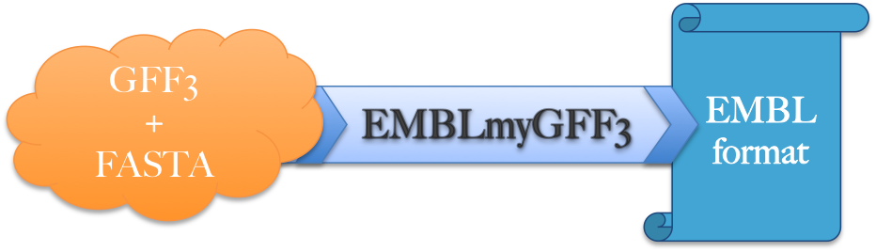
The main steps in genome annotation
1
2
3
4
5
Downstream analysis
Structural annotation
Manual curation
Functional annotation
QC assembly
Submission

Slide 14
QC assembly
The quality of the assembly will heavily influence the quality of the annotation
    SNP-errors can change start/stop-codons/splice sites
    Indels can cause frame-shifts
    High fragmentation could break loci
    missing loci cannot be annotated
    => Annotation tools have difficulties to deal with those problems
Notes:
if a locus is completely missing from the assembly, it cannot be annotated

Slide 15
QC assembly
Before to start a project check:
Fragmentation (N50, number of sequences, how many small contigs)
Sanity of the fasta file (Ns, IUPAC, lowercase nucleotides)
Completeness / duplication / fragmentation
Presence of Organelles
Other (GC content, how distant from other species)
# BUSCO version is: 3.0.2
# The lineage dataset is: fungi_odb9 (Creation date: 2016-02-13, number of species: 85, number of BUSCOs: 290)
#
# Summarized benchmarking in BUSCO notation for file genome.fa
# BUSCO was run in mode: genome
C:98.6%[S:97.9%,D:0.7%],F:0.0%,M:1.4%,n:290
286 Complete BUSCOs (C)
284 Complete and single-copy BUSCOs (S)
2 Complete and duplicated BUSCOs (D)
0 Fragmented BUSCOs (F)
4 Missing BUSCOs (M)
290 Total BUSCO groups searched
Notes:
Presence of Organelles is important but we do not have time to investigate this

Slide 16

Structural annotation
What to annotate?
Feature type | DB associated | Tool example
Coding genes | Ensembl, NCBI, EBI, Uniprot | https://juke34.github.io/awesome-genome-annotation/
ncRNA | Rfam | infernal
tRNA | Sprinzl database | tRNAscan-SE
snoRNA |  | snoscan
miRNA | miRBase | Splign miR-PREFeR (for plant)
Repeats | Repbase, Dfam | RepeatModeler, repeatMasker, REPET, EDTA
Pseudogenes |  | pseudopipe
…
=> Focus on Repeats and coding genes
Why repeats?
Notes:
Because it is important to increase the quality of the annotation

Slide 17
Repeat Masking
Repeatmodeler to find new repeats
  http://www.repeatmasker.org/RepeatModeler/
Repeatmasker to mask known repeats
  http://www.repeatmasker.org
EDTA - The Extensive de novo TE Annotator https://github.com/oushujun/EDTA
  + Increase quality of the annotation

Slide 18
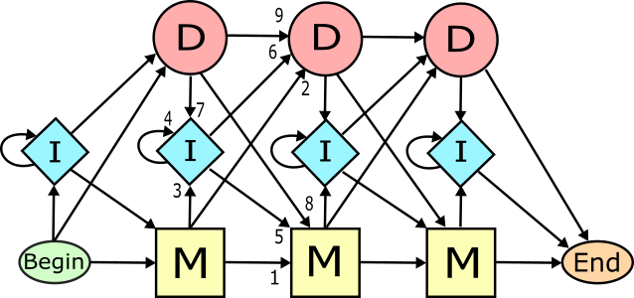
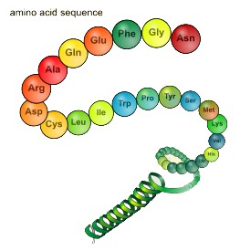
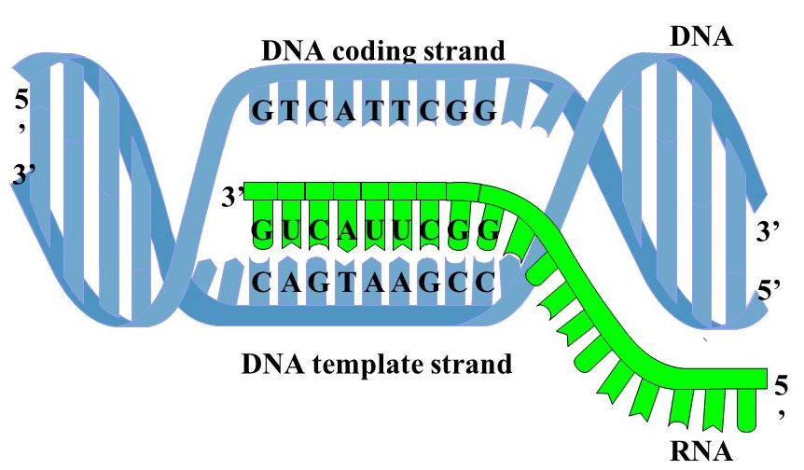
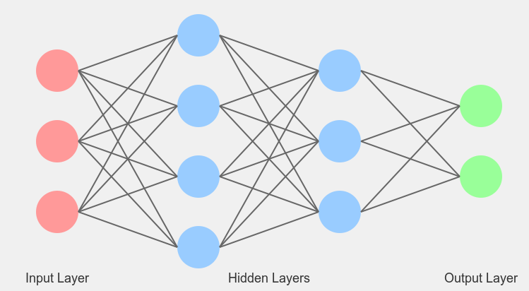
Coding genes
Types of data needed
Machine Learning
Proteins
Transcripts
HMM
Deep Learning
Known amino acid sequences from other organisms
Assembled from RNA-seq or downloaded ESTs

Slide 19
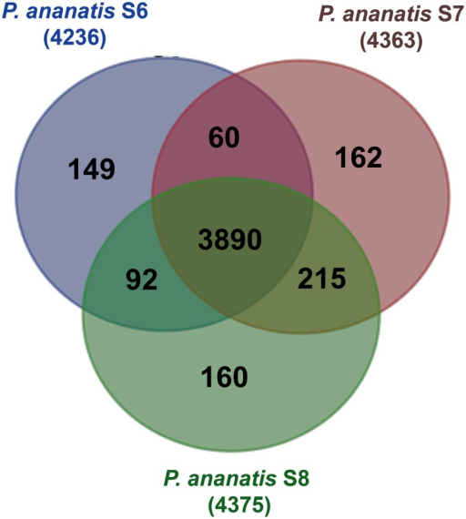
Assessing an annotation
No annotation method is perfect, they do mistakes !!
Simple statistics (number genes / number exon per gene)
(and compare against assembly result )
Protein/transcript evidence (AED score in MAKER)
Comparative genomics
Domain / Function attached
Visualization

Slide 20
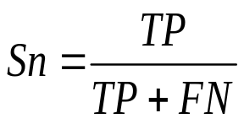
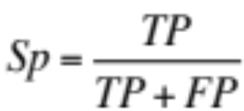
Assessing an annotation
Assess the quality of the ab-initio model/training:
TN
FN
TP
FP
TN
FN
TP
FN
TN
~
REALITY
PREDICTION
Sensitivity is the proportion of true predictions compared to the total number of correct genes (including missed predictions)
Specificity is the proportion of true predictions among all predicted genes (including incorrectly predicted ones)
Ab Initio methods can approach 100% sensitivity, however as the sensitivity increases, accuracy suffers as a result of increased false positives.

Slide 21
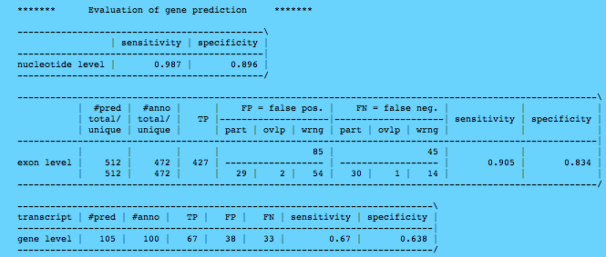
Assessing an annotation

Slide 22
Visualization / Manual curation tools
Name | Standalone | Web tool | Manual curation | year | comment
Artemis | X |  | X | 2000 | Can save annotation in EMBL format
IGV | X |  |  | 2011 | Popular
Savant | X |  |  | 2010 | Sequence Annotation, Visualization and ANalysis Tool. enable Plug-ins
Tablet | X |  | X | 2013
IGB | X |  |  | 2008 | enable Plug-ins. Can load local and remote data (dropbox, UCSC genome, etc)
Jbrowse |  | X |  | 2010 | GMOD (successor of Gbrowse)
Web Apollo |  | X | X | 2013 | Active community (gmod). Based on Jbrowse. Real-time collaboration
UCSC |  | X |  | 2000 | A large amount of locally stored data must be uploaded to servers across the internet
Ensembl genome browsers |  | X |  | 2002 | A large amount of locally stored data must be uploaded to servers across the internet
Annotation can be improved by manual curation

Slide 23
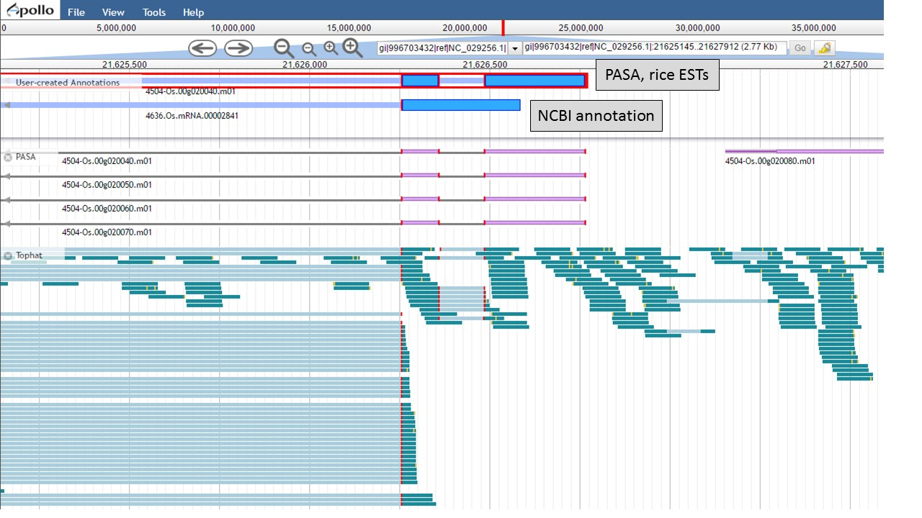
Visualization / Manual curation tools

Slide 24
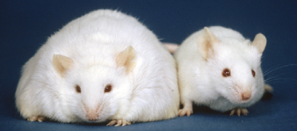
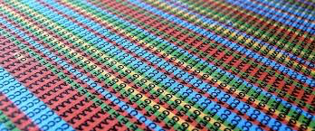
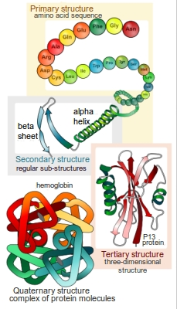
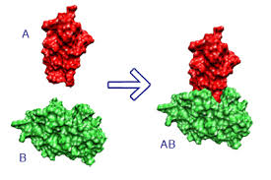
Functional annotation
Most methods only build gene models, no functional inference
Accurate
Experimentally
=> Mutants, knockout, etc.
Computationally
  Sequence-based
  Structure based
  Protein-protein interaction data
Mice homozygous for the diabetes 3J spontaneous mutation
limited accuracy

Slide 25
Effort versus accuracy
accuracy
Effort / time

Slide 26
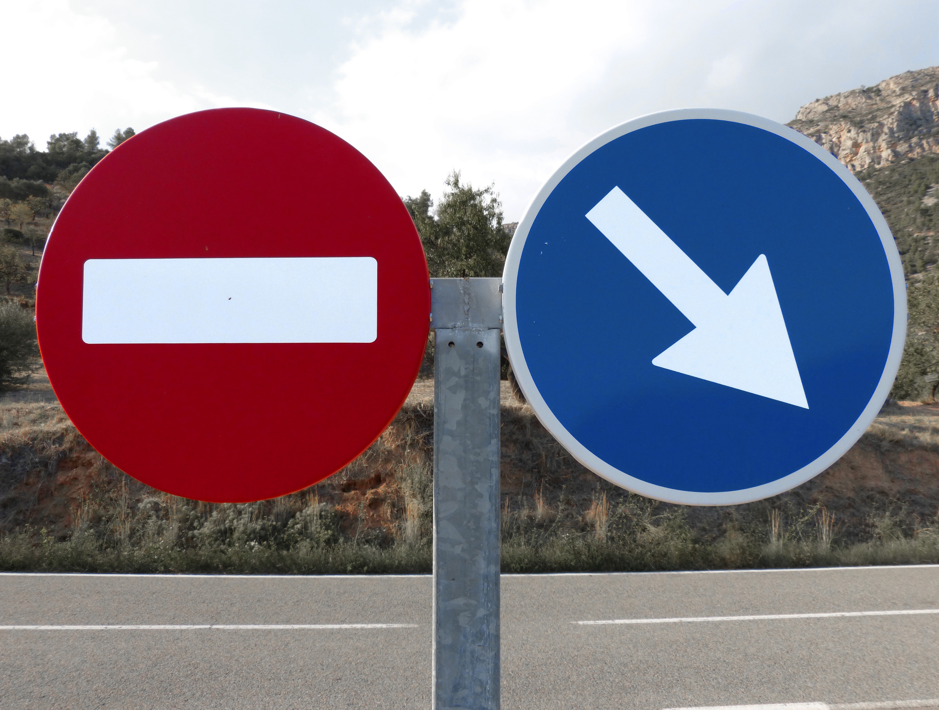
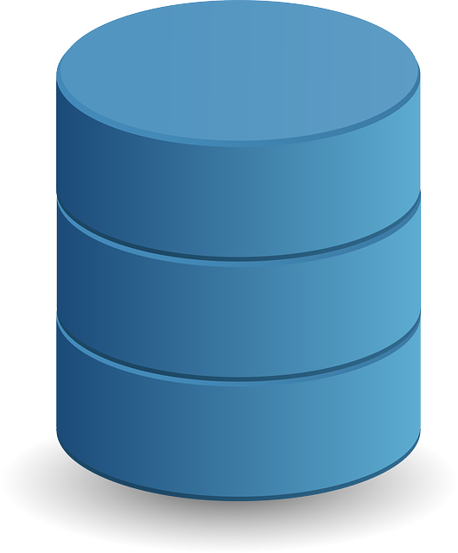
Data Submission
Submit your annotation in public archives e.g. EBI, NCBI, etc.
GFF
 | EBI | NCBI
converter | EMBLmyGFF3 | GAG Manual + table2asn
Expected format | Flat file (EMBL) | ASN.1 format

Slide 27

Thank you for your attention

