Slide 1






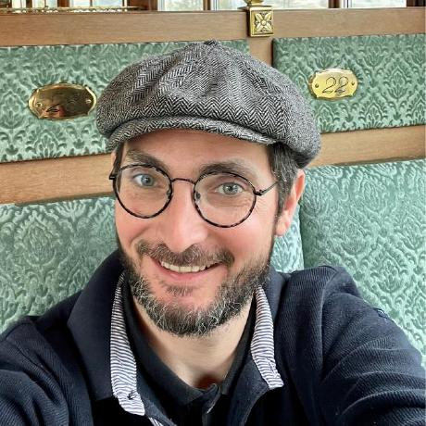



Methods in genome annotation
with a focus on eukaryotes and protein coding genes
22/09/2025
Jacques.dainat@ird.fr
Juke34
@Jacquesdainat.bsky.social
Jacques Dainat Ph.D.
Notes:
Question: Avez-vous une idée de comment procéder?
Je ne vais malheureusement pas aborder la thématique de comment coder de manière reproductible en R

Slide 2
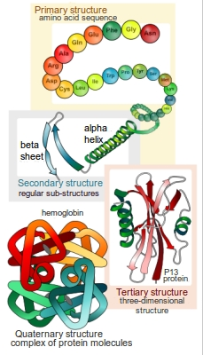
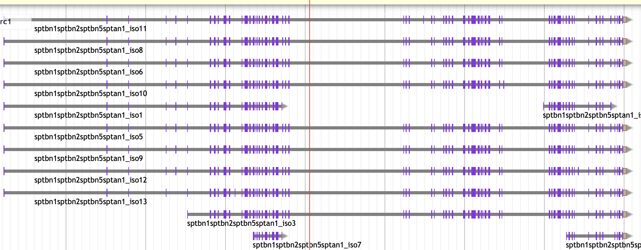
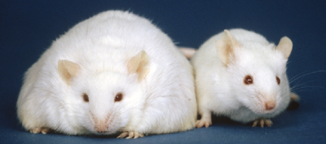
What is annotation ?
Structural annotation:
Find out where the regions of interest (usually genes) are in the sequence data and what they look like.
=> Gene prediction / Gene Finding
functional annotation:
Find out what the regions do. What do they code for?
VS

Slide 3
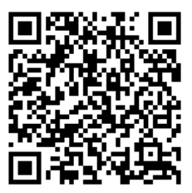
Annotation tools
First annotation tools
90’s
>100 annotation tools*
Nowadays
Structural annotation + functional annotation + …
GFF

Slide 4
Experimental vs Preditive
Experimental
(ESTs, cDNAs, RNA-seq)
Predictive
Isolate and clone cognate transcripts (as cDNA) sequence them and compare cDNA with genomic DNA
=> It’s the ONLY secure method but:
Cloning is time consuming.
Lowly expressed genes are difficult to detect.
…
Intrinsic (Machine Learning)
Use only the DNA sequence itself to predict genes based on statistical models of gene structure
Extrinsic
Use external biological evidence, like RNA-Seq, ESTs, protein alignments, or known homologs, to guide annotation
Hybrid
Modern methods often integrate intrinsic and extrinsic signals, blurring the line…
4/70

Slide 5
The different approaches
Similarity-based methods :
These use similarity to annotated sequences like proteins and transcripts
Ab initio prediction :
Machine learning based methods (probabilistic: Likelihood, Bayesian | deterministic: Neural networks)
Hybrid approaches :
  Ab initio tools with the ability to integrate external evidence/hints
Comparative (homology) based gene finders :
These align genomic sequences from different species and use the alignments to guide the gene predictions
Chooser, combiner approaches :
These combine gene predictions of other gene finders
Pipelines :
These combine multiple approaches, can annotate other types of features, work on functional annotation, etc.

Slide 6
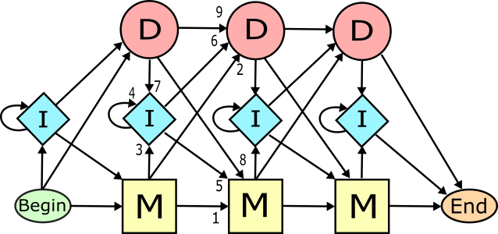
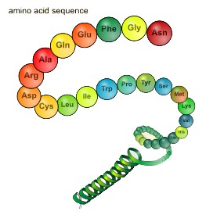
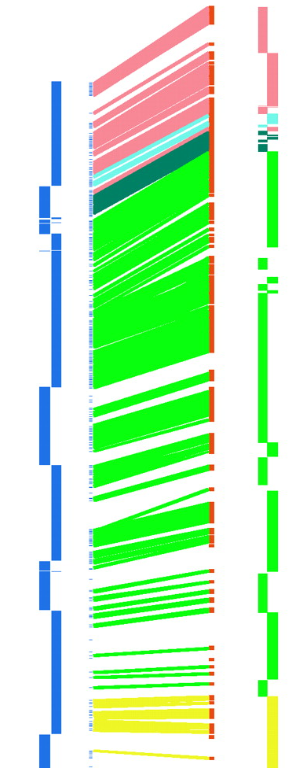
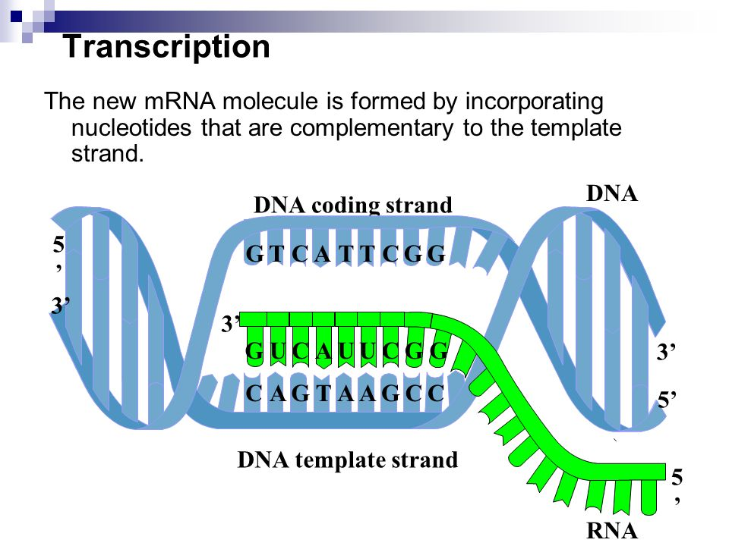
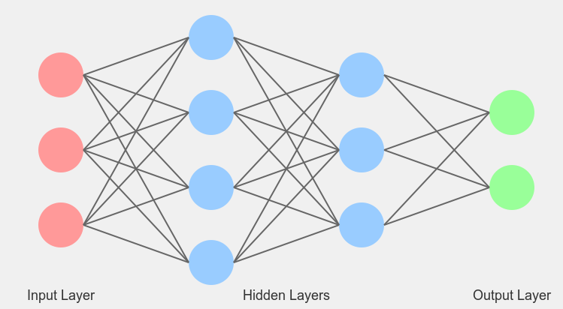
Types data used vs methods - the main lines
Extrinsic
Intrinsic
Transcripts
Proteins
Genomes
ML models
Assembled from RNA-seq or downloaded ESTs
Known amino acid sequences from other organisms
Genome from close related species
probabilistic (HMM, GHMM)
Annotation approach
deterministic (CNN, RNN i.e deep learning )
Similarity | X | X
Comparative |  |  | X
Pure ab initio |  |  |  | X
Hybrid | X | X | X | X
Chooser/combiner | X | X |  | X
Pipeline | X | X |  | X
Notes:
example of probabilitics methods:
- Likelihood methods
- Bayesian methods

Slide 7
Extrinsic approaches
Similarity-based methods
These use similarity to annotated sequences like
            Proteins
            Transcripts
            ESTs

Slide 8
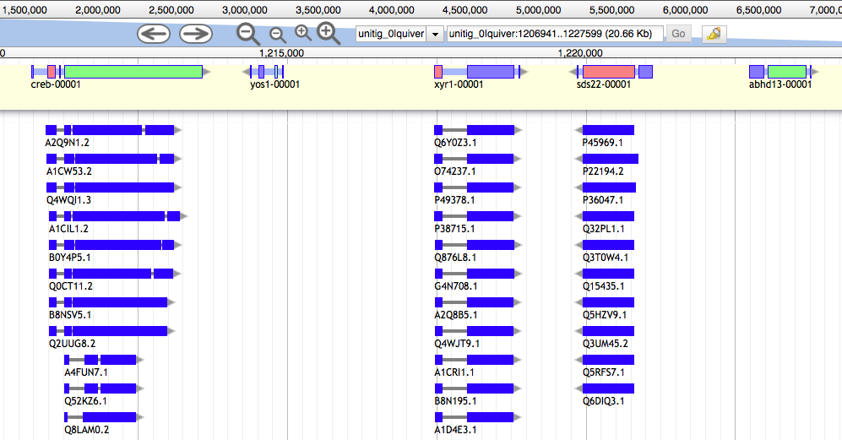
Similarity-based method: Protein data
Protein sequences are aligned to the genome
Conserved in sequence => conserved annotation with little noise

Slide 9
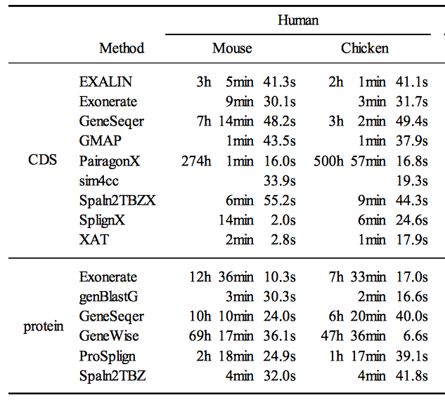
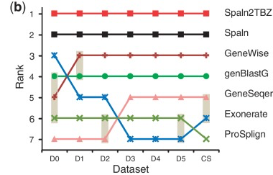
Similarity-based method: Protein data
  Limits :
    Related to pre-existing data
    Proteins from model organisms often used => bias?
    Proteins can be incomplete
    Protein can be wrong (PE)
    No UTR
  Rough approximation (fast?)
  Splice-site aware alignment (slow?)
AA
Pmatch
tblastn
PSimScan
AA
Exonerate
Genewise
GenomeThreader
Miniprot
Nucleic Acids Res. 2012 Nov 1;40(20):e161.
doi: 10.1093/nar/gks708. Epub 2012 Jul 30.

Slide 10

Similarity-based method: Protein data
Popular tools
GenomeThreader
Exonerate
MAKER3
<=>
BLASTX
GenomeThreader or Exonerate

Slide 11
Exercise

Slide 12
Similarity-based method: Transcript data
DNA
Exon
Intron
Exon
Intron
Exon
Intron
Exon
UTR
UTR
ATG
Start codon
GT
AG
GT
AG
GT
AG
TAG, TAA, TGA
Stop codon
Transcription
Pre-mRNA
UTR
UTR
AA
ATG
Start codon
TAG, TAA, TGA
Stop codon
AAAAA
Splicing
mRNA
UTR
UTR
AAAAAAAAA
ATG
Start codon
TAG, TAA, TGA
Stop codon
Translation

Slide 13
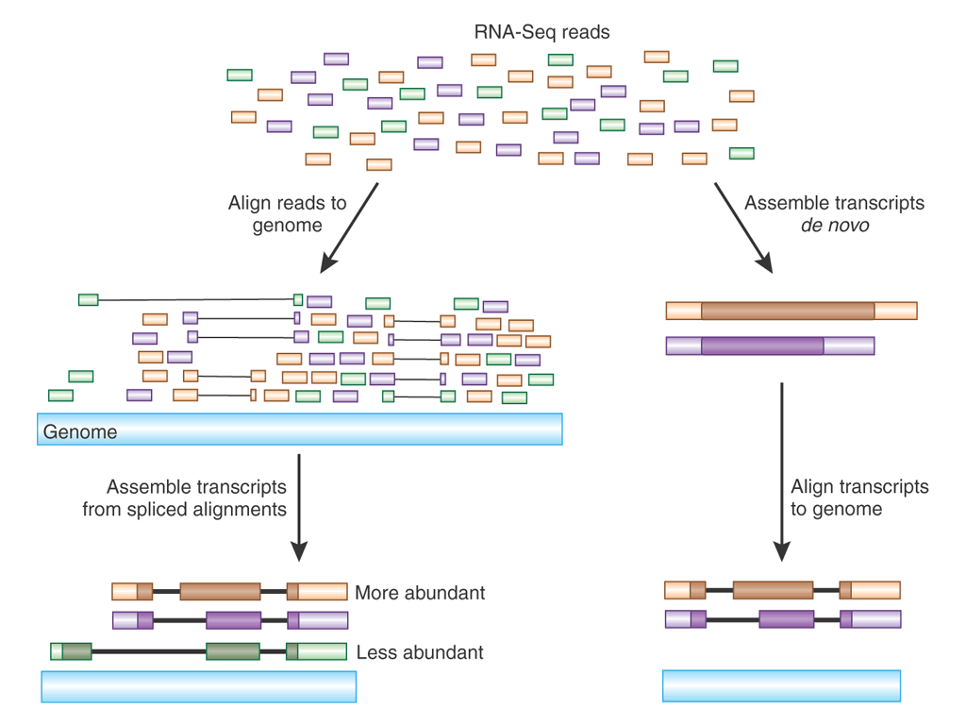
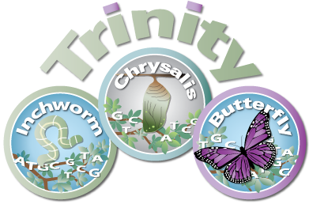
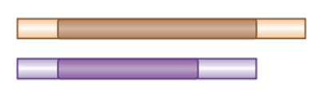
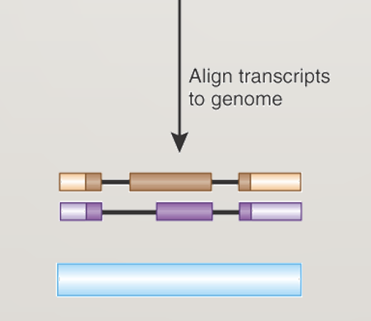
Short Reads
Long Reads
Guided
Assembly
De novo
Assembly
Hisat2, Star, Bowtie2, bwa-mem
Splice-site aware alignment (slow?)
Stringtie
DNA
Exonerate
Gmap
GenomeThreader
Minimap2
Rough approximation (fast?)
DNA
Blastn
Vsearch
NSimScan
https://home.cc.umanitoba.ca/~frist/PLNT7690/lec12/lec12.3.html

Slide 14
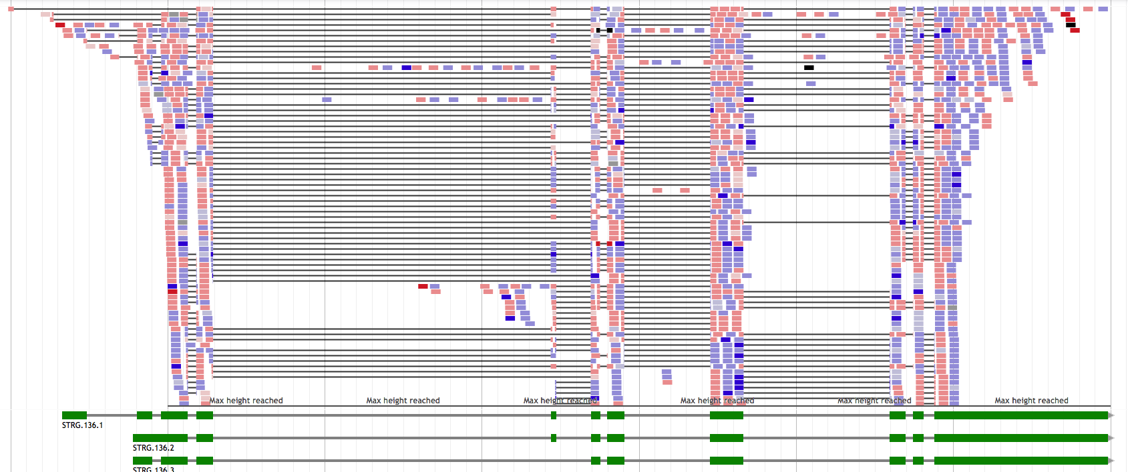
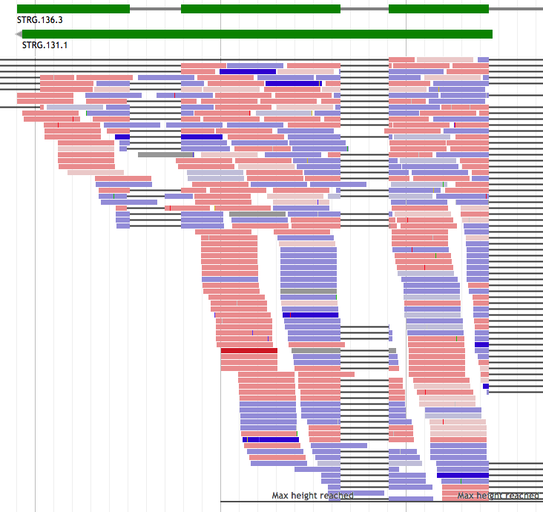
RNA-seq - Spliced reads
RNA-seq – pre-mRNA noise

Slide 15
Similarity-based method: Transcript data
Should always be included in an annotation project
From the same organism as the genomic data => unbiased
Sample different tissues or life stages if possible
  Limits :
  Hard to catch low expressed / peculiar expressed (stage of life, condition, etc.) / isoforms
  Can be very noisy (tissue/species dependent), can include pre-mRNA
  short-reads:
  need to be assembled first
  Transcriptome assembly errors
Long-reads:
  error rate / frameshift / indels

Slide 16

Similarity-based method: Transcript data
Popular tools
GenomeThreader
PASA
MAKER3
GMAP and/or BLAT
<=>
BLASTN
GenomeThreader or Exonerate

Slide 17
Exercise

Slide 18
Extrinsic approaches
Comparative methods

Slide 19
Similarity-based method: Transcript data
spliced reads
Exon
Intron
Exon
Intron
Exon
Intron
Exon
DNA
UTR
UTR
ATG
Start codon
GT
AG
GT
AG
GT
AG
TAG, TAA, TGA
Stop codon
Transcription
Pre-mRNA
UTR
UTR
AA
ATG
Start codon
TAG, TAA, TGA
Stop codon
AAAAA
Splicing
mRNA
UTR
UTR
AAAAAAAAA
Mapping / Alignment
Annotation (DNA)

Slide 20
Similarity-based method: Transcript data

Slide 21
Similarity-based method: Transcript data
pre-mRNA noise
Exon
Intron
Exon
Intron
Exon
Intron
Exon
DNA
UTR
UTR
ATG
Start codon
GT
AG
GT
AG
GT
AG
TAG, TAA, TGA
Stop codon
Transcription
Pre-mRNA
UTR
UTR
AA
ATG
Start codon
TAG, TAA, TGA
Stop codon
AAAAA
Splicing
mRNA
UTR
UTR
AAAAAAAAA
Mapping / Alignment
Annotation (DNA)

Slide 22
Similarity-based method: Transcript data

Slide 23
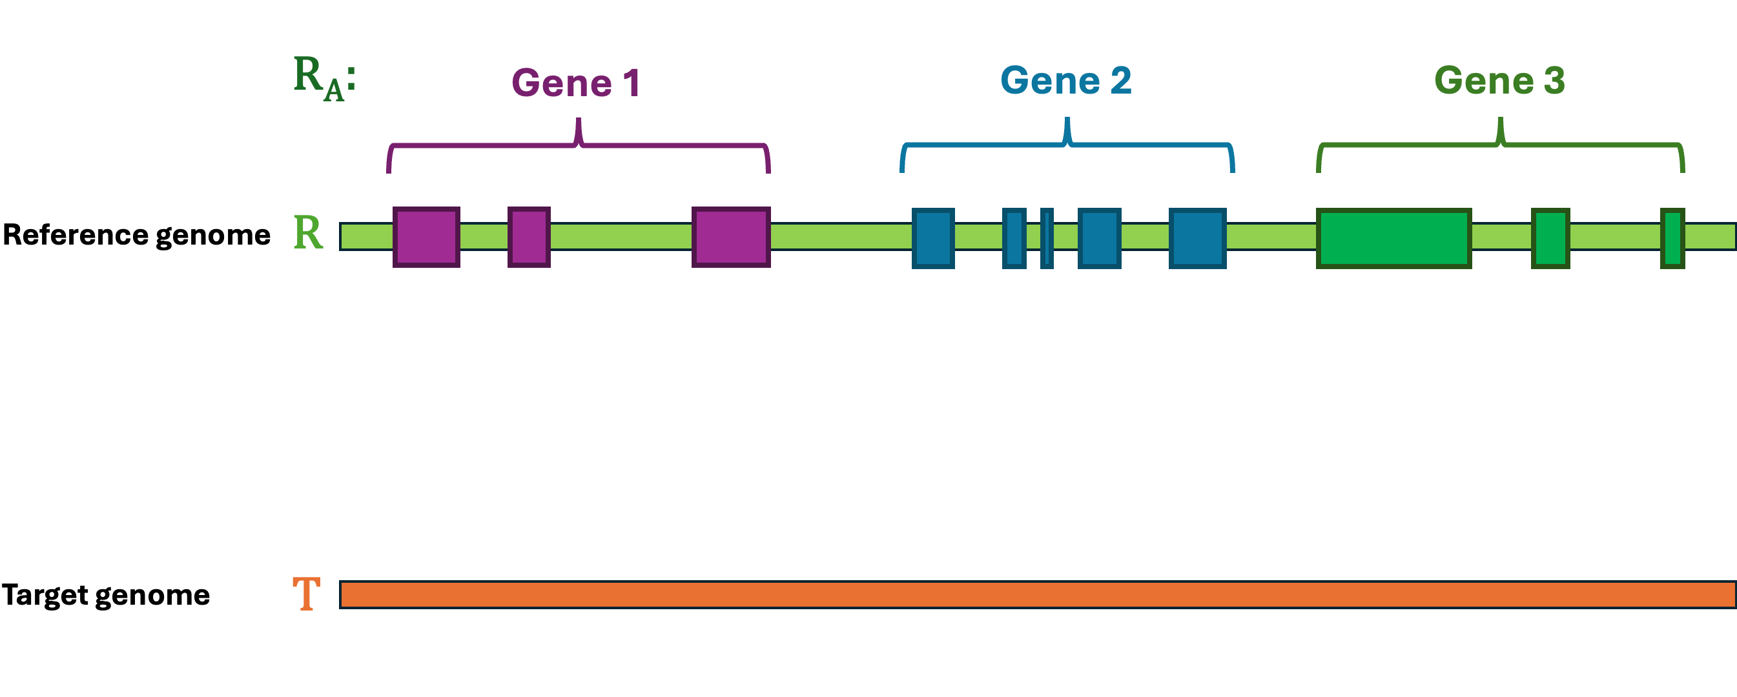
Comparative-based method (projection tools)
Tools that use whole-genome alignments between closely related species.
Transfer gene models based on conserved synteny, gene structure, and alignment blocks.
LASTZ
Mummer
Satsuma
SynMap
Pecan
HAL
Popular tools
  Kraken
  TransMap (UCSC)
chained alignments
graph alignments

Slide 24
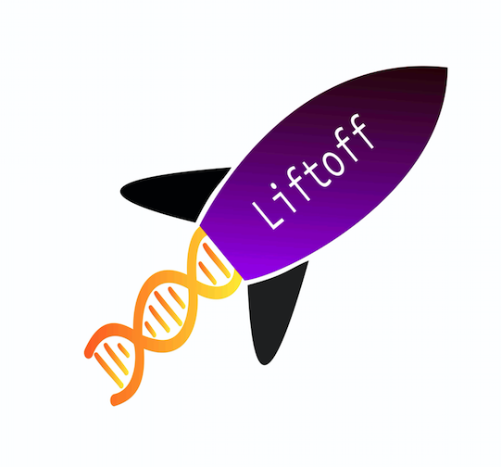

Comparative-based method (projection tools)
Tools that use local alignments between species.
Transfer gene models based on gene alignment.
Popular tools
LiftOff
LiftOn
transfer annotation between closely related species
transfer annotation between close and distant related species
minimap2
Miniprot
Notes:
DNA-based mapping tools help to address this challenge, but they are only able to transfer annotation between closely related species. Here we introduce LiftOn, a homology-based software tool that integrates DNA and protein alignments to enhance the accuracy of genome-scale annotation and to allow mapping between relatively distant species.

Slide 25
Exercise

Slide 26
Intrinsic approaches
ab initio
Using Machine Learning approaches (probabilistic and/or deterministic models) to predict features

Slide 27
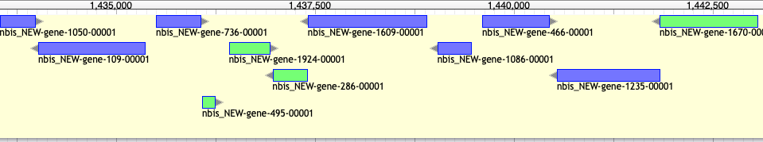
Intrinsic / ab initio
Bacterial gene prediction
- Short intergenic regions
- Uninterrupted ORFs (No intron)
- Very conserved signals
  easy problem: Accuracy > 90%

Slide 28
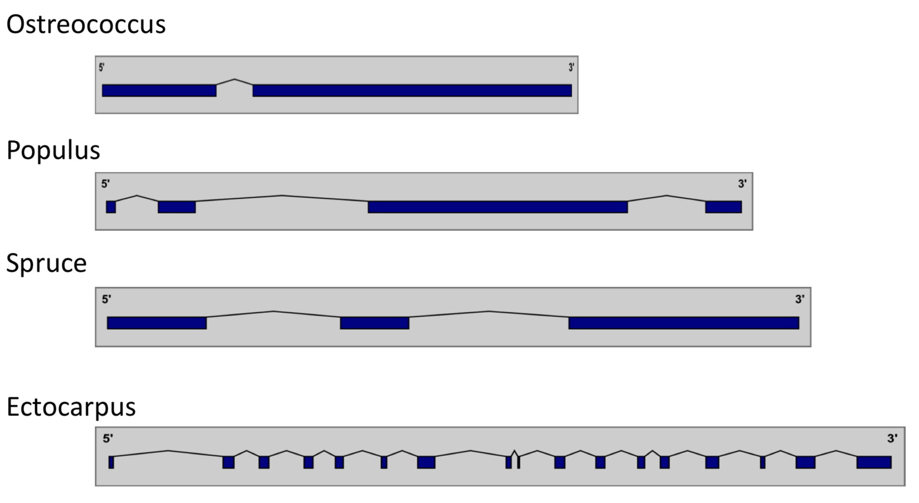
Intrinsic / ab initio
Eukaryotic gene prediction
- Presence of intron => structures differ
- Isoforms
- New features (e.g. lncRNAs)
                => Hard problem: Accuracy < 70%
                => Requires training

Slide 29
Probabilistic methods
gene content
signal detection
Statistical properties of protein-coding sequence
learn from existing data.
These are like landmarks in the genome, they tell the model where to look.
  codon usage
  hexamer usage
  GC content
  compositional bias between codon positions
  nucleotide periodicity
  exon/intron size
  …
  Promoter
  ORF
  Start codon
  Splice site (Donor and acceptor)
  Stop codon
  Poly(A) tail
  CpG islands
  …
=> Ab initio tools will combine this information through different Probabilistic models (e.g. HMM, GHMM, WAM) to calculate the most probable combination that represents a valid gene

Slide 30
Probabilistic methods
Popular tools
SNAP Works ok, easy to train, not as good as others
especially on longer intron genomes.
Augustus Works great, hard to train (but getting better).
GeneMark-ES no hints, buggy, not good for fragmented genomes or long introns (Best suited for Fungi).
FGENESH Works great, costs money even for training.
GlimmerHMM (Eukaryote)
GenScan
Gnomon (NCBI)
Supported by MAKER
Self training!
http://weatherby.genetics.utah.edu/MAKER/wiki/index.php/MAKER_Tutorial

Slide 31
Deterministic methods
Neural networks (CNN, bLSTM) predicts
for each base, the probability of being:
      in an exon
      in an intron
      at a splice site
      in UTRs, etc.
Captures complex, long-range sequence dependencies.
=> struggles to precisely locate exon boundaries
=> base-level predictions can be
  Noisy (e.g., false positives),
  Biologically inconsistent (e.g., a stop codon in the middle of a predicted CDS),
  Missing structure (e.g., incorrect start/stop, fragmented exons).
+
HMM postprocessor
Ensures coherent gene structures by filtering noisy outputs.

Slide 32
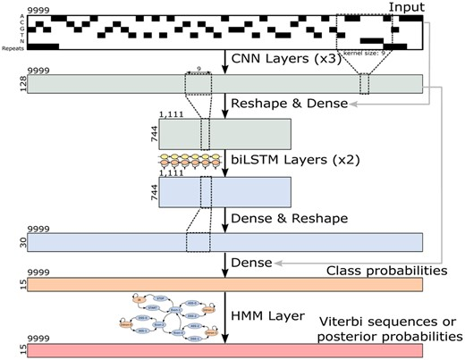
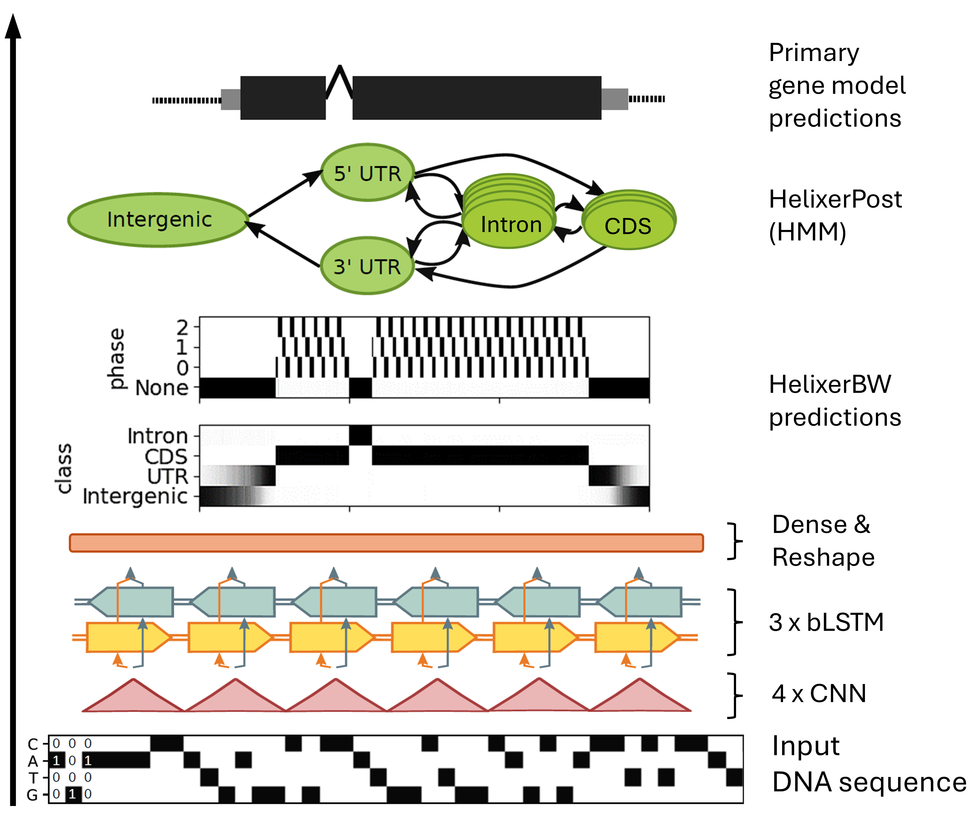
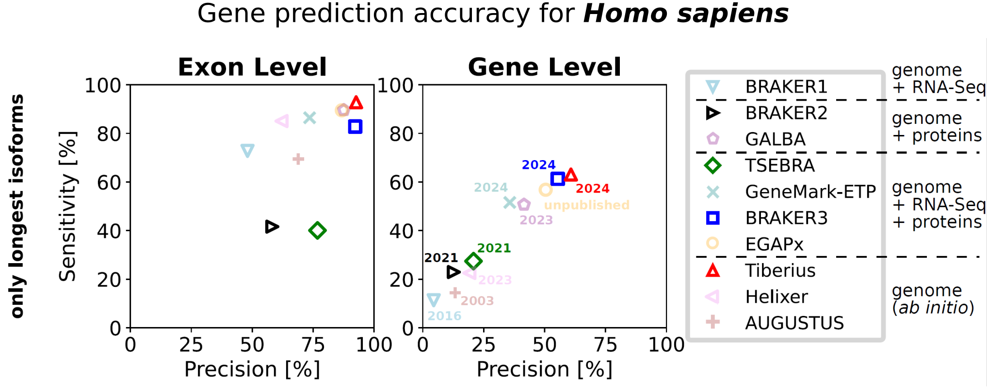
Deterministic methods
Popular tools
Helixer
Tiberius
Helixer–de novo Prediction of Primary Eukaryotic Gene Models Combining Deep Learning and a Hidden Markov Model
End-to-End Deep Learning with an HMM for Gene Prediction
https://doi.org/10.1101/2023.02.06.527280
https://github.com/weberlab-hhu/Helixer
https://academic.oup.com/bioinformatics/article/40/12/btae685/7903281
https://github.com/Gaius-Augustus/Tiberius
Notes:
In Tiberius HMM is used during both training and inference

Slide 33
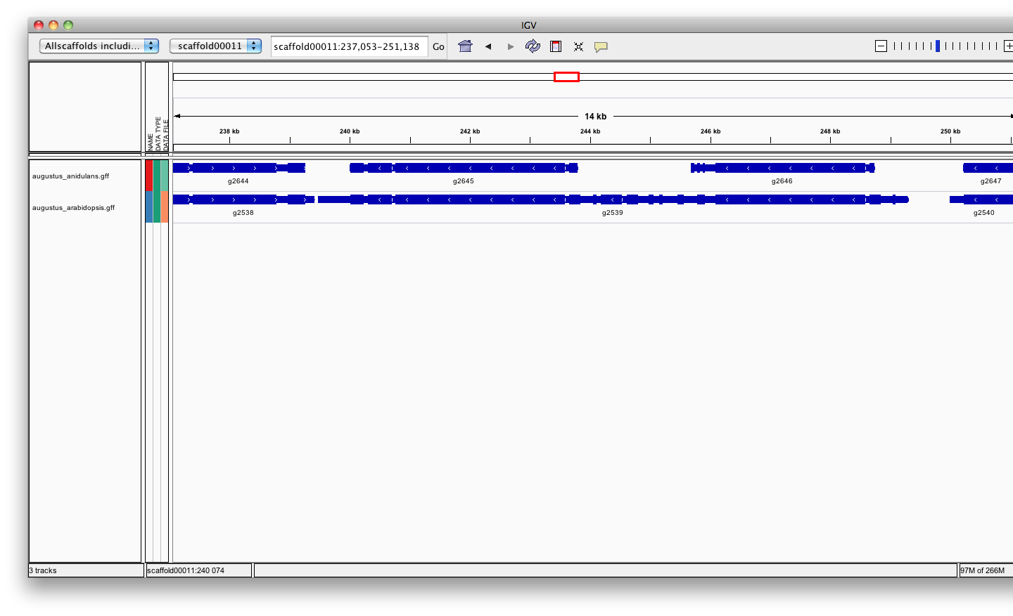
Training intrinsic / ab initio gene-finders
Ab-initio tools need of a models (also called profile) => Training
  Few self-trained tools, most need a separate training procedure
  The quality of the gene-finder results hugely relies on the quality of the training!
  Needs training for every genome / phylogenetic range (= different training sets)
A fungal genome
Fungi
Plants
Training
Probabilistic
Deterministic
    A sets of high quality genomes (>3)
    => Species that generalize well to your target species
    A sets of high quality genes (>500)
    => These ”known” genes are usually inferred from aligned transcripts or proteins

Slide 34
Intrinsic / ab initio
Strengths :
  Fast and easy
  Annotate unknown genes
  Sensitivity ok
  Need no external evidence**
Limits :
  No UTR*
  No alternatively spliced transcripts*
  Bad specificity / precision (Over prediction of exons or/and genes)
  Training needed (Need external evidence**)
Common errors in annotation:
  Split single gene into multiple predictions
  Fused with neighboring genes
  May be less accurate than homology based method:
    Exon boundaries
    Splicing sites
Hybrid method

Slide 35
Exercise

Slide 36
Hybrid approaches
Evidence-drivable gene predictors incorporate hints/extrinsic information in the form of alignments (transcript, protein, whole genome) to increase the accuracy of the gene prediction.
Can predict locus without extrinsic information
Improve prediction when extrinsic information available

Slide 37
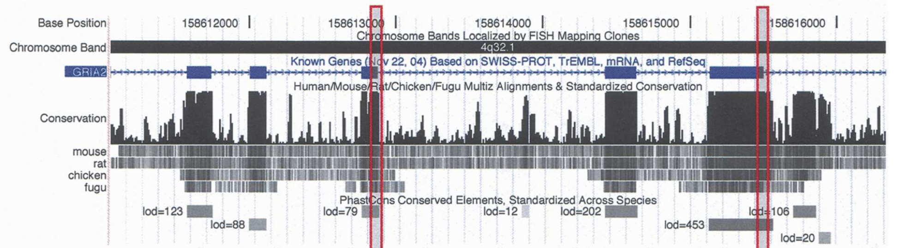
Hybrid: Comparative + ab initio
functional parts e.g. exons, tend to be more conserved than the non-functional ones, the introns.
Alignment of genomic sequences from different species and use the alignments to guide the ab-initio gene predictions.
Limits : - Whole genome alignment is time/memory consuming
- Need relatively close related genome (<50 My)

Slide 38
Hybrid: Comparative + ab initio
Dual genome, de novo gene structure prediction:
  Rosetta (Pioneer – 2000)
  SGP-2 (2001) – considers only the conservation in protein-coding regions
  TWINSCAN (2001) - included models of conservation in splice sites and start and stop codons
  SLAM (2003)
  TWAIN (2005)
More than 2 genomic sequences:
  NSCAN* (2006)
  Conrad *(CRF, 2007)
  CONTRAST* (CRF, 2008) -> 58% accuracy
  Augustus-CPG*
*Can use similarity-based information

Slide 39
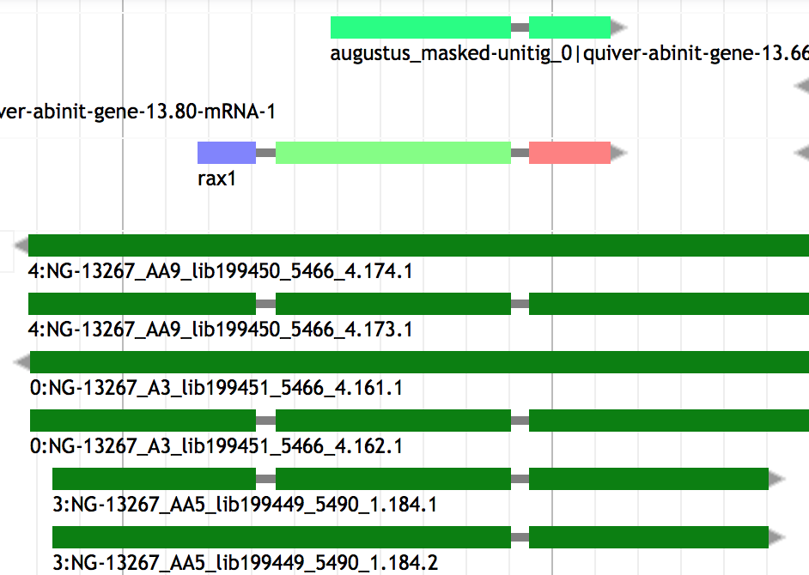
Hybrid: Similarity based + ab initio
Evidence-drivable gene predictors / Ab initio evidence-based approaches incorporate hints in the form of EST or protein alignments to increase the accuracy of the gene prediction.
Strength :
Lot of data available
Protein well conserved
High accuracy
Limits :
Extra computation to generate alignments
heterogeneous sequence quality :
  Incomplete
  Error during transcriptome assembly
  Contamination
  Sequence missing
  Orientation error

Slide 40
Hybrid: Similarity based + ab initio
Popular tools
GenomeScan Blast hit used as extra guide
Augustus 16 types of hints accepted (gff): start, stop, tss, tts, ass, dss, exonpart, exon, intronpart, intron, CDSpart, CDS, UTRpart, UTR, irpart, nonexonpart.
GeneMark-ETP Protein and transcript based evidence hints
SNAP Accepts EST and protein-based evidence hints.
Gnomon* Uses EST and protein alignments to guide gene prediction and add UTRs
FGENESH+ Best suited for plant
Self training!

Slide 41
Hybrid: Similarity based + ab initio
BRAKER2: automatic eukaryotic genome annotation with GeneMark-EP+ and AUGUSTUS supported by a protein database.
Brůna T, Hoff KJ, Lomsadze A, Stanke M, Borodovsky M. NAR Genom Bioinform. 2021 Jan 6;3(1):lqaa108. doi: 10.1093/nargab/lqaa108. PMID: 33575650; PMCID: PMC7787252.
Does not require pre-trained parameters or a separate expert-prepared training step.
Good result

Slide 42
Exercise

Slide 43
Combiner / Chooser
Combining heterogeneous data into gene models
Selection of gene models

Slide 44
Chooser / combiner
Combiner concept: combining different lines of evidence into gene models
Evidence:
ESTs / Transcripts
Proteins
Gene prediction (ab-initio or evidence-based)
Gene models
﻿=> add untranslated regions (UTR)

Slide 45
Chooser / combiner
Combiner concept: combining different lines of evidence into gene models
Evidence: ESTs / Transcripts / Proteins
Gene prediction (ab-initio or evidence-based)
=> Select the best possible set of exons and combine them in a consensus gene model

Slide 46
Chooser / combiner
Chooser concept: Select best gene models
Evidence: ESTs / Transcripts / Proteins
Gene models
=> Choose the prediction whose best matches the evidence

Slide 47
Chooser / combiner
Chooser concept: Select best gene models
Gene models
=> Choose the prediction whose structure best represents the consensus

Slide 48
Chooser / combiner
Use battery of gene finders and evidence (transcript, protein) alignments and:
Tool | Consensus based chooser | Evidence based chooser | weight of different sources | Comment
A) Choose the prediction whose best matches the evidence
MAKER* |  | X
PASA* |  | X
GeMoMa |  | X |  | You can weight on presence in multiple genome
B) Choose the best possible set of exons and combine them in a new consensus gene model
JIGSAW | X
EVM Evidencemodeler | X | X | X | User can set the expected evidence error rate manually or/and learn from a training set
Evigan | X |  | X | Unsupervised learning method
Ipred |  | X |  | Does not require any a priori knowledge Can also combine only evidences to create a gene model
Strength => They improve on the underlying gene prediction models
Notes:
EVM choose the post-processed gene model that is most consistent with the evidences
~ GAZE : GAZE (Howe et al. 2002), pro- vides a general framework to assemble an optimal set of gene structures given a user-supplied feature set, scoring scheme,
Ipred: Franziska Zickmann and Bernhard Y Renard BMC Genomics. 2015; 16(1): 134.doi: 10.1186/s12864-015-1315-9
EVIGAN is the scuccessor of GLEAN
* Are pipelines that contain chooser

Slide 49
Exercise

Slide 50
Pipelines
(The ultimate step)
Align evidence
add annotation (UTR, score, gene name)
train ab initio models
Annotation of other features (Repeat, tRNA, etc)
Add functions
And more…

Slide 51
Tool | Repeat | Transcript / RNAseq | Protein | Comparative | Ab inito | Function | other | Comment
PASA |  | X | X
MAKER3 | X | X | X |  | X |  | tRNA | Can be used to improve an existing annotation
EGAPx (NCBI) | X | X | X |  | X | X | tRNA, RFAM
Comparative Annotation Toolkit (CAT) |  | X | X | X | X
Ensembl | X | X | X | X |  |  | Rfam Pseudogenes lncRNA | Difficult to use
Funannotate | X | X | X |  | X |  | tRNA | Originally for Fungi.
BRAKER3 |  | X | X |  | X
EASL |  | X | X |  | X | X | BUSCO | Automated with Nextflow
More or less automated…

Slide 52
Exercise

Slide 53
Closing remarks

Slide 54
Closing remarks
How to choose your Method?
Scientific question behind ( need of a conservative annotation vs exhaustive)
Species dependent ( Fungi / Eukaryotes / Prokaryotes)
phylogenetic relationship of the investigated genome to other annotated genomes (Terra incognita, close, already annotated).
Data available (hmm profile, RNAseq, etc…)
Depending on computing resources (ab initio vs pipeline)

Slide 55

Closing remarks
>100 annotation tools many methods
6 main class of approaches (Similarity-based, ab initio, hybrid, comparative, combiner, pipeline )
Many combination of tools
Several ab-initio tools together give better result that one alone (complement each other)
Pipelines ease the task and give good results
Most methods only build gene models, no functional inference
No annotation method is perfect, they do mistakes !!
Annotation requires manual curation to be close to perfect
An annotation (as assembly) is never finished, it can always be improved => to know how when to stop
QC after annotation (and before)!!
Submit your annotation in public archive !!

Slide 56

Thank you for your attention

Slide 57
To go further
Building better genome annotations across the tree of life
https://www.biorxiv.org/content/10.1101/2024.04.12.589245v1.full

