Slide 1





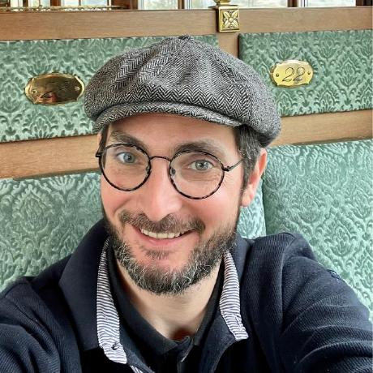



Functional annotation
22/09/2025
Jacques.dainat@ird.fr
Juke34
@Jacquesdainat.bsky.social
Jacques Dainat Ph.D.
Notes:
Question: Avez-vous une idée de comment procéder?
Je ne vais malheureusement pas aborder la thématique de comment coder de manière reproductible en R

Slide 2
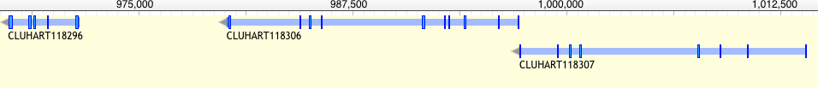
Functional annotation – why?
Understanding the function of gene product is key to understanding how a limited number of interacting gene products can generate life, from simple unicellular organisms to the incredibly complex multi-cellular Homo sapiens.
Rison,S.C., Hodgman,T.C. and Thornton,J.M. (2000) Comparison of functional annotation schemes for genomes. Funct. Integr. Genomics, 1, 56–69.
Proteins vary in structure as well as function
?
?
?
Antibodies?
Energy?
Enzyme?
Contractile protein?
Transport Protein?
Storage Protein?
Structural Protein?
Hormone?
Notes:
Metabolic reconstruction. What can an organism do and how?
Evolutionaly analysis. How does an organism compare to the rest?

Slide 3
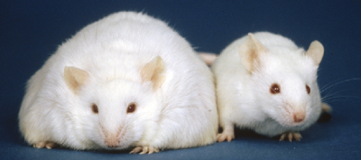
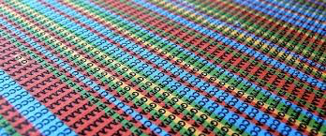
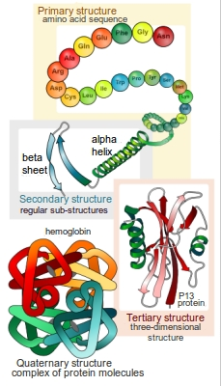
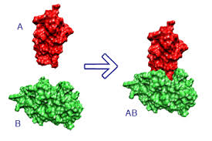
Functional annotation – how?
Experimentally (accurate)
- Mutants, knockout, etc.
Computationally (limited accuracy)
  Sequence-based
  Structure based
  Protein-protein interaction
Mice homozygous for the diabetes 3J spontaneous mutation

Slide 4
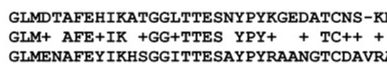
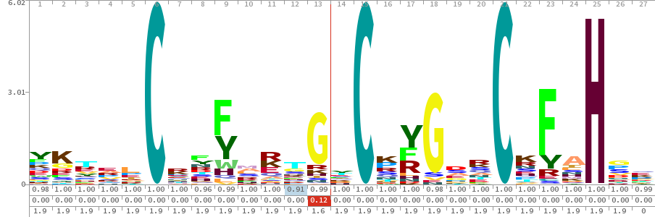
Methods - Sequence-based
Based on similarity
  => Best blast hit
Based on Motif
  => Proscan, MEME, QuasiMotiFinder
Based on Profile
  => HMM or other statistical signature
Q
S
D-X-[KR]-P-{WYF}-X5
Any amino acid
either
Any amino acid except
Whole sequence
e.g. Psi-BLAST*, PIRSF
…
structural classification
e.g. SUPERFAMILY
domain
e.g. PFAM
Localization (e.g membrane, golgi, secreted)
e.g. SignalP, TMHMM
Notes:
Clustering => How choose the representative in the cluster ? Need to prioritize … by organism model as example.
Motif = pattern = regular expression: basic because there is no weight for each position.
Signatures are predictive models, provided by several different databases,
In genetics, a sequence motif is a nucleotide or amino-acid sequence pattern that is widespread and has, or is conjectured to have, a biological significance. For proteins, a sequence motif is distinguished from a structural motif, a motif formed by the three-dimensional arrangement of amino acids which may not be adjacent.
Multiple EM for Motif Elicitation (MEME) is a tool for discovering motifs in a group of related DNA or protein sequences.
The term motif is use to refer to a part of a protein sequence that is associated with a particular biological function.
The presence of a particular motif within a protein sequence can be used to suggest functions for uncharacterised proteins.

Slide 5
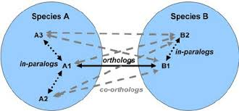
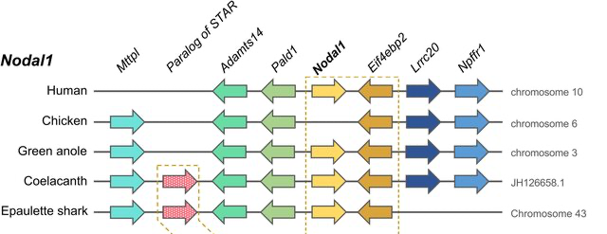
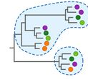
Methods - Sequence-based
Use of evolutionary relationship (Orthology)
  Based on Clustering
  => KOG (Eukaryotic) / COG(Prokaryotic)
  Based on synteny
    => conservation of gene order/organization across species
  Based on phylogeny
  => Quite complicated at large scale

Slide 6
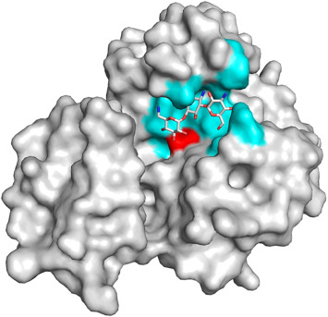
Methods - Structure-based
Focuses on the 3D conformation of a single protein and similarity to know structures to infer function.
  Global structure
  Classification of overall protein folds and domain (e.g. SCOP, CATH, FSSP)
  local structure
  Functionally relevant parts of the structure e.g. clefts, ligand-binding pockets, interfaces, surfaces.
  It often suggests where ligands, cofactors, or partner proteins may interact (e.g. CASTp, fpocket, ProFunc).
  active-site residues (atomic level)
    Specific catalytic or ligand-binding residues. Residues are often more conserved than the overall fold (e.g. PDBSiteScan, Catalytic Site Atlas)

Slide 7
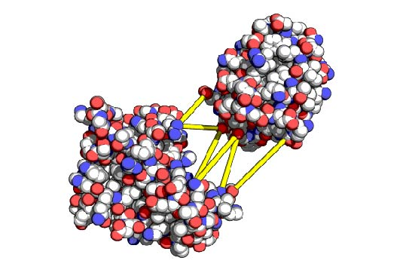
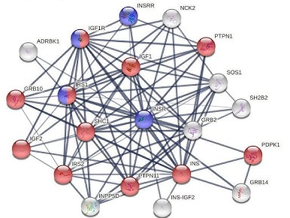
Methods – Protein-Protein interaction
  Structure-guided interaction prediction (who interacts)
  Docking and modeling of protein complexes (e.g. HADDOCK, ClusPro)
  Identifies potential interaction partners and functional interfaces.
  Pathway and network context (what role)
  Integration of predicted PPIs into biological networks (e.g. STRING).
  Guilt-by-association: uncharacterized proteins may inherit function from well-annotated neighbors.
  Supports placement of proteins into pathways and complexes.

Slide 8
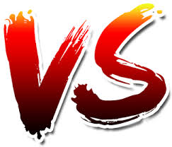
Functional annotation is actually kind of complex…
  Multidimensional problem:
  A protein can have a molecular function, a cellular role, and be part of a functional complex or pathway
  Descriptive levels
  Molecular function can be illustrated at multiple levels e.g. 'enzyme' category versus a more specific 'protease' assignment
  Similarities (structural or in sequence) function.
  - Similar sequences but different functions (new domain => new combination => different function)
  - Different sequences may have same function (convergence) : Profiles helpful
  - Two proteins may have a similar fold but different functions
  Looks for conserved domains more reliable than whole sequence ?
  How to go from conserved domains to assigning a function to your protein?
=> Importance is to gather as much information as possible

Slide 9
Databases
Database | Information | Comment
CARD | Antibiotic Resistance | Comprehensive Antibiotic Resistance Database
Catalytic Site Atlas (CSA) | Sites | Database of catalytic residues and enzyme active sites
DIP | Interaction | Database of interacting proteins
eggNOG | Orthologous groups | Functional classification of proteins based on orthology (COG/KOG)
GO | Gene Ontology | Three structured, controlled vocabularies (ontologies) : biological processes, cellular components and molecular functions
KEGG | Pathway | Kyoto Encyclopedia of Genes and Genomes
PDB | Protein structures | Main repository of experimentally determined 3D protein structures
Pfam | Protein families | Multiple sequence alignments and hidden Markov models
Prosite | Protein domains | Protein domains and motifs Database of conserved protein motifs and functional sites
Reactome | Pathway | Curated and peer reviewed pathway database
Uniprot | Protein sequence and functional annotation database | Comprehensive resource for protein sequences, functional annotation, domains, post-translational modifications, subcellular localization, and cross-references to multiple biological databases
… | … | …

Slide 10
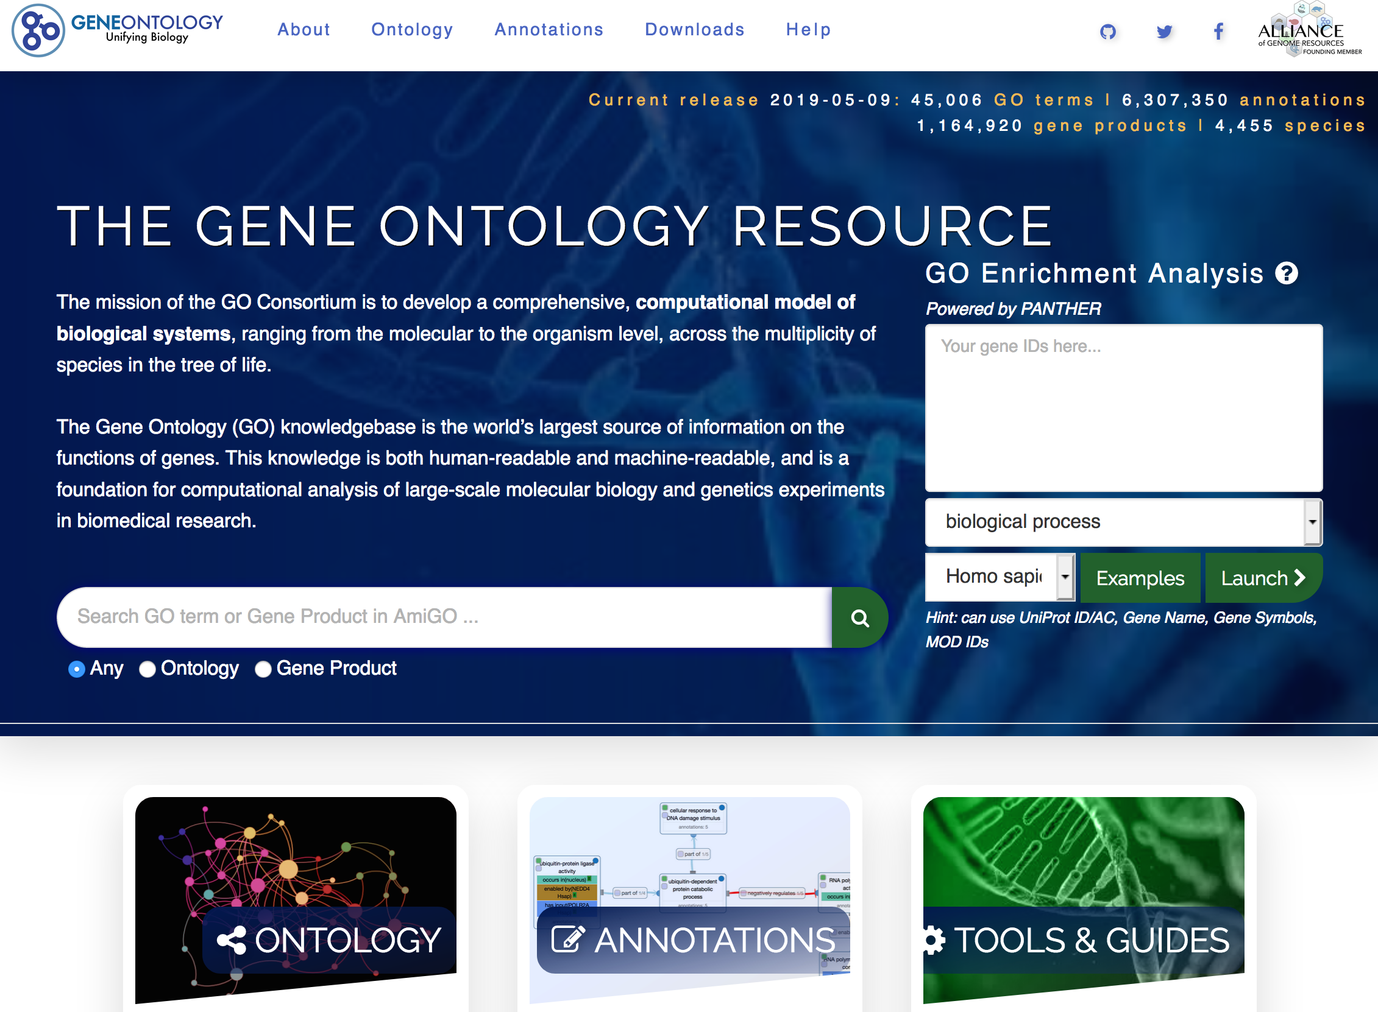
Gene Ontology
Gene Ontology (GO) is a major bioinformatics initiative that uses a controlled vocabulary (> 60 000 terms) to standardize the representation of gene and gene product attributes across all species.
http://www.geneontology.org/

Slide 11
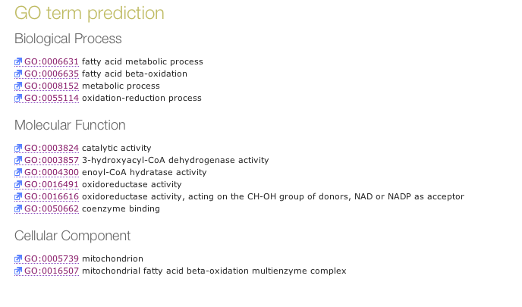
Gene Ontology
Gene Ontology (GO) organizes function into three complementary aspects:
pathways and larger processes
made up of the activities
of multiple gene products.
molecular activities
of gene products
where gene products are active

Slide 12
Main type of functional information
Protein
Name and general function
Similarity to known proteins and orthologs
Domains
(regions associated with a biochemical function or structural role)
Protein features
(e.g. secretory signal peptides, Transmembrane helix)
Biological pathways
Gene Ontology terms (GO: molecular function, biological process, cellular component)
These annotations exist at different biological scales:
  Molecular level → domains, catalytic activity
  Cellular level → localization, pathways
  Systems level → biological processes and networks
Notes:
Pathways describe how genes, proteins, metabolites, and signaling molecules interact in processes such as:
metabolism,
signal transduction,
gene regulation,
or cellular responses.

Slide 13
Main type of functional information
Protein
Name and general function
Similarity to known proteins and orthologs
Sequence Similarity :
The most used (popular)
Quick
Easy to use
Accurate (>70%)
Many resources: even structural domains information
Less computationally demanding
Watson JD et al. : Towards fully automated structure-based function prediction in structural genomics: a case study. J Mol Biol. 2007, 367: 1511-1522. 10.1016/j.jmb.2007.01.063.
Tools: BlastP , MMseqs2, Diamond, ...
Database: Uniprot, eggnog, …
Notes:
Pathways describe how genes, proteins, metabolites, and signaling molecules interact in processes such as:
metabolism,
signal transduction,
gene regulation,
or cellular responses.

Slide 14
Sequence similarity
Limits
Reliability of the database used e.g. Uniprot (exhausive) vs Swissprot (reliable)
Orthology not certain - best blast-hit does not equal orthologous!
Minimum e-value (arbitrary)
Bias due to well conserved domains
Best Hit (used as template) is not necessary the best annotated sequence to use => Could apply a prioritization rule (Species X first, then Y, etc).

Slide 15
Main type of functional information
Protein
Name and general function
Similarity to known proteins and orthologs
Domains
(regions associated with a biochemical function or structural role)
Protein features
(e.g. secretory signal peptides, Transmembrane helix)
Biological pathways
Gene Ontology terms (GO: molecular function, biological process, cellular component)
BlastP , MMseqs2, Diamond
HMMER (profil), SignalP (Motif), TMHMM (Motif), etc…
Notes:
Pathways describe how genes, proteins, metabolites, and signaling molecules interact in processes such as:
metabolism,
signal transduction,
gene regulation,
or cellular responses.

Slide 16
Tools
Tool | Approach | Comment
Trinotate | Best blast hit + protein domain identification (HMMER/PFAM) + protein signal peptide and transmembrane domain prediction (signalP/tmHMM), and leveraging various annotation databases (eggNOG/GO/Kegg databases). | Partially automated
Annocript | Best blast hit | Collects the best-hit and related annotations (proteins, domains, GO terms, Enzymes, pathways, short)
Annot8r | Best blast hits | A tool for Gene Ontology, KEGG biochemical pathways and Enzyme Commission EC number annotation of nucleotide and peptide sequences.
Sma3s | Best blast hit + Best reciprocal blast hit + clusterisation | 3 annotation levels
afterParty | BLAST, InterProScan | web application
Interproscan | Run separate search applications HMMs, fingerprints, patterns => InterPro | Created to unite secondary databases
Blast2Go | Best* blast hits (picks out GO terms based on blast hits and uniprot with statistical significance test ) | Commercial ! Contain nice downstream analysis/visualization components Plugin for Geneious or CLC bio Workbench
Notes:
Adapted to transcriptome: Trinotate, Annocript

Slide 17
Interpro/Interproscan
InterPro
is an integrative database that combines the main protein signature databases (Pfam, PROSITE, SMART, CATH, SUPERFAMILY, etc.).
A signature
is a motif, a profile, or an HMM (Hidden Markov Model) provided by a member database that describes a protein family, a domain, an active site, or another functional region.
Integrated signature
is a signatures linked to an InterPro entry
InterPro entries
is a curated biological interpretations combining multiple integrated signatures.
InterProScan
is the software that compares a given protein sequence against all these signature databases to assign potential functions.

Slide 18
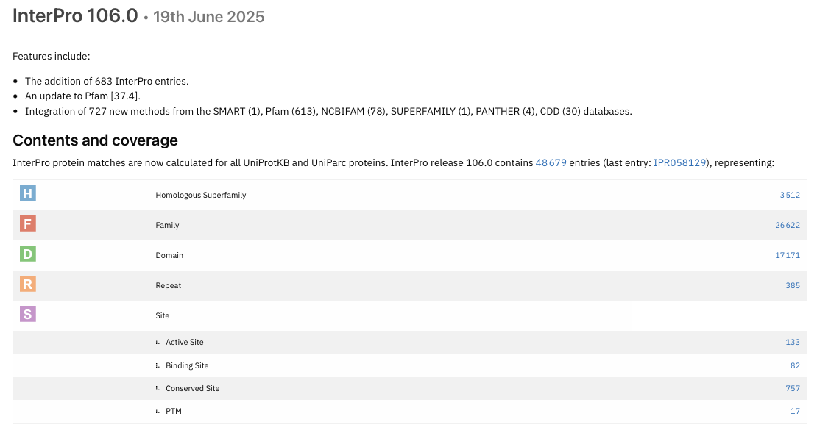
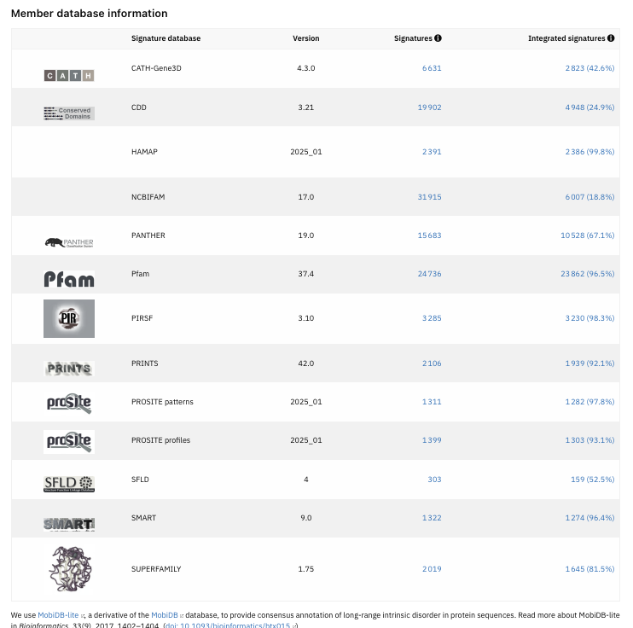

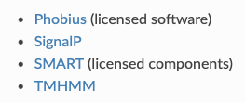
Interpro
pathway :
- MetaCyc
- Reactome
other licensed analysis available:
Total 113 003 61386
Notes:
Not integrated signatures = signature not yet curated or do not reach InterPro's standards for integration

Slide 19
Interproscan
Search against signature databases
InterProScan runs searches in parallel (Each database uses its own search engine:
    Pfam → HMMER (HMM profiles).
    PROSITE → regular expressions or profiles.
    SUPERFAMILY → structural HMMs.
    COILS → prediction of coiled-coil regions.
Result aggregation
All matches are collected and for each match, InterProScan adds:
Associated InterPro ID (if --iprlookup is used e.g. IPR002568) <= It unifies results coming from different databases.
Associated GO terms (if --goterms is used).
Associated pathways (if --pa is used).

Slide 20
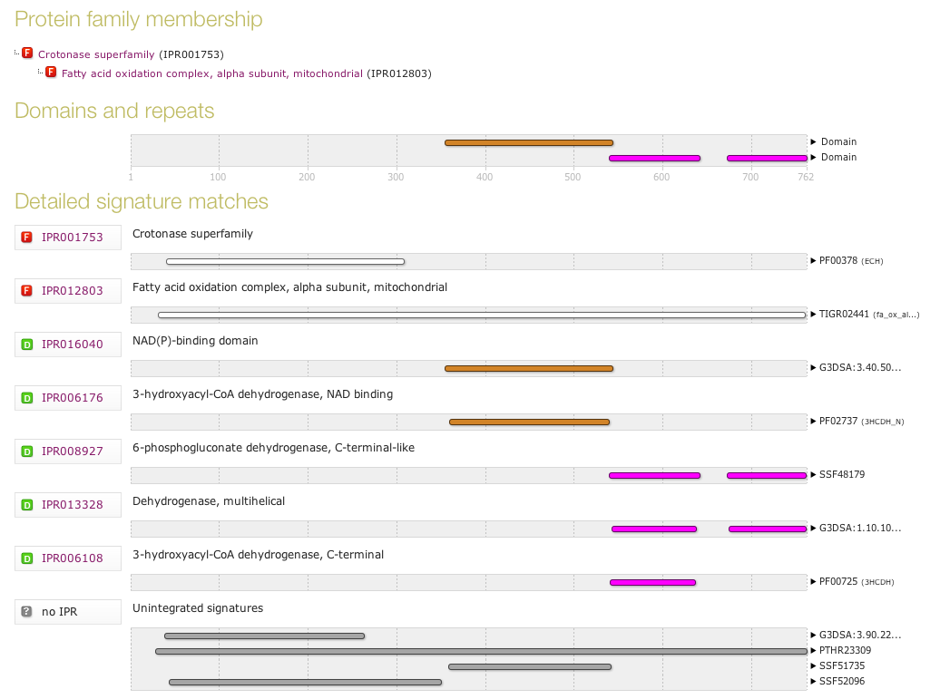
Interproscan

Slide 21
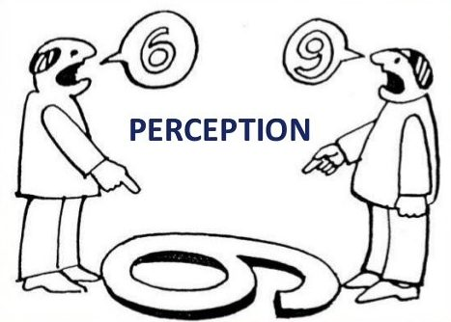
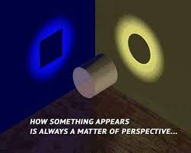
One word about network
Categorizations of gene function (e.g GO) in a hierarchy of categories is helpful
BUT
gene has no function alone
Pathways / regulatory networks explain how genes interact so what they are doing!
E.g. databases for pathway :
    KEGG
    MetaCyc
    Reactome
    UniPathway
Notes:
Perspective !!
Categorizations of gene function, such as those used in the Gene Ontology Project slot each gene into one category in a hierarchy of categories. They are helpful, but they ignore the fact that an individual gene has no function in isolation.
Gene function prediction is a stepping stone to the more important problem of inferring regulatory networks that explain how genes interact so as to enable cellular processes.
Put in perspective of PATWAY is better !
There is more information in a network compared to sequence or structure alone. A network provides a global view of the context of each gene.

Slide 22
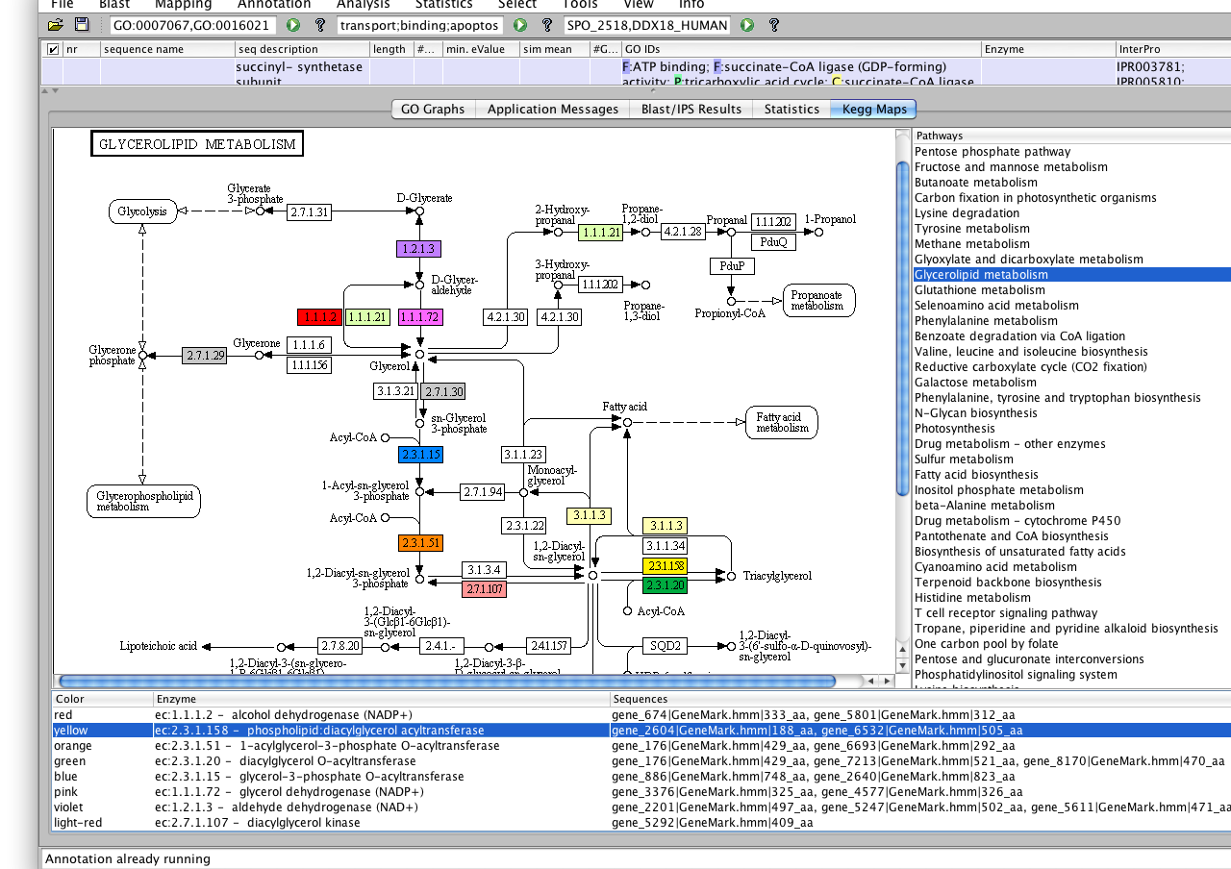
KEGG

Slide 23

Closing remarks
Structural annotation matters
Functional annotation depends strongly on the quality of structural annotation
Common issues: gene fusions, gene splits, partial genes, over-predictions, wrong ORFs
Limits of functional annotation
  Errors can propagate from databases => experimental validation is essential
  Annotation quality depends on the database used
  Many proteins remain hypothetical or uncharacterized (Depends largely on conventional experiments)
Beyond sequence similarity
  High sequence similarity ≠ identical function
  Functional understanding requires additional context:
                Pathway integration
                Spatial/temporal regulation
                Biological networks

Slide 24

Thank you for your attention

