Slide 1









Methods in genome annotation
22/09/2025
Jacques.dainat@ird.fr
Juke34
@Jacquesdainat.bsky.social
Jacques Dainat Ph.D.
Notes:
Question: Avez-vous une idée de comment procéder?
Je ne vais malheureusement pas aborder la thématique de comment coder de manière reproductible en R

Slide 2
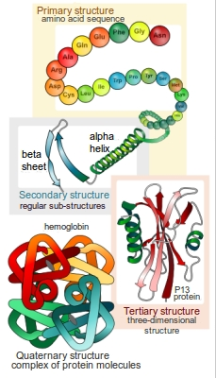
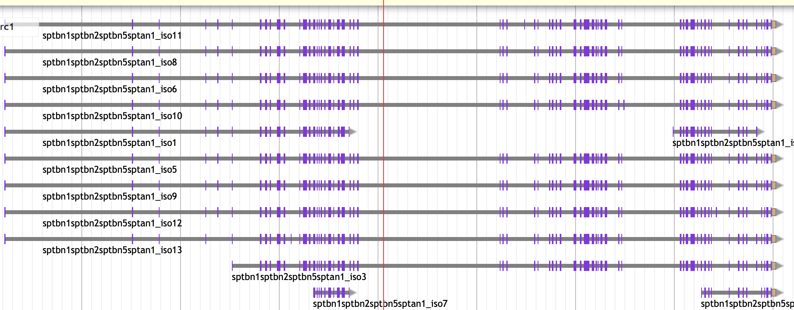
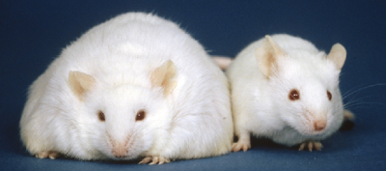
What is annotation ?
Structural annotation:
Find out where the regions of interest (usually genes) are in the sequence data and what they look like.
=> Gene prediction / Gene Finding
functional annotation:
Find out what the regions do. What do they code for?
VS

Slide 3
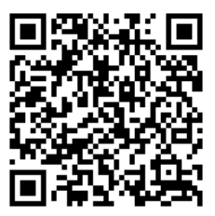
Annotation tools
First annotation tools
90’s
>100 annotation tools*
Nowadays
Structural annotation + functional annotation + …
GFF

Slide 4
Experimental vs Predictive
Experimental
(ESTs, cDNAs, RNA-seq)
Predictive
computational methods
Isolate and clone cognate transcripts (as cDNA) sequence them and compare cDNA with genomic DNA
=> It’s the ONLY secure method but:
Cloning is time consuming.
Lowly expressed genes are difficult to detect.
…
Intrinsic (Machine Learning)
Use only the DNA sequence itself to predict genes based on statistical models of gene structure
Extrinsic
Use external biological evidence, like RNA-Seq, ESTs, protein alignments, or known homologs, to guide annotation
Hybrid
Modern methods often integrate intrinsic and extrinsic signals, blurring the line…
4/70

Slide 5
The different approaches
Similarity-based methods :
These use similarity to annotated sequences like proteins and transcripts
Ab initio prediction :
Machine learning based methods (probabilistic: Likelihood, Bayesian | deterministic: Neural networks)
Hybrid approaches :
  Ab initio tools with the ability to integrate external evidence/hints
Comparative (homology) based gene finders :
These align genomic sequences from different species and use the alignments to guide the gene predictions
Chooser / Combiner :
Selects among existing predictions according to evidence or confidence.
Constructs consensus gene models by integrating evidence from different sources.
Pipelines :
These combine multiple approaches, can annotate other types of features, work on functional annotation, etc.

Slide 6
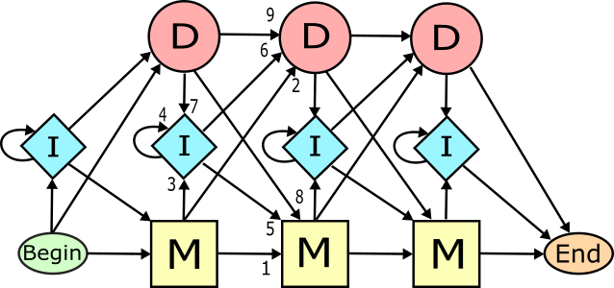
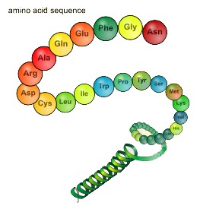
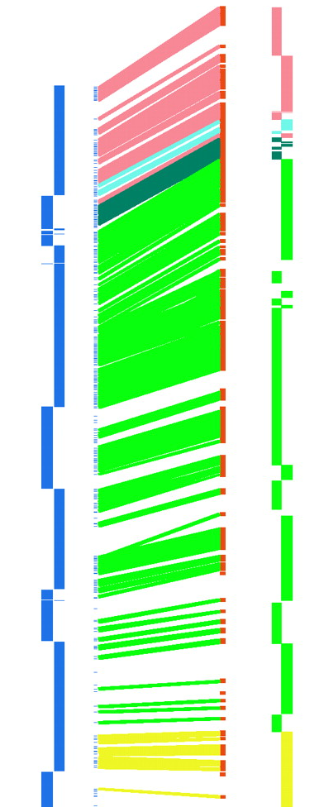
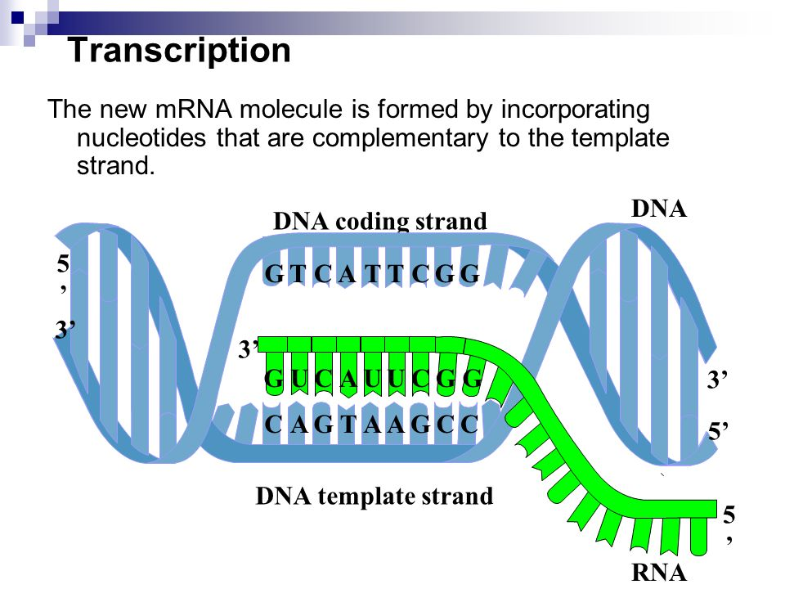
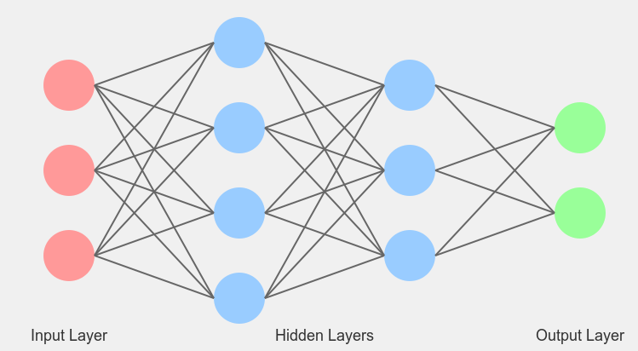
Types data used vs methods - the main lines
Extrinsic
Intrinsic
Transcripts
Proteins
Genomes
ML models
Assembled from RNA-seq or downloaded ESTs
Known amino acid sequences from other organisms
Genome from close related species
probabilistic (HMM, GHMM)
Annotation approach
deterministic (CNN, RNN i.e deep learning )
Similarity | X | X
Comparative |  |  | X
Pure ab initio |  |  |  | X
Hybrid | X | X | X | X
Chooser/Combiner | X | X |  | X
Pipeline | X | X |  | X
Notes:
example of probabilitics methods:
- Likelihood methods
- Bayesian methods

Slide 7
Extrinsic approaches
Similarity-based methods
These use similarity to annotated sequences like
            Proteins
            Transcripts
            ESTs

Slide 8
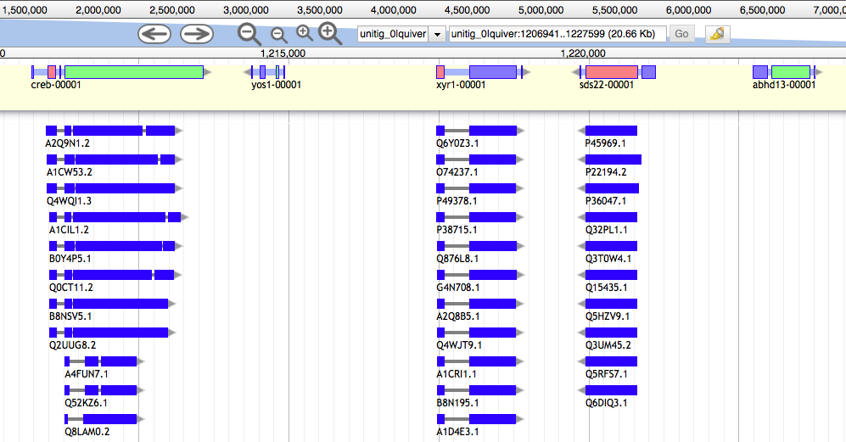
Similarity-based method: Protein data
Evidence sequences (protein, est, etc.) are aligned to the genome
Conserved in sequence => conserved annotation with little noise
  Limits :
  Related to pre-existing data
  Data from model organisms often used => bias?
  Data can be incomplete
  Data can be wrong

Slide 9
Extrinsic approaches
Comparative methods

Slide 10
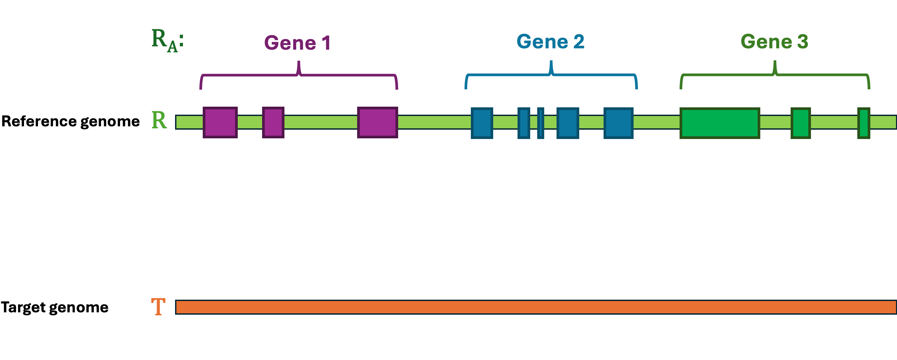
Comparative-based method (projection tools)
Tools that use whole-genome alignments between closely related species.
Transfer gene models based on conserved synteny, gene structure, and alignment blocks.
LASTZ
Mummer
Satsuma
SynMap
Pecan
HAL
Popular tools
  Kraken (not the kmer tool one)
  TransMap (UCSC)
chained alignments
graph alignments

Slide 11
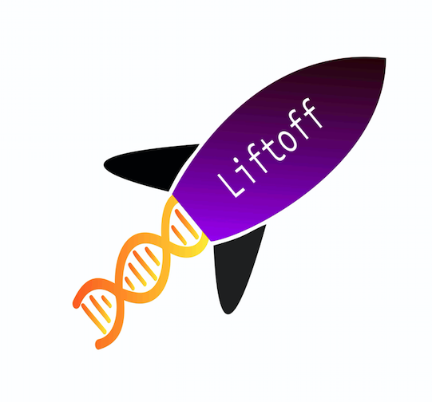

Comparative-based method (projection tools)
Tools that use local alignments between species.
Transfer gene models based on gene alignment.
Popular tools
LiftOff
LiftOn
transfer annotation between closely related species
transfer annotation between close and distant related species
minimap2
Miniprot
Notes:
DNA-based mapping tools help to address this challenge, but they are only able to transfer annotation between closely related species. Here we introduce LiftOn, a homology-based software tool that integrates DNA and protein alignments to enhance the accuracy of genome-scale annotation and to allow mapping between relatively distant species.

Slide 12
Intrinsic approaches
ab initio
Using Machine Learning approaches (probabilistic and/or deterministic models) to predict features

Slide 13
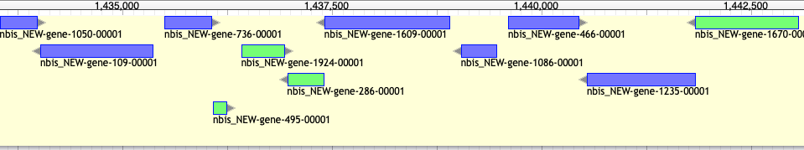
Intrinsic / ab initio
Bacterial gene prediction
- Short intergenic regions
- Uninterrupted ORFs (No intron)
- Very conserved signals
  easy problem: Accuracy > 90%

Slide 14
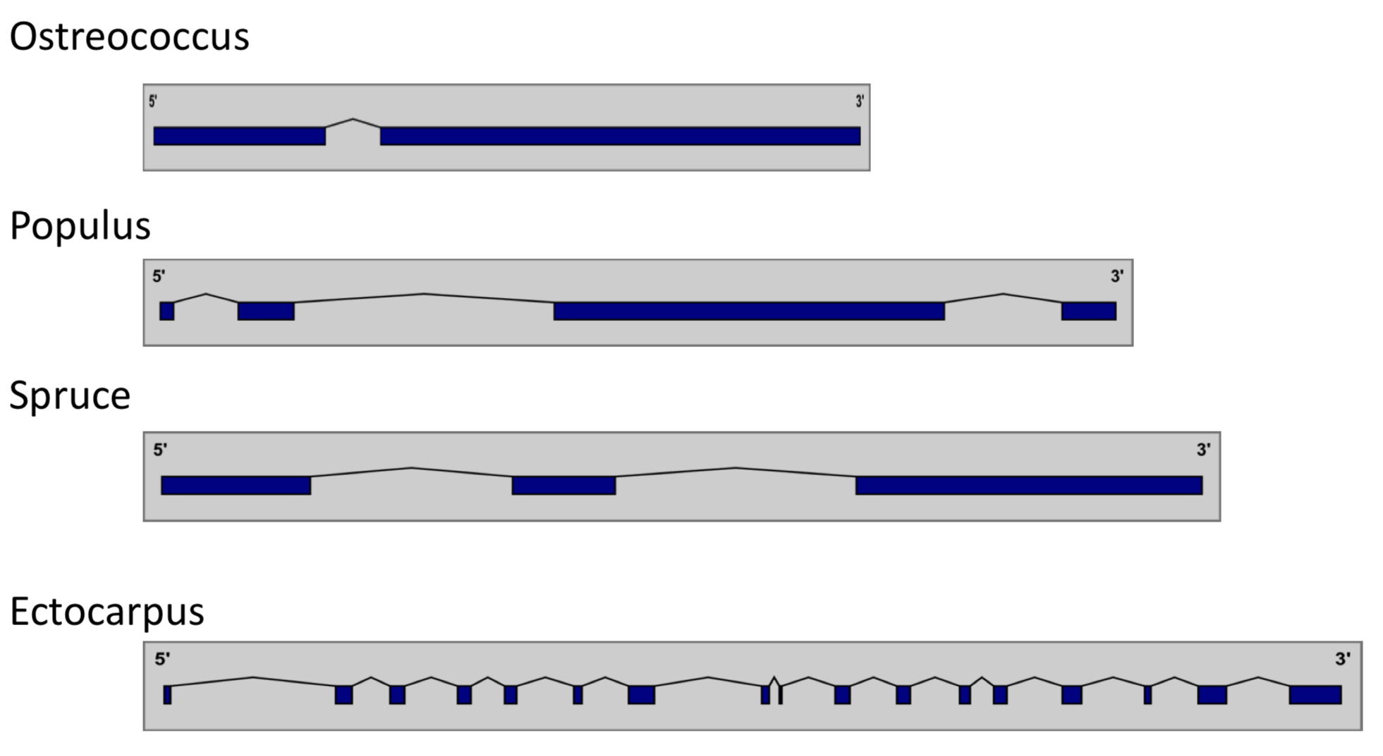
Intrinsic / ab initio
Eukaryotic gene prediction
- Presence of intron => structures differ
- Isoforms
- New features (e.g. lncRNAs)
                => Hard problem: Accuracy < 70%
                => Requires training

Slide 15
Probabilistic methods
gene content
signal detection
Statistical properties of protein-coding sequence
learn from existing data.
These are like landmarks in the genome, they tell the model where to look.
  codon usage
  hexamer usage
  GC content
  compositional bias between codon positions
  nucleotide periodicity
  exon/intron size
  …
  Promoter
  ORF
  Start codon
  Splice site (Donor and acceptor)
  Stop codon
  Poly(A) tail
  CpG islands
  …
=> Ab initio tools will combine this information through different Probabilistic models (e.g. HMM, GHMM, WAM) to calculate the most probable combination that represents a valid gene

Slide 16
Probabilistic methods
Popular tools (Prokaryote)
Complete bacterial or archaeal genomes
  Prodigal a widely used baseline for protein-coding gene prediction
  Pyrodigal a reimplementation of Prodigal in Python
  GeneMarkS-2
  GLIMMER 3 (requires a training step for a new organism)
Metagenomes assemblies
  FragGeneScan (particularly relevant when sequences contain sequencing errors or frameshifts)
  MetaGeneMark
  MetaGene
  MetaGeneAnnotator

Slide 17
Probabilistic methods
Popular tools (Eukaryote)
SNAP Works ok, easy to train, not as good as others
especially on longer intron genomes.
Augustus Works great, hard to train (but getting better).
GeneMark-ES no hints, buggy, not good for fragmented genomes or long introns (Best suited for Fungi).
FGENESH Works great, costs money even for training.
GlimmerHMM (Eukaryote)
GenScan
Gnomon (NCBI)
Self training!
http://weatherby.genetics.utah.edu/MAKER/wiki/index.php/MAKER_Tutorial

Slide 18
Deterministic methods
Neural networks (CNN, bLSTM) predicts
for each base, the probability of being:
      in an exon
      in an intron
      at a splice site
      in UTRs, etc.
Captures complex, long-range sequence dependencies.
=> struggles to precisely locate exon boundaries
=> base-level predictions can be
  Noisy (e.g., false positives),
  Biologically inconsistent (e.g., a stop codon in the middle of a predicted CDS),
  Missing structure (e.g., incorrect start/stop, fragmented exons).
+
HMM postprocessor
Ensures coherent gene structures by filtering noisy outputs.

Slide 19
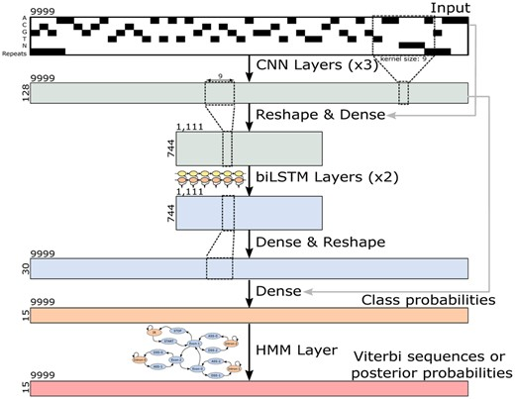
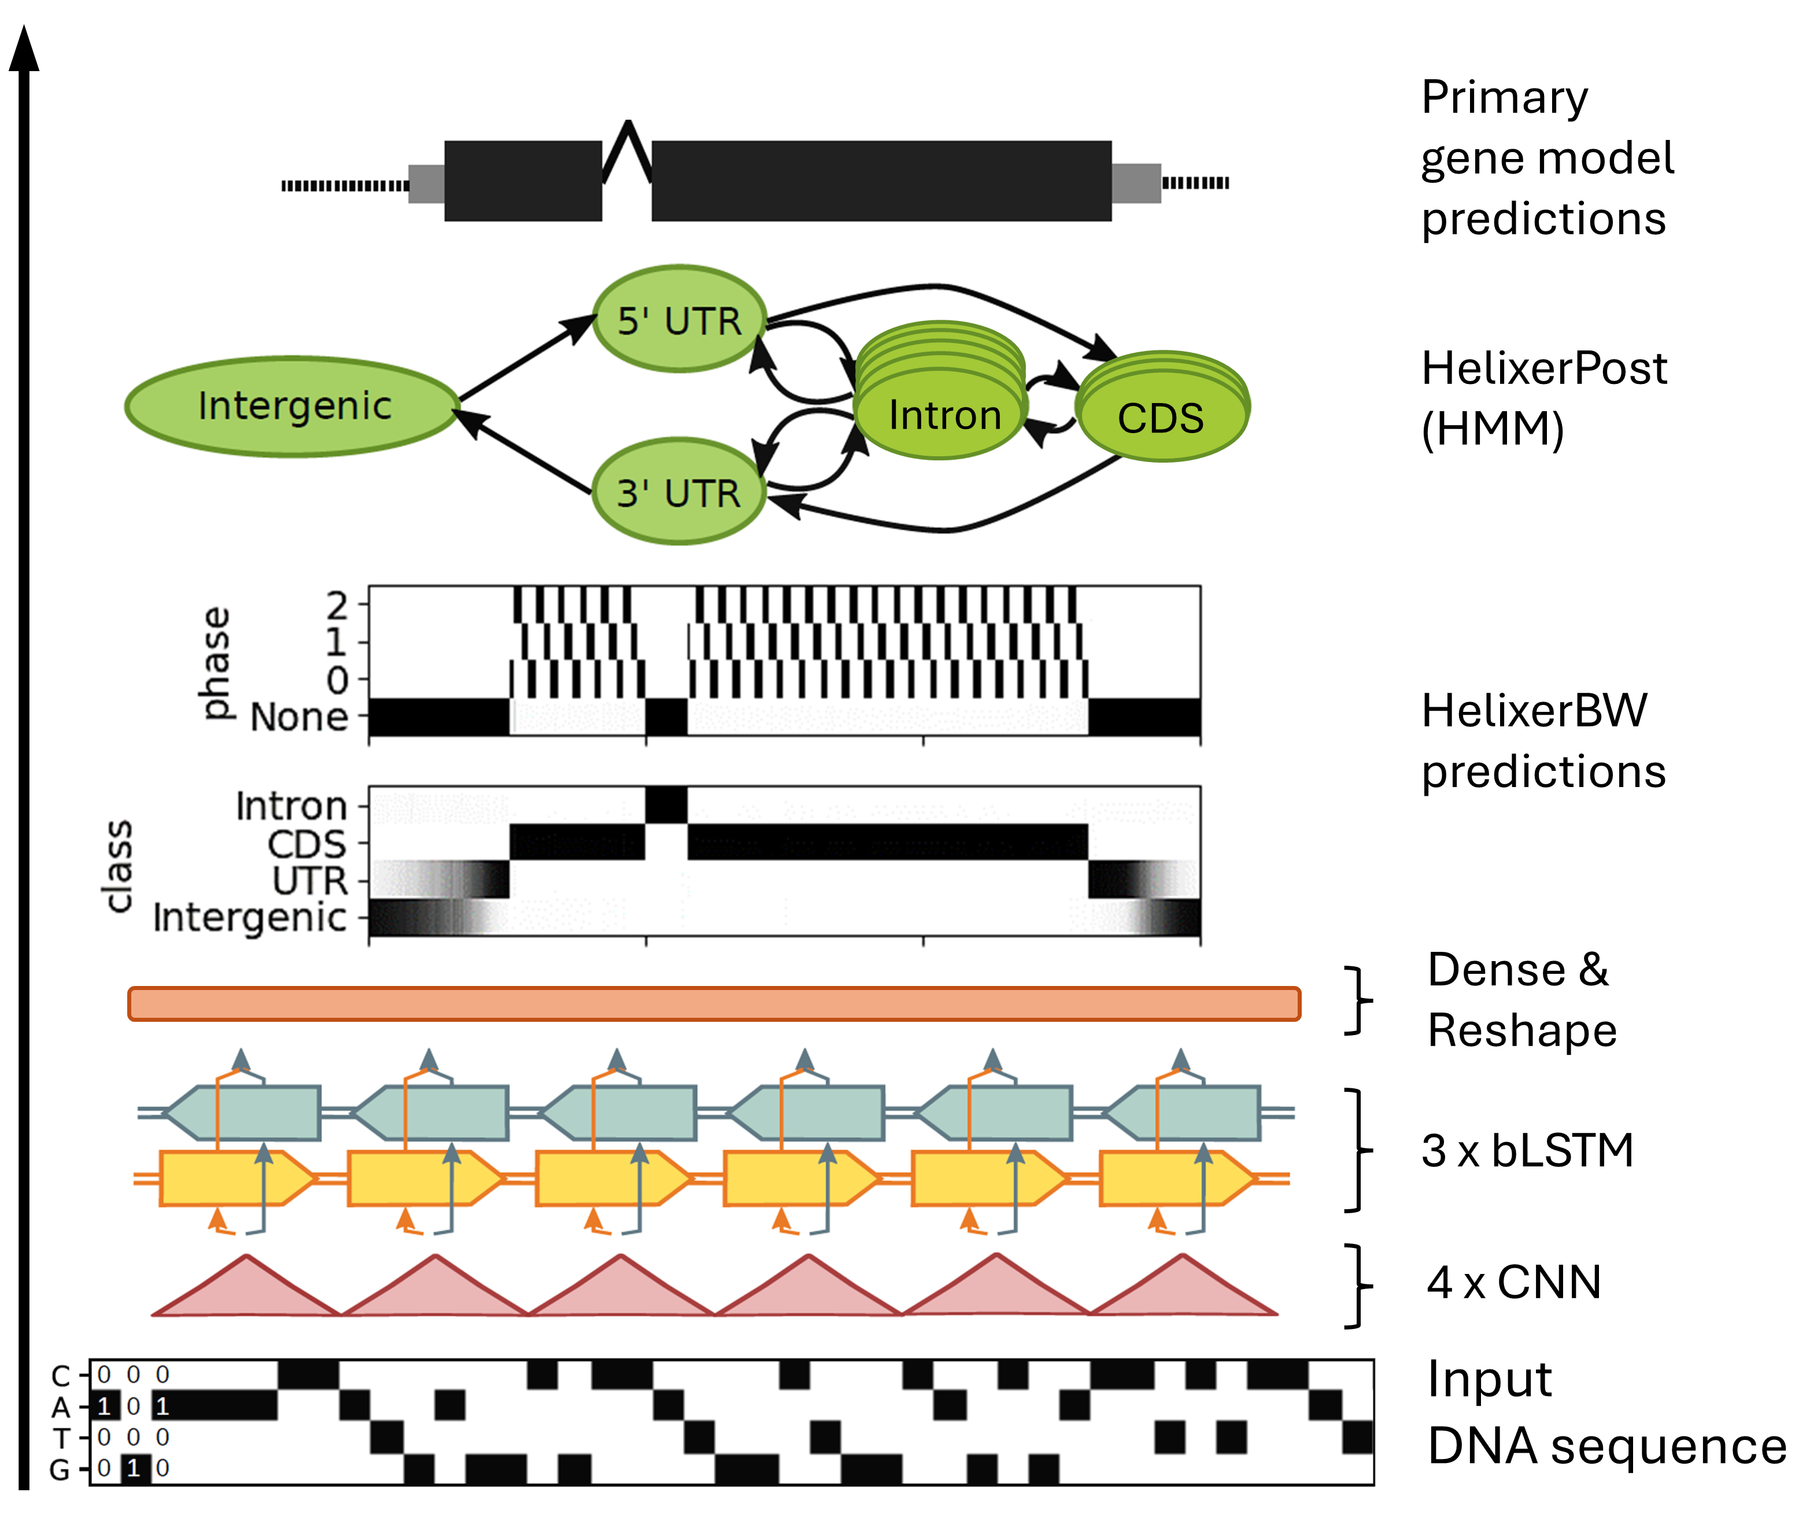
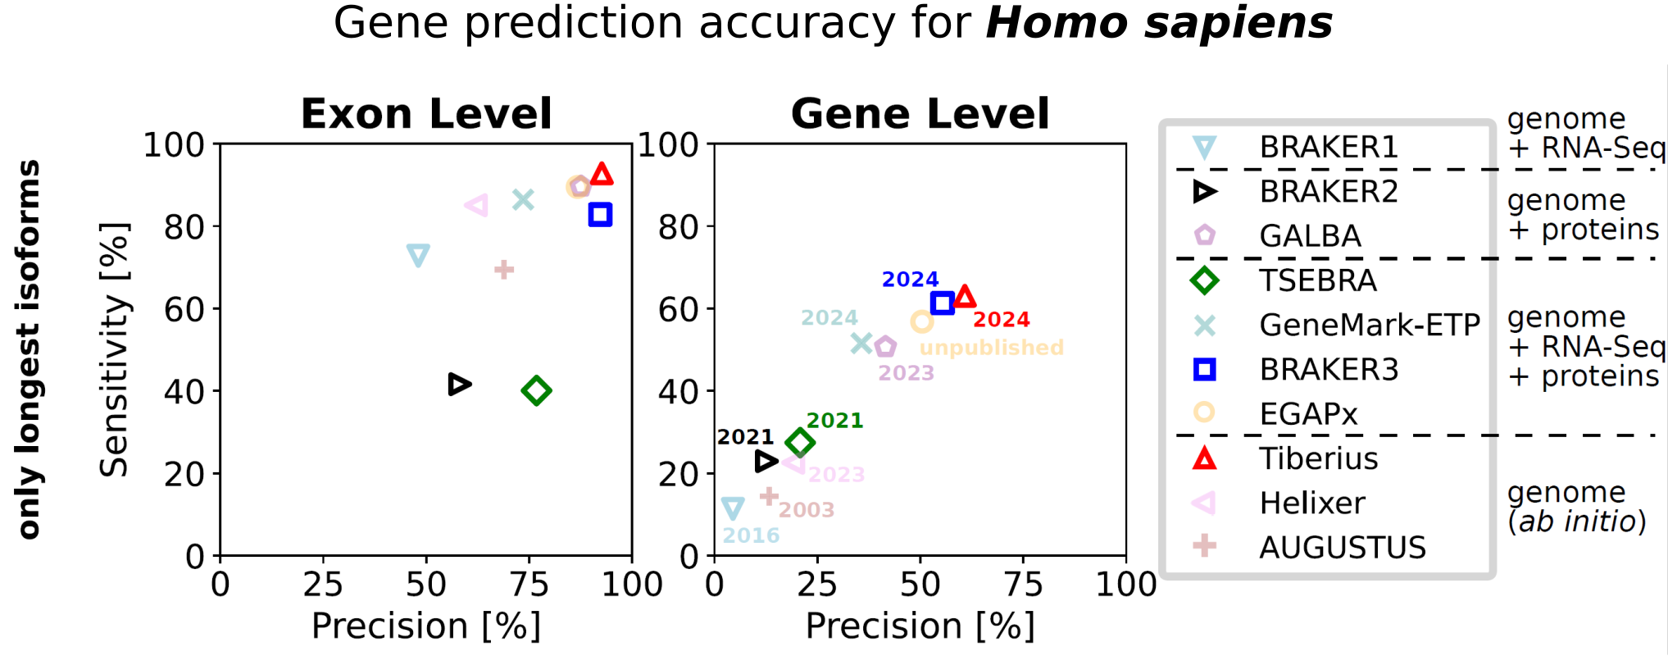
Deterministic methods
Popular tools (Eukaryote)
Helixer
Tiberius
Helixer–de novo Prediction of Primary Eukaryotic Gene Models Combining Deep Learning and a Hidden Markov Model
End-to-End Deep Learning with an HMM for Gene Prediction
https://doi.org/10.1101/2023.02.06.527280
https://github.com/weberlab-hhu/Helixer
https://academic.oup.com/bioinformatics/article/40/12/btae685/7903281
https://github.com/Gaius-Augustus/Tiberius
Notes:
In Tiberius HMM is used during both training and inference

Slide 20
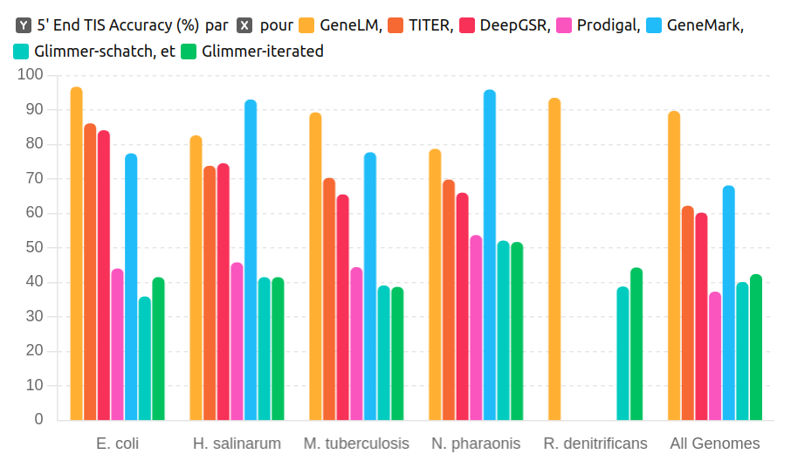
Deterministic methods
Popular tools (prokaryote)
GeneLM
=> needs training

Slide 21
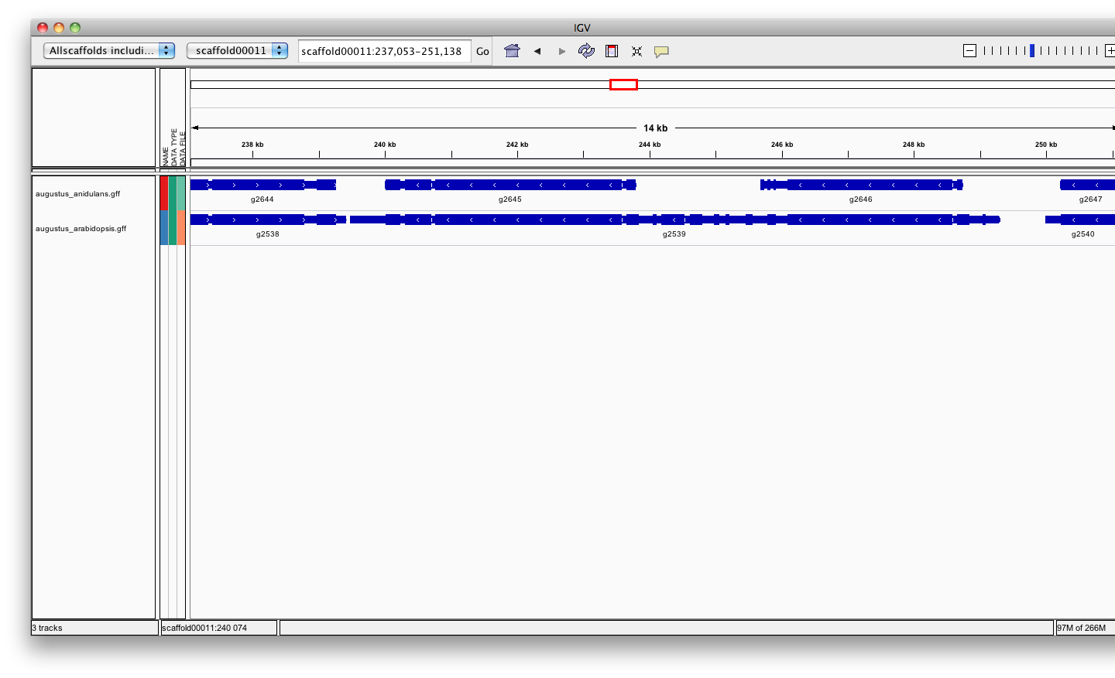
Training intrinsic / ab initio gene-finders
Ab-initio tools need of a models (also called profile) => Training
  Few self-trained tools, most need a separate training procedure
  The quality of the gene-finder results hugely relies on the quality of the training!
  Needs training for every genome / phylogenetic range (= different training sets)
A fungal genome
Fungi
Plants
Training
Probabilistic
Deterministic
    A sets of high quality genomes (>3)
    => Species that generalize well to your target species
    A sets of high quality genes (>500)
    => These ”known” genes are usually inferred from aligned transcripts or proteins

Slide 22
Intrinsic / ab initio
Strengths :
  Fast and easy
  Annotate unknown genes
  Sensitivity ok
  Need no external evidence
Limits :
  Split single gene into multiple predictions
  Fused with neighboring genes
  May be less accurate than homology-based methods (Exon boundaries)
  Some tools need training

Slide 23
Hybrid approaches
Evidence-drivable gene predictors incorporate hints/extrinsic information in the form of alignments (transcript, protein, whole genome) to increase the accuracy of the gene prediction.
Can predict locus without extrinsic information
Improve prediction when extrinsic information available

Slide 24
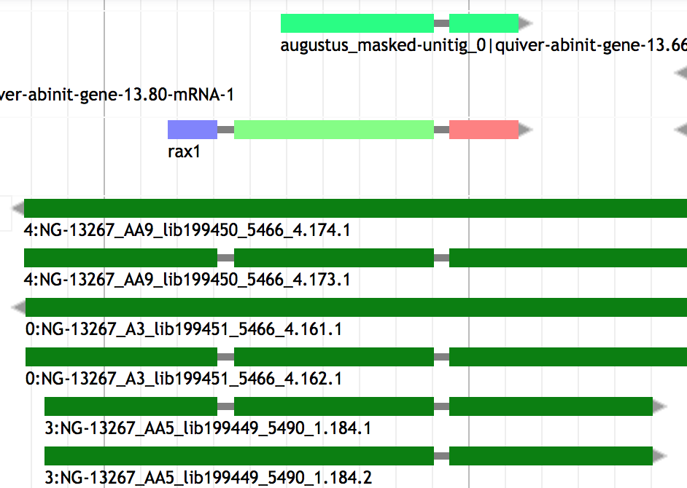
Hybrid: Similarity based + ab initio
Evidence-drivable gene predictors / Ab initio evidence-based approaches incorporate hints (e.g. protein) alignments to increase the accuracy of the gene prediction.
Can improve :
  Split single gene into multiple predictions
  Fused with neighboring genes
  Exon boundaries
Tools :
  PGAP (NCBI) - constrains or influences gene prediction
  Bakta - gene boundaries refinement

Slide 25
Chooser / Combiner
Selection of gene models
Combining heterogeneous data into gene models

Slide 26
Chooser / combiner
Use battery of gene finders and evidence (transcript, protein) alignments and:
Chooser: Selects among existing predictions according to evidence or confidence.
Combiner: Constructs consensus gene models by integrating evidence from different sources.
Tool | Consensus based chooser | Evidence based chooser | weight of different sources | Comment
GeMoMa |  | X |  | You can weight on presence in multiple genome
JIGSAW | X
EVM Evidencemodeler | X | X | X | User can set the expected evidence error rate manually or/and learn from a training set
Evigan | X |  | X | Unsupervised learning method
=> Ipred |  | X |  | Does not require any a priori knowledge Can also combine only evidences to create a gene model
Notes:
EVM choose the post-processed gene model that is most consistent with the evidences
~ GAZE : GAZE (Howe et al. 2002), pro- vides a general framework to assemble an optimal set of gene structures given a user-supplied feature set, scoring scheme,
Ipred: Franziska Zickmann and Bernhard Y Renard BMC Genomics. 2015; 16(1): 134.doi: 10.1186/s12864-015-1315-9
EVIGAN is the scuccessor of GLEAN
* Are pipelines that contain chooser

Slide 27
Pipelines
(The ultimate step)
Align evidence (proteins)
Annotation of other features (Repeat, tRNA, etc)
Add functions
And more…

Slide 28
Pipeline
Tool | Protein | Ab inito | Function | Other annotated features | Comment
PGAP | X | X | X | tRNA, rRNA, ncRNA, pseudogenes, CRISPR, mobile elements | Integrates protein alignments, protein-family HMMs and GeneMarkS-2+ for structural and functional annotation
Prokka | X | X | X | tRNA, tmRNA, rRNA, ncRNA, CRISPR; signal peptides when supported by the relevant dependencies | Uses Pyrodigal for CDS prediction.
Bakta | X | X | X | tRNA, tmRNA, rRNA, ncRNA, regulatory regions, CRISPR, pseudogenes, replication origins, sORFs | Uses Prodigal for CDS prediction. Huge database used.
DFAST | X | X | X | RNA genes and other genomic features, depending on the modules used
RAST / RASTtk | X | X | X | RNA features, metabolic functions and other features, depending on the workflow
BV-BRC | X | X | X | tRNA, rRNA, repeat regions, prophages, antimicrobial resistance genes, virulence factors, protein families | CDS prediction uses Prodigal followed by Glimmer

Slide 29

Thank you for your attention

