Slide 1
Final Release
RED_Cloud
VIS

Slide 2
System introduction
RED_Cloud telemetry system
Track Information
  GPS
  Electric Motor Controller
  Battery Management System

Slide 3
Timeline
Initial Meeting with Ambiente – Nov. '10
Requirements – Jan. '11
SRS – April '11
Business Case Acceptance – May '11
Alpha Release – May '11
Beta Release – May '11
Parts Arrival – Jun '11
Final Release – Jun '11

Slide 4
Why RED_Cloud
This type of system has not been applied to electric vehicles
Red Cloud (previously Ambiente Motors) needed a cost effective solution
Telemetry data is important to the maintenance of electric vehicles

Slide 5
Client & end users
Red Cloud
Fleet Managers
Engineers
Independent Electric Vehicle Manufacturers

Slide 6
Purpose for the system
Allows controllers monitoring capability
Tracks information related to sensors
Displays information in real time to controllers

Slide 7
Requirements Gathering process
Worked off notes gathered from meeting with ambiente
Gathered UI elements from Jim
Redefined the requirements in feb. '11

Slide 8
Show Requirements Doc.

Slide 9
Requirements → Business Case
Track information related to EMC → 1.1
Track BMS → 1.3
Track GPS → 1.4
Update Stored Information → 2
Report to Web Side → 3

Slide 10
Requirements relation to business case

Slide 11
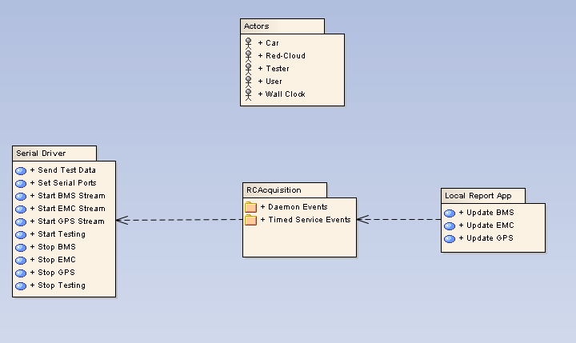
Use Cases

Slide 12
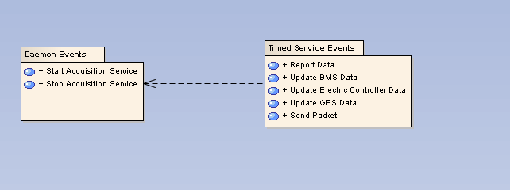
Use Cases Contd.

Slide 13
Display Requirements Trace

Slide 14
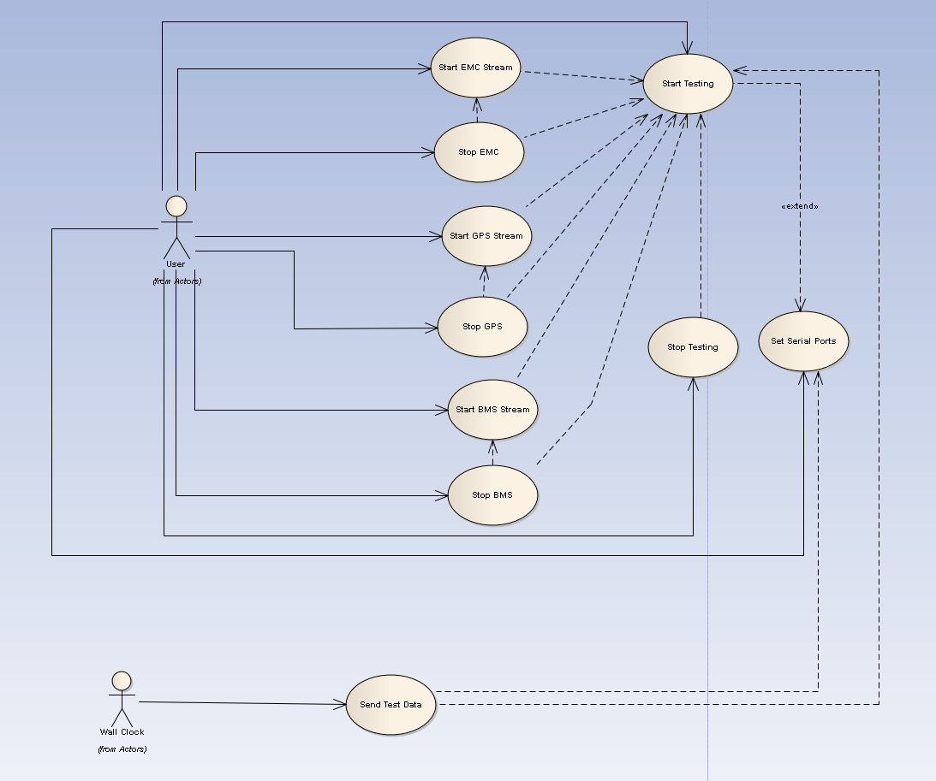
Use Case Model Structure

Slide 15
Impact Analysis
Changing the GPS will cause the following
  3 Classes refactored
  7 High Priority reqs will change

Slide 16
Summary
Business Case
Architectures
Use Cases
Requirements

