Slide 1
Lecture 18
MATH1401
Fall 2021
Decisions and Uncertainty

Slide 2
Class Checklist
Lab 6 – Due Date : Tuesday 11/5 – 9 PM
Quiz 13 – Tuesday: 9/21 – Covers Chapter 11.1-11.3

Slide 3
Decisions and Uncertainty

Slide 4
Incomplete Information
We are trying to choose between two views of the world, based on data in a sample.
It is not always clear whether the data are consistent with one view or the other.
Random samples can turn out quite extreme. It is unlikely, but possible.

Slide 5
Testing Hypotheses
A test chooses between two views of how data were generated
The views are called hypotheses
The test picks the hypothesis that is better supported by the observed data

Slide 6
Null and Alternative
The method only works if we can simulate data under one of the hypotheses.
Null hypothesis
A well defined chance model about how the data were generated
We can simulate data under the assumptions of this model – “under the null hypothesis”
Alternative hypothesis
A different view about the origin of the data

Slide 7
Test Statistic
The statistic that we choose to simulate, to decide between the two hypotheses
Questions before choosing the statistic:
What values of the statistic will make us lean towards the null hypothesis?
What values will make us lean towards the alternative?
Preferably, the answer should be just “high” or just “low”. Try to avoid “both high and low”.

Slide 8
Prediction Under the Null Hypothesis
Simulate the test statistic under the null hypothesis; draw the histogram of the simulated values
This displays the empirical distribution of the statistic under the null hypothesis
It is a prediction about the statistic, made by the null
hypothesis
It shows all the likely values of the statistic
Also how likely they are (if the null hypothesis is true)
The probabilities are approximate, because we can’t generate all the possible random samples

Slide 9
Conclusion of the Test
Resolve choice between null and alternative hypotheses
Compare the observed test statistic and its empirical distribution under the null hypothesis
If the observed value is not consistent with the distribution, then the test favors the alternative (“data is more consistent with the alternative”)
Whether a value is consistent with a distribution:
A visualization may be sufficient
If not, there are conventions about “consistency”

Slide 10
Another Example

Slide 11
The Problem
Large(-ish) Statistics class divided into 12 discussion sections
Graduate Student Instructors (GSIs) lead the sections
After the midterm, students in Section 3 notice that the average score in their section is lower than in others

Slide 12
The GSI’s Defense
GSI’s position (Null Hypothesis):
If we had picked my section at random from the whole class, we could have got an average like this one.
Alternative:
No, the average score is too low. Randomness is not the only reason for the low scores.
(Demo)

Slide 13
Statistical Significance

Slide 14
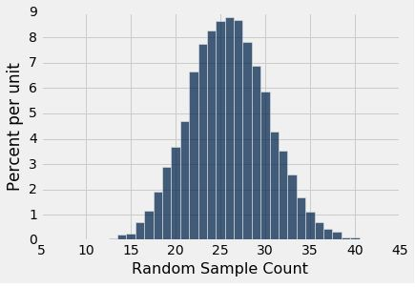
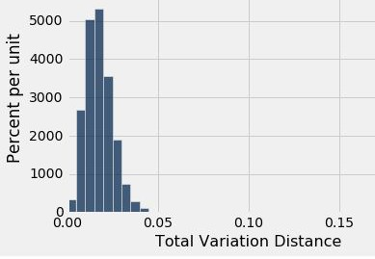
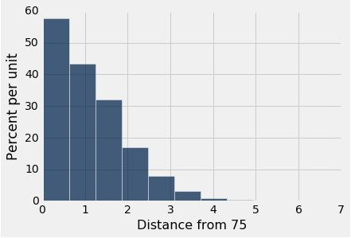
Tail Areas
Alabama Jury
Alameda Jury
Pea Plants
Observed Number (8)
Observed TVD (0.14)
Observed Distance (1.32)

Slide 15
Conventions About Inconsistency
“Inconsistent with the null”: The test statistic is in the tail of the empirical distribution under the null hypothesis
“In the tail,” first convention:
The area in the tail is less than 5%
The result is “statistically significant”
“In the tail,” second convention:
The area in the tail is less than 1%
The result is “highly statistically significant”
(Demo)

Slide 16
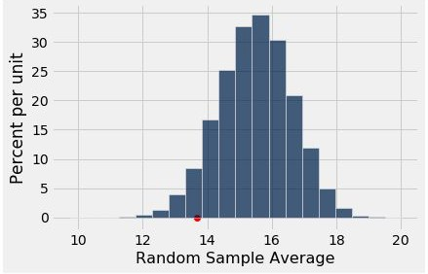
The P-Value as an Area
Empirical distribution of the test statistic under the null hypothesis
The red dot is the observed statistic.

Slide 17
Definition of the P-value
Formal name: observed significance level
The P-value is the chance,
under the null hypothesis,
that the test statistic
is equal to the value that was observed in the data
or is even further in the direction of the alternative.

Slide 18
How We’ve Tested Thus Far

Slide 19
Hypothesis Testing Review
One Category (ex: percent of flowers that are purple)
Test Statistic (1): empirical_percentage
Test Statistic (1): abs(empirical_percentage - null_percentage)
How to Simulate: sample_proportions(n, null_dist)
Multiple Categories (ex: ethnicity distribution of jury panel)
Test Statistic: tvd(empirical_dist, null_dist)
How to Simulate: sample_proportions(n, null_dist)
Numerical Data (ex: scores in a lab section)
Test Statistic: empirical_mean
○ How to Simulate: population_data.sample(n, with_replacement=False)

