Slide 1
Lecture 19
MATH1401
Fall 2021
A/B Testing

Slide 2
Class Checklist
Lab 6 – Due Date : Friday 11/5 – 9 PM

Slide 3
Review: Statistical Significance

Slide 4
Conventions About Inconsistency
“Inconsistent with the null”: The test statistic is in the tail of the empirical distribution under the null hypothesis
“In the tail,” first convention:
The area in the tail is less than 5%
The result is “statistically significant”
“In the tail,” second convention:
The area in the tail is less than 1%
The result is “highly statistically significant”

Slide 5
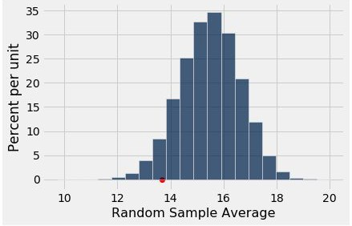
The P-Value as an Area
Empirical distribution of the test statistic under the null hypothesis
The red dot is the observed statistic.

Slide 6
Definition of the P-value
Formal name: observed significance level
The P-value is the chance,
if the null hypothesis is true,
that the test statistic
is equal to the value that was observed in the data
or is even further in the direction of the alternative.

Slide 7
A/B Testing

Slide 8
Comparing Two Samples
Compare values of sampled individuals in Group A with values of sampled individuals in Group B.
Question: Do the two sets of values come from the same underlying distribution?
Answering this question by performing a statistical test is called A/B testing.
(Demo)

Slide 9
The Groups and the Question
Random sample of mothers of newborns. Compare:
(A) Birth weights of babies of mothers who smoked during pregnancy
(B) Birth weights of babies of mothers who didn’t smoke
Question: Could the difference be due to chance alone?

Slide 10
Hypotheses
Null:
In the population, the distributions of the birth weights of the babies in the two groups are the same. (They are different in the sample just due to chance.)
Alternative:
In the population, the babies of the mothers who smoked weigh less, on average, than the babies of the non-smokers.

Slide 11
Test Statistic
Group A: non-smokers
Group B: smokers
Statistic: Difference between average weights Group B average - Group A average
Negative values of this statistic favor the alternative
(Demo)

Slide 12
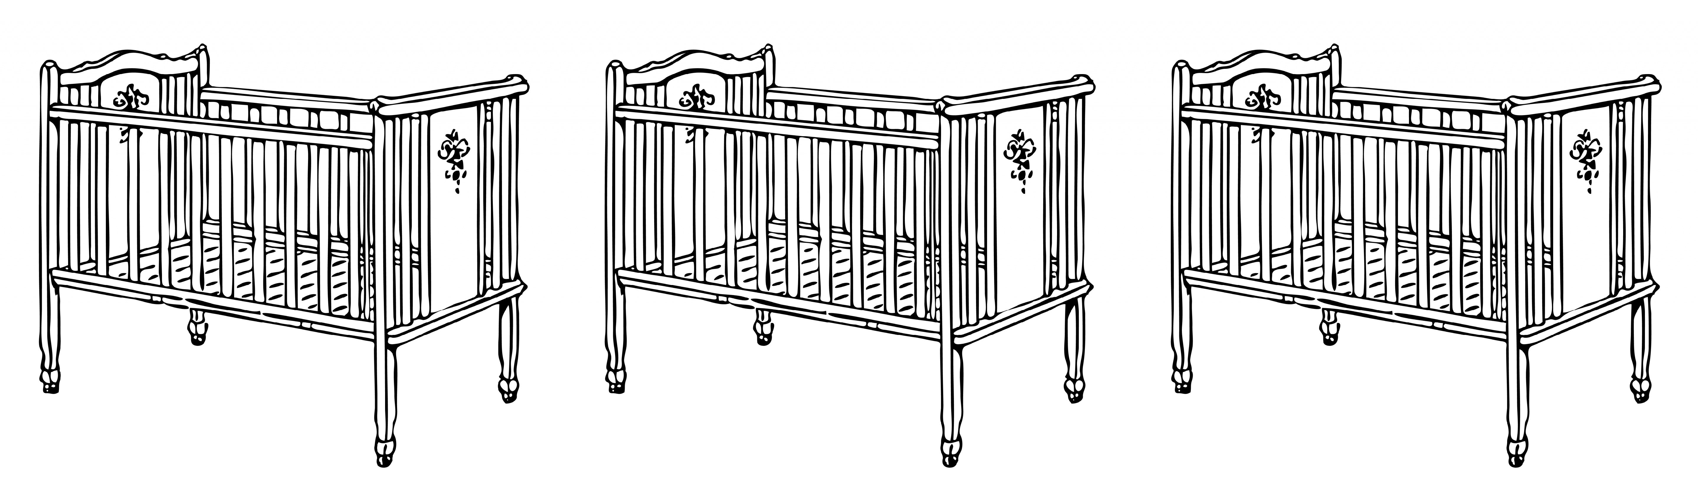
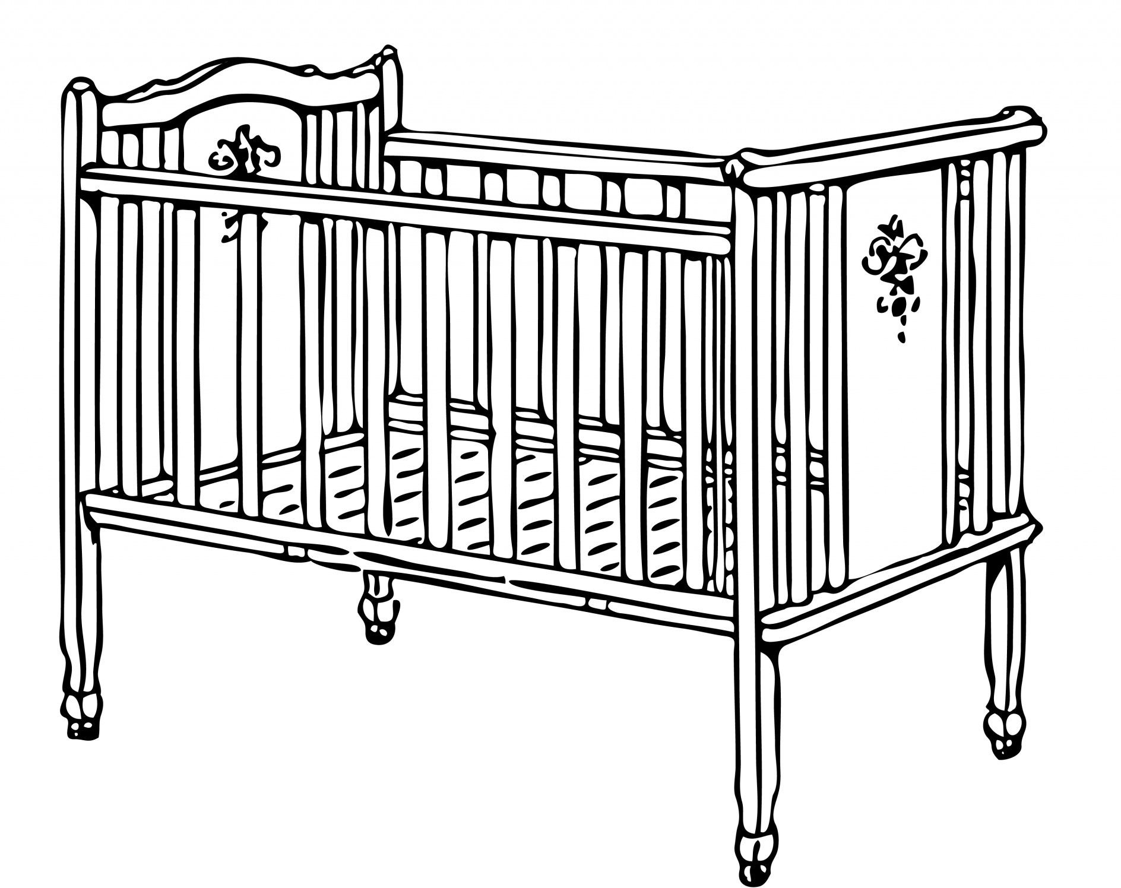
The Data
...
Non-smoker 117 oz
Non-smoker
120 oz
Non-smoker
113 oz
Smoker
128 oz
Smoker
108 oz
...

Slide 13
Shuffling Labels Under the Null
...
Smoker
120 oz
Non-smoker
113 oz
Non-smoker
128 oz
Smoker
108 oz
...
Smoker
117 oz

Slide 14
Shuffling Rows

Slide 15
Random Permutation
tbl.sample(n)
Table of n rows picked randomly with replacement
tbl.sample()
Table with same number of rows as original tbl, picked randomly with replacement
tbl.sample(n, with_replacement = False)
Table of n rows picked randomly without replacement
tbl.sample(with_replacement = False)
All rows of tbl, in random order
(Demo)

Slide 16
Simulating Under the Null
If the null is true, all rearrangements of labels are equally likely
Plan:
Shuffle all group labels
Assign each shuffled label to a birth weight
Find the difference between the averages of the two shuffled groups
Repeat
(Demo)

