Slide 1
Lecture 6
MATH1401
Fall 2021
Tables (Again)

Slide 2
Class Checklist
Lab 2 – Due Date : Thursday 9/9 – 5 PM
Graded Questions : 1.1, 2.1,2.1.1,3.1-3.6, 4.1-4.2
HW 2 – Tuesday: 9/14
Quiz 4 – Tuesday: 9/7 – Covers Chapter 5
Quiz 5 – Thursday: 9/9 – Covers Chapter 6

Slide 3
Review

Slide 4
Lecture 5 Review
Declare an Array
Array Operations - +,-,*,**
Use np.range()
Read a table
Table.read_table(filename) - reads a table from a spreadsheet

Slide 5
Table Structure
A Table is a sequence of labeled columns
Labels are strings
Columns are arrays, all with the same length
Label
Name
Code
Area (m2)
California
CA
163696
Nevada
NV
110567
Row
Column

Slide 6
Create a table
Table()
Creates an empty table
Table().with_column(‘Name’,arraydata)
Creates a table with column ‘Name’ and entries given by arraydata

Slide 7
More Table Methods
t.num_rows: finds number of rows
t.num_columns: finds number of columns
t.labels: returns array of labels
t.relabeled(‘oldlabel’,’newlabel’): replaces old label with new label
t.column(‘columnName’)- returns column as an array
(Demo)

Slide 8
Tables

Slide 9
Lecture 6 Checklist
Use table.where(column,are.condition)
Numerical Data
Categorical Data

Slide 10
Manipulating Rows
t.sort(column) sorts the rows in increasing order
t.sort(column, descending=True)sorts the rows in decreasing order
t.take(row_numbers) keeps the numbered rows
Each row has an index, starting at 0

Slide 11
Manipulating Rows
t.where(column, value) keeps all rows
for which a column's value equals some particular value
t.where(column, are.condition) keeps all rows for which a column's value satisfies a condition

Slide 12
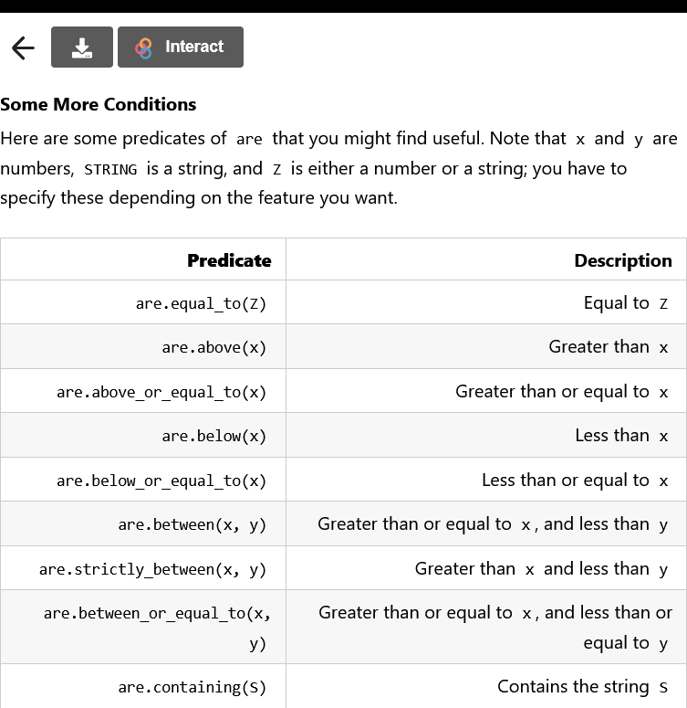
Manipulating Rows

Slide 13
Discussion Questions
The table nba has columns PLAYER, POSITION, and SALARY.
Create an array containing the names of all point guards (PG) who make more than $15M/year
guards = nba.where('POSITION', 'PG') guards.where('SALARY', are.above(15)).column('PLAYER')
After evaluating these two expressions in order, what's the result of the second one?
nba.drop('POSITION') nba.num_columns
(Demo)

Slide 14
Attribute Types

Slide 15
Types of Attributes
All values in a column of a table should be both the same type and be comparable to each other in some way
Numerical — Each value is from a numerical scale
Numerical measurements are ordered
Differences are meaningful
Categorical — Each value is from a fixed inventory
May or may not have an ordering
Categories are the same or different

Slide 16
“Numerical” Attributes
Just because the values are numbers, doesn’t mean the variable is numerical
Census example has numerical SEX code (0, 1, and 2)
It doesn’t make sense to perform arithmetic on these “numbers”, e.g. 1 - 0 or (0+1+2)/3 are meaningless
The variable SEX is still categorical, even though numbers were used for the categories

Slide 17
Census Data

Slide 18
The Decennial Census
Every ten years, the Census Bureau counts how many people there are in the U.S.
In between censuses, the Bureau estimates how many people there are each year.
Article 1, Section 2 of the Constitution:
“Representatives and direct Taxes shall be apportioned among the several States … according to their respective Numbers …”

Slide 19
Census Table Description
Values have column-dependent interpretations
The SEX column: 1 is Male, 2 is Female
The POPESTIMATE2010 column: 7/1/2010 estimate
In this table, some rows are sums of other rows
The SEX column: 0 is Total (of Male + Female)
The AGE column: 999 is Total of all ages
Numeric codes are often used for storage efficiency
Values in a column have the same type, but are not necessarily comparable (AGE 12 vs AGE 999)
http://www2.census.gov/programs-surveys/popest/datasets/2010-2015/national/asrh/nc-est2015-agesex-res.pdf

Slide 20
Analyzing Census Data
Leads to the discovery of interesting features and trends in the population
(Demo)

