Slide 1
Lecture 11
MATH1401
Fall 2021
Groups

Slide 2
Class Checklist
Lab 4 - Due Date : Thursday: 9/30 – 9 PM
Graded Questions:1.1-1.5, 2.1-2.4, 3.1-3.6, 4.2
Quiz 8 – Tuesday: 9/28 – Covers Chapter 8

Slide 3
Review of Lecture 10

Slide 4
Apply
The apply method creates an array by calling a function on every element in input column(s)
First argument:
Other arguments:
Function to apply The input column(s)
table_name.apply(function_name, 'column_label')

Slide 5
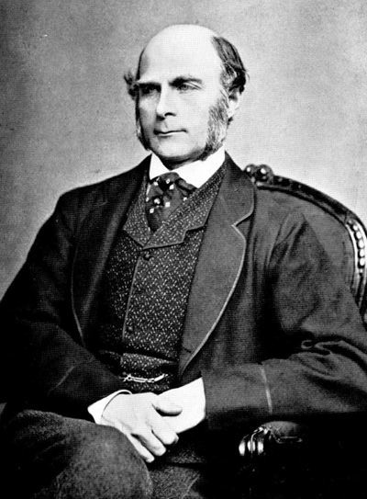
Sir Francis Galton
1822 - 1911 (knighted in 1909)
A pioneer in making predictions
Particular (and troublesome) interest in heredity
Charles Darwin's half-cousin
(Demo)

Slide 6
Lecture 11 Checklist – Chapter 8.2, 8.3
Apply – apply function to column
Group – find categorical distribution
Apply functions and make table
Group – find groups based on categorical variables
Pivot – Display groups of categorical variables

Slide 7
Lists
(Demo)

Slide 8
Lists are Generic Sequences
A list is a sequence of values (just like an array), but the values can all have different types
[2+3, 'four', Table().with_column('K', [3, 4])]
Lists can be used to create table rows.
If you create a table column from a list, it will be converted to an array automatically.
Lists can even contain other lists.

Slide 9
Grouping
(Demo)

Slide 10
Grouping by One Column
The group method aggregates all rows with the same value for a column into a single row in the resulting table.
First argument:
Second argument:
Which column to group by (Optional) How to combine values
len — number of grouped values (default)
list — list of all grouped values
sum — total of all grouped values
etc.

Slide 11
Cross-Classification

Slide 12
Grouping By Multiple Columns
The group method can also aggregate all rows that share the combination of values in multiple columns
First argument:
Second argument:
A list of which columns to group by (Optional) How to combine values
(Demo)

Slide 13
Pivot Tables

Slide 14
Pivot
Cross-classifies according to two categorical variables
Produces a grid of counts or aggregated values
Two required arguments:
First: variable that forms column labels of grid
Second: variable that forms row labels of grid
Two optional arguments (include both or neither)
values=’column_label_to_aggregate’
collect=function_to_aggregate_with
(Demo)

Slide 15
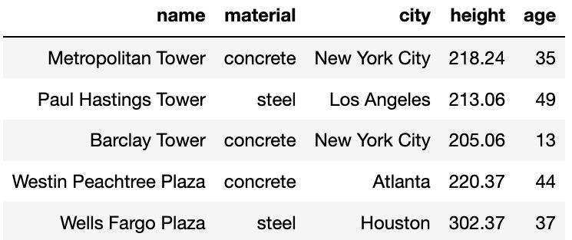
Challenge Question
For each city, what’s the tallest building for each material?
For each city, what’s the age difference between the oldest steel building and the oldest concrete building?
sky
(Demo)

Slide 16
Group or Pivot?
For cross-classification:
Pivot Table
One combo of grouping variables per entry
Two grouping variables: columns and rows
Aggregate values of
values column
Missing combos = 0
Grouped Table
One combo of grouping variables per row
Any number of grouping variables
Aggregate values of all other columns in table
Missing combos absent
(or empty string)

