Slide 1
Lecture 8
MATH1401
Fall 2021
Visualization – Part II

Slide 2
Class Checklist
HW - 2 Due Date : Tuesday: 9/14 – 9 PM
Graded Questions:1.1-1.3, 2.1-2.5, 3.1-3.5, 4.1-4.2, 6.1-6.7
Lab 3 – Due Date : Friday 9/17 – 9 PM
Graded Questions : 1.1,1.1.1, 3.1-3.2,4.1-4.3, all questions from section 2
Quiz 6 – Tuesday: 9/14 – Covers Chapter 7

Slide 3
Review

Slide 4
Lecture 7 - Review
Identify Numerical Data
Identify Categorical Data
Plot numerical data with Line plot, Scatter Plot
Plot categorical data with bar graphs

Slide 5
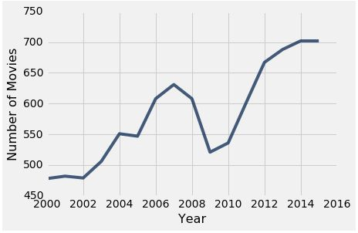
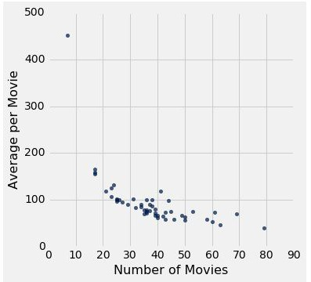
Plotting Two Numerical Variables
Line graph: plot
Scatter plot : scatter

Slide 6
When to use a line vs scatter plot?
Use line plots for sequential data: if...
...your x-axis has an order
...sequential differences in y values are meaningful
Usually: x-axis is time or distance
Use scatter plots for non-sequential data
When you’re looking for associations

Slide 7
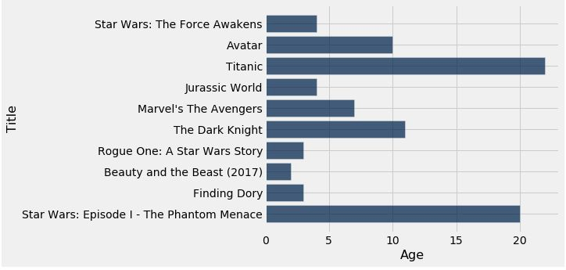
How Do You Generate This Chart?
Top 10 highest grossing movies
Number of years since release

Slide 8
Distributions!

Slide 9
Lecture 8 - Overview
Distributions – Numerical Vs. Categorical
Bar Graph
display categorical distributions
lengths of the bars are the value for each category
Histograms
display numerical distributions
heights of bars measure densities

Slide 10
Lecture 8 – Programming Checklist
Table.group(“Column”) – Count Frequency of each individual returns result as a table
Table.barh(‘categorical’,’numerical’) – Create a bar graph with ‘categorical’ on x-axis and numerical on y-axis
Table.barh(‘numerical’,bins,unit) – Create a histogram ‘numerical1’ on x-axis
Table.bin(‘numerical’,bins) – Count frequency of each item in each bin

Slide 11
Terminology
Individuals: those whose features are recorded
Variable: an attribute
A variable has different values
Values can be numerical or categorical, and of many sub-types within these
Each individual has exactly one value of the variable
Distribution: For each different value of the variable, the frequency of individuals that have that value
(Demo)

Slide 12
Distributions of Categorical Variables

Slide 13
Visualization
Bar charts are commonly used to visualize categorical distributions
One axis is categorical, one numerical
(Demo)

Slide 14
Displaying a Categorical Distribution
The distribution of a variable (a column, e.g. Studios) describes the frequencies of its different values
The group method counts the number of rows for each
value in the column (e.g. the number of top movies released by each studio)
Bar charts can display the distribution of a categorical
variable (e.g. studios):
One bar for each category
Length of bar is the count of individuals in that category
You can choose the order of the bars

Slide 15
Distributions of Numerical Variables

Slide 16
Binning Numerical Values
Binning is counting the number of numerical values that lie within ranges, called bins.
Bins are defined by their lower bounds (inclusive)
The upper bound is the lower bound of the next bin
188, 170, 189, 163, 183, 171, 185, 168, 173, ...
The [185,190) bin
160
165
170
175
180
185
190
(Demo)

Slide 17
Area Principle

Slide 18
Area Principle
Areas should be proportional to the values they represent.
For example
If you represent 20% of a population by
Then 40% can be represented by:
But not by:

Slide 19
Drawing Histograms

Slide 20
Histogram
Chart that displays the distribution of a numerical variable
Uses bins; there is one bar corresponding to each bin
Uses the area principle:
The area of each bar is the percent of individuals in the corresponding bin
(Demo)

Slide 21
Density

Slide 22
Histogram Axes
By default, hist uses a scale (normed=True) that ensures the area of the chart sums to 100%
The area of each bar is a percentage of the whole
The horizontal axis is a number line (e.g., years), and the bins sizes don’t have to be equal to each other
The vertical axis is a rate (e.g., percent per year)
(Demo)

Slide 23
How to Calculate Height
The [40, 65) bin contains 51 out of 200 movies
“52 out of 200” is 25.5%
The bin is 65 - 40 = 25 years wide
25.5 percent
Height of bar =
25 years
= 1.02 percent per year

Slide 24
Height Measures Density
% in bin
---------------------
width of bin
Height =
The height measures the percent of data in the bin
relative to the amount of space in the bin.
Height measures crowdedness, or density.
Units: percent per unit on the horizontal axis

Slide 25
Area Measures Percent
Area of bar = % in bin = Height x width of bin
“How many individuals in the bin?” Use area.
“How crowded is the bin?” Use height.

Slide 26
Bar Chart or Histogram?
To display a distribution:
Bar Chart
Distribution of categorical variable
Bars have arbitrary (but equal) widths and spacings
height (or length) and
area of bars proportional to the percent of individuals
Histogram
Distribution of numerical variable
Horizontal axis is numerical: to scale, no gaps, bins can be unequal
Area of bars proportional to
the percent of individuals;
height measures density

