Slide 1
Lecture 14
MATH1401
Fall 2021
Probability and Simulations
Notes:
1. make conclusions based on the data of random samples
2. We must understand what random samples are
3. To do so we must understand probabilities
4. We are able to simulate randomness for certain events using python
5. review how to simulate events using iterations

Slide 2
Class Checklist
Lab 5 – Due Date : Friday 10/22 – 9 PM
Graded Questions : 1.1-1.5, 2.1-2.3, 3.1-3.3
Quiz 11 – Tuesday: 10/19 – Covers Chapter 9.3
Quiz 12 – Thursday: 10/21 – Covers Chapter 10

Slide 3
Lecture 14 Checklist
Understand the Monty Hall Problem
Find Probabilities
An event that does not happen - Complements
When two events both must happen - Intersection
When an event can happen in two ways - Addition
When at least one event must happen - Or

Slide 4
Control Statements

Slide 5
Control Statements: if
These statements control the sequence of computations that are performed in a program
The purpose of if is to define functions that choose different behavior based on their arguments
if <conditional>: if x>y:
<if body> print(‘oka’)

Slide 6
Control Statements: For
These statements control the sequence of computations that are performed in a program
The purpose of for is to perform a computation for every element in a list or array
For i in array: for i in np.arrange(1,10):
<for body> print(i)
(Demo)

Slide 7
The Monty Hall Problem
Notes:
The monty hall problem has puzzled academic and statiticacns for 40 to 50 years.
The setting of the problem is a game show where behind two doors is a goat and behind the third door is a prize like a car.

Slide 8
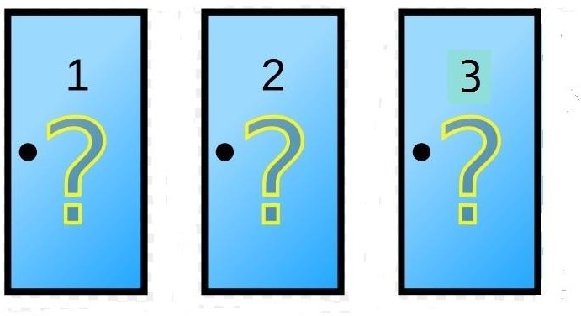
Monty Hall Problem
https://probabilityandstats.files.wordpress.com/2017/05/monty-hall-pic-1.jpg
Notes:
The goal is to choose the door that contains the prize if you choose correctly then you get to keep it
The game is as follows:
The contest makes an initial choice but the door in not opened
The host opens one of the other doors to reveal a goat

Slide 9
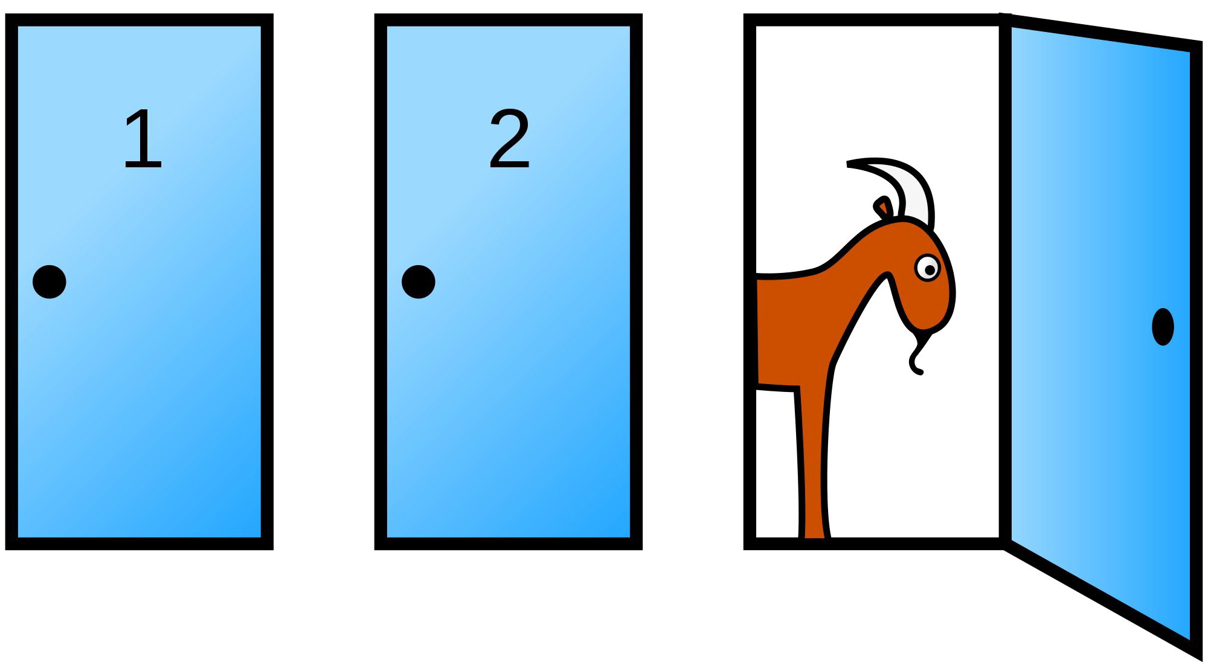
The Final Choice
(Demo)
https://en.wikipedia.org/wiki/Monty_Hall_problem
Notes:
Therefore at least one of the remaining doors has a prize and the other one has a goat
The contest now can choose to open the original door they picked or the remaining door.
Which option will lead to a higher chance of winning?
We can optimally choice the door using probability!
First – before we make any choice, there is a 1/3 chance of the prize being chosen out
Then after the goat door is revealed, there leaves only two options
Either our original door which has a 1/3 chance of being correct or the complement choosing the other door
To compute the complement, we take the universe 1 – the probability of our choice and arrive at 2/3
Therefore we should choice the other door! b/c it has a 2/3 chance of being correct!

Slide 10
Probability
Notes:
In this course we will think of probabilities as relative frequencies
We will now see the ways probabilities are calculated

Slide 11
Basics
Lowest value: 0
Chance of event that is impossible
Highest value: 1 (or 100%)
Chance of event that is certain
Complement: If an event has chance 70%, then the chance that it doesn’t happen is
100% - 70% = 30%
1 - 0.7 = 0.3

Slide 12
Equally Likely Outcomes
Assuming all outcomes are equally likely, the chance of an event A is:
number of outcomes that make A happen
P(A) =
total number of outcomes
Notes:
Provided that all outcomes are equally likely to occur we can compute the chance of event A occurring
This is given by all possible ways event A can occur divided by the total number of outcomes

Slide 13
Multiplication Rule
Chance that two events A and B both happen
= P(A happens) x P(B happens given that A has happened)
The answer is less than or equal to each of the two chances being multiplied
The more conditions you have to satisfy, the less likely you are to satisfy them all

Slide 14
A Question
I have three cards: ace of hearts, king of diamonds, and queen of spades.
I shuffle them and draw two cards at random without replacement.
What is the chance that I get the Queen followed by the King?
(Demo)
Notes:
Lets look at an example
Suppose you have the following three cards
You shuffle them and draw 2 cards at randm without replacement
What is the chance that you get a queen followed by a king.
There are two ways of thinking about this first list all possile outcomes and divide it into the desired out come
Or treat it consecutive eveents

Slide 15
Addition Rule
If event A can happen in exactly one of two ways, then
P(A) = P(first way) + P(second way)
The answer is greater than or equal to the chance of each individual way

Slide 16
Another Question
I have three cards: ace of hearts, king of diamonds, and queen of spades.
I shuffle them and draw two cards at random without replacement.
What is the chance that one of the cards I draw is a King and the other is Queen?
(Demo)
Notes:
The king has a 1/3 chance of being chosen
Then the deck has only two cards queen and jack therefore the queen has ½ chance of begin chosen
To compute the overall probability we multiple them together

Slide 17
Complement: At Least One Head
In 3 tosses:
Any outcome except TTT
P(TTT) = (1/2) x (1/2) x (1/2) = 1/8
P(at least one head) = 1 - P(TTT) = 1 - (1/8) = 87.5%
In 10 tosses:
1 - (1/2)**10 ≅ 99.9%
(Demo)

