Slide 1
Lecture 16
MATH1401
Fall 2021
Assessing Models
Notes:
1. make conclusions based on the data of random samples
2. We must understand what random samples are
3. To do so we must understand probabilities
4. We are able to simulate randomness for certain events using python
5. review how to simulate events using iterations

Slide 2
Class Checklist
Homework 5 - Due Date : Friday: 10/29 – 9 PM
Graded Questions:1.1-1.4,2.1-2.4,2.6,3.1,3.4,5.1-5.5
Quiz 13 - Models : Friday: 10/29

Slide 3
Review: Assessing Models

Slide 4
Models
A model is a set of assumptions about the data
In data science, many models involve assumptions about processes that involve randomness
“Chance models”
Key question: does the model fit the data?

Slide 5
Approach to Assessment
If we can simulate data according to the assumptions of the model, we can learn what the model predicts.
We can then compare the model’s predictions (simulations) to the data that were observed.
If the data and the model’s predictions are not consistent, that is evidence against the model.

Slide 6
Two Viewpoints

Slide 7
Model and Alternative
Jury selection:
Model: The people on the jury panels were selected at random from the eligible population
Alternative viewpoint: No, they weren’t

Slide 8
Steps in Assessing a Model
Choose a statistic to measure “discrepancy” between model and data
Simulate the statistic under the model’s assumptions
Compare the data to the model’s predictions:
Draw a histogram of simulated values of the statistic
Compute the observed statistic from the real sample
If the observed statistic is far from the histogram, that is evidence against the model

Slide 9
Discussion Questions
In each of (a) and (b), choose a statistic that will help you decide between the two viewpoints.
Data: the results of 400 tosses of a coin
(a)
“This coin is fair.”
“No, it’s not.”
(b)
“This coin is fair.”
“No, it’s biased towards heads.”

Slide 10
“Fair”
For both (a) and (b),
The number of heads in the 400 tosses is a good starting point, but might need adjustment
A number of heads around 200 suggests “fair”

Slide 11
Answers
Very large or very small values of the number of heads suggest “not fair.”
The distance between number of heads and 200 is the key
Statistic: | number of heads − 200 |
Large values of the statistic suggest “not fair”
Large values of the number of heads suggest “biased towards heads”
Statistic: number of heads

Slide 12
Comparing Distributions

Slide 13
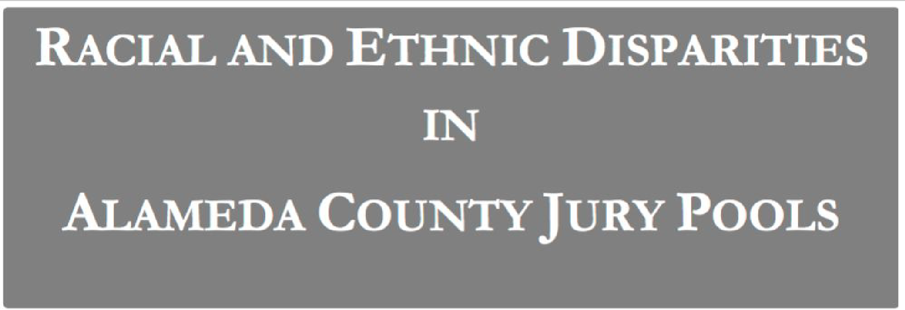
Jury Selection in Alameda County

Slide 14
Jury Panels
Eligible jurors in a County
List of eligible residents
Jury panel
Jury
Section 197 of California's Code of Civil Procedure says, "All persons selected for jury service shall be selected at random, from a source or sources inclusive of a representative cross section of the population of the area served by the court."
(Demo)

Slide 15
A New Statistic

Slide 16
Distance Between Distributions
People on the panels are of multiple ethnicities
Distribution of ethnicities is categorical
To see whether the the distribution of ethnicities of the panels is close to that of the eligible jurors, we have to measure the distance between two categorical distributions
(Demo)

Slide 17
Total Variation Distance
Every distance has a computational recipe
Total Variation Distance (TVD):
For each category, compute the difference in proportions between two distributions
Take the absolute value of each difference
Sum, and then divide the sum by 2
(Demo)

Slide 18
Summary of the Method
To assess whether a sample was drawn randomly from a known categorical distribution:
Use TVD as the statistic because it measures the distance between categorical distributions
Sample at random from the population and compute the TVD from the random sample; repeat numerous times
Compare:
Empirical distribution of simulated TVDs
Actual TVD from the sample in the study

Slide 19
Testing Hypotheses

Slide 20
Testing Hypotheses
A test chooses between two views of how data were generated
The views are called hypotheses
The test picks the hypothesis that is better supported by the observed data

Slide 21
Null and Alternative
The method only works if we can simulate data under one of the hypotheses.
Null hypothesis
A well defined chance model about how the data were generated
We can simulate data under the assumptions of this model – “under the null hypothesis”
Alternative hypothesis
A different view about the origin of the data

Slide 22
Test Statistic
The statistic that we choose to simulate, to decide between the two hypotheses
Questions before choosing the statistic:
What values of the statistic will make us lean towards the null hypothesis?
What values will make us lean towards the alternative?
Preferably, the answer should be just “high”. Try to avoid “both high and low”.

Slide 23
Prediction Under the Null Hypothesis
Simulate the test statistic under the null hypothesis; draw the histogram of the simulated values
This displays the empirical distribution of the statistic under the null hypothesis
It is a prediction about the statistic, made by the null
hypothesis
It shows all the likely values of the statistic
Also how likely they are (if the null hypothesis is true)
The probabilities are approximate, because we can’t generate all the possible random samples

Slide 24
Conclusion of the Test
Resolve choice between null and alternative hypotheses
Compare the observed test statistic and its empirical distribution under the null hypothesis
If the observed value is not consistent with the distribution, then the test favors the alternative (“data is more consistent with the alternative”)
Whether a value is consistent with a distribution:
A visualization may be sufficient
If not, there are conventions about “consistency”

