Slide 1
Lecture 16
MATH1401
Fall 2021
Assessing Models
Notes:
1. make conclusions based on the data of random samples
2. We must understand what random samples are
3. To do so we must understand probabilities
4. We are able to simulate randomness for certain events using python
5. review how to simulate events using iterations

Slide 2
Class Checklist
Homework 5 - Due Date : Friday: 10/29 – 9 PM
Graded Questions:1.1-1.4,2.1-2.4,2.6,3.1,3.4,5.1-5.5
Quiz 12 - Probability : Tuesday: 10/26

Slide 3
Summary – Sections 10.0-10.1
Random Samples – Large Random Samples are indistinguishable from the population
Assessing Models – General Framework for testing hypothesis

Slide 4
Discussion Question
A population has 100 people, including Rick and Morty. We sample two people at random without replacement.
P(both Rick and Morty are in the sample)
P(neither Rick nor Morty is in the sample)

Slide 5
Discussion Question
A population has 100 people, including Rick and Morty. We sample two people at random without replacement.
P(both Rick and Morty are in the sample)
= P(first Rick, then Morty) + P(first Morty, then Rick)
= (1/100) * (1/99) + (1/100) * (1/99) = 0.0002
P(neither Rick nor Morty is in the sample)
= (98/100) * (97/99) = 0.9602

Slide 6
Review: Distributions
Any random quantity has a probability distribution:
All possible values it can take
The probability it takes each value
After repeated draws, it has an empirical distribution:
All observed values it took
The proportion of times it took each value
After many independent draws, the empirical distribution looks more and more like the probability distribution
(Demo)

Slide 7
Inference

Slide 8
Inference
Statistical Inference:
Making conclusions based on data in random samples
Example:
fixed
Use the data to guess the value of an unknown number
depends on the random sample Create an estimate of the unknown quantity

Slide 9
Terminology
Parameter
A number associated with the population
Statistic
A number calculated from the sample
A statistic can be used as an estimate of a parameter
(Demo)

Slide 10
Probability Distribution of a Statistic
Values of a statistic vary because random samples vary
“Sampling distribution” or “probability distribution” of the statistic:
All possible values of the statistic,
and all the corresponding probabilities
Can be hard to calculate
Either have to do the math
Or have to generate all possible samples and calculate the statistic based on each sample

Slide 11
Empirical Distribution of a Statistic
Empirical distribution of the statistic:
Based on simulated values of the statistic
Consists of all the observed values of the statistic,
and the proportion of times each value appeared
Good approximation to the probability distribution of the statistic
if the number of repetitions in the simulation is large
(Demo)

Slide 12
Assessing Models

Slide 13
Models
A model is a set of assumptions about the data
In data science, many models involve assumptions about processes that involve randomness
“Chance models”
Key question: does the model fit the data?

Slide 14
Approach to Assessment
If we can simulate data according to the assumptions of the model, we can learn what the model predicts.
We can then compare the predictions to the data that were observed.
If the data and the model’s predictions are not consistent, that is evidence against the model.

Slide 15
Jury Selection

Slide 16
Swain vs. Alabama, 1965
Talladega County, Alabama
Robert Swain, black man convicted of crime
Appeal: one factor was all-white jury
Only men 21 years or older were allowed to serve
26% of this population were black
Swain’s jury panel consisted of 100 men
8 men on the panel were black

Slide 17
Supreme Court Ruling [in English]
About disparities between the percentages in the eligible population and the jury panel, the Supreme Court wrote:
“... the overall percentage disparity has been small and reflects no studied attempt to include or exclude a specified number of Negroes”
The Supreme Court denied Robert Swain’s appeal

Slide 18
Supreme Court Ruling [in Data]
Paraphrase: 8/100 is less than 26%, but not different enough to show Black men were systematically excluded
Question: is 8/100 a realistic outcome if the jury panel selection process were truly unbiased?

Slide 19
Sampling from a Distribution
Sample at random from a categorical distribution
sample_proportions(sample_size, pop_distribution)
Samples at random from the population
Returns an array containing the distribution of the categories in the sample
(Demo)

Slide 20
A Genetic Model

Slide 21
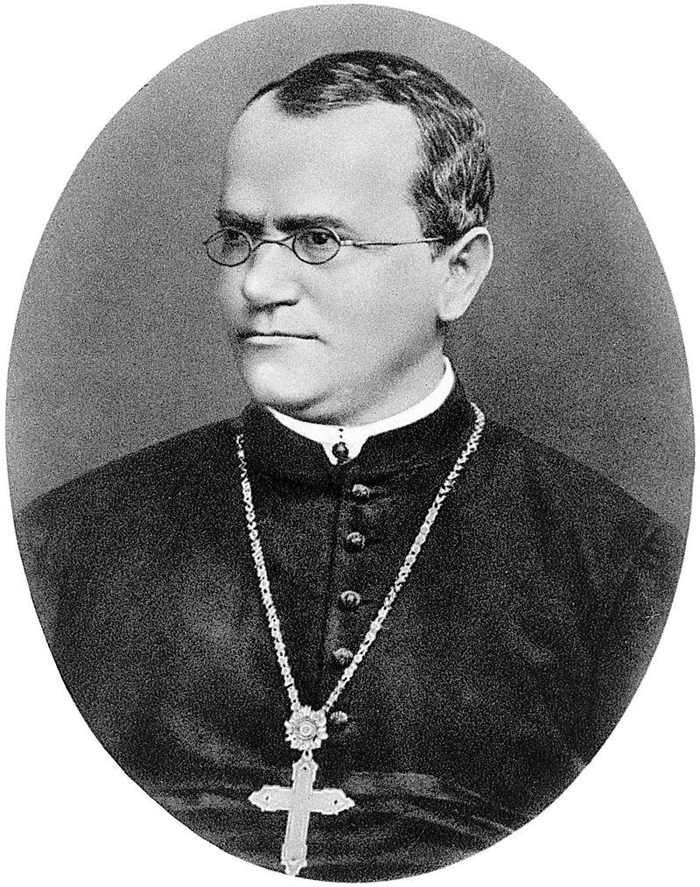
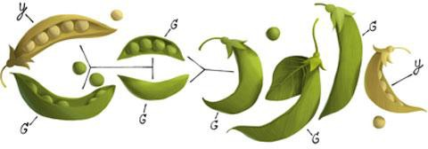
Gregor Mendel, 1822-1884

Slide 22
A Model
Pea plants of a particular kind
Each one has either purple flowers or white flowers
Mendel’s model:
Each plant is purple-flowering with chance 75%,
regardless of the colors of the other plants
Question:
Is the model good, or not?

Slide 23
Choosing a Statistic
Take a sample, see what percent are purple-flowering
If that percent is much larger or much smaller than 75, that is evidence against the model
Distance from 75 is the key
Statistic:
| sample percent of purple-flowering plants - 75 |
If the statistic is large, that is evidence against the
model
(Demo)

Slide 24
Two Viewpoints

Slide 25
Model and Alternative
Jury selection:
Model: The people on the jury panels were selected at random from the eligible population
Alternative viewpoint: No, they weren’t
Genetics:
Model: Each plant has a 75% chance of having purple flowers
Alternative viewpoint: No, it doesn’t

Slide 26
Steps in Assessing a Model
Choose a statistic to measure discrepancy between model and data
Simulate the statistic under the model’s assumptions
Compare the data to the model’s predictions:
Draw a histogram of simulated values of the statistic
Compute the observed statistic from the real sample
If the observed statistic is far from the histogram, that is evidence against the model

