Slide 1
Lecture 7
MATH1401
Fall 2021
Visualization – Part I

Slide 2
Class Checklist
Lab 2 – Due Date : Thursday 9/9 – 9 PM
Graded Questions : 1.1, 2.1,2.1.1,3.1-3.6, 4.1-4.2
HW - 2 Due Date : Tuesday: 9/14 – 9 PM
Graded Questions:1.1-1.3, 2.1-2.5, 3.1-3.5, 4.1-4.2, 6.1-6.7
Quiz 5 – Thursday: 9/9 – Covers Chapter 6
Quiz 6 – Tuesday: 9/14 – Covers Chapter 7

Slide 3
Table Review

Slide 4
Lecture 6 Checklist
Use table.where(column,are.condition)
Numerical Data
Categorical Data

Slide 5
Manipulating Tables
t.where(column, value) keeps all rows
for which a column's value equals some particular value
t.where(column, are.condition) keeps all rows for which a column's value satisfies a condition
t.column(‘columnName’)returns column as an array
t.num_rows finds number of rows

Slide 6
Types of Attributes
All values in a column of a table should be both the same type and be comparable to each other in some way
Numerical — Each value is from a numerical scale
Numerical measurements are ordered
Differences are meaningful
Categorical — Each value is from a fixed inventory
May or may not have an ordering
Categories are the same or different

Slide 7
Census Data

Slide 8
The Decennial Census
Every ten years, the Census Bureau counts how many people there are in the U.S.
In between censuses, the Bureau estimates how many people there are each year.
Article 1, Section 2 of the Constitution:
“Representatives and direct Taxes shall be apportioned among the several States … according to their respective Numbers …”
(Demo)

Slide 9
Lecture 7 Checklist – Chapter 7, 7.1
Identify Numerical Data
Identify Categorical Data
Plot numerical data with Line plot, Scatter Plot
Plot categorical data with bar graph

Slide 10
Numerical Data

Slide 11
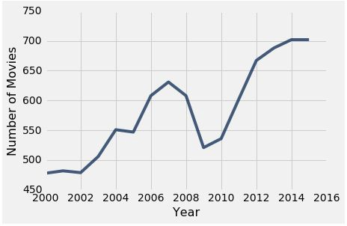
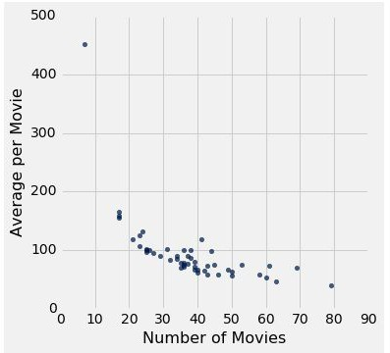
Plotting Two Numerical Variables
Line graph: plot
Scatter plot : scatter
(Demo)

Slide 12
When to use a line vs scatter plot?
Use line plots for sequential data: if...
...your x-axis has an order
...sequential differences in y values are meaningful
...there’s only one y-value for each x-value
Usually: x-axis is time or distance
Use scatter plots for non-sequential data
When you’re looking for associations

Slide 13
Categorical Data
(Demo)

Slide 14
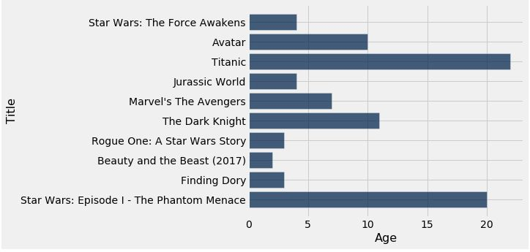
How Do You Generate This Chart?
Top 10 highest grossing movies
Number of years since release

