Slide 1
Lecture 10
MATH1401
Fall 2021
Groups

Slide 2
Class Checklist
HW 3 - Due Date : Friday: 9/24 – 9 PM
Graded Questions:1.1-1.7, 2.1-2.5, 2.7, 3.1,3.3, 4.3-4.5
Lab 3 – Due Date : Thursday 9/30 – 9 PM
Quiz 7 – Thurday: 9/23 – Covers Chapter 8

Slide 3
Review of Lecture 9

Slide 4
Histogram
Distribution of numerical variable
Horizontal axis is numerical: bins can be unequal
Area of bars proportional to the percent of individuals
Height of bars measures density

Slide 5
Area and Height
Area of bar = % in bin = Number of indivuals in bin x 100
--------------------------------------
Total number of indivuals
% in bin
---------------------
width of bin
Area of bin
---------------------
width of bin
Height =
=

Slide 6
Defining Functions

Slide 7
Def Statements
def spread(values):
return max(values) - min(values)
(Demo)

Slide 8
Apply

Slide 9
Apply
The apply method creates an array by calling a function on every element in input column(s)
First argument:
Other arguments:
Function to apply The input column(s)
table_name.apply(function_name, 'column_label')
(Demo)

Slide 10
Prediction

Slide 11
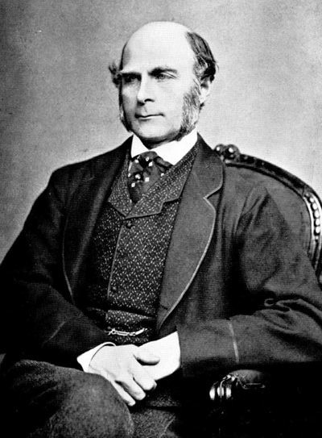
Sir Francis Galton
1822 - 1911 (knighted in 1909)
A pioneer in making predictions
Particular (and troublesome) interest in heredity
Charles Darwin's half-cousin
(Demo)

Slide 12
Grouping

Slide 13
Grouping by One Column
The group method aggregates all rows with the same value for a column into a single row in the resulting table.
First argument:
Second argument:
Which column to group by (Optional) How to combine values
len — number of grouped values (default)
list — list of all grouped values
sum — total of all grouped values
(Demo)

