Slide 1
Lecture 9
MATH1401
Fall 2021
Functions

Slide 2
Class Checklist
HW 3 - Due Date : Friday: 9/24 – 9 PM
Graded Questions:1.1-1.7, 2.1-2.5, 2.7, 3.1,3.3, 4.3-4.5
Lab 3 – Due Date : Tuesday 9/21 – 9 PM
Graded Questions : 1.1,1.1.1, 3.1-3.2,4.1-4.3, all questions from section 2
Quiz 6 – Tuesday: 9/21 – Covers Chapter 7
Quiz 7 – Thurday: 9/23 – Covers Chapter 8

Slide 3
Charts Review

Slide 4
Review: Charts
Scatter plot: relation between numerical variables
Line graph: sequential data (over time, etc.)
Bar chart: distribution of categorical data
Histogram: distribution of numerical data

Slide 5
Bar Chart or Histogram?
To display a distribution:
Bar Chart
Distribution of categorical variable
Bars have arbitrary (but equal) widths and spacings
height (or length) and
area of bars proportional to the percent of individuals
Histogram
Distribution of numerical variable
Horizontal axis is numerical: to scale, no gaps, bins can be unequal
Area of bars proportional to
the percent of individuals;
height measures density
(Demo)

Slide 6
Density

Slide 7
How to Calculate Height
The [6, 6.5) bin contains 263 out of 1324 sleepers
“263 out of 1324” is 19.86%
The bin is 6.5 – 6 = .5 hours wide
19.86 percent
Height of bar =
.5 hours
= 1.02 percent per hour

Slide 8
Height Measures Density
% in bin
---------------------
width of bin
Height =
The height measures the percent of data in the bin
relative to the amount of space in the bin.
Height measures density.
Units: percent per unit on the horizontal axis

Slide 9
Area Measures Percent
Area of bar = % in bin = Height x width of bin
“How many individuals in the bin?” Use area.
“How crowded is the bin?” Use height.

Slide 10
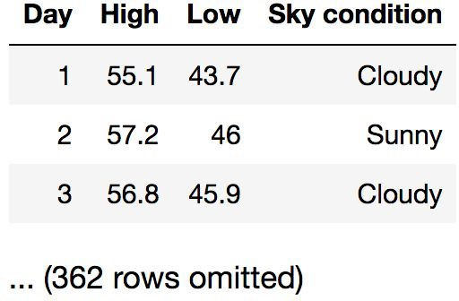
Discussion Question
You have data about daily temperatures as shown. Which type of chart would show the answer to each question?
Are there more cloudy than sunny days?
What percentage of days have a high above 72º?
Do hotter days tend to also have hotter nights?
(Demo)

Slide 11
Lecture 9 - Overview
Defining Functions
arguments
body
return values
Apply Method
Apply a function to each entry in a column

Slide 12
Lecture 9 – Programming Checklist
functions keywords
def – defines a new function
doc strings – function description
body – indentation by 4 spaces
return – returns a specified value
Apply Method
Table_name.apply(function_to_apply, “column_name”)
Applys funtionc_to_apply to column “column_name”

Slide 13
Defining Functions

Slide 14
Def Statements
User-defined functions give names to blocks of code
Name Argument names (parameters)
def spread(values):
Return expression
return max(values) - min(values)
Body
(Demo)

Slide 15
Discussion Question
What does this function do? What kind of input does it take? What output will it give? What's a reasonable name?
def f(s):
return np.round(s / sum(s) * 100, 2)
(Demo)

Slide 16
Apply

Slide 17
Apply
The apply method creates an array by calling a function on every element in input column(s)
First argument:
Other arguments:
Function to apply The input column(s)
table_name.apply(function_name, 'column_label')
(Demo)

