Slide 1
Lecture 21
DATA 8
Fall 2021
Confidence Intervals

Slide 2
Estimation

Slide 3
Quantifying Uncertainty
The estimate is usually not exactly right:
Estimate = Parameter + Error
How accurate is the estimate, usually?
How big is a typical error?
When we have a census, we can do this by simulation
(Demo)

Slide 4
Where to Get Another Sample?
We want to understand errors of our estimate
Given the population, we could simulate
...but we only have the sample!
To get many values of the estimate, we needed many random samples
Can’t go back and sample again from the population:
No time, no money
Stuck?

Slide 5
The Bootstrap
A technique for simulating repeated random sampling
All that we have is the original sample
… which is large and random
Therefore, it probably resembles the population
So we sample at random from the original sample!

Slide 6
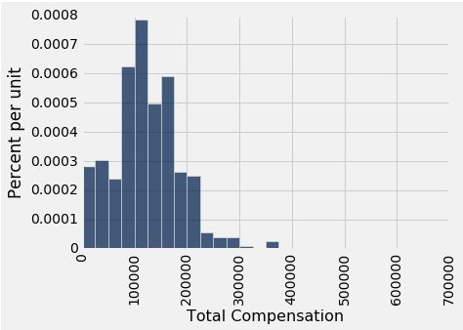
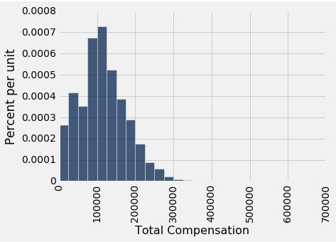
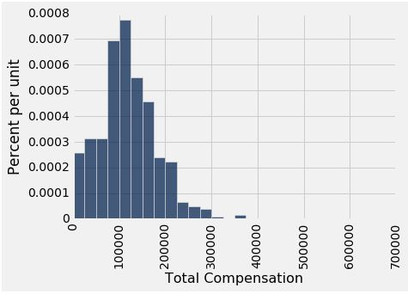
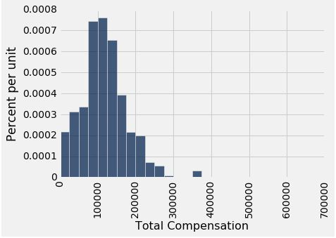
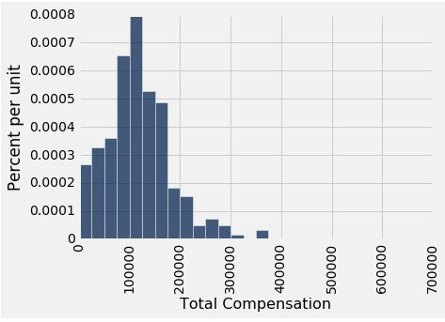

Why We Need the Bootstrap
resamples
population
sample
What we wish we could get
What we really get

Slide 7
Key to Resampling
From the original sample,
draw at random
with replacement
as many values as the original sample contained
The size of the new sample has to be the same as the original one, so that the two estimates are comparable
(Demo)

Slide 8
Confidence Intervals

Slide 9
95% Confidence Interval
Interval of estimates of a parameter
Based on random sampling
95% is called the confidence level
Could be any percent between 0 and 100
Higher level means wider intervals
The confidence is in the process that gives the interval:
It generates a “good” interval about 95% of the time.
(Demo)

Slide 10
Each line here is a confidence interval from a fresh sample from the population

Slide 11
Use Methods Appropriately

Slide 12
Can You Use a CI Like This?
By our calculation, an approximate 95% confidence interval for the average age of the mothers in the population is (26.9, 27.6) years.
True or False:
About 95% of the mothers in the population were between 26.9 years and 27.6 years old.
Answer: False. We’re estimating that their average age is in this interval.

Slide 13
Is This What a CI Means?
An approximate 95% confidence interval for the average age of the mothers in the population is (26.9, 27.6) years.
True or False:
There is a 0.95 probability that the average age of mothers in the population is in the range 26.9 to 27.6 years.
Answer: False. The average age of the mothers in the population is unknown but it’s a constant. It’s not random. No chances involved.

Slide 14
When Not to Use The Bootstrap
If you’re trying to estimate very high or very low percentiles, or min and max
If you’re trying to estimate any parameter that’s greatly affected by rare elements of the population
If the probability distribution of your statistic is not roughly bell shaped (the shape of the empirical distribution will be a clue)
If the original sample is very small

Slide 15
Confidence Intervals For Testing

Slide 16
Using a CI for Testing
Null hypothesis: Population average = x
Alternative hypothesis: Population average ≠ x
Cutoff for P-value: p%
Method:
Construct a (100-p)% confidence interval for the population average
If x is not in the interval, reject the null
If x is in the interval, can’t reject the null

