Slide 1
Lecture 5
MATH1401
Fall 2021
Arrays and Tables

Slide 2
Class Checklist
Homework 1 – Due Date : Friday 9/3 – 5 PM
Graded Questions : 1.1, 2.1,2.1.1, 2.2, 3.1-3.3, 4.1-4.3, 5.1-5.4, 7.1
Lab 2 – Thursday: 9/9
Quiz 3 – Thursday: 9/2 – Covers Chapter 4
Quiz 4 – Tuesday: 9/7 – Covers Chapter 5

Slide 3
Review

Slide 4
Lecture 4 Review
int/floats
strings
bools
comparisons

Slide 5
Overview

Slide 6
Lecture 5 - Checklist
Arrays
Array Methods
Array Functions
Ranges
Tables and Arrays

Slide 7
Lecture 4 Checklist - Programming
Declare an Array
Array Operations - +,-,*,**
Be able to use array functions: np.sum(), np.average(), np.count_nonzero(),len()
Be able to use array methods: array.item()
Be able to declare a long array using np.range()
Create a table and read a table

Slide 8
Arrays

Slide 9
Arrays
An array contains a sequence of values
To make an array use make_array(v1,v2,…,vk)
All elements of an array should have the same type
make_array(1,2,3,4,5) – makes array
make_array(1,2,3,’4’,5) – produces unintended error

Slide 10
Arrays Operations
Operations +,-,*,** between arrays are defined
Arrays must be the same length
Operations are applied to each element individually
make_array(1,2,3)* make_array(4,5,6) = make_array(4,10,18)
An operation between a number and an array is well defined (Demo)

Slide 11
Array Functions

Slide 12
Arrays Access
Each value in an array has a position
Positions begin at 0 and end at length -1
make_array(‘a’,’b’,’c’,’d’,’e’,’f’)
position 0 1 2 3 4 5
length of array 6
Access a position using array.item(position)

Slide 13
Arrays Functions
Common functions include Average and Sum
np.average(arrayhere) – finds the average of the elements in the array
np.sum(arrayhere) – finds the sum of the elements in the array
len(arrayhere) – finds the length of the array

Slide 14
Ranges

Slide 15
Ranges
A range is an array of consecutive numbers
np.arange(end):
An array of increasing integers from 0 up to end
np.arange(start, end):
An array of increasing integers from start up to end
np.arange(start, end, step):
A range with step between consecutive values
The range always includes start but excludes end

Slide 16
Ways to create a table
Table.read_table(filename) - reads a table from a spreadsheet
Table() - an empty table
and… select, where, sort and so on all create new tables

Slide 17
Example

Slide 18
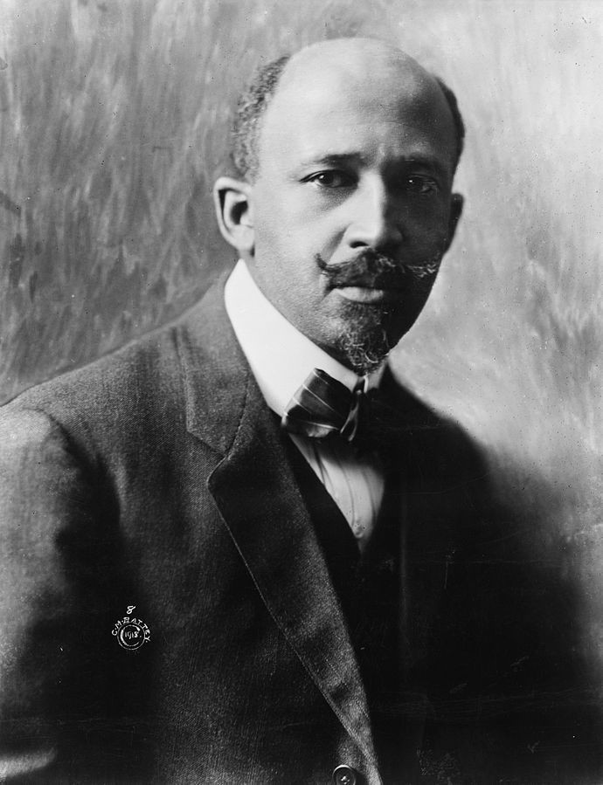
W. E. B. Du Bois, 1868-1963
Scholar, historian, activist, and data scientist
NAACP founder
Made a series of visualizations for the 1900 Paris Exposition
Goal: change the way people see Black Americans
Hundreds of photographs and patents
60+ handmade graphs in 3 months
Notes:
Lets go over a real world example
We will go over some data from 1900s
We will look at a experiment by William Du bois
He was a data scientist before the term, an activist and the founder of the NAACP
Back in 1900, the usa was extremely segratated and there was a lot of racially motivated crimes directed towards black americans
His goal was to change the percepation of black americans
To do these collected data, took photos and made graphs to present at a government Expo
We do not have his graphs but we have the data set

Slide 19
(Demo)

Slide 20
Discussion Question
Use the table functions we learned this week to find the income bracket (“class”) that spent the highest percentage of their income on rent.

