Slide 1
Cryptography – Day 4
One Time Pad and Optimality

Slide 2
Review

Slide 3
Private-key encryption
A private-key encryption scheme is defined by a message space M and algorithms (Gen, Enc, Dec)
Gen determines a probability distribution over Key Space.
Message space has some fixed probability distribution.
Key Space and Message Space are independent.

Slide 4

Private-key encryption
A private-key encryption scheme is defined by a message space M and algorithms (Gen, Enc, Dec)
key
key
ciphertext
c
k
k
m
c := Enc_{k}(m)
m := Dec_{k}(c)
message/plaintext
decryption
encryption

Slide 5
Crypto definitions (generally)
Security guarantee/goal
What we want to achieve
Threat model
What (real-world) capabilities the attacker is assumed to have

Slide 6
Crypto definitions (generally)
Security guarantee/goal
What we want to achieve
Regardless of any prior information the attacker has about the plaintext, the ciphertext should leak no additional information about the plaintext
Threat model
What (real-world) capabilities the attacker is assumed to have
Attacker Observes only one Ciphertext.

Slide 7
Perfect secrecy (formal)
Encryption scheme (Gen, Enc, Dec) with message space M and ciphertext space C is perfectly secret if for every distribution over M, every m ∈ M, and every c ∈ C with Pr[C=c] > 0, it holds that Pr[M = m | C = c] = Pr[M = m].

Slide 8
Concept Check
Consider the shift cipher, and the distribution; Pr[M=‘hi’] = 0.3, Pr[M=‘no’] = 0.2, Pr[M=‘in’]= 0.5
What is the Pr[M = ‘hi’ | C = ‘xy’]?
= Pr[C = ‘xy’ | M = ‘hi’] · Pr[M = ‘hi’]/Pr[C = ‘xy’]

Slide 9
Perfectly Secret Encryption
The shift cipher is not perfectly secret!
At least not for 2-character messages
How to construct a perfectly secret scheme?

Slide 10
One-time pad
Patented in 1917 by Vernam
Recent historical research indicates it was invented (at least) 35 years earlier
Proven perfectly secret by Shannon (1949)

Slide 11
One-time pad
Let M = {0,1}^{n}
Gen: choose a uniform key k ∈ {0,1}^{n}
Enc_{k}(m) = k ⊕ m
Dec_{k}(c) = k ⊕ c
Correctness: Dec_{k}( Enc_{k}(m) ) = m

Slide 12
One-time pad
n bits
key
n bits
n bits
⊕
message
ciphertext

Slide 13
Perfect secrecy of one-time pad
Note that any observed ciphertext can correspond to any message (why?)
(This is necessary, but not sufficient, for perfect secrecy)
So, having observed a ciphertext, the attacker cannot conclude for certain which message was sent

Slide 14
Implementing the one-time pad

Slide 15
Key generation
Read desired number of bytes from /dev/urandom
Output the result to a file

Slide 16
Encryption
Plaintext = sequence of ASCII characters
Key = sequence of hex digits
Read them; XOR them to get the ciphertext

Slide 17
Decryption
Reverse encryption
Read ciphertext and key; XOR them to recover the message

Slide 18
Limitations and Optimality

Slide 19
One-time pad
The one-time pad achieves perfect secrecy!
One-time pad has historically been used in the real world
E.g., “red phone” between DC and Moscow
Not currently used!
Why not?

Slide 20
One-time pad
Several limitations

Slide 21
One-time pad
Several limitations
The key is as long as the message

Slide 22
One-time pad
Several limitations
The key is as long as the message
Only secure if each key is used to encrypt a single message
(Trivially broken by a known-plaintext attack)

Slide 23
One-time pad
Several limitations
The key is as long as the message
Only secure if each key is used to encrypt a single message
(Trivially broken by a known-plaintext attack)
⇒ Parties must share keys of (total) length equal to the (total) length of all the messages they might ever send

Slide 24
Using the same key twice?
Say c₁ = k ⊕ m₁ c₂ = k ⊕ m₂
Attacker can compute c₁ ⊕ c₂ = (k ⊕ m₁) ⊕ (k ⊕ m₂) = m₁ ⊕ m₂
This leaks information about m₁, m₂!

Slide 25
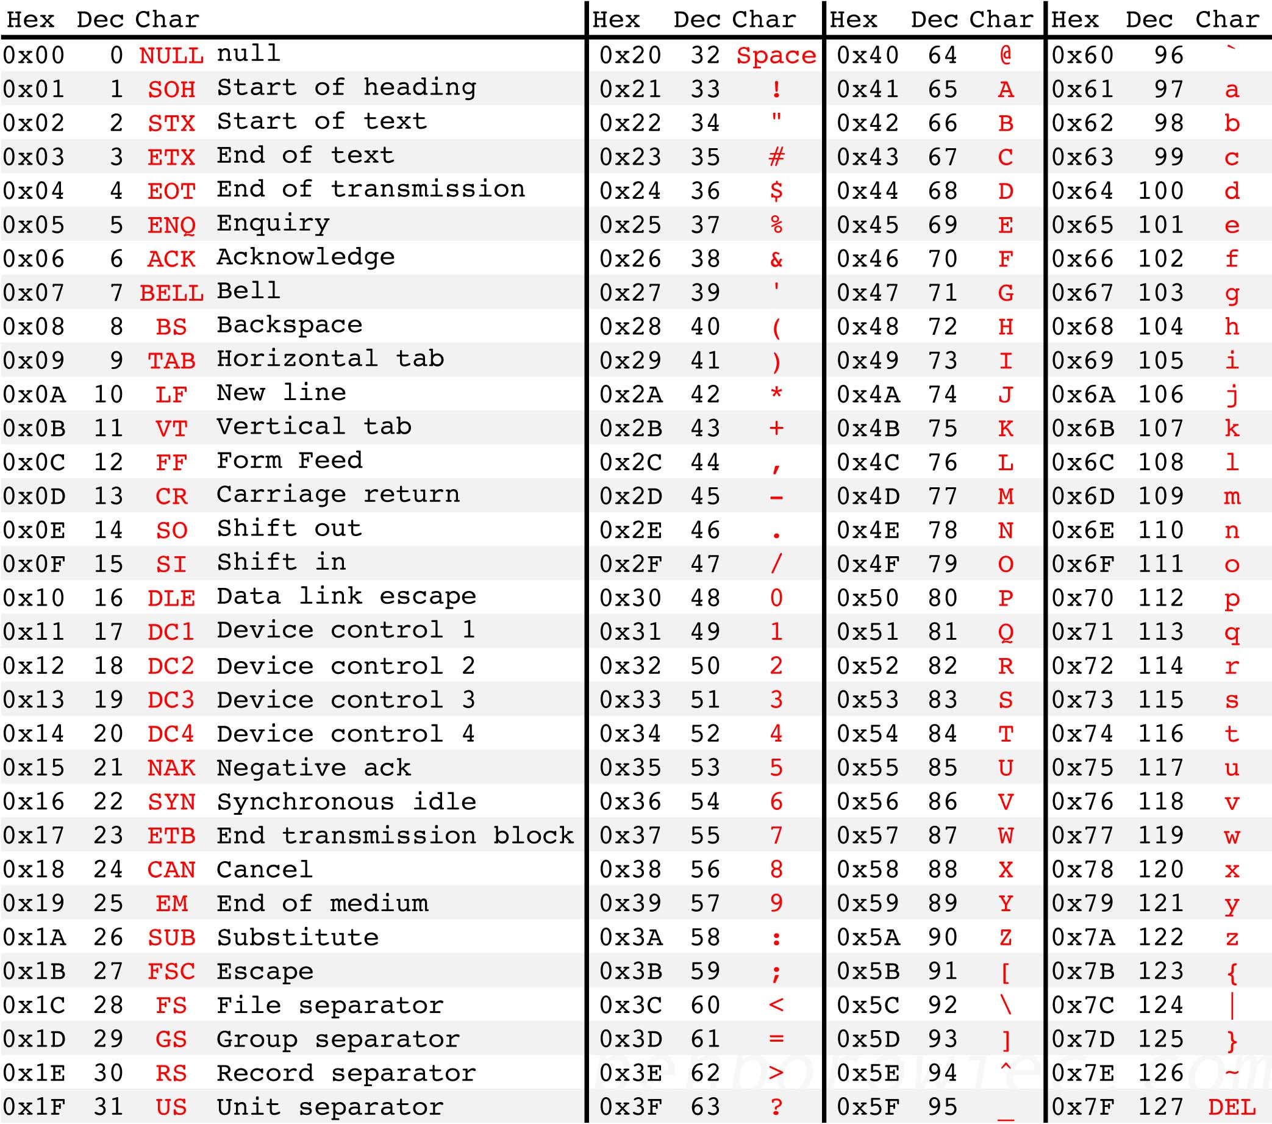
Letters all begin with 01…
The space character begins with 00…
XOR of two letters gives 00…
XOR of letter and space gives 01…
Easy to identify XOR of letter and space!
Source: http://benborowiec.com/2011/07/23/better-ascii-table/

Slide 26
In pictures
01…
01…
01…
00…
…
00…
…
01…
01…
01…
01…
01…
…
00…
00…
00…
01…

Slide 27
In pictures
01…
01…
01…
00…
…
00…
…
01…
01…
01…
01…
01…
…
00…
00…
00…
01010000
01010000 = 00100000 ⊕ ??

Slide 28
One-time pad
Drawbacks
Key as long the message
Only secure if each key is used to encrypt once
Trivially broken by a known-plaintext attack
These limitations are inherent for schemes achieving perfect secrecy

Slide 29
Optimality of the one-time pad
Theorem: if (Gen, Enc, Dec) with message space M is perfectly secret, then |K| ≥ |M|.
Intuition:
Given any ciphertext, try decrypting under every possible key in K
This gives a list of up to |K| possible messages
If |K| < |M|, some message is not on the list

